Slide 1
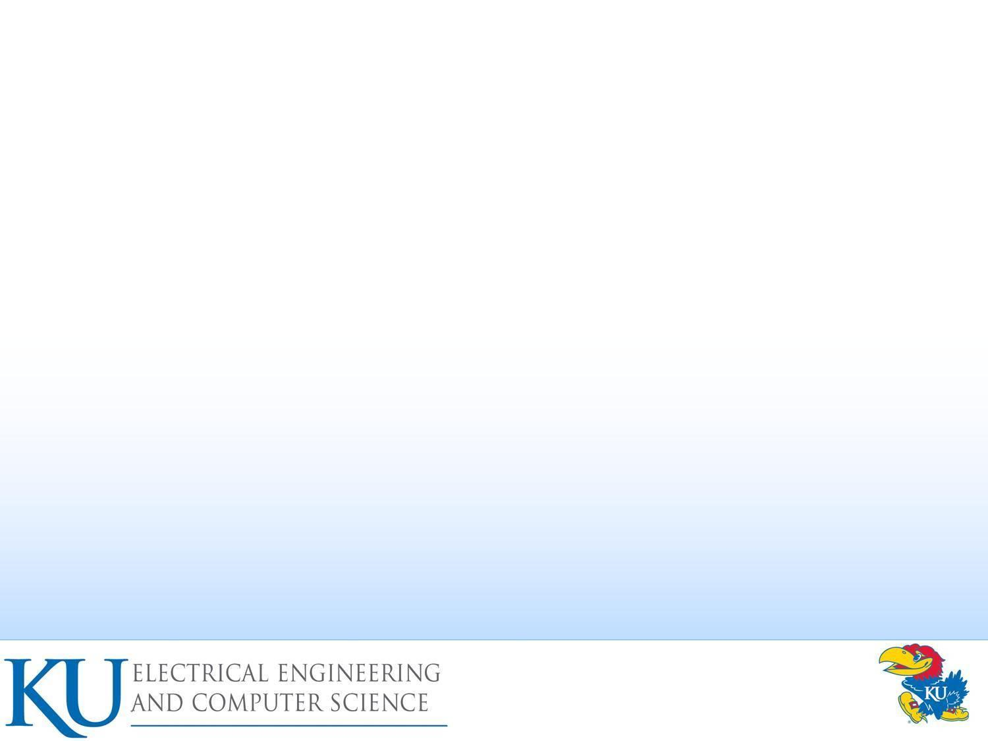
Chapter 23 – Linux Security
Chapter 24 – Windows and Windows Vista Security
Windows vs. Linux Security
Computer Security: Principles and
Practice
EECS 710
Professor: Hossein Saiedian
Presented by Purvi Patel

Slide 2
Agenda
Background
Windows Security Architecture
Linux Security Model
Evaluation: Windows vs. Linux Design
Windows Vulnerabilities
Linux Vulnerabilities
Means of Evaluating Metrics
Evaluation: Windows vs. Linux Vulnerabilities
  CERT: Comparing Query Result for “Microsoft” and “Linux” Keywords
System Hardening
  Windows Defenses
  Linux System Hardening
    OS-Level
    Application-Level
OS Security Capabilities: Windows vs. Linux
Conclusion

Slide 3
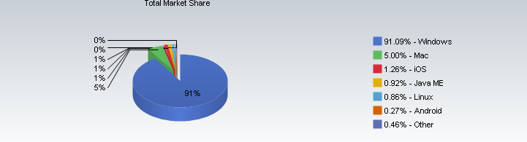
Background: Operating System Market Share (October 2010)

Slide 4
Background: Windows
Advantages
  User friendly
  Enhancements can help millions of users
  Defects found quickly because of widespread use
Disadvantages
  Security defects can leave millions vulnerable
  Non-technical user-base
  Industry dominance leaves MS handcuffed - any move to expand capabilities seen as anticompetitive

Slide 5
Background: Linux
Advantages
  Stability
  Free Software
  Runs on old hardware
  Security
Disadvantages
  Learning curve
  Equivalent programs
  More technical ability needed
  Not all hardware compatible
Notes:
Advantages:
The majority of Linux variants are available for free or at a much lower price than Microsoft Windows.
Linux is and has always been a very secure Operating System. Although it still can be attacked when compared to Windows, it much more secure.
The majority of Linux variants and versions are notoriously reliable and can often run for months and years without needing to be rebooted
Disadvantages:
Although the majority Linux variants have improved dramatically in ease of use, Windows is still much easier to use for new computer users
Linux has a large variety of available software programs, utilities, and games. However, Windows has a much larger selection of available software.
Required someone who knows Linux really well. Alternately, you could hire someone who has experience with Linux. A good Linux administrator needs to be on hand as you start to migrate your systems over. This is a disadvantage financially, at least in the beginning.
Some of the latest and greatest hardware that is being produced is not compatible with Linux. One thing you can do is before your purchase, ask if the hardware vendor has support for Linux. Some manufacturers do write their own Linux drivers and distribute them with your purchase, making it very easy to integrate with your existing system.

Slide 6
Agenda
Background
Windows Security Architecture
Linux Security Model
Evaluation: Windows vs. Linux Design
Windows Vulnerabilities
Linux Vulnerabilities
Means of Evaluating Metrics
Evaluation: Windows vs. Linux Vulnerabilities
  CERT: Comparing Query Result for “Microsoft” and “Linux” Keywords
System Hardening
  Windows Defenses
  Linux System Hardening
    OS-Level
    Application-Level
OS Security Capabilities: Windows vs. Linux
Conclusion

Slide 7
Windows Security Architecture
Security Reference Monitor
Local Security Authority
Security Account Manager
Active Directory
Local vs. Domain Accounts
Access Control Lists
Integrity Control
User Account Controls
Notes:
Anyone who wants to understand windows security must have knowledge of the basic fundamental security blocks of security system.
There are many components in windows that make up the fundamental security infrastructure.

Slide 8
Security Reference Monitor (SRM)
Kernel Mode Component that
  Performs Access Checks
  Generates Audit Log Entries
  Manipulates User Privileges
Notes:
Its kernel mode component that performs access checks, generates audit log entities, and manipulates user privileges
Simply put it checks for proper authorization before granting access to objects
Object manager is client of SRM: It asks SRM if the process has the proper rights to execute a certain type of action on an object
Uses Access Control Lists to do this, which we will cover later in this presentation
Implement auditing function to keep track of attempts to access an object
Implements DoD C2 level security: Department of Defense: C2 Level Security:
The following list includes some of the most important requirements of C2-level security, as defined by the U.S. Department of Defense:
It must be possible to control access to a resource by granting or denying access to individual users or named groups of users.
Memory must be protected so that its contents cannot be read after a process frees it. Similarly, a secure file system, such as NTFS, must protect deleted files from being read.
Users must identify themselves in a unique manner, such as by password, when they log on. All auditable actions must identify the user performing the action.
System administrators must be able to audit security-related events. However, access to the security-related events audit data must be limited to authorized administrators.
The system must be protected from external interference or tampering, such as modification of the running system or of system files stored on disk.

Slide 9
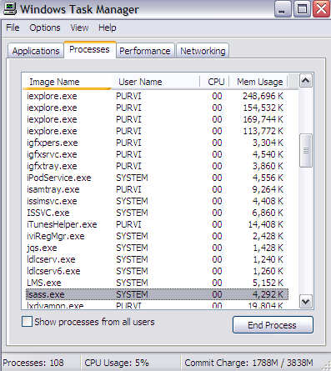
Local Security Authority (LSA)
Responsible for enforcing local security policy
  Lsass.exe
  User mode
Issues security tokens to accounts
Key component of the logon process
Notes:
Resides in user-mode process named lsass.exe and is responsible for enforcing local security policy in windows.
Responsible for validating users for both local and remote logon
Issues security tokens to accounts as they log on to the system
Security policy includes
Password policy (complexity rules …expiration times etc.)
Auditing policy and privilege settings
During the local (interactive) logon to a machine, a person enters their name and password to the logon dialog. This information is passed to the LSA, which then calls the appropriate authentication package. The password is sent in a nonreversible secret key format using a one-way hash function. The LSA then queries the SAM database for the user's account information. If the key provided matches the one in the SAM, the SAM returns the users SID and the SIDs of any groups the user belongs to. The LSA then uses these SIDs to generate the security access token.
Was successfully exploited in the Sasser worm (by an 18 year old German student) :2004

Slide 10
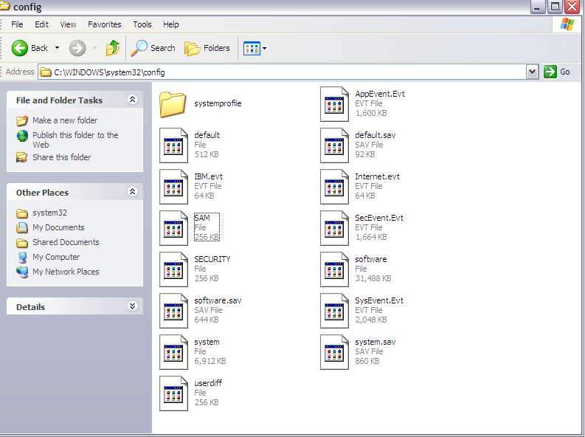
Security Account Manager (SAM)
A database that stores user accounts and local users and groups security information
SamSrv.exe
Notes:
Database that stores user accounts and relevant security information about local users and local groups
Accounts Manager (SAM) is a registry file
Stores users' passwords in a hashed format
When a user logs on to a computer using a local account, the SAM process (Samsrv) takes the logon information and performs a lookup against the SAM database, which resides in the windows system32/config directory(Something similar in UNIX, think etc/password). If credential match, then the user can log on to the system, assuming there are no other factors preventing logon, such as logon time restrictions or privilege issues.
Note that SAM does not perform the logon; that is the job of the LSA.
The SAM file is binary rather than text and passwords are stored using the MD4 hash algorithms.
On windows vista, the SAM stores password information using a password-based key derivation function (PBKCS).
In an attempt to improve the security of the SAM database against offline software cracking, Microsoft introduced the SYSKEY function in Windows NT 4.0. When SYSKEY is enabled, the on-disk copy of the SAM file is partially encrypted, so that the password hash values for all local accounts stored in the SAM are encrypted with a key (usually also referred to as the "SYSKEY").
In the case of online attacks, it is not possible to simply copy the SAM file to another location. The SAM file cannot be moved or copied while Windows is running, since the Windows kernel obtains and keeps an exclusive filesystem lock on the SAM file, and will not release that lock until the operating system has shut down or a blue screen exception has been thrown. However, the in-memory copy of the contents of the SAM can be dumped using various techniques, making the password hashes available for offline brute-force attack.

Slide 11
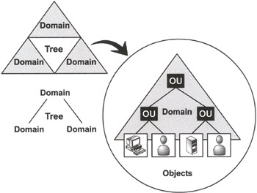
Active Directory
Directory Service
  Server-based authentication
  Centrally managed
Notes:
A directory service used to store information about the network resources across a domain and also centralizes the network.
Server based authentication
Centrally managed
Its microsofts’s LDAP directory included with window server 2000 and later.
All client versions of windows, including windows XP and windows Vista, can communicate with AD to perform security operations including account logon
Windows client will authenticate using AD when the user logs on to the computer using a domain account rather than a local account.
Like the SAM scenario, the user’s credential information sent securely across the network, verified by AD, and then if the information is correct, the user can Logon.

Slide 12
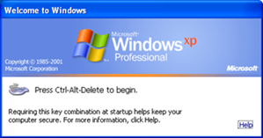
WinLogon & NetLogon
WinLogon – keyboard requests
NetLogon – network requests
Notes:
WinLogon handles local logons at the keyboard and NetLogon handles logons across the network
Winlogon is the component of Microsoft Windows operating systems that is responsible for handling the secure attention sequence, loading the user profile on logon, and optionally locking the computer when a screensaver is running (requiring another authentication step). The actual obtainment and verification of user credentials is left to other components.
Winlogon is a common target for several threats that could modify its function and memory usage. Increased memory usage for this process might indicate that it has been "hijacked". In Windows Vista and later operating systems, Winlogon's roles and responsibilities have changed significantly.
When a computer is joined to a domain, the Netlogon service allows users and services to authenticate to the domain through a secure channel. If your computer is not part of a domain, you do not need this service, but since it is only run manually, there is no benefit to disabling it
Maintains a secure channel between this computer and the domain controller for authenticating users and services. If this service is stopped, the computer may not authenticate users and services and the domain controller cannot register DNS records. If this service is disabled, any services that explicitly depend on it will fail to start

Slide 13
Local vs. Domain Accounts
Local Accounts for computers not hooked up to a network
Networked computers can be:
  Workgroup joined
  Domain joined
Notes:
Networked windows computer can be one of two configuration either domain joined or workgroup
Difference between a workgroup and a domain is simply where accounts are authenticated
The workgroup has no domain controllers; authentication is performed on each computer, and a domain authenticates accounts at domain controllers running AD

Slide 14
Workgroup Joined
A collection of computers connected together
Only local accounts in SAM can be used
No infrastructure to support AD
Notes:
Wokgroup: when computer is workgroup, only local accounts can be used, held in the SAM
Notion of workgroup smipy a collection of computers connected to one another using a network; but rather using central database of accounts in AD, the machines use only local accounts

Slide 15
Domain Joined
Share access to networked printers, file servers, etc.
Centrally Managed
  More secure
  Scalable
Notes:
Domain joined: user can gain access to the computer using domain accounts, which are centrally managed in active directory
If they wish also can log on using local accounts but local accounts may not have access to domain resources such as networked printers, web servers, email servers and so on
Pros and Cons to each scenario
Domain has major advantage of being centrally managed; as such is much more secure
If environment has 1000 computers and an employee leaves, the user’s account can be disabled centrally rather than on 1000 individual computer
Only advantage of using local accounts is that a computer does not need the infrastructure required to support a domain using AD

Slide 16
Windows Login Example
Administrator creates a user account (full name, username, password, group, privileges)
Windows creates an SID in the form of
  S-1-5-21-AAA-BBB-CCC-RRR (page 723)
In windows, username can be in two formats
  SAM format: support by all versions of Windows (legacy format)
    Form: DOMAIN/username
  User Principle Name (UPN) and looks more like RFC822 email address
    Example: username@domain.company.com
Notes:
now we know the basic elements that makes up the core windows security infrastructure. Lets go over example when user logs on to a windows system
before a user log on to windows network, domain administrator must add user’s account information to the system; this will include username, account name(must be unique), password
optionally the admin can grant group membership and privileges
Windows creates an SID in the form of
S-1-5-21-AAA-BBB-CCC-RRR
S : means SID
1: SID version number
5: identifier authority
21: means not unique , which just means there is no guarantee of uniqueness, a SID is unique within a domain
AAA-BBB-CCC: unique number representing domain
RRR: called relative ID (RID) ; its unique number that increments by 1 as each SID unique
In windows, username can be in two formats
SAM format: support by all versions of Windows (legacy format)
Form: DOMAIN/username
User Principle Name (UPN) and looks more like RFC822 email address
Example: username@domain.company.com

Slide 17
Windows Login Example
User logs in with keyboard
Information is sent to the AD (domain controller)
If successful token is generated and sent to user
Token contains
  User’s SID
  Group membership
  Privileges

Slide 18
Review Question
A user hits Ctrl+Alt+Del and logs into Windows with a keyboard…
What Windows process captures this login?

Slide 19
Answer
The WinLogon process captures logins at the keyboard
WinLogon passes information to the domain controller (Active Directory) to perform logon
WinLogon would pass the information to the SAM (if local) which would give true/false authentication status
LSA would generate token if SAM verifies true username/password combination

Slide 20
Windows Privileges
System-wide permissions assigned to user accounts
Some are considered “dangerous”
  Act as part of the OS privilege
  Debug programs privilege
  Backup files and directories privilege
Some are considered “benign”
  Bypass traverse checking privilege
Notes:
Privileges are essentially system wide permissions assigned to user accounts
In other words, A privilege is something that you “get to do” . For example: windows privileges includes ability to backup the computer. Performing backup is privileged because it by pass all access checks so a complete backup is performed.
There are over 45 privileges in Windows Vista.
Some privileges are considered ‘dangerous” such as
Act as part of the OS privilege: known as trusted computing base (TCB) privilege
It allows code run by the an account granted this privilege to act as part of the most trusted code in operating system: security code
Most dangerous, is granted only the local system account, even admin are granted this privilege
Debug programs privilege:
Allows an account to debug any process running in windows
Because of nature of debuggers, this privilege basically means a user can run any code he or she wants in any running process
Backup files and directories privilege
Any process running with this privilege will by pass all access control list(ACL) checks
Some privileges are generally deemed “benign”
Bypass traverse checking
Used to traverse directory trees even though the user may not have permission on the traversed directory.
This privilege is assigned to all user accounts by default and is used as NTFS file system optimization

Slide 21
Access Control List (ACL)
Discretionary ACL
  Grants or denies access to protected resources such as files, shared memory, etc.
System ACL
  Used for auditing and to enforce mandatory integrity policy (Vista)
Notes:
An ACL is a list of permissions attached to an object
The list specifies who or what is allowed to access the object and what operations are allowed to be performed on the object.
Windows has two forms of access control list
Discretionary ACL (DACL):
Grants and denies access to protected resources in windows such as files, shared memory
System ACL (SACL)
Used for auditing and in windows vista used to enforce mandatory integrity policy
Objects that requires protection are assigned a DACL (and possible SACL), which includes SID of object owner as well as a list of access control entries (ACEs)
Each ACE includes a SID and an access mask
Access mask could include an ability to read, write, create, delete , modify and so on

Slide 22
Access Control Lists (ACL) (continued)
Objects needing protection are assigned an ACL that includes
  SID of object owner
  List of access control entries (ACEs)
Each ACE includes a SID and Access Mask
  Access mask could include
    Read, Write, Create, Delete, Modify, etc.

Slide 23
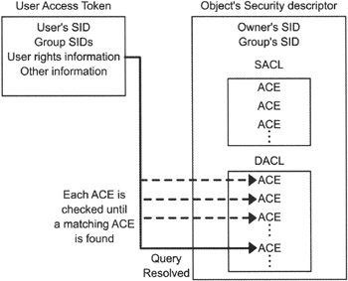
Access Control Example
User opens text file

Slide 24
Integrity Control
New to Vista: a low-level change to Windows that isolates different objects on a trust-based scale
Controlled by a new OS component called Windows Integrity Control (WIC)
Integrity levels trounce permissions
  Example: malware no longer runs in the privilege level of the logged-on user, as it does in XP
  It runs in the integrity level of the object that spawned it
Makes process isolation and other Vista security measures possible
Notes:
Windows Integrity Control (WIC) capabilities in Windows Vista by examining how it protects objects such as files and folders on Vista computers, the different levels of protection offered
WIC is intended to protect a system from malware and user error by helping to establish different levels of trust on objects.
The purpose of WIC is to protect objects, whether they are files, printers, named pipes, registry keys, and so on from attacks, malware or even innocent user error. The concept of WIC is based on establishing the trustworthiness of the various objects and controlling the interactions between objects based on their integrity, or level of trustworthiness.
The primary objective of WIC is to ensure that only objects with an integrity level equal to or greater than the target object are allowed to interact with it. Essentially, if an object is less trustworthy, it is prohibited from acting on, or interacting with more trustworthy objects

Slide 25
Six Integrity Levels
Object and Principals are labeled
Untrusted
Low
Medium
High
System
Installer
Notes:
In order to police the interactions between objects, Windows must first determine the trustworthiness, or integrity level of each object. WIC assigns one of the following six integrity levels to each object:
Untrusted. Rarely seen; for anonymous logons.
Low. Internet features (including IE 7 and the Temporary Internet Files folder).
Medium. The default integrity level. Used for Standard User accounts and most files.
High. Administrator accounts.
System. Most of the kernel and system services.
Installer. Why? Because installers need to have a higher integrity level than other objects in order to ensure uninstall works properly.

Slide 26
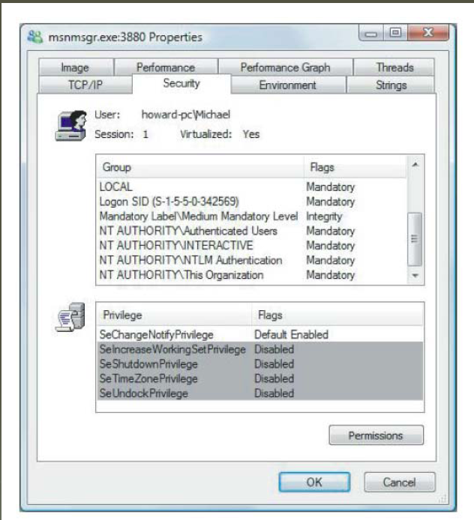
MAC: Vista Integrity Control
Having Integrity Control in Windows Vista
  Limits operations changing an object’s state
Notes:
One of my favorite new security features in Windows Vista is Mandatory Integrity Control (MIC).
While discretionary access control lists (DACLs) are useful, they have some limitations. They do little to safeguard system stability and they can’t stop malicious software from tricking users into executing it.
MIC adds the notion of trustworthiness evaluation into the operating system. Subjects with low degrees of trustworthiness can’t change data of higher degrees; subjects with high degrees of trustworthiness can’t be forced to rely on data of lower degrees
Whiteboard: When a Modify (e.g. Write) operation occurs first check that the Subjects integrity level dominates the Objects integrity level.
I find these levels interesting. Levels are mandatory, and are always assigned by the OS itself or an administrator.
Look how different elements of the system are trusted in different ways.
Internet below standard user. [Smart]
Installer? Image an attack found a way to create a file or process at a level above “High.” [Even the administrator wouldn’t be able to delete it]

Slide 27
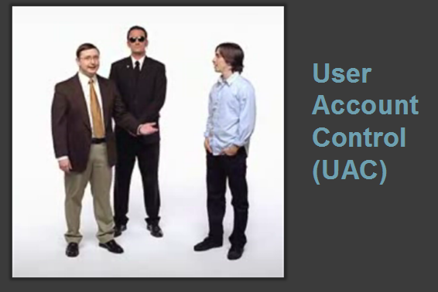
User Account Controls
A new feature in Windows Vista designed to help prevent unauthorized changes to your compute
UAC is similar to security features in UNIX-like operating systems
Perhaps the most reviled and misunderstood feature ever added to Windows
Notes:
This feature is so well-known that even Apple makes fun of it in their "I'm a PC, I'm a Mac ads." But here's some irony and perhaps hypocrisy for you: Apple's Mac OS X includes a feature just like User Account Control and always had. It's just good security.
Put another way: UAC tries to help you from making stupid mistakes. It also tries to prevent malware from acting on your behalf.

Slide 28
User Account Controls (continued)
How it works: When your consent is required to complete a task, UAC will prompt you with a dialog box
Tasks that will trigger a UAC prompt include anything that will affect the integrity or security of the underlying system
  This is a surprisingly long list of tasks
UAC works slightly differently with standard user and administrator-class accounts
Notes:
How it works: When your consent is required to complete a task, UAC will prompt you with a dialog box.
Tasks that will trigger a UAC prompt include anything that will affect the integrity or security of the underlying system. This is a surprisingly long list of tasks.

Slide 29
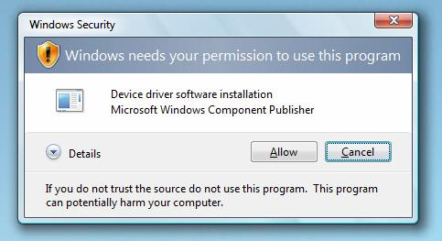
UAC Consent UI: Type 1
Prompt: Windows needs your permission to continue
Why you see this: You attempt to change a potentially dangerous system setting, such as a running a Control Panel
Notes:
This dialog occurs when you try to change a Windows system component.
In the example shown, the user is an admin-class user, so they only have to click “Allow” (or type CTRL+A) to move along. If the user were a standard user, you’d see the same dialog, but with a space for entering the name and password of an admin-level account.

Slide 30
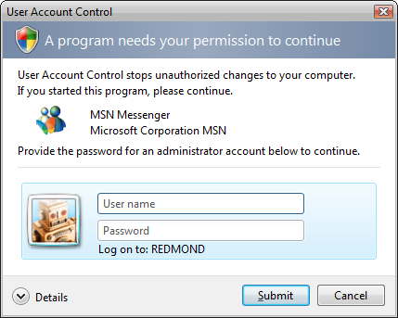
UAC Consent UI: Type 2
Prompt: A program needs your permission to continue
Why you see this: An external application with a valid digital signature is attempting to run with admin privileges
Notes:
This one is identical to the previous example except that an external application is attempting to perform a task that requires ***a higher integrity level***.
In this example, I am showing the standard user experience, where a user name and password is required to continue. Had this been an admin account, you'd only see the Allow/Cancel buttons. Note that the applications is "trusted" in the sense that Vista can confirm its digital signature. But it still requires elevation, so UAC snaps to attention.

Slide 31
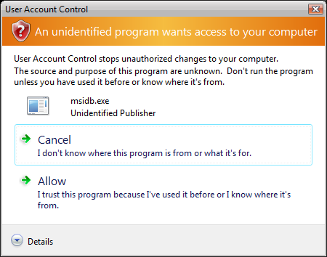
UAC Consent UI: Type 3
Prompt: An unidentified program wants access to your computer
Why you see this: in external application without a valid digital signature is trying to run
Notes:
My favorite UAC dialog, because it's so colorful and large: This happens when an unknown application--e.g. virtually any third party application you download from the Internet today--tries to run on Vista.
Again, this is the admin experience, with Allow/Cancel options. But notice how different this dialog is. Microsoft is *really* trying to get your attention this time. That's because Vista has no idea whether this application is safe.
Do you see the problem with these dialogs? Aside from being annoying, which they are, the fear is that users will simply get used to them popping up and will mindlessly click Allow all the time.

Slide 32
UAC: What’s really happening
Administrator accounts now logon with a mixed token
Half of this mixed token is a standard user token: this is what is typically used to determine your memberships and privileges
The other half, the administrator token, is invoked only when required: you can do so manually (run as) or automatically (certain tasks in Vista are tagged as requiring an admin token)

Slide 33
Review Question
When a Modify (e.g. Write) operation occurs first check that the subjects integrity level dominates the objects integrity level
This is most like a property of which?
  Bell-LaPadula model
  Biba Model
  Chinese Wall Model

Slide 34
Answer: Biba Model
Simple Integrity Rule
  A subject can modify an object only if the integrity level of the subject dominates the integrity level of the object
        I(S)>=I(O)

Slide 35
Agenda
Background
Windows Security Architecture
Linux Security Model
Evaluation: Windows vs. Linux Design
Windows Vulnerabilities
Linux Vulnerabilities
Means of Evaluating Metrics
Evaluation: Windows vs. Linux Vulnerabilities
  CERT: Comparing Query Result for “Microsoft” and “Linux” Keywords
System Hardening
  Windows Defenses
  Linux System Hardening
    OS-Level
    Application-Level
OS Security Capabilities: Windows vs. Linux
Conclusion

Slide 36
Linux Security Model
Overview of Linux Security Model
File System Security (DAC)
Users and Groups
File and Directory Permissions
Kernel Space vs. User Space

Slide 37
Overview of Linux Security Model
Since Linux Torvalds created in 1991, it has been evolved into one of the world’s most popular and versatile operating system
Free, open-sourced and available in a wide variety of “distributions”
Traditional security model
  People or processes with “root” privileges can do anything
  Other accounts can do much less
Goal of hackers – to gain root privilege
Linux can be run robust and secure
  Many system Admin fail to use the security features
  Add-on tools like sudo and Tripwire available
Crux of the problem – Discretionary Access Control
Notes:
Traditional security model
People or processes with “root” privileges can do anything
Other accounts can do much less
Thus, from attacker perspective, the challenge is cracking a linux system therefore boils down to grating root privileges
Once root privileges granted, attackers can erase or edit logs; hide their processes, files and directories; and basically redefine the reality of the system as experienced by its admins and users.
Linux security is a game of “root takes all”
Main cause of exposure: many linux admins fail to take advantage of the security features available to them
People can and do run robust, secure linux systems by making careful native linux security contols, plus selected add-on tools such as sudo or Tripleware
However crux of the problem of linux secutiry is linux security model on discretionary access control (DAC)

Slide 38
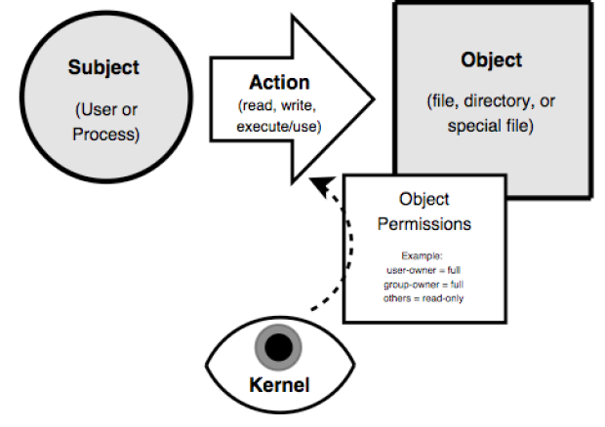
Linux Security Transactions
Notes:
In the linux DAC system there users, each belongs to one or more group
There are objects: files and directories
Users read, write, and execute these objects, based on the object’s permissions of which each object has three sets: user-owner, group-owner, and other
These permissions are enforced by the linux kernel, the brain of operating system
Basic transaction: subject attempts some action against some object
Whoever owns an object can set or change its permissions
Real weakness: root account has ability to both takes ownership and change the permissions s of all objects in the system, this provide way for attackers to hijack those privileges
Lets take closer look at how the linux DAC implementation actually works

Slide 39
File System Security
In Linux everything is a file
I/O to devices is via a “special” file
  Example: /dev/cdrom points to /dev/hdb which is a special file
Have other special files like named pipes
  A conduit between processes / programs
Since almost everything a file – security very important
Notes:
Linux treats everything as file
Documents, pictures even executable programs are very easy to conceptualize as files
Special files such as named pipes, act as I/O “conduits”, allowing one process or program to pass data to another.
One common example of a named pipe on linux systems is /dev/urandom: when programs reads this file /dev/urandom return random characters from kernal’s random number generators

Slide 40
Users and Groups
Users and Groups are not files
Users
  Someone or something capable of using files
  Can be human or process
  e.g. lpd (Linux Printer Daemon) runs as user lp
Groups
  List of user accounts
  User’s main group membership specified in /etc/passwd
  User can be added to additional group by editing /etc/group
  Command line -> useradd, usermod, and userdel
Notes:
There are two things on a Unix system that aren’t represented by files: user accounts and group accounts which for short we can call users and groups
User account represents some or something capable of using files…ex users, processes
Standard linux user accounts “lp” for example, is used by the line printer demon(lpd): lpd program runs as the user lp
A group account is simply a list of user accounts. Each user accounts is defined with a main group membership, but may in fact belongs to as many groups as you went or need it to
User’s main group memebership is specified in the user account’s entry in /etc/password; you can add that user to additional groups by editing /etc/group and adding the username to the end of the entry for each group the user needs to belong to or via the usermod command

Slide 41
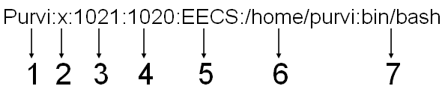
Understanding: /etc/password
username: Used when user logs in. It should be between 1 and 32 characters in length
password: An x character indicates that encrypted password is stored in /etc/shadow file
user ID (UID): Each user must be assigned a user ID (UID). UID 0 (zero) is reserved for root and UIDs 1-99 are reserved for other predefined accounts
  UID 100-999 are reserved by system for administrative and system accounts/groups
group ID (GID): The primary group ID (stored in /etc/group file)
user ID Info: The comment field
  Allows you to add extra information about the users such as user's full name, phone # etc
  This field used by finger command
home directory: The absolute path to the directory the user will be in when they log in
  If this directory does not exists then users directory becomes /
command/shell: The absolute path of a command or shell (/bin/bash)
  Typically, this is a shell. Please note that it does not have to be a shell.

Slide 42

Understanding of /etc/group
group_name: Name of group
password: Generally password not used, hence it is empty/blank. It can store encrypted password. Useful to implement privileged groups
group ID (GID): Group ID must be assigned to every user
group List: List of user names of users who are members of the group. The user names must be separated by commas

Slide 43
File Permissions
Files have two owners: a user & a group
  Each with its own set of permissions
  With a third set of permissions for other
Permissions are to read/write/execute in order user/group/other
  rw-rw -r-- 1 maestro user 35414 Mar 25 01:38 baton.txt
Permission can be changed using chmod command

Slide 44
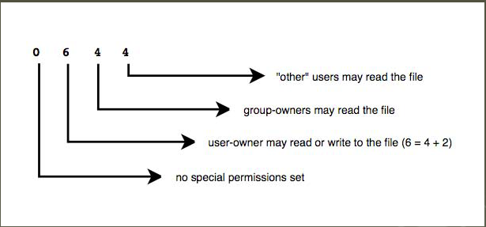
Numeric File Permissions
Read (r) = 4
Write (w) = 2
Execute (x) = 1
Example from textbook:
  drwxr-x--- 8 biff drummers
  288 Mar 25 01:38
  extreme_casseroles

Slide 45
Directory Permissions
Permissions on folder slightly works different
  read = list contents
  write = create or delete files in directory
  execute = use anything in or change working directory to this directory
Example from textbook:
    $ chmod g+rx extreme_casseroles
    $ ls -l extreme_casseroles
    drwxr-x--- 8 biff drummers 288 Mar 25 01:38 extreme_casseroles

Slide 46
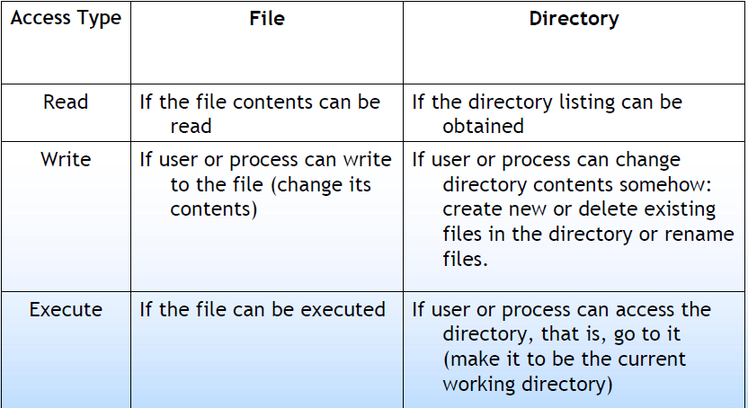
Difference between File and Directory
Permissions

Slide 47
Sticky Bit
Used to trigger process to “stick” in memory or lock file in memory
  Usage now obsolete
Currently used on directories to suppress deletion of file that is owned by others
  Other users cannot delete even if they have write permissions
Set group-write bit for directory
  Example from textbook:
    Chmod g+w ./extreme_casseroles
Set sticky bit using chmod command with +t flag
  Example from textbook:
    chmod +t extreme_casseroles
Directory listing includes t or T flag
  Example from textbook:
    drwxrwx--T 8 biff drummers 288 Mar 25 01:38 extreme_casseroles ()
The permissions are not inherited by child directories
Notes:
Drummer friend Biff wants to all his fellow drummers not only to read this recipes, but also to add their own….he needs set the “group-write” bit for this directory.
There’s only one problem with this: “write” permissions include both the ability to create new files in this directory, but also to delete them. What’s to stop one of his drummer pals from deleting other people's recipes? The ‘sticky bit”
In linux, When you set sticky bit on a directory, it limits user ability to delete things in that directory, to delete a given file in the directory you must either own that file or own that directory.
To issue sticky bit, issue chomd comand with +t flag
After issuing sticky bit command, not the “T” at the end of permissions string, “T” denotes that the directory is not “other-executable” but has the stick bit set.
A lowercase “t” would denote that directory is othe-executable and has the stick bit set

Slide 48
SetUID and SetGID
SetUI bit: means program “run with same privileges as” owner
  No matter who executes it
SetGID bit: means “run with same privileges as” a member of group that owns it
  Again regardless of who executes it
Are very dangerous if set of any file owned by if root or other privileged account or group
  Only used on executable files, not shell scripts
  The command “sudo” is much better tool for delegating root’s authority
Note that the linux kernel ignores the setid and setgid bits on shell scripts; these bits only work on binary (compiled) executables
Notes:
Most dangerous permissions bit in the unix world” setuid and setgid

Slide 49
SetGID and Directories
SetUID has no effects on directories
SetGID does and causes any file created in a directory to inherit the directory's group-owner
Useful if users belong to other groups and routinely create files to be shared with other members of those groups
  Instead of manually changing its group

Slide 50
Kernel Space and User Space
Kernel space: refers to memory used by the Linux kernel and its loadable modules (e.g device drivers)
User space: refers to memory used by all other processes
Since kernel enforces Linux DAC and security, its extremely critical to isolate kernel from user space
  For this reason, kernel space never swapped to disk
  Only root may load and unload kernel modules

Slide 51
Mandatory Access Controls
Linux uses a DAC security model
Mandatory Access Controls (MAC) imposes a global security policy on all users
  Users may not set controls weaker than policy
  Normal admin done with accounts without authority to change the global security policy
  But MAC systems have been hard to manage
Novell’s SuSE Linux has AppArmor
RedHat Enterprise Linux has SELinux
“pure” SELinux for high-sensitivity, high-security
Notes:
DAC security model, owner of given system object can set whatever access permissions on that resource he/she likes
User who creates a file on a MAC system generally may not set access controls on that file that are weaker than the controls dictated by the system security policy
In MAC based system, only thing the superuser account is used for is maintaining the global security policy. Day-to-day system administration is performed using accounts that lack the authority to change the global security policy. As a result, its impossible to compromise the entire system by attacking any one process.
To create an effective global security policy requires detailed knowledge of the intended behavior of application on the system. Thus MAC systems have been hard to manage. Furthermore the more restrictive the security controls are on a given system, less convenient that system becomes for its users to use.

Slide 52
Agenda
Background
Windows Security Architecture
Linux Security Model
Evaluation: Windows vs. Linux Design
Windows Vulnerabilities
Linux Vulnerabilities
Means of Evaluating Metrics
Evaluation: Windows vs. Linux Vulnerabilities
  CERT: Comparing Query Result for “Microsoft” and “Linux” Keywords
System Hardening
  Windows Defenses
  Linux System Hardening
    OS-Level
    Application-Level
OS Security Capabilities: Windows vs. Linux
Conclusion

Slide 53
Evaluation: Windows vs. Linux Design
It is possible that email and browser-based viruses, trojans and worms are the source of the myth that Windows is attacked more often than Linux
Do the attacks so often succeed on Windows because the attacks are so numerous, or because there are inherent design flaws and poor design decisions in Windows?
  Many, if not most of the viruses, trojans, worms and other malware infect Windows machines through vulnerabilities in Microsoft Outlook and Internet Explorer
In the most cases where Linux system are compromised
  The primary cause was inadequately configured security settings

Slide 54
Windows Design Flaws/Poor Design Decisions
Windows has evolved from a single-user design to a multi-user model few years back
Windows is monolithic, not modular, by design
Windows depends too heavily on an RPC model
Windows focuses on its familiar graphical desktop interface

Slide 55
Evolved from Single-User Design to a multi-user model few years back
Windows has long been hampered by its origin as a single-user system
  Windows was originally designed to allow both users and applications free access to the entire system, which means anyone could tamper with a critical system program or file
Windows XP was the first version of Windows to reflect a serious effort to isolate users from the system, so that users each have their own private files and limited system privileges
  This caused many legacy Windows applications to fail
  Solution: Windows XP includes a compatibility mode - a mode that allows programs to operate as if they were running in the original insecure single-user design
Windows XP represented progress, but even Windows XP could not be justifiably referred to as a true multi-user system
Notes:
Windows has long been hampered by its origin as a single-user system. Windows was originally designed to allow both users and applications free access to the entire system, which means anyone could tamper with a critical system program or file. It also means viruses, Trojans and other malware could tamper with any critical system program or file, because Windows did not isolate users or applications from these sensitive areas of the operating system.
Windows XP was the first version of Windows to reflect a serious effort to isolate users from the system, so that users each have their own private files and limited system privileges. This caused many legacy Windows applications to fail, because they were used to being able to access and modify programs and files that only an administrator should be able to access. That’s why Windows XP includes a compatibility mode - a mode that allows programs to operate as if they were running in the original insecure single-user design. This is also why each new version of Windows threatens to break applications that ran on previous versions. As Microsoft is forced to hack Windows into behaving more like a multi-usersystem, the new restrictions break applications that are used to working without those restraints.
Windows XP represented progress, but even Windows XP could not be justifiably referred to as a true multi-user system.

Slide 56
Monolithic by Design, not Modular
Monolithic Design: one where most features are integrated into a single unit
Microsoft successfully makes competing products irrelevant by integrating more and more of the services they provide into its operating system
  But this approach creates a monster of inextricably interdependent services
Interdependencies side effects:
  Every flaw in a piece of that system is exposed through all of the services and applications that depend on that piece of the system
  Unstable by nature: when you design a system that has too many interdependencies, you introduce numerous risks when you change one piece of the system
Thus, Monolithic system tends to make security vulnerabilities more critical than they need to be
Notes:
monolithic system is one where most features are integrated into a single unit.
Another direct result of deliberate design decisions such as its monolithic design (integrating too many features into the core of the operating system)
Microsoft made the Netscape browser irrelevant by integrating Internet Explorer so tightly into its operating system that it is almost impossible not to use IE. Like it or not, you invoke Internet Explorerwhen you use the Windows help system, Outlook, and many other Microsoft and third-party applications.
best business interest of Microsoft but this approach made impossible to escape from independent services
Interdependencies like these have two unfortunate cascading side effects.
First, in a monolithic system, every flaw in a piece of that system is exposed through all of the services and applications that depend on that piece of the system
Example: When Microsoft integrated Internet Explorer into the operating system, Microsoft created a system where any flaw in Internet Explorer could expose your Windows desktop to risks that go far beyond what you do with your browser
A single flaw in Internet Explorer is therefore exposed in countless other applications, many of which may use Internet Explorer in a way that is not obvious to the user, giving the user a false sense of security.
Finally, a monolithic system is unstable by nature. When you design a system that has too many interdependencies, you introduce numerous risks when you change one piece of the system
The Windows XP service pack 2 already has a growing history of causing existing third-party applications to fail.
This is the natural consequence of a monolithic system - any changes to one part of the machine affect the whole machine, and all of the applications that depend on the machine.

Slide 57
Depends Heavily on an RPC Model
RPC stands for Remote Procedure Call
Simply put, an RPC is what happens when one program sends a message over a network to tell another program to do something
RPCs are potential security risks because they are designed to let other computers somewhere on a network to tell your computer what to do
  Unfortunately, Windows users cannot disable RPC because Windows depends upon it, even if your computer is not connected to a network
The most common way to exploit an RPC-related vulnerability is to attack the service that uses RPC, not RPC itself
Notes:
RPC stands for Remote Procedure Call. Simply put, an RPC is what happens when one program sends a message over a network to tell another program to do something. For example, one program can use an RPC to tell another program to calculate the average cost of tea in China and return the answer. The reason it’s called a remote procedure call is because it doesn’t matter if the other program is running on the same machine, another machine in the next cube, or somewhere on the Internet.
RPCs are potential security risks because they are designed to let other computers somewhere on a network to tell your computer what to do. Whenever someone discovers a flaw in an RPC-enabled program, there is the potential for someone with a network-connected computer to exploit the flaw in order to tell your computer what to do. Unfortunately, Windows users cannot disable RPC because Windows depends upon it, even if your computer is not connected to a network. Many Windows services are simply designed that way. In some cases, you can block an RPC port at your firewall, but Windows often depends so heavily on RPC mechanisms for basic functions that this is not always possible.
The most common way to exploit an RPC-related vulnerability is to attack the service that uses RPC, not RPC itself

Slide 58
Focuses on its Familiar Graphical Desktop Interface
Microsoft considers its familiar Windows interface as the number one benefit for using Windows Server 2003
  Quote from the Microsoft web site, “With its familiar Windows interface, Windows Server 2003 is easy to use. New streamlined wizards simplify the setup of specific server roles and routine server management tasks...”
By advocating this type of usage, Microsoft invites administrators to work with Windows Server 2003 at the server itself, logged in with Administrator privileges
  This makes the Windows administrator most vulnerable to security flaws, because using vulnerable programs such as Internet Explorer expose the server to security risks

Slide 59
Linux Design Flaws/Poor Design Decisions
Linux is based on a long history of well fleshed-out multi-user design
Linux is mostly modular by design
Linux does not depend upon RPC to function, and services are usually configured not to use RPC by default
Linux servers are ideal for headless non-local administration

Slide 60
Based on Multi-User Design
Linux does not have a history of being a single-user system
  Therefore it has been designed from the ground-up to isolate users from applications, files and directories that affect the entire operating system
Each user is given a user directory where all of the user’s data files and configuration files are stored
  When a user runs an application, such as a word processor, that word processor runs with the restricted privileges of the user
Notes:
Linux does not have a history of being a single-user system. Therefore it has been designed from the ground-up to isolate users from applications, files and directories that affect the entire operating system. Each user is given a user directory where all of the user’s data files and configuration files are stored. When a user runs an application, such as a word processor, that word processor runs with the restricted privileges of the user. It can only write to the user’s own home directory. It cannot write to a system file or even to another user’s directory unless the administrator explicitly gives the user permission to do so.
Even more important, Linux provides almost all capabilities, such as the rendering of JPEG images, as modular libraries. As a result, when a word processor renders JPEG images, the JPEG rendering functions will run with the same restricted privileges as the word processor itself. If there is a flaw in the JPEG rendering routines, a malicious hacker can only exploit this flaw to gain the same privileges as the user, thus limiting the potential damage. This is the benefit of a modular system, and it follows more closely the spherical analogy of an ideally designed operating system (see the section Windows is Monolithic by Design, not Modular).
Given the default restrictions in the modular nature of Linux; it is nearly impossible to send an email to a Linux user that will infect the entire machine with a virus.

Slide 61
Modular by Design, not Monolithic
Linux is for the most part a modularly designed operating system
  From the kernel (the core “brains” of Linux) to the applications
Not everything in Linux is modular
  The two most popular graphical desktops: KDE and GNOME, are somewhat monolithic by design
The Linux kernel supports modular drivers, but it is essentially a monolithic kernel where services in the kernel are interdependent
  Any adverse impact of this monolithic approach is minimized by the fact that the Linux kernel is designed to be as minimal a part of the system as possible
Notes:
Linux is for the most part a modularly designed operating system, from the kernel (the core “brains” of Linux) to the applications.
Not everything in Linux is modular. The two most popular graphical desktops, KDE and GNOME, are somewhat monolithic by design; at least enough so that an update to one part of GNOME or KDE can potentially break other parts of GNOME or KDE
The Linux kernel supports modular drivers, but it is essentially a monolithic kernel where services in the kernel are interdependent. Any adverse impact of this monolithic approach is minimized by the fact that the Linux kernel is designed to be as minimal a part of the system as possible.
Linux follows the following philosophy almost to a point of fanaticism: “Whenever a task can be done outside the kernel, it must be done outside the kernel.” This means that almost every useful feature in Linux (“useful” as perceived by an end user) is a feature that does not have access to the vulnerable parts of a Linux system.

Slide 62
Not Constrained by an RPC Model
Most Linux distributions install programs with network access turned off by default
Even when Linux applications use the network by default, they are most often configured to respond only to the local machine and ignore any requests from other machines on the network
Unlike Windows Server 2003, you can disable virtually all network-related RPC services on a Linux machine and still have a perfectly functional desktop
Notes:
Most Linux distributions install programs with network access turned off by default. For example, the MySQL SQL database server is usually installed such that it does not listen to the network for instructions. If you build a web site using Apache and MySQL on the same server machine, then Apache will interact with MySQL without MySQL having to listen to the network
Even when Linux applications use the network by default, they are most often configured to respond only to the local machine and ignore any requests from other machines on the network.
Unlike Windows Server 2003, you can disable virtually all network-related RPC services on a Linux machine and still have a perfectly functional desktop.

Slide 63
Ideal for Headless Non-local Administration
A Linux server can be installed, and often should be installed as a “headless” system (no monitor is connected) and administered remotely
  Often the ideal type of installation for servers because a remotely administered server is not exposed to the same risks as a locally administered server
This may be one of the most important differentiating factors between Linux and Windows
  Because it virtually negates most of the critical security vulnerabilities that are common to both Linux and Windows systems, such as the vulnerabilities of the Mozilla browser vs. the Internet Explorer browser
Notes:
A Linux server can be installed, and often should be installed as a “headless” system (no monitor is connected) and administered remotely. This is often the ideal type of installation for servers because a remotely administered server is not exposed to the same risks as a locally administered server.
For example, you can log into your desktop computer as a normal user with restricted privileges and administer the Linux server through a browser-based administration interface. Even the most critical browser-based security vulnerability affects only your local user-level account on the desktop, leaving the server untouched by the security hole.
This may be one of the most important differentiating factors between Linux and Windows, because it virtually negates most of the critical security vulnerabilities that are common to both Linux and Windows systems, such as the vulnerabilities of the Mozilla browser vs. the Internet Explorer browser

Slide 64
Agenda
Background
Windows Security Architecture
Linux Security Model
Evaluation: Windows vs. Linux Design
Windows Vulnerabilities
Linux Vulnerabilities
Means of Evaluating Metrics
Evaluation: Windows vs. Linux Vulnerabilities
  CERT: Comparing Query Result for “Microsoft” and “Linux” Keywords
System Hardening
  Windows Defenses
  Linux System Hardening
    OS-Level
    Application-Level
OS Security Capabilities: Windows vs. Linux
Conclusion

Slide 65
Windows Vulnerabilities
Windows like all other OS has security bugs
  Bugs have been exploited to compromise customer accounts
Multiple versions of Windows
  Each with substantial user-base
Attackers are now (organized) criminals highly motivated by money
Microsoft Security Bulletin Summaries and Webcasts provides latest vulnerabilities list and relative security updates (and status)

Slide 66
Windows Vulnerabilities Example
Vulnerabilities in Windows Kernel Could Allow Elevation of Privilege Microsoft Security Bulletin MS10-021, April 2010)
  Most severe of these vulnerabilities could allow elevation of privilege if an attacker logged on locally and ran a specially crafted application
  An attacker must have valid logon credentials and be able to log on locally to exploit this vulnerability
    The vulnerability could not be exploited remotely or by anonymous users

Slide 67
Windows Vulnerabilities Example
Vulnerabilities in Windows Kernel Could Allow Elevation of Privilege Microsoft Security Bulletin MS10-021, April 2010) (continued)
  Security update resolves several privately reported vulnerabilities in Microsoft Windows
    Rated Important for all supported editions of Microsoft Windows 2000, Windows XP, Windows Server 2003, and the original release version of Windows Vista
    Rated Moderate for all supported versions of Windows Vista Service Pack 1 and Windows Vista Service Pack 2, Windows Server 2008, Windows 7, and Windows Server 2008 R2
    Most likely result in a denial of service condition

Slide 68
Agenda
Background
Windows Security Architecture
Linux Security Model
Evaluation: Windows vs. Linux Design
Windows Vulnerabilities
Linux Vulnerabilities
Means of Evaluating Metrics
Evaluation: Windows vs. Linux Vulnerabilities
  CERT: Comparing Query Result for “Microsoft” and “Linux” Keywords
System Hardening
  Windows Defenses
  Linux System Hardening
    OS-Level
    Application-Level
OS Security Capabilities: Windows vs. Linux
Conclusion

Slide 69
Linux Vulnerabilities
Default Linux installations (un-patched and unsecured) have been vulnerable to
  Buffer overflows
  Race conditions
  Abuse of programs run “SetUID root”
  Denial of Service (DoS)
  Web application vulnerabilities
  Rootkit attacks
Notes:
We will discuss on next few slides weakness of linux systems
Some of the most common and far-reaching vulnerabilities in default linux installations
Buffer overflows
Race conditions
Abuse of programs run “SetUID root”
Denial of Service (DoS)
Web application vulnerabilities
Rootkit attacks

Slide 70
Buffer Overflow
Buffer overflow problems always have been associated with security vulnerabilities
  In the past, lots of security breaches have occurred due to buffer overflow
A buffer overflow attack occurs when the attacker intentionally enters more data than a program was written to handle
  The extra data overwrites on top on another portion of memory that was meant to hold something else, like part of the program's instructions
  This allows an attacker to overwrite data that controls the program and can takeover control of the program to execute the attacker's code instead of the program
Perfect for remote access attacks because they give the attacker a great opportunity to launch and execute their attack code on the target computer
As a user, the best thing to do is to take away the ability for the vulnerability to be exploited by knowing what programs are in use and keeping patches up to date
Notes:
We talk about buffer overflow, security vulnerabilities are associated with it
What is buffer overflow?
Buffer overflow occurs when attackers intentionally enters more data than a program was written to handle
As a user, the best thing to do is to take away the ability for the vulnerability to be exploited by know what programs are in use and keeping patches up to date

Slide 71
SetUID Root Vulnerabilities
SetUID root program is a root-owned program
  Runs as root no matter who executes it
Unprivileged users can gain access to unauthorized privileged resources
Must be very carefully programmed
SetUID root programs necessary
  – Example: to change password
Distributions now do not ship with unnecessary SetUID root programs
System attackers still scan for them
Notes:
As we discuss earlier when “setuid” permissions bit is set program will run with the privileges of the user that owns it, rather than those of the process or user executing it
SetUID root program is a root-owned program---Runs as root no matter who executes it
If setuid root program can be exploited or abused in some way (for example via buffer overflow or race condition) then Unprivileged users can gain access to unauthorized privileged resources
So running setuid root is necessary for programs that need to be run by unprivileged users yset must provide such users with access to privileged functions. For example changing their password, which requires changes to protected system files.
Thus such program required must programmed very carefully
Due to history of abuse against setuid root programs, major linux distributions no longer ship with unneccessary setuid-root programs
But System attackers still scan for them

Slide 72
Web Application Vulnerabilities
Very broad category of vulnerabilities
When written in scripting languages
  Not as prone to classic buffer overflows
  Can suffer from poor input-handling, XSS, SQL code injection etc.
Linux distributions ship with few “enabled-by-default” web applications
  Example: default CGI scripts included with Apache Web server
Notes:
This is very broad category of vulnerabilitie
As we know web applications written in scripting languages such as PHP, Perl and Java, thus it may not be as prone to classic buffer overflows (thanks to the additional layers of abstraction presented by those languages)
However it can suffer from poor input handling, including cross-site scriptiing, SQL code injection
Now days, Linux distributions ship with few “enabled-by-default” web applications…for example default CGI scripts included with Apache Web server

Slide 73
Rootkit Attacks
If successfully installed before detection, it is very difficult to find and remove
Originally began as collections of hacked commands
  Hiding attacker’s files, directories, processes
Now use loadable kernel modules (LKMs)
  Intercepts system calls in kernel-space
  Hides attacker from user
Even LKMs not completely invisible
  May be able to detect with chkrootkit
  Generally have to wipe and rebuild system
Notes:
This attack, which allows an attackers to cover her tracks, typically occurs after root compromise
Rootkits began as collections of “hacked replacements” for common unix commands (like ls) that behaved like legitimate commands they replaced, except for hiding an attacker’s file, directories or processes. For example, if an attacker was able to replace a compromised linux system ls command with a rookkit version of ls, then anyone executing ls command to view files and directories would see everything except that attacker’s files and directories
Since the advent of loadable kernel modules (LKMs), rootkits have more frequently taken the form of LKMs. An LKM rootkit covers the tracks of attackers in kernal space and intercept system calls pertaining to any user’s attempts to view the intruder’s resources.
Luckily, LKM rootkit is not completes invisible
Many traditional LKM rootkits are detectable with scrip chkrootkit, available at www.chkrootkit.org.
However attacker gets far enough, we have to wipe and rebuild system

Slide 74
Agenda
Background
Windows Security Architecture
Linux Security Model
Evaluation: Windows vs. Linux Design
Windows Vulnerabilities
Linux Vulnerabilities
Means of Evaluating Metrics
Evaluation: Windows vs. Linux Vulnerabilities
  CERT: Comparing Query Result for “Microsoft” and “Linux” Keywords
System Hardening
  Windows Defenses
  Linux System Hardening
    OS-Level
    Application-Level
OS Security Capabilities: Windows vs. Linux
Conclusion

Slide 75
Means Of Evaluating Metrics
The severity of security vulnerabilities, derived from the following metrics:
  Damage potential (how much damage is possible?)
  Exploitation potential (how easy is it to exploit?)
  Exposure potential (what kind of access is necessary to exploit the vulnerability?)
Overall severity risk
  Given the above three factors, the overall severity risks range from minimal to catastrophic
  Example: Microsoft often ranks a security flaw as Critical for all Windows operating systems except Windows Server 2003, in which case it is ranked at the lower value, Important
    The reason given for this difference is that Windows Server 2003 has different default settings than other versions of Windows

Slide 76
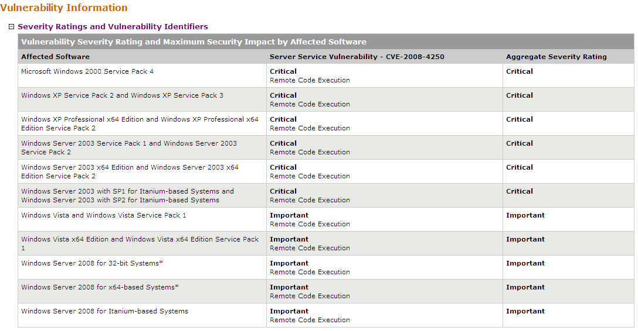
Example: Microsoft Security Bulletin MS08-067 – Critical

Slide 77
Agenda
Background
Windows Security Architecture
Linux Security Model
Evaluation: Windows vs. Linux Design
Windows Vulnerabilities
Linux Vulnerabilities
Means of Evaluating Metrics
Evaluation: Windows vs. Linux Vulnerabilities
  CERT: Comparing Query Result for “Microsoft” and “Linux” Keywords
System Hardening
  Windows Defenses
  Linux System Hardening
    OS-Level
    Application-Level
OS Security Capabilities: Windows vs. Linux
Conclusion

Slide 78
Evaluation: Windows Vs. Linux
Vulnerabilities
The United States Computer Emergency Readiness Team (CERT) uses its own set of metrics to evaluate the severity of any given security flaw
I query CERT vulnerabilities notes database for “Windows” and “Linux” keywords to examine metrics for the 40 most recent reported vulnerabilities
A number between 0 and 180 expresses the final metric, where the number 180 represents the most serious vulnerability
The ranking is not linear
  In other words, a vulnerability ranked 100 is not twice as serious as a vulnerability ranked at 50
CERT considers any vulnerability with a score of 40 or higher to be serious enough to be a candidate for a special CERT Advisory and US-CERT technical alert

Slide 79
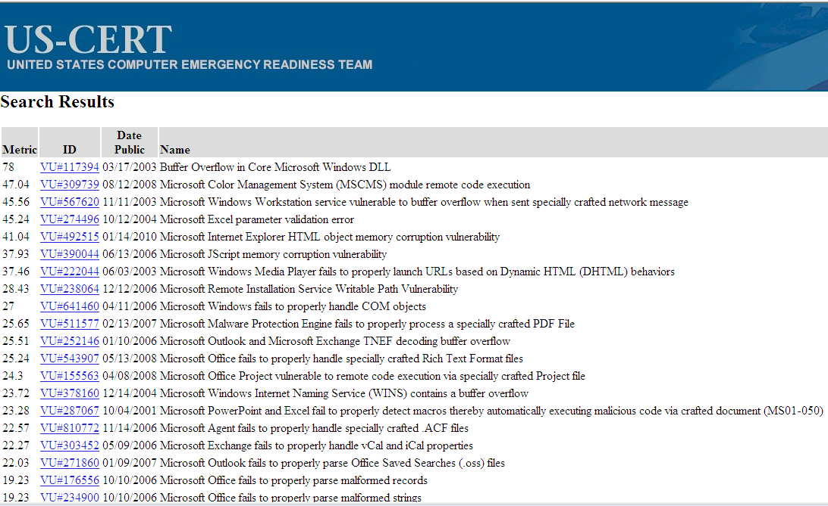
CERT: Query Result for Keyword “Microsoft”

Slide 80
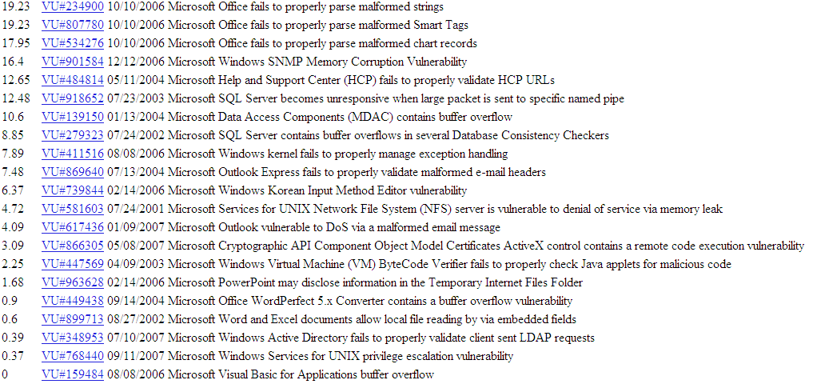
CERT: Query Result for Keyword “Microsoft” (continued)

Slide 81
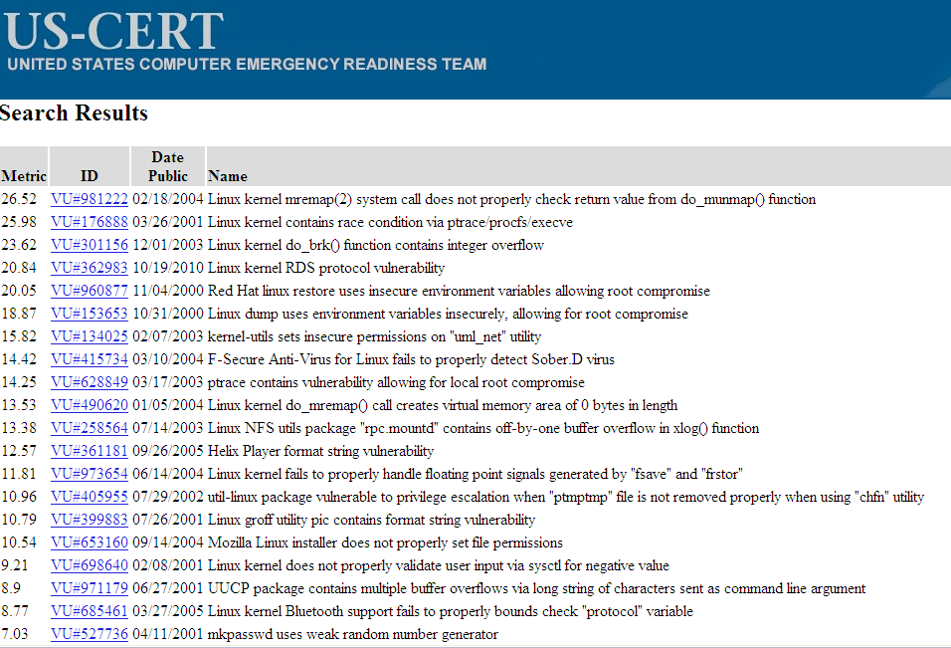
CERT: Query Result for Keyword “Linux”

Slide 82
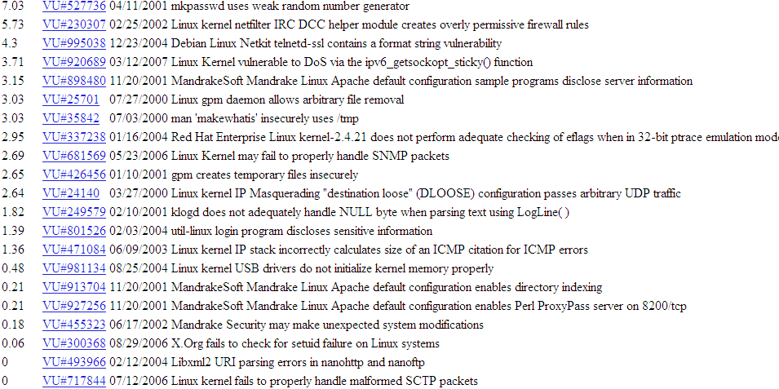
CERT: Query Result for Keyword “Linux” (continued)

Slide 83
CERT: Evaluation of Query Results for “Microsoft” and “Linux”
CERT web search capabilities do not produce perfectly desirable results in terms of granularity or longevity
  Especially True for Linux
    The “Linux” search results include a number of Oracle security vulnerabilities that are common to Linux, UNIX, and Windows
  In Top 40 CERT results for “Microsoft”,
    Top entry containing the severity metric of 78
    5 entries have a severity rating of 40 or greater
  In Top 40 CERT results for Linux
    Top entry containing the severity metric of 26.52
    None other entry have a severity rating 27 or greater
Note that CERT results only reflect how Windows security flaws tend to be far more frequently severe than those of Linux
  These results cannot be expected to mirror our own analysis of recent vulnerability patches

Slide 84
Agenda
Background
Windows Security Architecture
Linux Security Model
Evaluation: Windows vs. Linux Design
Windows Vulnerabilities
Linux Vulnerabilities
Means of Evaluating Metrics
Evaluation: Windows vs. Linux Vulnerabilities
  CERT: Comparing Query Result for “Microsoft” and “Linux” Keywords
System Hardening
  Windows Defenses
  Linux System Hardening
    OS-Level
    Application-Level
OS Security Capabilities: Windows vs. Linux
Conclusion

Slide 85
System Hardening
Shoring up defenses, reducing exposed functionality, disabling less-used features
  Called attack surface reduction
  80/20 rule of functionality
  Not always achievable
    Strip mobile code support on servers
Servers easier to harden
  Used for specific and controlled purposes
  Administrative users with better skills than workstation users
Notes:
Process of hardening is process of shoring up defenses, reducing the amount of functionality exposed to untrusted users and disabling less-used features.
In microsoft it called Attack surface reduction.
The concept is simple: apply 80/20 rule to features. If the feature is not used by 80% of population, then feature should be disabled by default.
While this was goal it was not always achievable, as disabling too many features makes product unusable for nontechnical users.
Servers easier to harden because
Used for specific and controlled purposes
Administrative users with better skills than workstation users

Slide 86
Windows Defenses
Microsoft Security Development Lifecycle
  Net effect approx. 50% reduction in security bugs
  Vista used SDL start to finish
Categorize Security Defenses
  Account defenses
  Network defenses
  Buffer over-run defenses
  Browser defenses
Notes:
After 2001, microsoft decide to change its software development process to better accommodate secure design, coding, testing and maintenance requirements, with one goal in mind: reduce the number of vulnerabilities in all microsoft products.
This process improvement is called the security development lifecycle.
The core SDL requirements includes mandatory security education, secure design requirements, attack surface analysis and reduction…etc.

Slide 87
Account Defenses
Least Privilege
  Operate with just enough privileges for task
Another defense is to strip privileges from an account soon after an application start
Windows Vista reserves default with UAC
  Users prompted to perform privileged operations
Notes:
The principle of least privilege dictates that users should operate with just enough privilage to get the tasks done, and no more.
Historically, windows xp users operated by default as members of the local administrators group, this was simply done for application compatibility reasons. In some cases( if applications run on windows 95,98 may not run on windows xp without administrator privilege) a windows xp user running as a “standard user” could run into some errors.
Another defense is to strip privileges from an account soon after an application start
Windows Vista reserves default with UAC
Users prompted to perform privileged operations

Slide 88
Network Defenses
Need more than account/user defenses
Vulnerable to network attacks
IPSec and IPv6 with authentication packets available in Vista
Built-in software firewall
  Block inbound connection of specific ports
  Block outbound connections
    Default settings on Vista
Notes:
There is one big problem with defenses that focus on user and user accounts: they do nothing to protect computers from low-level network attacks. So we need network defences.
Windows offers many network defenses, most notably native IPSec and IPv6, and bi-directional firewall.
See book for Detail discussion

Slide 89
Browser Defenses
Browser is key point of attack
  Via script code, graphics, helper objects, add-ons, cookies
Added defenses in IE7
  ActiveX disabled by default
  Protected mode

Slide 90
Cryptographic Services
Encrypting File System (EFS)
  Files and directories encrypted/decrypted transparently
  Generates random key, protected by DPAPI
Bitlocker Drive Encryption
  Encrypts entire volume with AES
  Key either USB or TPM 1.2 compatible chip
Data Protection API (DPAPI)
  Manages encryption key maintenance
  Keys derived from user’s password
Notes:
Windows includes full-fledged cryptographic defenses such as EFS, Bitlocker, data protection APIs
ETS allows files and directories to be encrypted and decrypted transparently for authorized users.
At a very high level, EFS works by generating a random encryption key and storing that key, encrypted using the user’s encryption key. This key is protected by data protection api in windows and the key used by DPAPI is derived form the user’s password.
Thus , Data protection API allows users to encrypt and decrypt data transparently.
Bitlocker encrypts the entire volume with using AES, and the encryption key is stored either on a USB drive or within a Trusted platform module (TPM) chip on the computer motherboard.
When booting a system that requires the USB device, the device must be present so the keys can be read by the computer, after which Bitlocker decrypts the hard drive on the fly, with no perceptible performance degradation.

Slide 91
Linux System Hardening
Can be done at system and application levels
Generalized steps to Linux System Hardening
  Preliminary Planning
  Physical System Security
  Operating System Installation
  Securing Local File Systems
  Configuring and Disabling Services
  Securing the root account
  User Authentication and User Account Attributes
  Securing Remote Authentication
  Setup Ongoing System Monitoring
  Backups

Slide 92
OS-Level Security Tools and Techniques
OS Installation: Software Selection and Initial Setup
Patch Management
Network-Level Access Controls
Using iptables for “Local Firewall” Rules
Antivirus Software
User Management
Password ageing
Root Delegation
Logging

Slide 93
OS Installation
Security begins with O/S installation
What software is run
  Unused applications liable to be left in default, un-hardened and un-patched state
Generally should not run:
  SMTP relay, X Window system, RPC services, R-services, inetd, SMTP daemons, telnet etc
Setting some initial system s/w configuration:
  Setting root password
  Creating a non-root user account
  Setting an overall system security level
  Enabling a simple host-based firewall policy
  Enabling SELinux
Notes:
Linux system security begins at operating system installation time: one of the most critical, system impacting decisions a system admin makes is what software will run on the system.
What software you should not run?
SMTP relay, X Window system, RPC services, R-services, inetd, SMTP daemons, telnet etc
Additionally, Linux installation utilities also perform varying amounts of initial system and software configuration such as
Setting root password
Creating a non-root user account
Setting an overall system security level
Enabling a simple host-based firewall policy
Enabling SELinux

Slide 94
Patch Management
Installed server applications must be:
  Configured securely
  Kept up to date with security patches
Patching can never win “patch rat-race”
Have tools to automatically download and Install security updates
  Example: up2date, YaST, apt-get
  Should not run automatic updates on change-controlled systems without testing
Notes:
Carefully selecting what gets installed on linux system is an important but also they must also kept up to date with security patches and configure securely
Patch rat-race : there will always be software vulnerabilities that attackers are able to exploit for some period of time before vendor issue patches for them.
Good news is modern linux distributions includes tools for automatically download and install security updates
Should not run automatic updates on change-controlled systems without testing because it may introduce instability

Slide 95
Network Access Controls
Network a key attack vector to secure
Libwrappers & TCP wrappers a key tool to check access
  Before allowing connection to service, tcpd first evaluate access control
    Defined in /etc/hosts.allow
    Defined in /etc/hosts.deny
Notes:
One of the most important attack vectors in linux threats is the network
Network-level access control (that is, controls that restrict access to local resources based on ip addresses of the networked system attempting to access them) are there for import tool in linux security

Slide 96
Using iptables for “Local Firewall” Rules
Also have the very powerful netfilter Linux kernel native firewall mechanism and iptables user-space front end
Useful on firewalls, servers, desktop
Typically for “personal” firewall use will:
  Allow incoming requests to specified services
  Block all other inbound service requests
  Allow all outbound (locally-originating) requests
Do have automated rule generators
If need greater security, manually configuration required
Notes:
Linux kernel’s native firewall mechanism, netfilter is powerful tool because netfilter is commonly referred to by the name of its user-space frontend, iptables.
Useful on firewalls, servers, desktop
Typically for “personal” firewall use will:
Allow incoming requests to specified services
Block all other inbound service requests
Allow all outbound (locally-originating) requests
Do have automated rule generators
If need greater security, manually configuration required

Slide 97
Antivirus Software
Historically Linux not as vulnerable to viruses
Windows targeted more due to popularity
Prompt patching of security holes more effective for worms
Viruses abuse users privileges
Non-privileged user account
  Less scope of being exploited
Growing Linux popularity means growing exploits
Hence antivirus software will be more important
  Various commercial and free Linux A/V

Slide 98
User Management
Guiding principles in user-account security:
  Be careful setting file / directory permissions
  Use groups to differentiate between roles
  Use extreme care in granting / using root privileges
Notes:
These guidelines user need to follow for security
Be careful setting file / directory permissions
Use groups to differentiate between roles
Use extreme care in granting / using root privileges

Slide 99
Password Aging
Maximum and minimum lifetime for user passwords
  Globally changed in /etc/login.defs
  To change password settings for existing users
    command line -> change
Notes:
Password againg is ste globally in the files /etc/login.defs and /etc/default/useradd but these settings are only applied when new user accounts are created
To modify password lifetime for existing account use the ‘change’ command

Slide 100
Root Delegation
“su” command allows users to run as root
  Use su with –c flag to allow you to run a command instead of an entire shell as root
  Must supply root password
  Drawback: many people will know root password
SELinux RBAC can limit root authority but it’s complex
“sudo” allows users to run as root
  But only need users password, not root password
  “sudoers” defined in /etc/sudoers file
  Open and configure the sudoers file using ‘visudo’
Notes:
“su” command allows users to run as root
Su with –c flag allows you to specify a single command to run as root rather than an entire shell session.
However, this require you to enter the root password, so required root password sharing. So only good for small number of people.
SELinux RBAC can limit root authority but it’s complex
Middle ground solution is sudo command. Sudo is configured via the file/etc/sudoers, but you should not edit this file directly. Rather you should used command visudo, which opens a special vi session.

Slide 101
Logging
Linux logs using syslogd or Syslog-NG
  Writes log messages to local/remote log files
Syslog-NG preferable because it has:
  Variety of log-data sources / destinations
  Much more flexible “rules engine” to configure
  Can log via TCP which can be encrypted
Change default logging settings on both
Log files careful management
  Balance number and size of log files
  Rotate log files and delete old copies - logrotate
Notes:
Logging isn’t a proactive control because logs only tell you about bad things that have already happened.
But effective logging helps ensure that the event of a system failure, sysystm admins can more quickly and accurately identify cause therefore effectively focus on recovery and remediation efforts
Linux logs using syslogd or Syslog-NG
Syslog-NG preferable because it has:
Variety of log-data sources / destinations
Much more flexible “rules engine” to configure
Can log via TCP which can be encrypted
Log files require careful management

Slide 102
Application Security (Hardening)
A large topic
Many security features are implemented in
Similar ways across different applications
Sub-topics
  Running as unprivileged user/group
  Running in chroot jail
  Modularity
  Encryption
  Logging

Slide 103
Running As Unprivileged User/Group
Every process “runs as” some user
Extremely important user is not root
  Since any bug can compromise entire system
May need root privileges, e.g. bind port
  Have root parent perform privileged function
  But main service from unprivileged child
User/group used should be dedicated
  Easier to identify source of log messages
Notes:
Every process “runs as” some user
Extremely important user is not root
Since any bug can compromise entire system
May need root privileges, e.g. bind port
Have root parent perform privileged function
But main service from unprivileged child
User/group used should be dedicated
Easier to identify source of log messages

Slide 104
Running in “chroot” Jail
“chroot” confines a process to a subset of /
  Maps a virtual “/” to some other directory
  Directories outside the chroot jail aren’t visible or reachable at all
  Contains effects of compromised daemon
Complex to configure and troubleshoot
Notes:
If an FTP daemon serves files from a particular directory says, /srv/ftp/public, there shouldn’t be any reason for that daemon to have access to the rest of the file system
Chroot system call confines a process to some subset of /, that is, it maps a virtual “/” to some other directory. We call this directory to which we restrict the daemon a chroot jail.
To the “chrooted” daemon, everyting in the chroot jail appears to actually be in /. Things in directories outside the chroot jail aren’t visible or reachable at all.
Complex to configure and troubleshoot

Slide 105
Modularity
Applications running as a single, large, multipurpose process can be:
  More difficult to run as an unprivileged user
  Harder to locate / fix security bugs in source
  Harder to disable unnecessary functionality
Hence modularity a highly prized feature
  Providing a much smaller attack surface
cf. postfix vs sendmail, Apache modules

Slide 106
Encryption
Sending logins & passwords or application data over networks in clear text exposes them to various network eavesdropping attacks
Hence many network applications now support encryption to protect such data
  SSL and TLS protocols in OpenSSL library used
May need own X.509 certificates to use
  Can generate/sign using openssl command
  May use commercial/own/free CA
Notes:
Sending logins & passwords or application data over networks in clear text exposes them to various network eavesdropping attacks
Hence many network applications now support encryption to protect such data SSL and TLS protocols in OpenSSL library used that require to use X.509 digital certificates.
Thus, need own X.509 certificates to use
can generate/sign using openssl command
May use commercial/own/free CA

Slide 107
Logging
Applications can usually be configured to log to any level of detail (debug to none)
Centralized logging using (syslog) can be used for consistency
Must ensure there is some form of logging management as discussed before like rotating
Notes:
Most applications can configured to log to whatever level of detail you want, ranging from “debugging” (maximum details) to none
Centralized logging using (syslog) can be used for consistency
Must ensure there is some form of logging management as discussed before like rotating

Slide 108
Agenda
Background
Windows Security Architecture
Linux Security Model
Evaluation: Windows vs. Linux Design
Windows Vulnerabilities
Linux Vulnerabilities
Means of Evaluating Metrics
Evaluation: Windows vs. Linux Vulnerabilities
  CERT: Comparing Query Result for “Microsoft” and “Linux” Keywords
System Hardening
  Windows Defenses
  Linux System Hardening
    OS-Level
    Application-Level
OS Security Capabilities: Windows vs. Linux
Conclusion

Slide 109
OS Security Capabilities: Linux vs. Windows
A qualitative assessment of operating system security is subjective and your "mileage may vary" based on present and past experience
A true comparison between Windows and Linux on the values of the inherent security of each operating system is hard to obtain, and the matter is extremely contentious among both security professionals and computer hobbyists

Slide 110
OS Security Capabilities: Linux vs. Windows (continued)
Because there are many more Windows systems in the world, there are simply more targets available for attack
  Windows a richer and more attractive target for malware developers
  Windows monoculture: because Windows systems are all tightly binary-compatible, a single successful attack can affect a large fraction of them
The security differences between Windows and Linux is heavily debated and the security track record of both operating systems has proven Linux has fewer serious vulnerabilities
  Also Linux derives its security from the underlying Unix design philosophy

Slide 111
OS Security Capabilities: Linux vs. Windows (continued)
 | Windows | Linux
Malware | As of 2009, well over 2 million malware programs target Windows Botnets: networks of infected computers controlled by malicious persons – with more than one million computers have been witnessed Once malicious software is present on a Windows-based system, it can sometimes be incredibly difficult to locate and remove As such, users are advised to install and run anti-malware programs In the event of rootkit infection, users may have to resort to reformatting the system's hard disk and re-installing Windows | As of 2006, more than 800 pieces of Linux malware had been discovered Some malware has propagated through the Internet. However, in practice, reports of bonafide malware presence on Linux-based systems are extremely rare Aniware Tools like ClamAV and Panda Security's DesktopSecure for Linux do exist

Slide 112
OS Security Capabilities: Linux vs. Windows (continued)
Open Vs. Closed | Claims its platform is more secure because of a comprehensive approach to security using the Security Development Lifecycle However, because Windows is closed-source, only Microsoft-employed programmers can fix bugs Recent Windows versions have some security vulnerabilities detected | Claims its platform is more secure because all of its code is reviewed by so many people that bugs are detected Anyone with programming experience is free to fix bugs and submit them for inclusion in future releases and updates However such an approach has indeed produced several vulnerabilities, although this is a rare case

Slide 113
OS Security Capabilities: Linux vs. Windows (continued)
Response Speed | There are claims that closed source offers a faster and more effective response to security issues However, critical bug fixes are released only once a month after extensive programming and testing, and certain bugs have been known to go un-patched for months or even years | Bugs can be fixed and rolled out within a day of being reported (often within hours), though usually it takes a few weeks before the patch is available on all distributions

Slide 114
OS Security Capabilities: Linux vs. Windows (continued)
User Accounts | In Windows Vista, all logged-in sessions run with standard user permissions, preventing malicious programs from gaining total control of the system Processes that require administrator privileges can be run using the User Account Control framework. For standard users, this presents a credentials dialogue that requires the password of a member of the administrators group (who are listed) For users who are already logged in an administrator, only confirmation is necessary The first user account created during the setup process is automatically a member of the administrators group The majority of users did not change to an account type with fewer rights, meaning that, in Windows versions prior to the introduction of UAC, malicious programs would have full control over the system However the security of the User Account Control is not guaranteed to prevent malicious programs and users from unlimited access in Windows | Users typically run as limited accounts, having created both administrator (root) and at least one user account during installation In most Linux distributions, there are commands (su, sudo) that will temporarily grant elevated permissions to processes that need it In practice, this can be very dangerous, as any error can lead to severe damage to the system New frameworks such as PolicyKit seek to rectify this problem However, as of Feb. 2009,PolicyKit is not in widespread use.

Slide 115
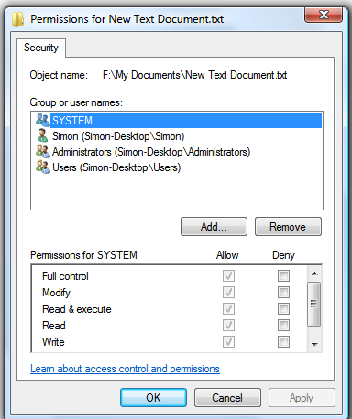
OS Security Capabilities: Linux vs. Windows (continued)
Windows: File System Permissions | The DOS based Windows ME, Windows 98, Windows 95, and previous versions of non-NT Windows only operated on the FAT file system and did not support file system permissions Windows NT and subsequent NT-based versions of Windows use NTFS-based Access Control Lists to administer permissions, using tokens On Windows XP and prior versions, most home users still ran all of their software with Administrator accounts, as this is the default setup upon installation The existence of software that would not run under limited accounts and the cumbersome "Run As..." mechanism forced many users to use administrative accounts However, few organizations have taken advantage of the richness of the Token based system of NTFS which can be applied to almost all NT operating system objects | File system permissions on a Windows Vista system.

Slide 116
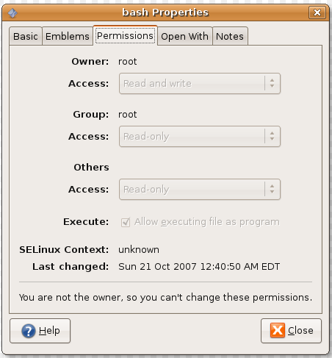
OS Security Capabilities: Linux vs. Windows (continued)
Linux: File System Permissions | Linux has a traditional Unix-like “user, group, other” approach to file system permissions at a minimum This approach is extended by Access Control Lists on some file systems There are some specific to Linux frameworks such as AppArmor and SELinux which add even finer-grained controls over which users and programs can access certain resources or perform certain operations Some distributions use them out of the box | File system permissions on an Ubuntu Linux system running GNOME

Slide 117
Agenda
Background
Windows Security Architecture
Linux Security Model
Evaluation: Windows vs. Linux Design
Windows Vulnerabilities
Linux Vulnerabilities
Means of Evaluating Metrics
Evaluation: Windows vs. Linux Vulnerabilities
  CERT: Comparing Query Result for “Microsoft” and “Linux” Keywords
System Hardening
  Windows Defenses
  Linux System Hardening
    OS-Level
    Application-Level
OS Security Capabilities: Windows vs. Linux
Conclusion

Slide 118
Conclusion
Security is a perennial concern for IT administrators
Managers need a framework to evaluate operating system security
The challenge in evaluating Windows and Linux on any criteria is that there is not a single version of each operating system
Users need to keep in mind that there are philosophical differences in the design of Linux and Windows
The ability to make either operating system more secure varies depending on architectural design
  The Windows operating system is designed to support applications by moving more functionality into the operating system, and by more deeply integrating applications into the Windows kernel
  Linux differs from Windows in providing a clear separation between kernel space and user space

Slide 119
Questions ?

Slide 120
References
Stallings, W., Brown, L., Computer Security: Principles and Practice, Prentice Hall, NJ,2008
Toxen, B., Real World Linux Security, Prentice Hall, NJ, 2002
Howard, M. LeBlanc, D., Writing Secure Code for Windows Vista, Microsoft Press, WA,2006
Ahmad, D., The Contemporary Software Security Landscape, IEEE Security and Privacy, vol. 5, no. 3, 2007, pp. 75-77
Xinyue, S., Stinson, M., Lee, R.,Albee, P., An Approach to Analyzing the Windows and Linux Security Models, IEEE Conference on Computer and Information Science (2006), July, pp. 56-62
Xinyue, S., Stinson, M., Lee, R., Albee, P., A Qualitative Analysis of Privilege Escalation, IEEE International Conference Proceedings on Information Reuse and Integration (2006), pp. 363-368

Slide 121
References (continued)
Unix System Hardening Checklist, Accessed Dec 8,2008, http://www.linux-mag.com/downloads/2002-10/guru/harden_list.htm
http://marketshare.hitslink.com/operating-system-market-share.aspx?qprid=8
http://www.kb.cert.org/vuls/bymetric?searchview&query=microsoft&searchorder=4&count=40
http://www.kb.cert.org/vuls/bymetric?searchview&query=linux&searchorder=4&count=40
http://www.microsoft.com/technet/security/bulletin/ms10-021.mspx
http://www.microsoft.com/technet/security/bulletin/ms08-067.mspx
http://people.eecs.ku.edu/~saiedian/Teaching/Fa10/710/Readings/linux-security.pdf

