Slide 1
Working with Docker
Bluestone Workshop 6.10.18

Slide 2
Plan
Docker story
Dockerfile + image structure
Volumes + networking
Security
Compose
Registry
Deployment
Excercises

Slide 3
Part 1
Docker Story

Slide 4
Pros/cons of virtual machines
The VM is a hardware abstraction: it takes physical CPUs and RAM from a host, and divides and shares it across several smaller virtual machines. There is an OS and application running inside the VM, but the virtualization software usually has no real knowledge of that.
A container is an application abstraction: the focus is really on the OS and the application, and not so much the hardware abstraction. Many customers actually use both VMs and containers today in their environments and, in fact, may run containers inside of VMs.

Slide 5
Simplest example
$ docker run hello-world

Slide 6
Docker engine
Docker engine consists of:
1. Server
a) set of apps/libs on top of Linux kernel
b) REST HTTP API
2. Client (which is HTTP based)

Slide 7
Docker environment
Engine is not all. Other parts consist of:
1. Store/Registry
2. Docker Compose
3. Orchestration tools:
a. Docker Swarm
b. AWS ECS
c. Kubernetes

Slide 8
Dockerfile + image
Docker have several base concepts:
1. image – set of virtual immutable file system layers + additional configuration
2. Dockerfile – layer definitions file
3. container – running instance of an image with mutable IO layer

Slide 9
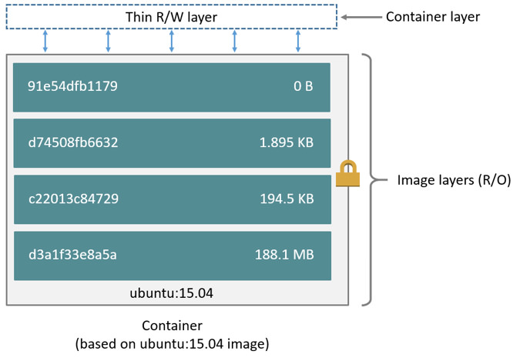
Image layers

Slide 10
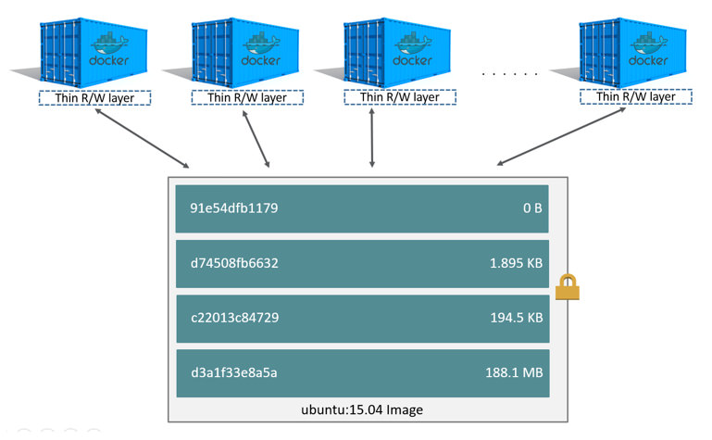
Image’s advantage

Slide 11
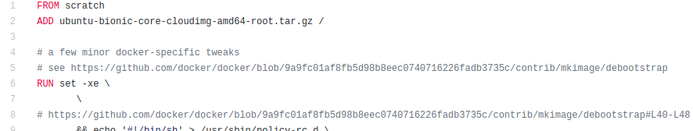
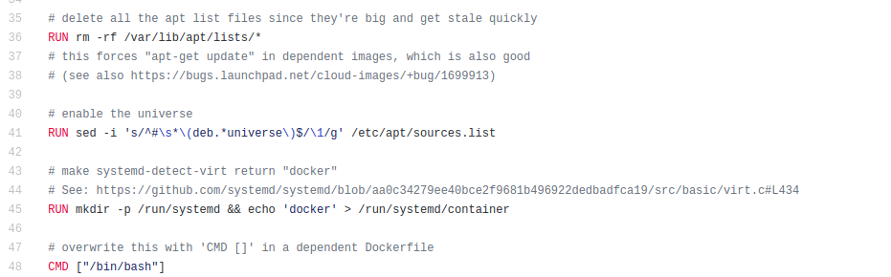
Ubuntu 18.04 Dockerfile
...
https://github.com/tianon/docker-brew-ubuntu-core/blob/222130dfdfa777c09a17b3f08ba68c5b9850e905/bionic/Dockerfile

Slide 12
Image inspection
> docker image inspect ubuntu

Slide 13
Image inspection
> docker image inspect ubuntu

Slide 14
Volumes - reason
Why to store data outside a container? Not making a container bigger, data can live after container is removed
Data can be shared between containers

Slide 15
Data mounting
It’s possible to mount a host directory inside a container. If you bind-mount into a non-empty directory on the container, the directory’s existing contents are obscured by the bind mount.
This can be beneficial, such as when you want to test a new version of your application without building a new image.

Slide 16
Docker tmpfs
It’s possible to have a temporary, in-memory volume. As opposed to volumes and bind mounts, a tmpfs mount is temporary, and only persisted in the host memory.
When the container stops, the tmpfs mount is removed, and files written there won’t be persisted.
Feature is supported by AWS ECS - https://aws.amazon.com/about-aws/whats-new/2018/03/amazon-ecs-adds-support-for-shm-size-and-tmpfs-parameters/

Slide 17
Network
There are multiple drivers that define how network communication is performed.
Default used is bridge driver which by default creates shared network between containers on the same host. All ports are shared between containers and none with host.
Ports publishing can be done using -p parameter.

Slide 18
Secutiry
Security is supported by seccomp kernel feature. It can allow tuning of access to host’s resources.
Usually there’s no need of seccomp profile configuration.
If you’ll have any problem with seccomp - use --security-opt seccomp=unconfined.

Slide 19
Docker Compose
Compose is a tool for defining and running multi-container Docker applications.
With Compose, you use a YAML file to configure your application’s services. Then, with a single command, you create and start all the services from your configuration.
AWS ECS supports compose - https://docs.aws.amazon.com/AmazonECS/latest/developerguide/ECS_CLI_tutorial_EC2.html

Slide 20
Compose + network
By default Compose sets up a single network for your app. Each container for a service joins the default network and is both reachable by other containers on that network, and discoverable by them at a hostname identical to the container name.
Example: compose in myapp directory will have containers attached to myapp_default network.

Slide 21
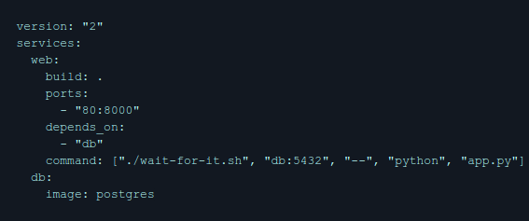
Compose + order
You can define running order by using depends_on keyword

Slide 22
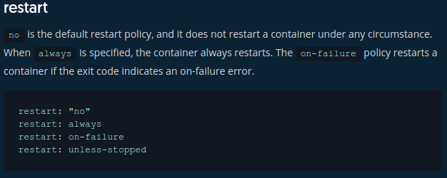
Compose + HA
You can define what happens when a service is killed

Slide 23
Compose example
> docker-compose up

Slide 24
Docker store/registry
For developers and operators, Docker Store is the best way to discover high-quality Docker content. It contains content that has been submitted for approval by qualified Store Vendor Partners. These products are published and maintained directly by a commercial entity. In addition, the Docker Certified logo distinguishes content by providing quality, provenance, and support assurances.
The Registry is a stateless, highly scalable server side application that stores and lets you distribute Docker images. The Registry is open-source, under the permissive Apache license.
AWS provides Amazon Elastic Container Registry - a fully-managed Docker container registry that makes it easy for developers to store, manage, and deploy Docker container images.

Slide 25
Deployment time
During deployment time you might consider following facts:
1. CPU time is shareable – you may want to provide soft limits there
2. Memory is limited – hard limit is needed here

Slide 26
Useful links
https://docs.docker.com/ - documentation
https://training.play-with-docker.com/ - nice and easy trainings
https://www.dwmkerr.com/learn-docker-by-building-a-microservice/ - more extensive tutorial

Slide 27
Exercises
Please go to <URL> and go through set of lessons

Slide 28
Excercises

