Slide 1
Control Flow Analysis
Compiler
Baojian Hua
bjhua@ustc.edu.cn

Slide 2
Front End
source code
lexical analyzer
tokens
parser
abstract syntax tree
semantic analyzer
IR

Slide 3
Middle End
AST
translation
IR1
translation
IR2
other IR and translation
asm

Slide 4
Intermediate Representation
Trees and Dags
  high-level, program structures
3-address code
  low-level, closer to ISA
Today, control-flow graph (CFG)
  more refined 3-address code
  good for optimizations

Slide 5
Control Flow Graph (CFG)

Slide 6
3-address Code: Recap
if (x < y){
z = 4;
m = 3;
}
else{
z = 6;
m = 5;
}
Cjmp (x<y, L_1, L_2);
L_1:
z = 4;
m = 3;
jmp L_3;
L_2:
z = 6;
m = 5;
jmp L_3;
L_3:

Slide 7
Control Structure
Cjmp (x<y, L_1, L_2);
L_1:
z = 4;
m = 3;
jmp L_3;
L_2:
z = 6;
m = 5;
jmp L_3;
L_3:
Cjmp (x<y, L_1, L_2);
L_1
L_2
z = 4;
m = 3;
jmp L_3;
z = 6;
m = 5;
jmp L_3;
L_3
…;

Slide 8
Moral
This graph-based representation is good for many purposes:
  flow analysis:
    for many program analysis, the program internal structure is important
  enable other analysis:
    such as data-flow analysis (to be discussed later)
  scheduling:
    try to minimizing “jump”s by rearranging the program structures

Slide 9
Basic Blocks &
Control Flow Graph
A basic block is a sequence of basic statements, executing from the beginning and exiting at the end
  can NOT enter the middle
  can NOT exit the from the middle
  no interleaving “jump” or “branch”
Control-flow graph is a graph consisting of basic blocks as vertices

Slide 10
Basic blocks and CFG
Cjmp (x<y, L_1, L_2);
block label (name)
L_1
L_2
z = 4;
m = 3;
jmp L_3;
z = 6;
m = 5;
jmp L_3;
basic blocks
ending with a “jump” statement
edge stands for control transfer
L_3
…;

Slide 11
Control Flow Graph
Data Structure
// Just a refined 3-address code
s -> x = v1 + v2
| x = v
| x = f (v1, v2, …, vn)
j -> Jump L
| Cjump (v, L1, L2)
| return
b -> Label L;
s1; s2; …, sn
j;
f -> b1, …, bn
prog -> f1, …, fn

Slide 12
Conversion into CFG
One can start directly from AST or HIL:
  good for language like MiniJava, which has regular control structures
Or one can start from 3-adress code or other IRs:
  may be easier for languages such as C, which have unstructured controls (e.g., goto)
Next, we discuss techniques dealing with CFG

Slide 13
CFG Traversal
Standard graph traversal algorithms:
  DFS, BFS, …
Important for linearization of nodes:
  Topo-sort order, quasi-topo-sort order, and reverse top-sort order
  We leave these operations to your algorithm course, and next we discuss two applications:
    dead-code eliminations (optimizations)
    extended basic blocks (EBBs)

Slide 14
#1: Dead code (block) elimination example
int f ()
{
int i = 3;
while (i<10){
i = i+1;
printi(i);
continue;
printi(i);
}
return 0;
}
L0
i=3
i<10? L1: L2
L1
printi(i)
jump L0
L3
printi(i)
jump L2
L2
return 0

Slide 15
#1: Dead code (block) elimination algorithm
// algorithm
// input: a CFG g for f
// output: a new CFG for
// function f
dfs (g);
for (each node n in g)
if (!visited(n))
delete (n);
L0
i=3
i<10? L1: L2
L1
printi(i)
jump L0
L3
printi(i)
jump L2
L2
return 0

Slide 16
#2: Extended basic blocks
Extended blocks from a block A is a maximal set of blocks with no join
  that is, every block (except for A) should have just one predecessor
  e.g., in the following
  graph, extended
  blocks from A are
  {A, B, C}
A
B
C
D

Slide 17
#2: EBBs
A
// Algorithm: give a node n,
// calculate EBB for this node.
// This is just a variant
// of DFS
ebb = {};
build_ebb (n: node)
ebb \/= {n};
foreach (successor m of n)
if (|pred(m)| ==1 && m\not\in ebb)
build_ebb (m);
B
C
D

Slide 18
Dominator

Slide 19
Dominators
A node a dominates a node d, iff every path from the entry node s0 to the node d goes through the node a
  a is a dominator of node d
  every node dominates itself
Dominator relationship is a partial order
  that is: reflexive, anti-symmetry, transitive
  leave the proof to you!

Slide 20
Example
1
A node a dominates a node d, iff every path from the entry node s0 to the node d goes through the node a. We write it as:
a dom d
2
3
4
D[5]
D[6]
1 dom 2
5
6
2 dom 4
2 dom 7
8
7
D[7]
4 dom 7
9
11
6 dom 7 ???
D[n]={all nodes x | x dom n}
10
12

Slide 21
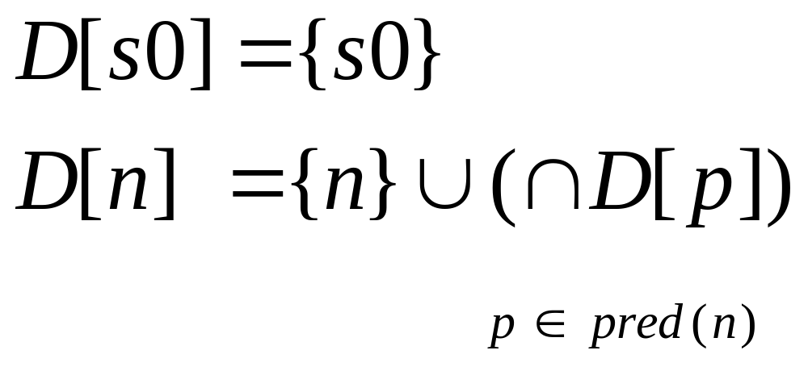
Equation
Fix-point algorithm
Can be accelerated by first ordering the nodes
  quasi-topo sort order
Or by Tarjan’s algorithm (nearly linear time)

Slide 22
Step #1: initialization
D[s0]={s0}
D[n]={all nodes}
1
D[1]={1}
D[2]={1, …, 12}
2
D[3]={1, …, 12}
3
4
D[4]={1, …, 12}
D[5]={1, …, 12}
5
6
D[6]={1, …, 12}
D[8]={1, …, 12}
8
7
D[7]={1, …, 12}
9
D[9]={1, …, 12}
11
D[11]={1, …, 12}
D[10]={1, …, 12}
10
12
D[12]={1, …, 12}

Slide 23
Step #2: calculate a quasi-topo sort order
quasi top-sort order:
1, 2, 3, 4, 5, 8, 9, 10, 6, 7, 11, 12
1
D[1]={1}
D[2]={1, …, 12}
2
D[3]={1, …, 12}
3
4
D[4]={1, …, 12}
D[5]={1, …, 12}
D[6]={1, …, 12}
5
6
D[8]={1, …, 12}
8
7
D[7]={1, …, 12}
9
D[9]={1, …, 12}
11
D[11]={1, …, 12}
D[10]={1, …, 12}
10
12
D[12]={1, …, 12}

Slide 24
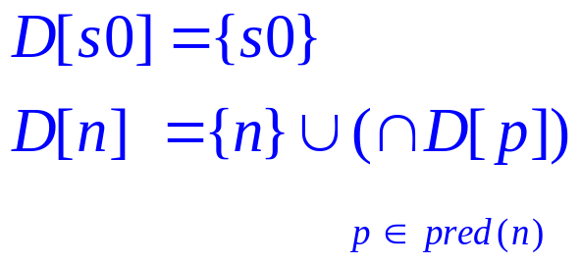
Step #3: calculate fix-point
quasi top-sort order:
1, 2, 3, 4, 5, 8, 9, 10, 6, 7, 11, 12
1
D[1]={1}
{1, 2}
D[2]={1, …, 12}
2
{1, 2, 3}
{1, 2, 4}
D[3]={1, …, 12}
3
4
D[4]={1, …, 12}
{1, 2, 4, 5}
D[5]={1, …, 12}
{1, 2, 4, 6}
5
6
D[6]={1, …, 12}
{1, 2, 4, 5, 8}
D[8]={1, …, 12}
{1, 2, 4, 7}
8
7
D[7]={1, …, 12}
{1, 2, 4, 5, 8, 9}
{1, 2, 4, 7, 11}
9
D[9]={1, …, 12}
11
D[11]={1, …, 12}
{1, 2, 4, 5, 8, 9, 10}
{1, 2, 4, 12}
D[10]={1, …, 12}
10
12
D[12]={1, …, 12}

Slide 25
Step #3: calculate fix-point
quasi top-sort order:
1, 2, 3, 4, 5, 8, 9, 10, 6, 7, 11, 12
1
D[1]={1}
D[2]={1, 2}
2
D[3]={1, 2, 3}
3
4
D[4]={1, 2, 4}
D[5]={1,2,4,5}
5
6
D[6]={1, 2, 4, 6}
D[8]={1,2,4,5,8}
8
7
D[7]={1, 2, 4, 7}
9
D[9]={1,2,4,5,8,9}
11
D[11]={1,2,4,7,11}
D[10]={1,2,4,5,8,9,10}
10
12
D[12]={1, 2, 4, 12}

Slide 26
Immediate dominator
Intuitively, an immediate dominator x for a node n is a node that is most close to n
  x dom n, x!=n
  for any y dom n, then y dom x
One can prove a theorem stating that for every node n (except for s0), n has just one immediate dominator
  write n’s immediate dominator as idom(n)

Slide 27
Immediate dominator
quasi top-sort order:
1, 2, 3, 4, 5, 8, 9, 10, 6, 7, 11, 12
1
D[1]={1}
D[2]={1, 2}
2
D[3]={1, 2, 3}
3
4
D[4]={1, 2, 4}
D[5]={1,2,4,5}
5
6
D[6]={1, 2, 4, 6}
D[8]={1,2,4,5,8}
8
7
D[7]={1, 2, 4, 7}
9
D[9]={1,2,4,5,8,9}
11
D[11]={1,2,4,7,11}
D[10]={1,2,4,5,8,9,10}
10
12
D[12]={1, 2, 4, 12}

Slide 28
Dominator Tree
1
2
3
4
5
6
7
12
8
11
9
10

Slide 29
Dominator Calculation Revisited
In 2005, Cooper et. al, published an interesting paper
  dominator tree-based, easy to implement
  Even comparable with Tarjan’s algorithm
Lesson: careful engineering of well-known slow algorithm may be profitable

Slide 30
Strict dominator
Node x is a strict dominator of y, if x dominates y, and x<>y
  sdom (x) = dom(x)-{x}
Dominance frontier of a node x:
  a set of nodes y such that x dominates a predecessor p of node y, but does not strictly dominates y
  df(x)=?
    read the algorithm in Tiger 19.1

Slide 31
Intuition for Dominance Frontier
s0
x
p
s
q
t

Slide 32
Dominance Frontier
Walk the dominator tree in post-order:
3, 10, 9, 8, 5, 6, 11, 7, 12, 4, 2, 1
1
1
df(1)={}
df(2)={2}
2
2
df(4)={2}
3
4
3
4
df(3)={2}
df(6)={7}
5
6
5
df(5)={5, 12, 7}
6
12
7
df(12)={}
8
7
8
df(7)={12}
df(8)={5, 12, 8}
9
11
9
11
df(11)={12}
df(9)={5, 12, 8}
10
12
10
df(10)={5, 12}

Slide 33
Loops

Slide 34
Natural Loops
Given a back edge m->h (for dominance), the natural loop for m->h is all nodes x that dominated by h and can reach m without going through h

Slide 35
Natural Loops
Loops(3->2)={2, 3}
Loops(4->2)={2, 4}
Loops(10->5)={5,8,9,10}
Loops(9->8)={8, 9}
1
1
2
2
3
4
3
4
5
6
5
6
12
7
8
7
8
9
11
9
11
10
12
10

Slide 36
Control-Dependency Graph (CDG)

Slide 37
Motivation
Node 1 controls whether or not node 2 will execute. We say node 2 is control-dependent on node 1.
1
A[0] = 0
1
2
A[1] = 1
2
3
3
Suppose we are running this program on a two-core CPU with core C0, C1. Then can we run node 1 on C0 and node2 on C1? (Parallelization!)
Node 2 is control-dependent on node 1, iff 1\in DF(2) in the reverse control flow graph.

Slide 38
Control Dependency Graph
A CDG of a CFG G has an edge x->y, iff y is control-dependent on x
Algorithm:
  construct reverse graph G’ of G
  calculate the dominator tree for G’
  for each node in G’, calculate the dominance frontier
    draw an edge x->y in CDG, for x\in DF(y)

Slide 39
Example
1
1
2
2
3
4
3
4
5
6
e
5
6
e
7
7
CFG
Reverse CFG

Slide 40
Example
DF(3)={2}
DF(6)={3}
1
3
5
6
DF(1)={}
1
2
DF(5)={3}
7
2
DF(2)={2}
DF(7)={2}
3
4
4
DF(4)={}
5
6
e
DF(e)={}
e
7
Dominator tree
Reverse CFG

Slide 41
Example
DF(3)={2}
DF(6)={3}
3
5
6
DF(1)={}
1
2
1
4
DF(5)={3}
7
2
DF(2)={2}
3
7
e
DF(7)={2}
4
DF(4)={}
5
6
DF(e)={}
e
Dominator tree
CDG

Slide 42
Example
1
2
2
1
4
3
4
3
7
e
5
6
e
5
6
7
CFG
CDG

