Slide 1
Memory Allocator Summary

Slide 2
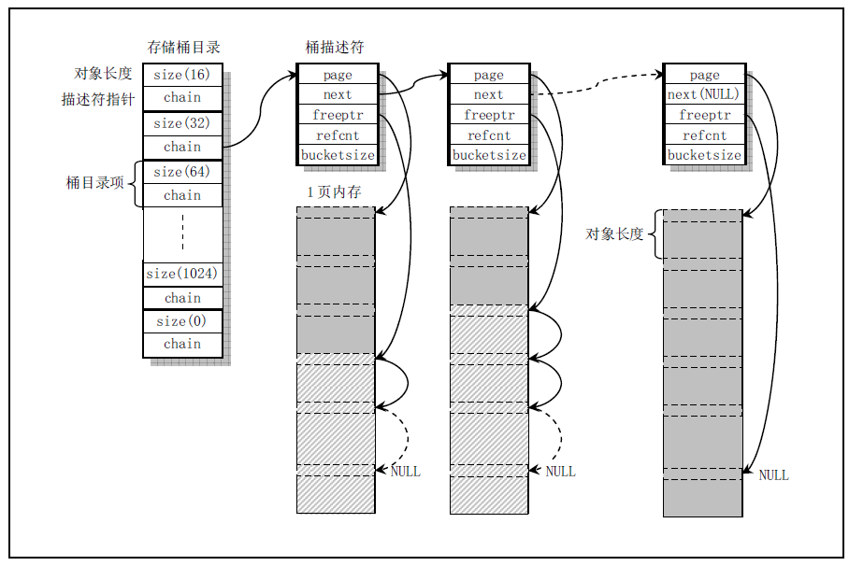
Linux 0.11 kmalloc/kfree

Slide 3
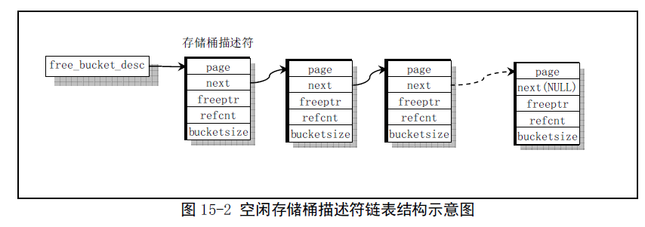
Linux 0.11 kmalloc/kfree

