Slide 1
Analysis of Representative Stock Indices in the United States on Time Series Forecasting
Group 2:
Mia Wang, Eric Gao, Cecilia Wang, Rona Zhang

Slide 2
01
Introduction
1.1 Background of the Study 1.2 Motivation of the Research 1.3 Scope of the Report

Slide 3

Background
The global financial markets have evolved significantly in recent decades, becoming increasingly interconnected and complex. One of the world’s most influential economy, the United States, has been at the forefront of this transformation.
Traditional analysis methods often fail to predict future trends effectively due to the inherently dynamic and non-linear nature of financial markets. So we need time series analysis, which takes into account temporal dependencies and fluctuations in the data over time, providing a deeper understanding of patterns and predictive insights.

Slide 4
Summary
Applying time series analysis to the study of the United States stock indices, including NASDAQ, DJIA, and SPX 500.
Unravel their underlying patterns, dependencies, and possibly forecast future movements.
ARIMA model & ETS model — Forecast
Compare the forecasting performance of ARIMA model and ETS model
Regularity, commonalities and differences behind three stock indices
Influence of different time windows

Slide 5
Scope
Time series analysis
Stock indices of the United States: NASDAQ, DJIA, and SPX 500
20 years — 1999 - 2019
Forecasting — data for 5 years — 2012 - 2017
primary data & secondary data
Potential limitations — unpredictable nature & numerous external factors
(political events, policy changes, global economic trends … )

Slide 6
02
Forecast and Analysis
2.1 Presentation of Data 2.2 Detailed Analysis

Slide 7
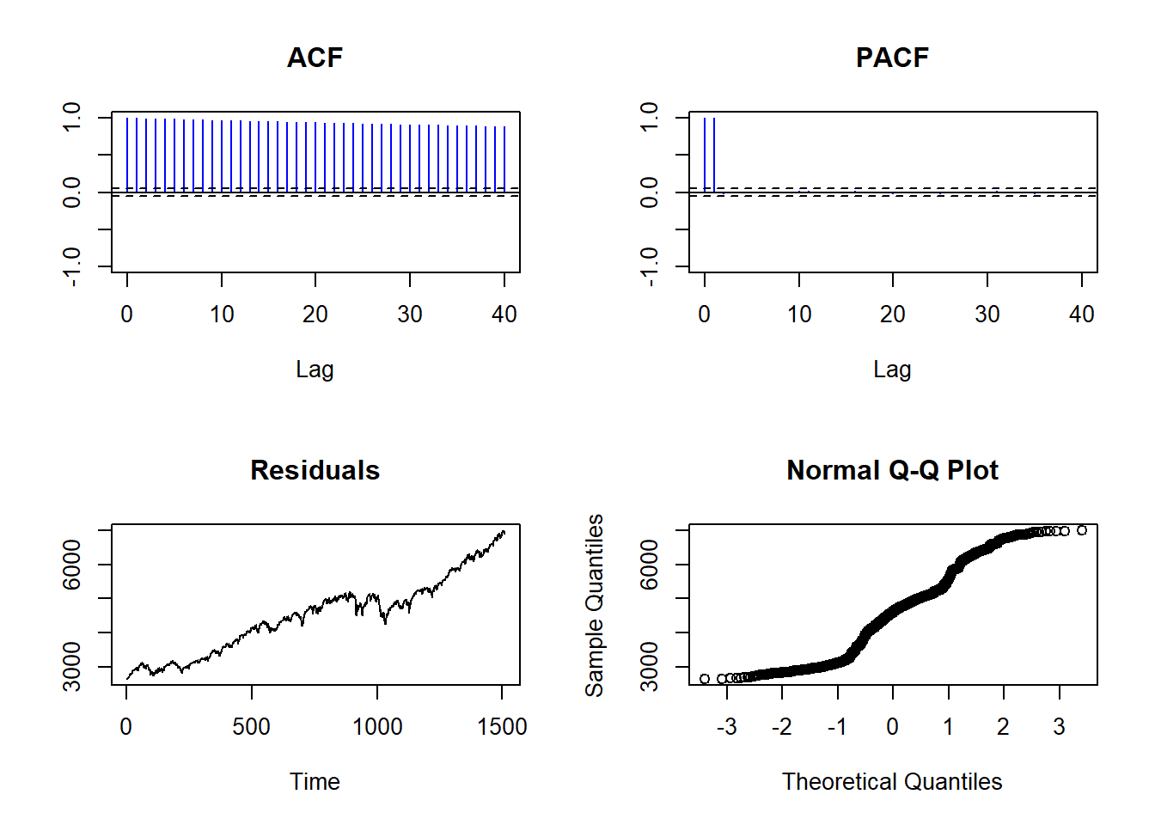
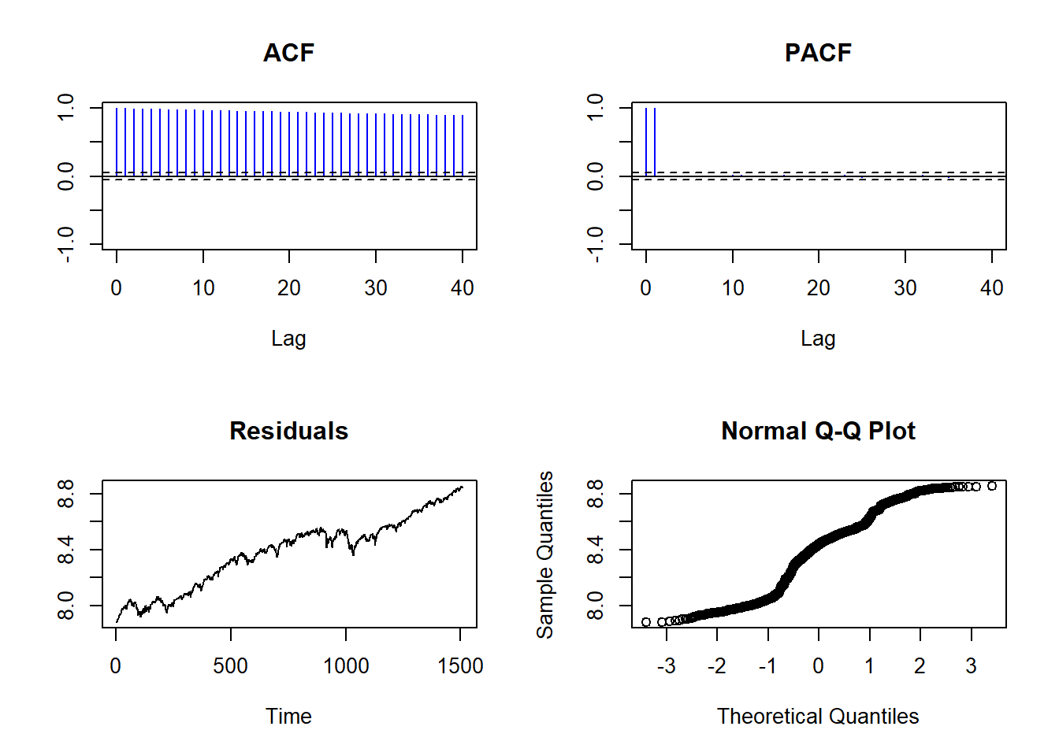
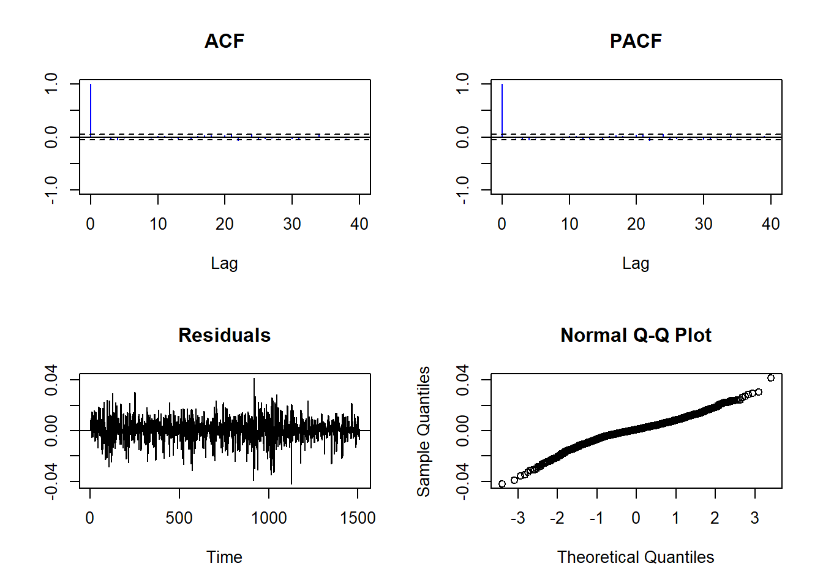
Precondition
Stock indexes aren't naturally stationary as they lack stable expectation, a constant variance, and they're highly correlated with residuals.
Logarithmic Transformation: Take the natural logarithm of stock prices, allowing the asset price return to resemble white noise with a normal distribution.
First Order Differencing: Find the difference between the day's opening and closing prices. This helps to eliminate trends, resulting in data with a constant mean and variance.
Notes:
从左到右，从上到下：Time series; log; logd

Slide 8
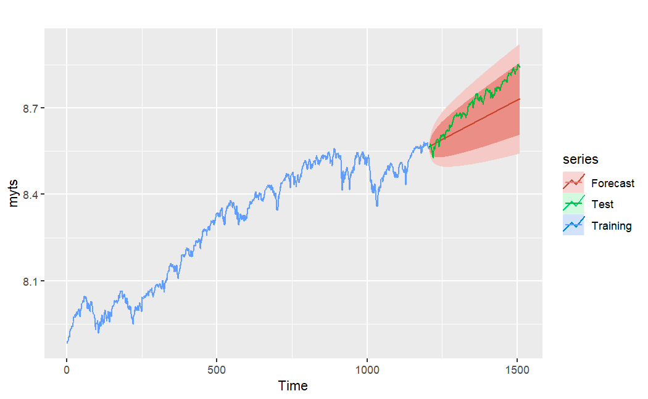
NASDAQ
ARIMA Model fitting results and analyses:

Slide 9
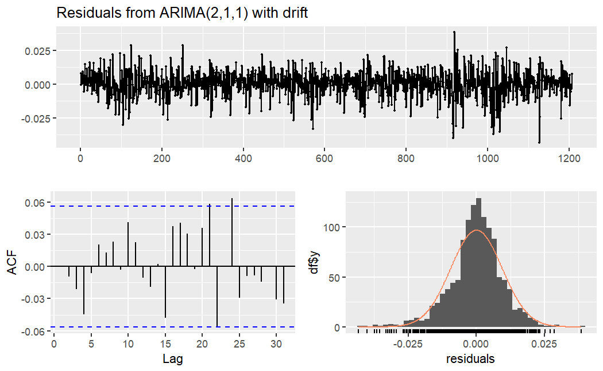
NASDAQ
ARIMA Model
fitting results and analyses:
Ljung-Box test
data: Residuals from ARIMA(1,1,1) with drift
Q* = 12.448, df = 8, p-value = 0.1323
Model df: 2. Total lags used: 10
ME RMSE MAE MPE MAPE MASE ACF1 Theil's U
Training set 0.0001713824 0.02012570 0.01526111 0.002466202 0.2039130 0.9591801 0.008511103 NA
Test set 0.0319201239 0.04008905 0.03608085 0.407990798 0.4623216 2.2677271 0.796134121 3.165462

Slide 10
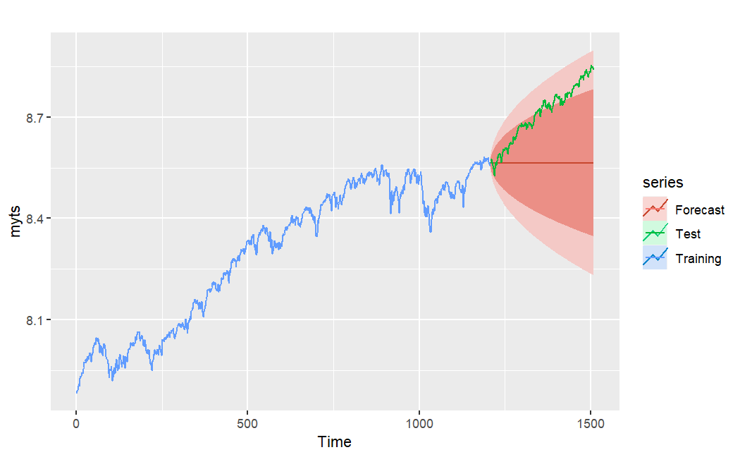
NASDAQ
ETS Model fitting results and analyses:

Slide 11
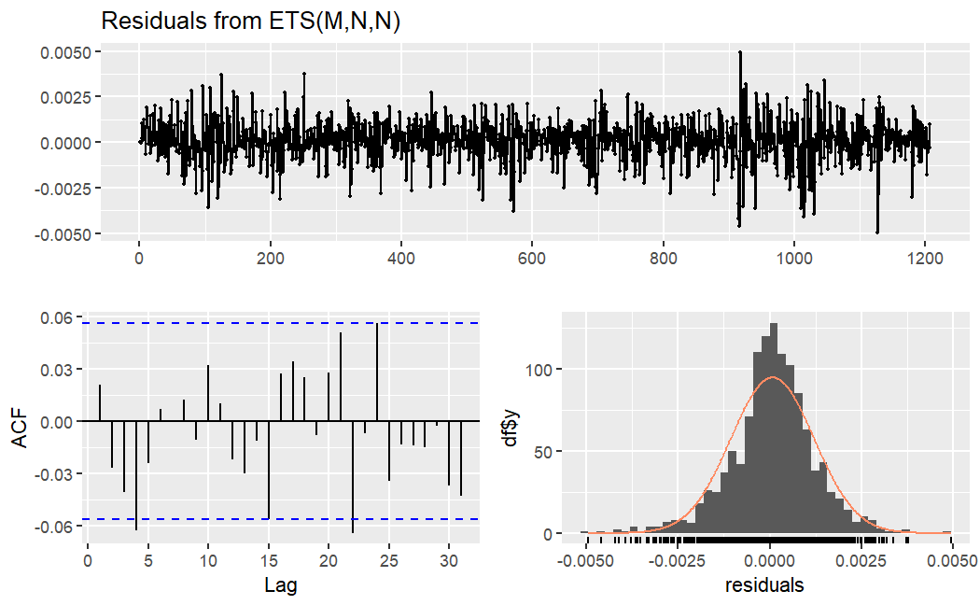
NASDAQ
ETS Model
fitting results and analyses:
Ljung-Box test
data: Residuals from ETS(M,N,N)
Q* = 10.604, df = 10, p-value = 0.3892
Model df: 0. Total lags used: 10
ME RMSE MAE MPE MAPE MASE ACF1 Theil's U
Training set 0.0005658478 0.009483681 0.007017078 0.006819715 0.08455626 0.9991833 0.02159828 NA
Test set 0.1446753505 0.166691575 0.145883177 1.652214585 1.66635679 20.7727547 0.98797550 26.18957

Slide 12
NASDAQ
Comparing the ARIMA model and the ETS model：
Model
ARIMA | Suitable for data with non-constant variance and dynamic temporal structures. Popular in financial time series forecasting. Capable of capturing autocorrelations and trends, useful for cyclical economic variables and policy-influenced factors.
ETS | Simpler, with more intuitive parameter interpretations. Restriction to multiplicative error, no trend, and no seasonality. Appropriate for stable, mature markets with predominantly multiplicative changes.

Slide 13
NASDAQ
Implications for Macroeconomics & Stock Market:
Stock market is volatile, influenced by factors like investor sentiment, macroeconomic indicators, and company-specific news.
ARIMA's ability to model temporal dependencies can be beneficial for stock price predictions.

Slide 14
NASDAQ
Economics realities:
The last decade has witnessed significant volatility due to events like COVID-19, geopolitical tensions, and policy changes.
These events lead to structural breaks in data, affecting both ARIMA and ETS model performance.

Slide 15
NASDAQ
Considerations for future forecasts:
Past model performance, changes in economic structures, and policies need to be considered.
Major events like government stimulus or interest rate changes can affect stock prices and overall economic conditions.

Slide 16
NASDAQ
Summary:
ARIMA and ETS strengths vary based on data characteristics and forecasting context.
Periodic model evaluations and adjustments necessary for maintaining predictive accuracy.
Incorporating external factors like policy changes and major events can enhance model performance.

Slide 17
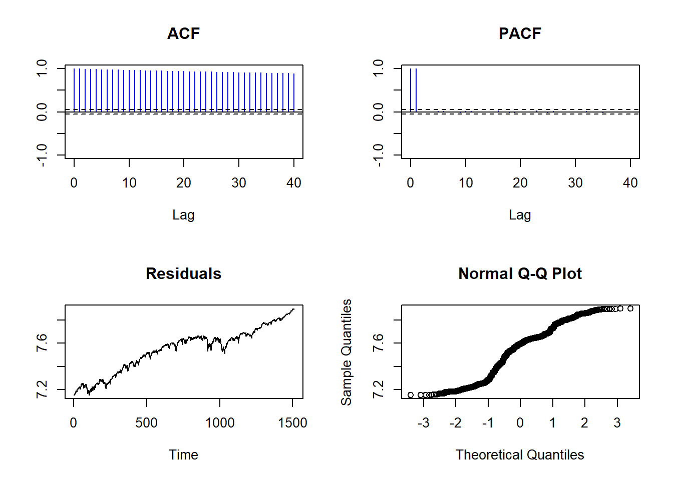
SPX500
Processing data--- logrithm transformation
Not enough
ACF, PACF not meet assumptions
Residuals – clear trend
Normal Q-Q plot — non-normality
differencing + log?

Slide 18
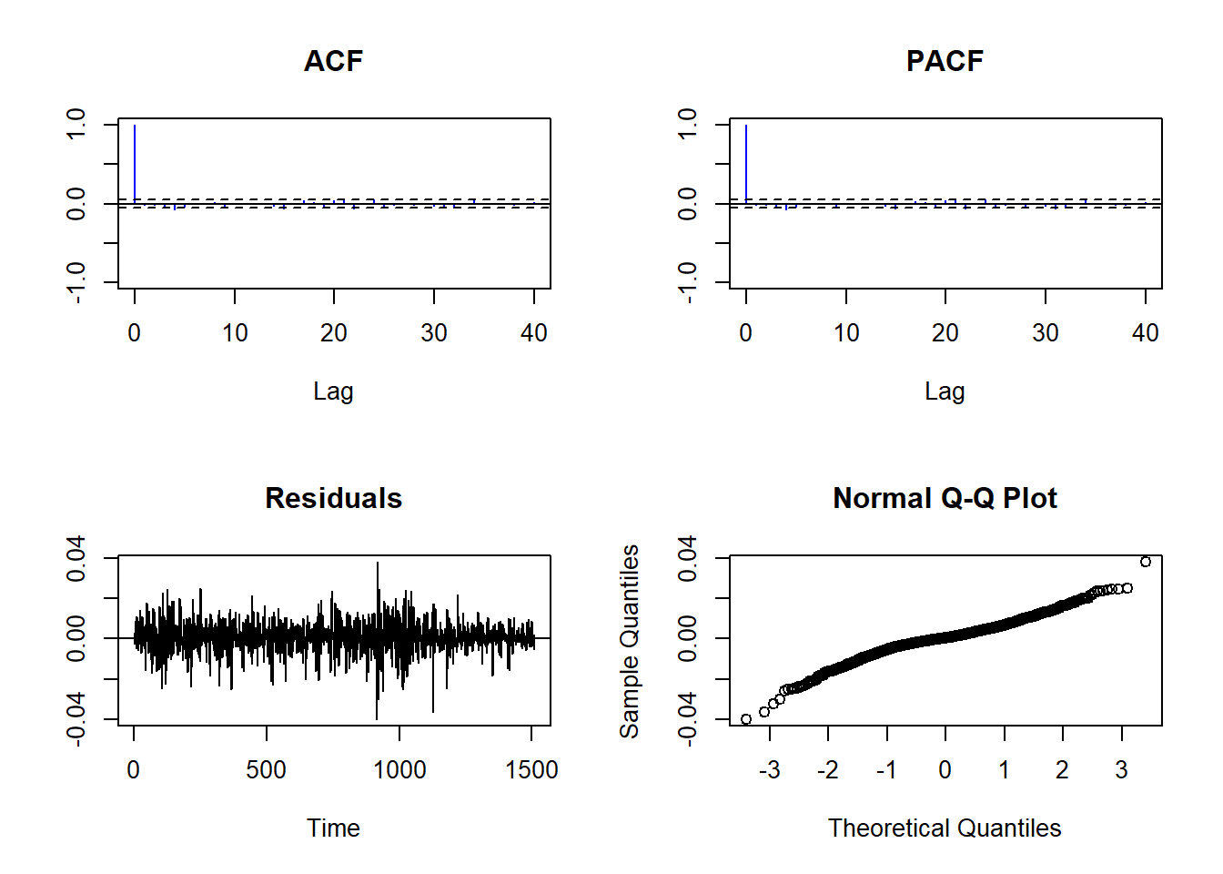
SPX500
Processing data--- differencing + logrithm transformation
One-time differencing operation + logrithm transformation
ACF, PACF — sharp cutoff after lag 1
Residuals —- random & stable
Normal Q-Q plot — follow a relatively straight line
Stationarity

Slide 19
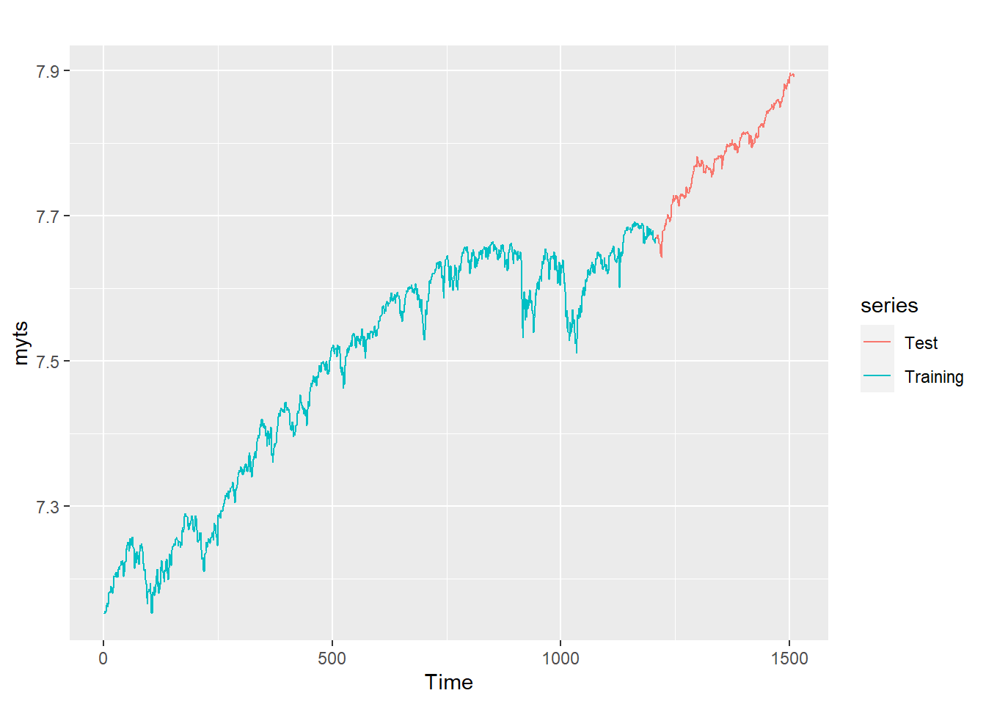
SPX500
Forecast - ARIMA model
training set — 80%
test set — 20%

Slide 20
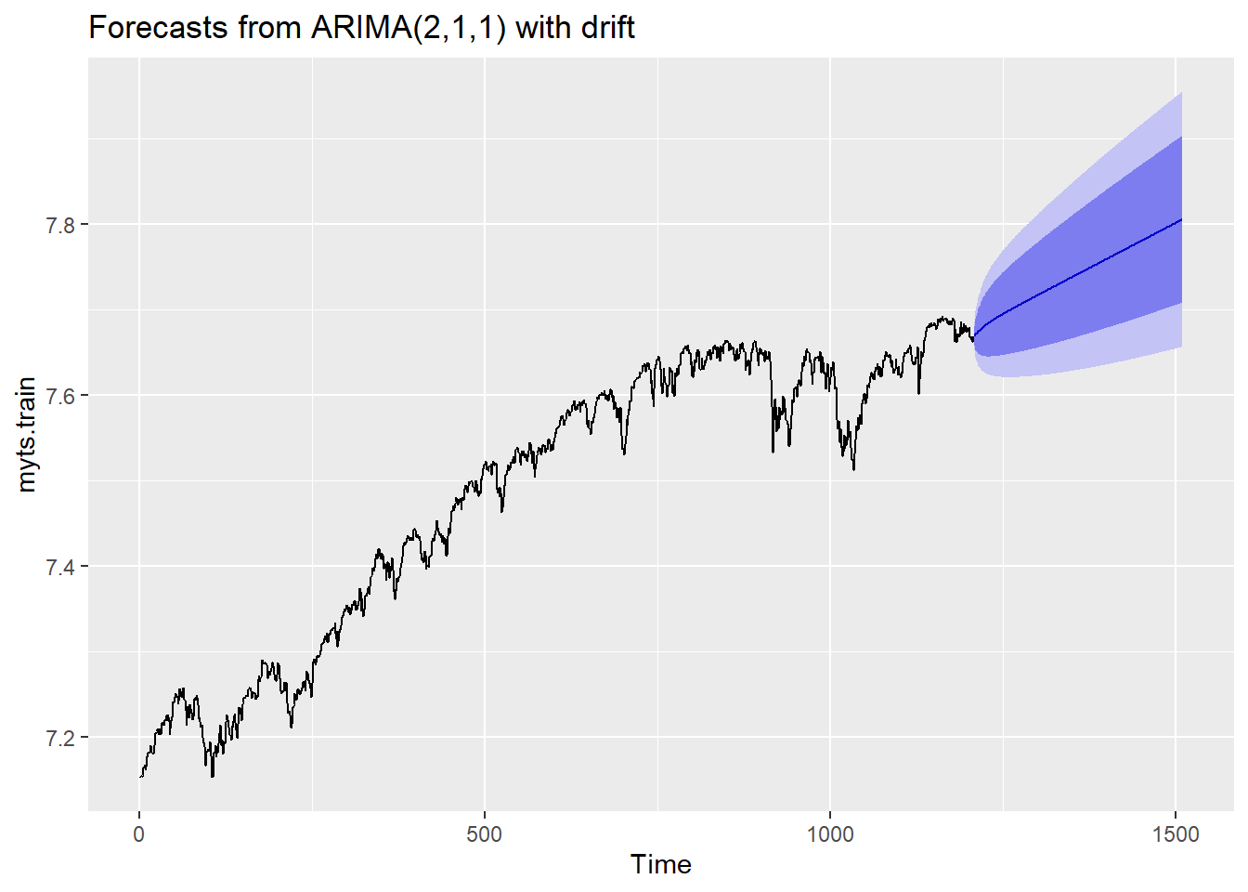
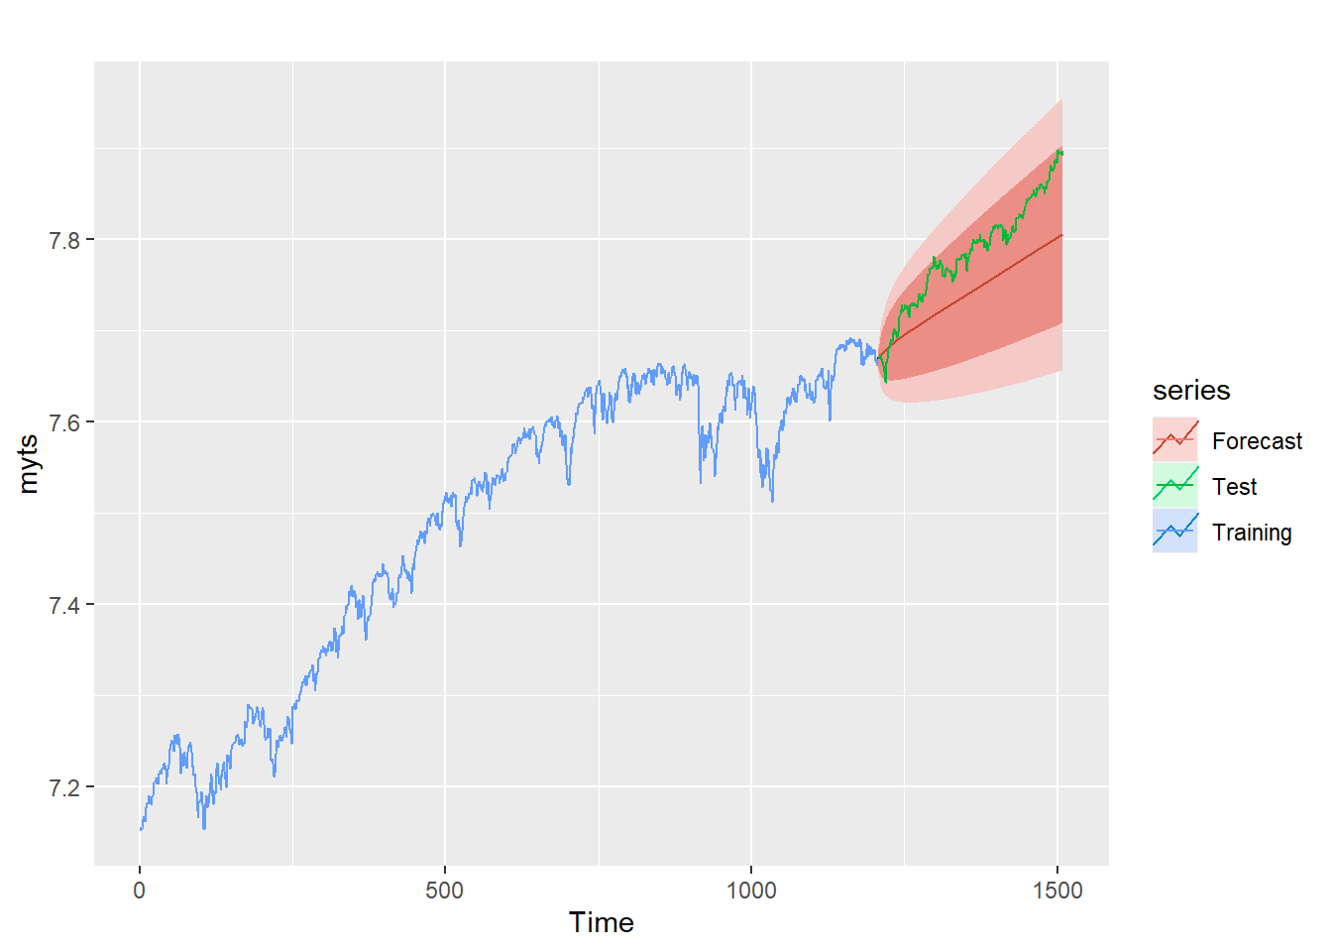
SPX500
Forecast - ARIMA model
auto.arima()
ARIMA(p,d,q) = ARIMA(2,1,1)

Slide 21
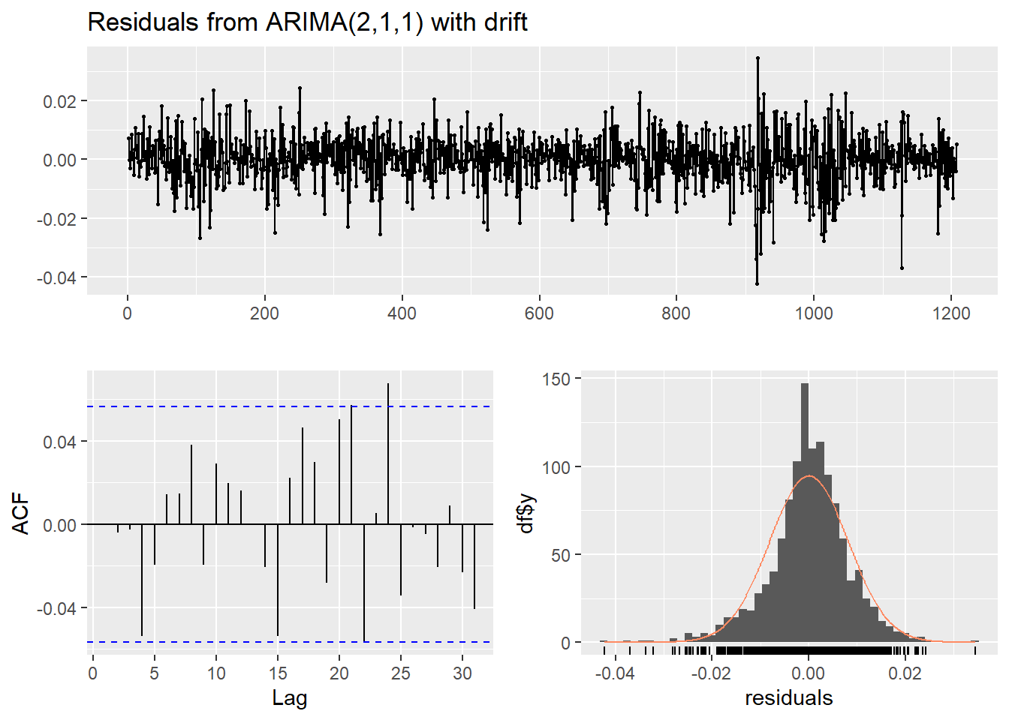
SPX500
Forecast - ARIMA model - Check Residuals
checkresiduals()
average and stable
ACF — white noise
Residuals — normal

Slide 22
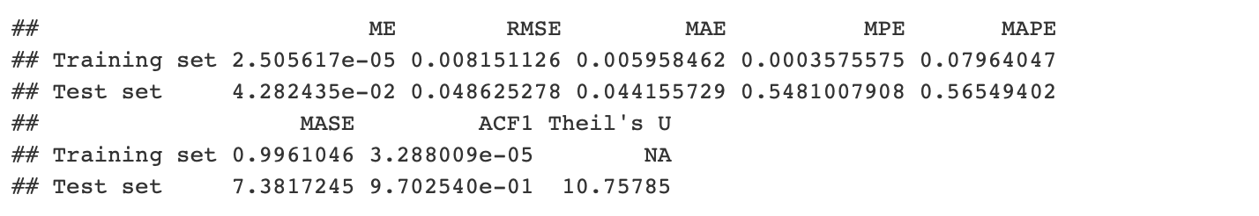
SPX500
Forecast - ARIMA model - Check Accuracy
accuracy()
Evaluation Metrics
RMSE, MAE , MAPE
the lower, the better
Fitting degree — high

Slide 23
SPX500
Forecast - ETS model
training set — 80%
test set — 20%

Slide 24
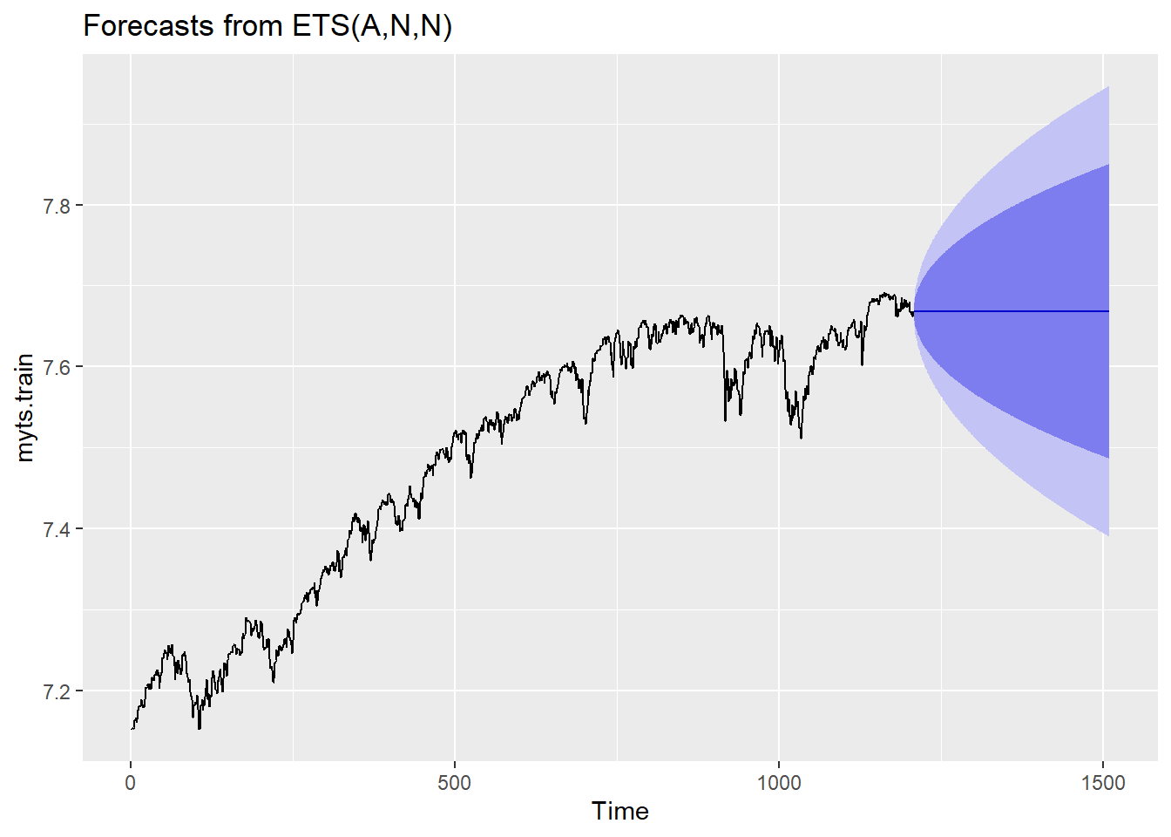
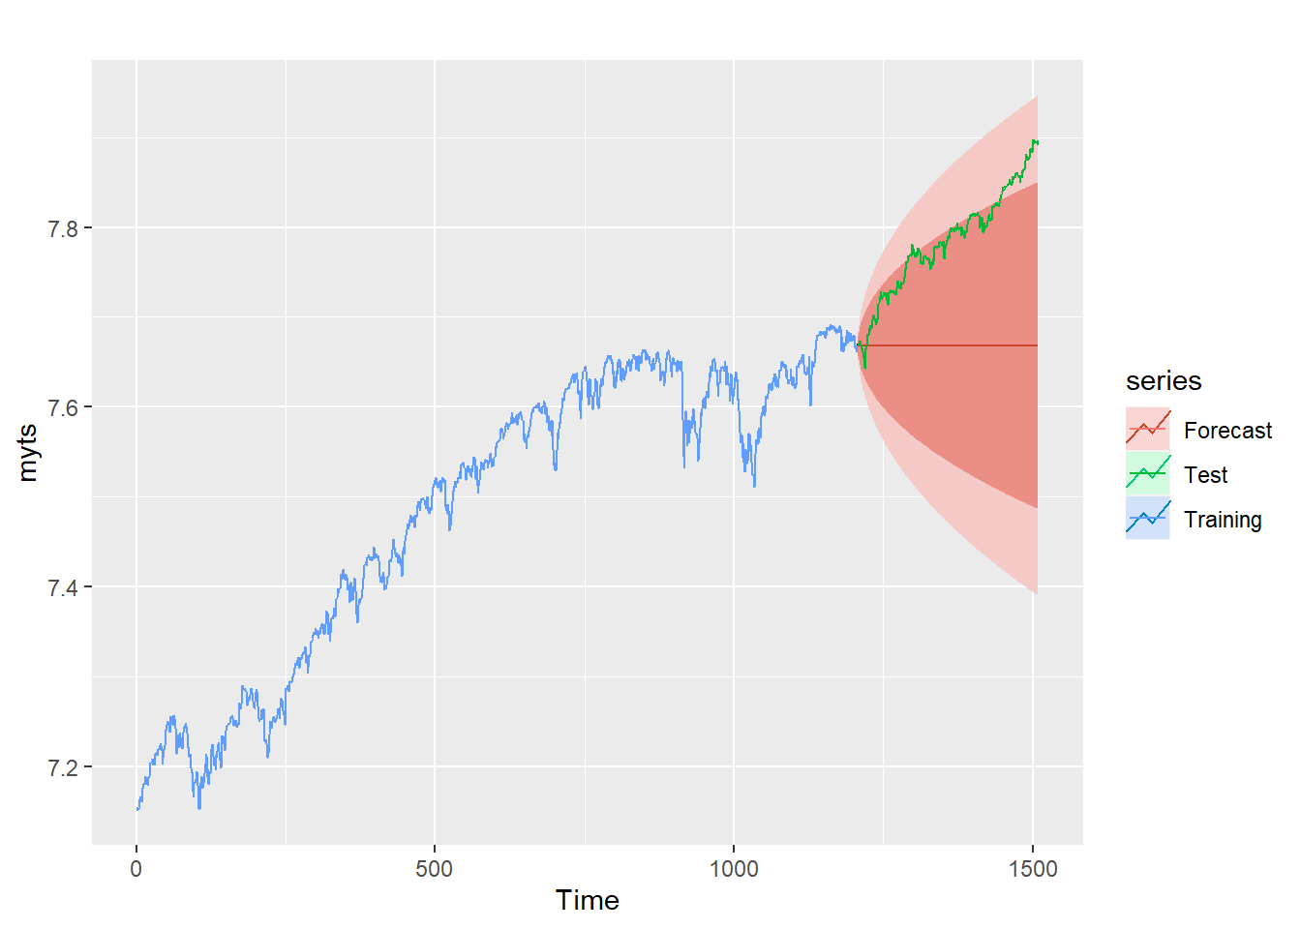
SPX500
Forecast - ETS model
ets()

Slide 25
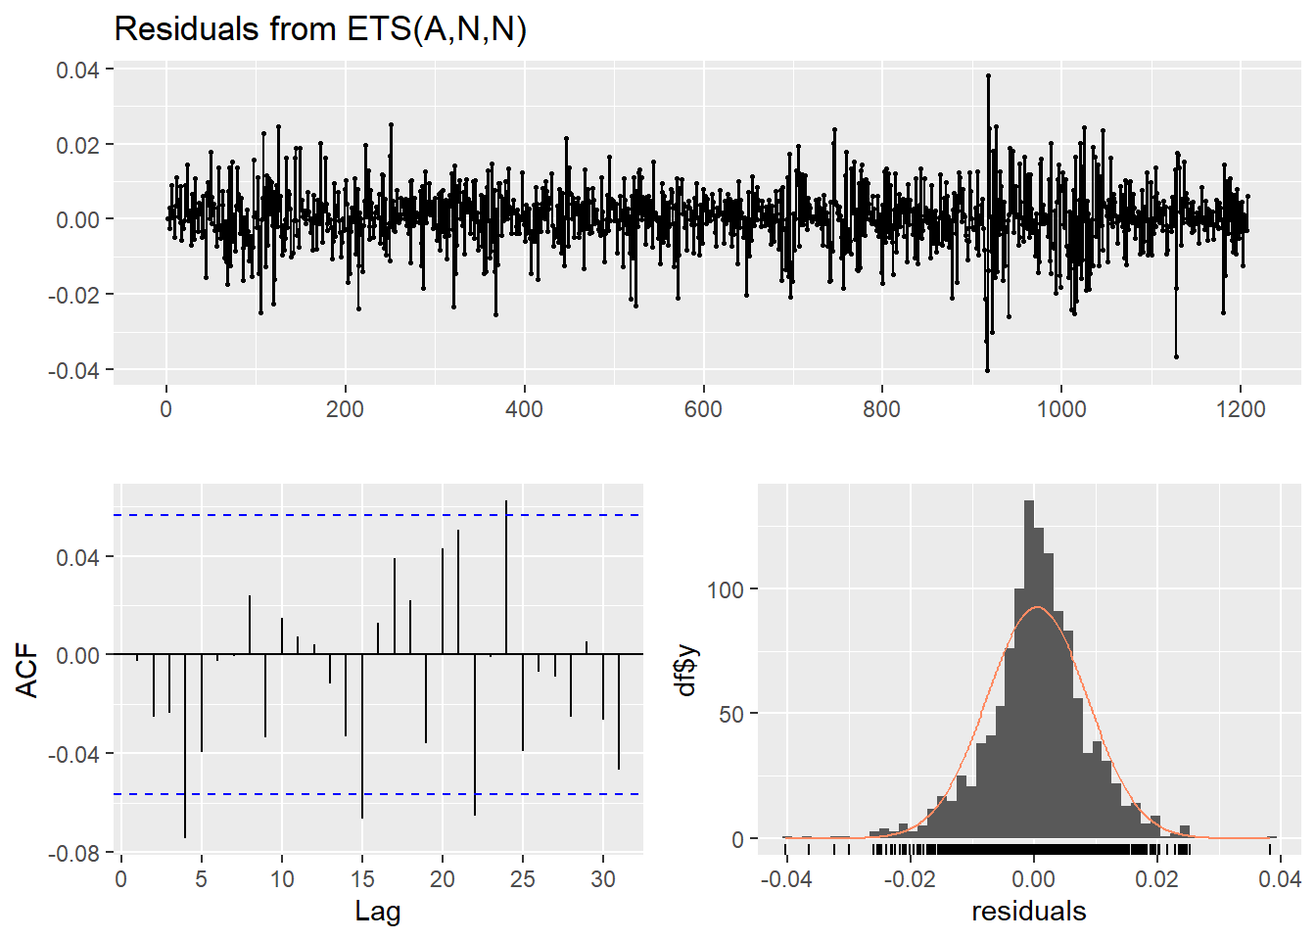
SPX500
Forecast - ETS model - Check Residuals
checkresiduals()
uniform trend
ACF — not white noise
Residuals — normal
Feasible but not so good

Slide 26
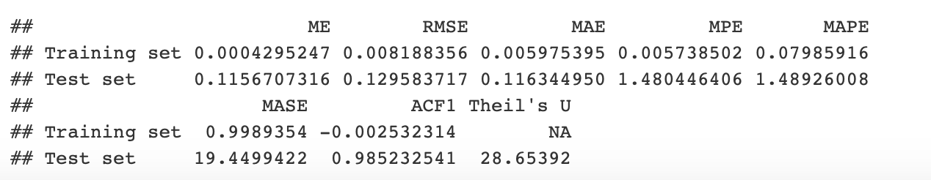
SPX500
Forecast - ETS model - Check Accuracy
accuracy()
Evaluation Metrics
RMSE, MAE , MAPE —- low but not enough

Slide 27
SPX500
Comparison - ARIMA model & ETS model
ARIMA model:
RMSE, MAE, MAPE … :
ARIMA < ETS
Differences — small
Optimal one — ARIMA
ETS model:

Slide 28
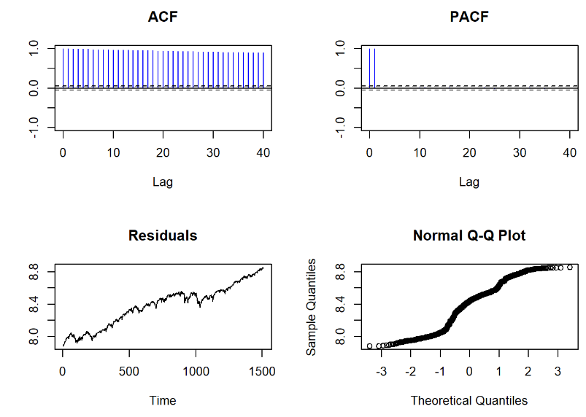
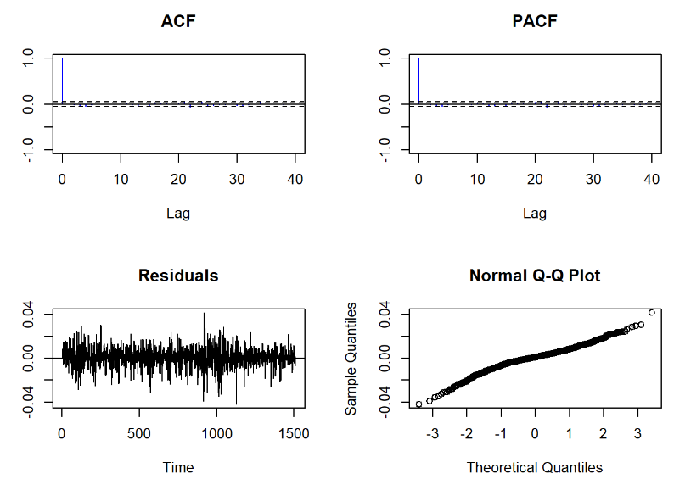
DJIA
log transformation of data：
first order differencing and log transformation of data：
Notes:
Looking at the log data, we see residuals with a general upward trend and random fluctuations, but no regular patterns. So, we applied first-order differencing. This seemed to remove the strong autocorrelation and linear trend, as shown by the ACF and PACF. The residuals now look like a smooth line in the normal Q-Q plot, suggesting they're normally distributed. So, our differenced data seems stationary and ready for time series forecasting.

Slide 29
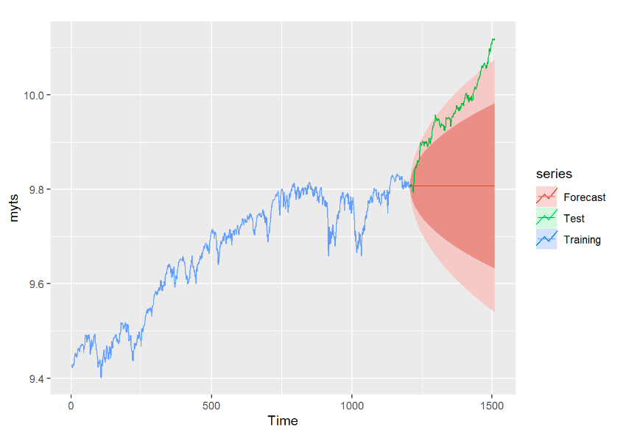
DJIA
———fitting with the automatic ARIMA model
Notes:
We used AutoARIMA to find the best-fitting model with the lowest AIC. The winner was ARIMA(0,1,0). We used this to forecast the next periods. The forecast shows an upward trend, but most predictions are within the 95% confidence interval, meaning the forecast isn't that great.

Slide 30
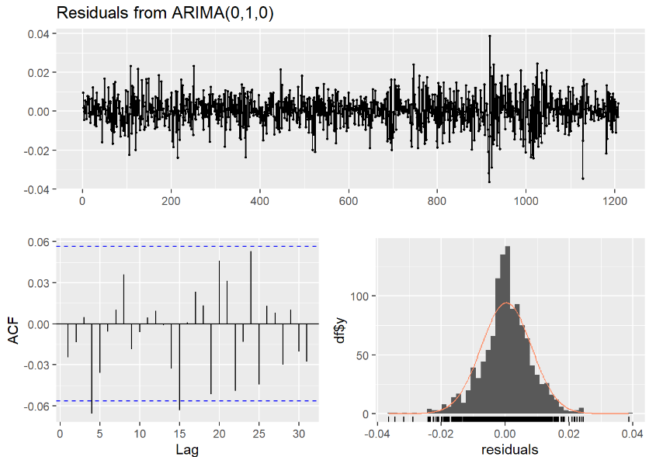
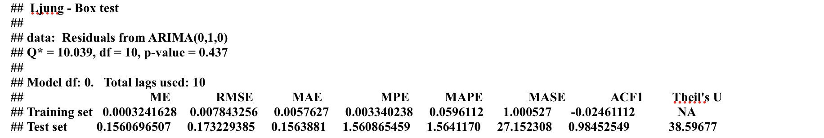
DJIA
———fitting with the automatic ARIMA model
Notes:
Analyzing the residuals, we found they're mostly around zero, with no autocorrelation, and seem normally distributed. The p-value of 0.437 shows the model beats random predictions. The RMSE values for the training and test sets are small, suggesting a good fit. This model's future predictions aren't great, indicating room for improvement.

Slide 31
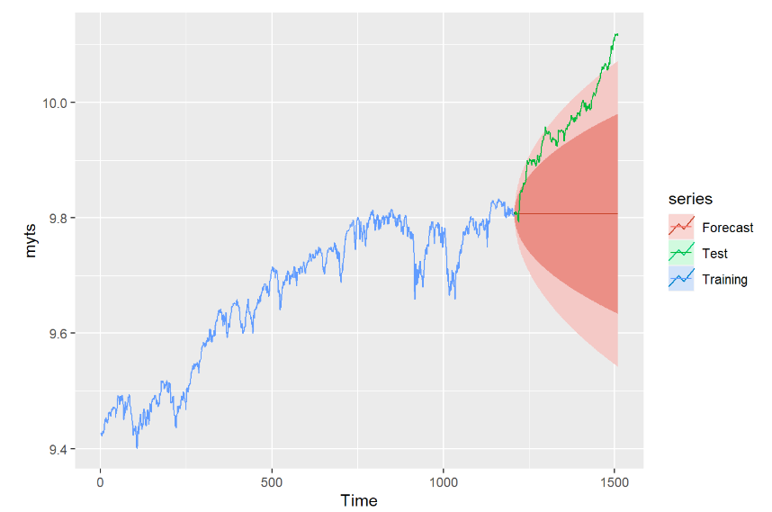
DJIA
———fitting with the ETS model
Notes:
We used the ETS model, specifically ETS(M, N, N), meaning multiplicative error, no trend, no seasonality, to fit the data. The predictions were similar to ARIMA's, showing an upward trend. But again, most of the data fell within the 95% confidence interval, indicating the predictions weren't great.

Slide 32
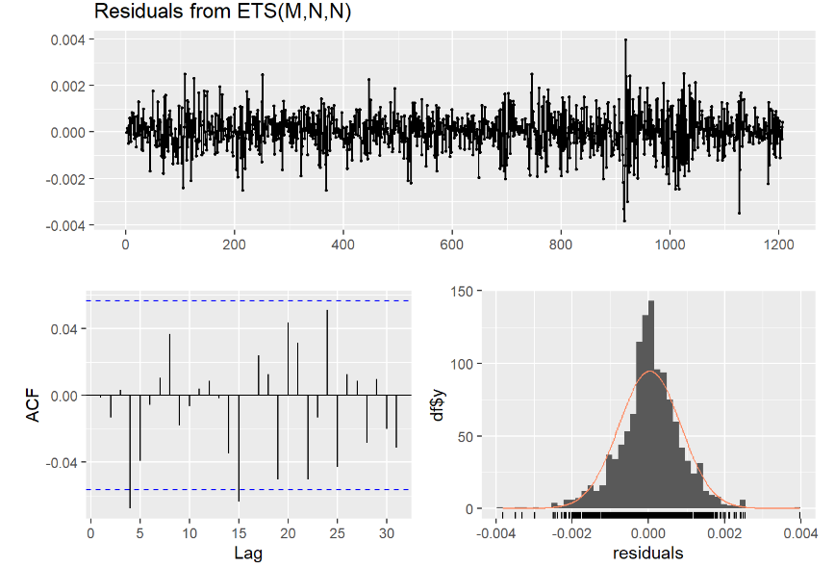
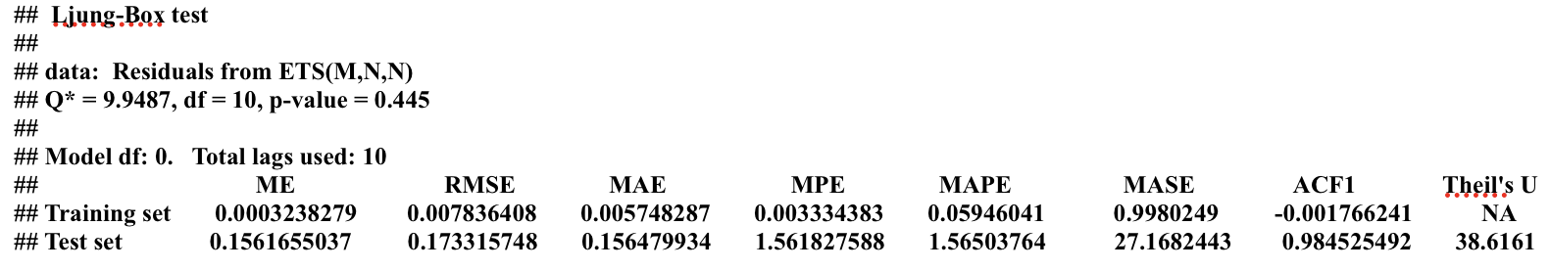
DJIA
———fitting with the ETS model
Notes:
We analyzed the residuals, much like with ARIMA. They mostly hover around zero, showing a normal distribution. With a p-value of 0.445, our model clearly beats randomness. The low RMSEs for training and test sets indicate a good fit. Yet, similar to ARIMA, our model's future predictions need some work.

Slide 33
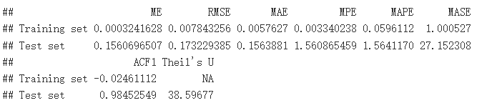
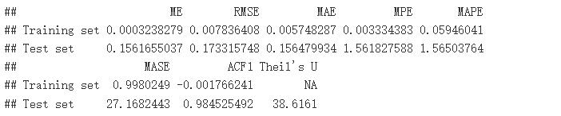
DJIA
———comparing ARIMA & ETS
ARIMA
ETS
Notes:
Comparing ARIMA and ETS, we look at RMSE, MAE, and MAPE. Lower values mean better accuracy. ETS has a slightly lower RMSE on training data than ARIMA, but the difference is tiny, almost negligible. So, both models perform similarly. They're useful but could use some fine-tuning for better accuracy.

Slide 34
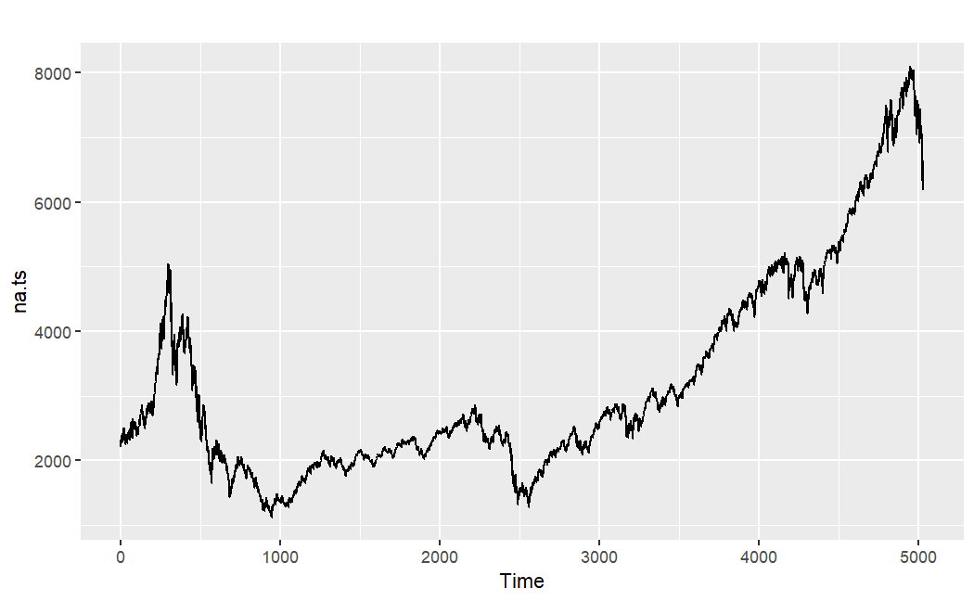
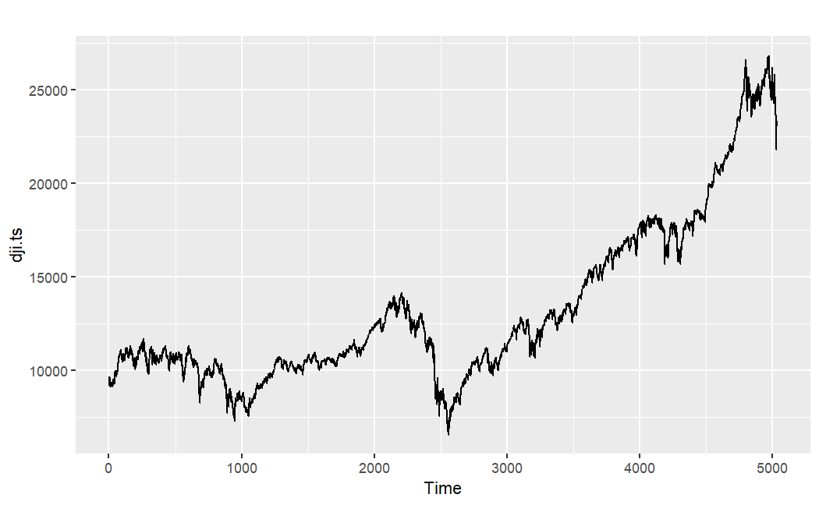
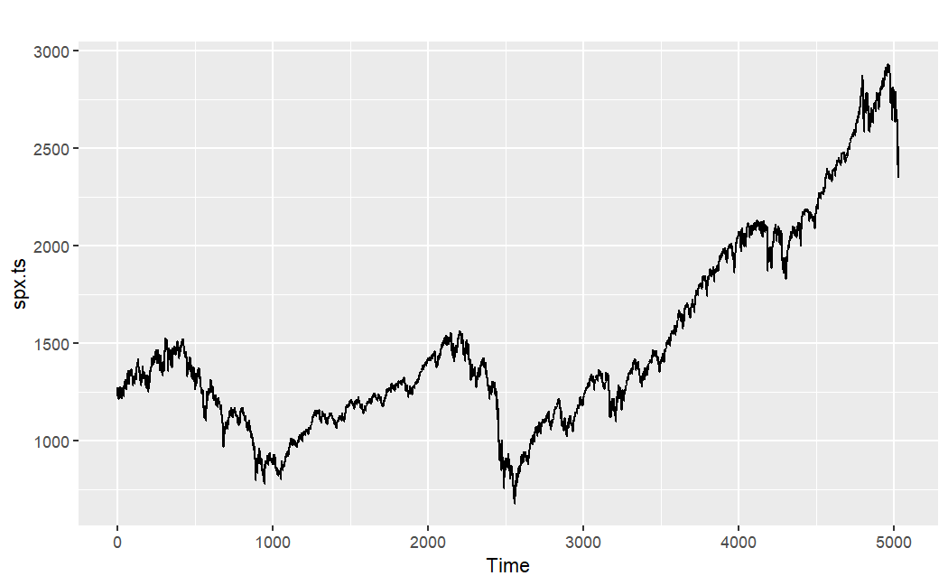
comparing NASDAQ & DJIA & SPX
NASDAQ
DJIA
SPX
Notes:
From 2012 to 2017, NASDAQ, DJIA, and SPX all trended upwards, showing a US bull market. But, they had unique performances due to their different compositions. NASDAQ, packed with tech stocks, was more volatile, reflecting the high-risk, high-reward nature of the tech sector. DJIA, with 30 big blue-chip stocks, mirrors the US industrial scene. SPX, with a mix of 500 companies, provides a wider snapshot of the US economy.

Slide 35
— Sir John Templeton
"The four most dangerous words in investing are:
'This time it's different.'"

Slide 36
The influence of time window
01
02
03
The length
The frequence
The average
The predictive power of the ARIMA model was examined for two distinct periods - the entire span from 2012 to 2017, and a shorter duration from 2014 to 2017.
The model's forecast quality was compared across three different frequencies (daily, weekly, and monthly) on the full 2012-2017 dataset.
The impact of weekly data averaging on the model's performance was investigated by using two weekly datasets from 2012 to 2017 - one based on data every seven days, and another using the average data of each week.

Slide 37
length
The first part of our study concerns the influence of the length of the time window on the forecasting results. Two different time periods have been considered - the full period from 2012 to 2017, and a shorter one from 2014 to 2017. The ARIMA model's predictive power is examined for both these periods.

Slide 38
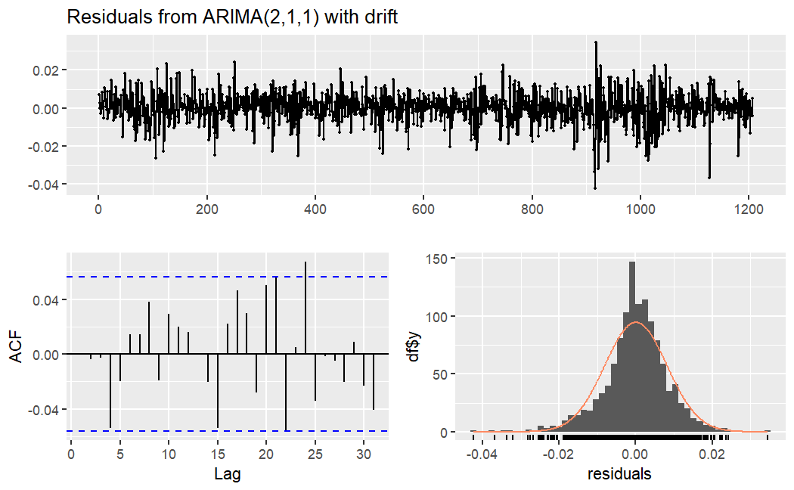

Length of time
5 years: ARIMA (2,1,1)
Ljung-Box test
data: Residuals from ARIMA(2,1,1) with drift
Q* = 7.7824, df = 7, p-value = 0.3522
Model df: 3. Total lags used: 10
ME RMSE MAE MPE MAPE MASE ACF1 Theil's U
Training set 2.505617e-05 0.008151126 0.005958462 0.0003575575 0.07964047 0.9961046 3.288009e-05 NA
Test set 4.282435e-02 0.048625278 0.044155729 0.5481007908 0.56549402 7.3817245 9.702540e-01 10.75785

Slide 39
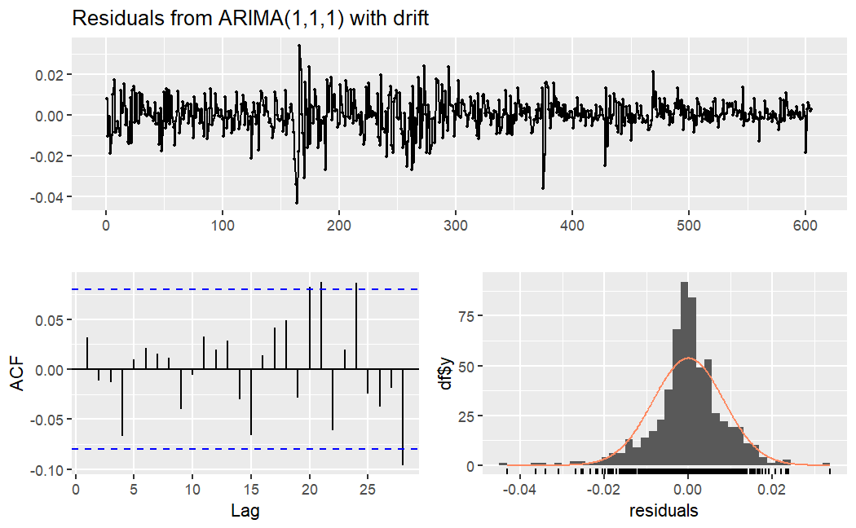
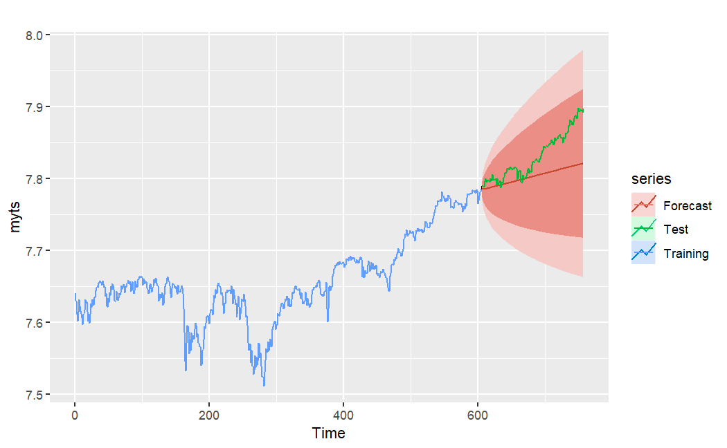
Length of time
3 years: ARIMA (1,1,1)
Ljung-Box test
data: Residuals from ARIMA(1,1,1) with drift
Q* = 5.1082, df = 8, p-value = 0.7459
Model df: 2. Total lags used: 10
ME RMSE MAE MPE MAPE MASE ACF1 Theil's U
Training set 3.638195e-06 0.008429114 0.005928125 -0.0000557846 0.0776588 0.996595 0.03214627 NA
Test set 2.788398e-02 0.035589545 0.028078593 0.3549637326 0.3574610 4.720377 0.96752675 8.663283

Slide 40
frequence
The second part delves into the effects of data frequency. Three different frequencies - daily, weekly, and monthly - were analyzed using the full 2012-2017 dataset. The forecasts produced by the ARIMA model for each frequency were then compared.

Slide 41
Length of time
5 years: ARIMA (2,1,1)
Ljung-Box test
data: Residuals from ARIMA(2,1,1) with drift
Q* = 7.7824, df = 7, p-value = 0.3522
Model df: 3. Total lags used: 10
ME RMSE MAE MPE MAPE MASE ACF1 Theil's U
Training set 2.505617e-05 0.008151126 0.005958462 0.0003575575 0.07964047 0.9961046 3.288009e-05 NA
Test set 4.282435e-02 0.048625278 0.044155729 0.5481007908 0.56549402 7.3817245 9.702540e-01 10.75785

Slide 42
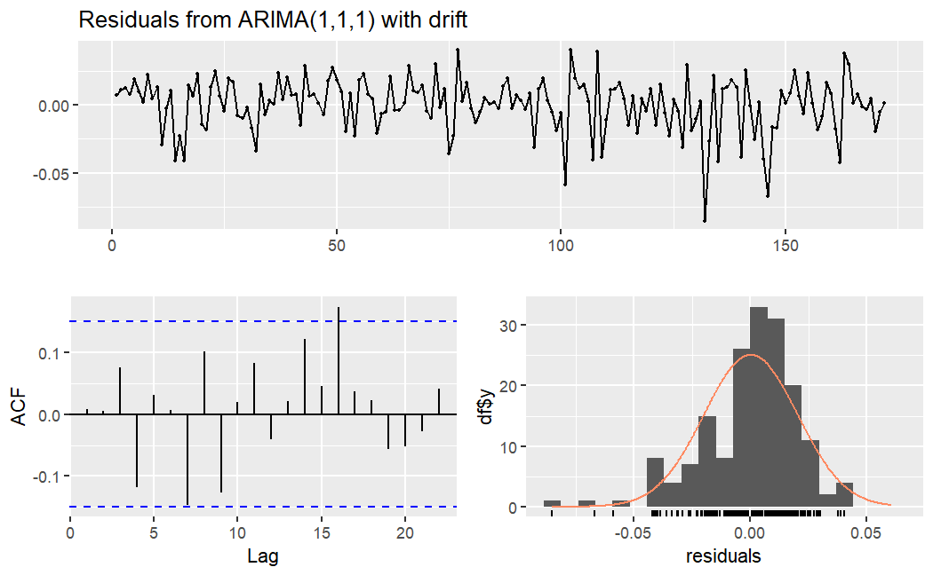

frequence of time
One week(7): ARIMA (1,1,1)
Ljung-Box test
data: Residuals from ARIMA(1,1,1) with drift
Q* = 12.448, df = 8, p-value = 0.1323
Model df: 2. Total lags used: 10
ME RMSE MAE MPE MAPE MASE ACF1 Theil's U
Training set 0.0001713824 0.02012570 0.01526111 0.002466202 0.2039130 0.9591801 0.008511103 NA
Test set 0.0319201239 0.04008905 0.03608085 0.407990798 0.4623216 2.2677271 0.796134121 3.165462

Slide 43
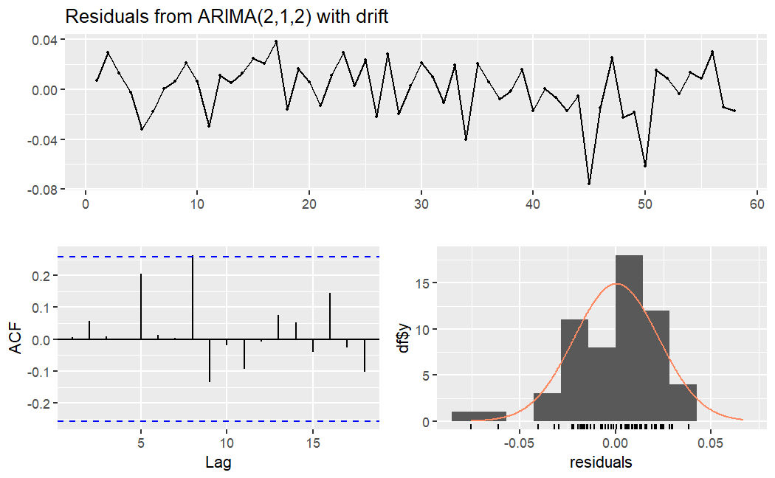
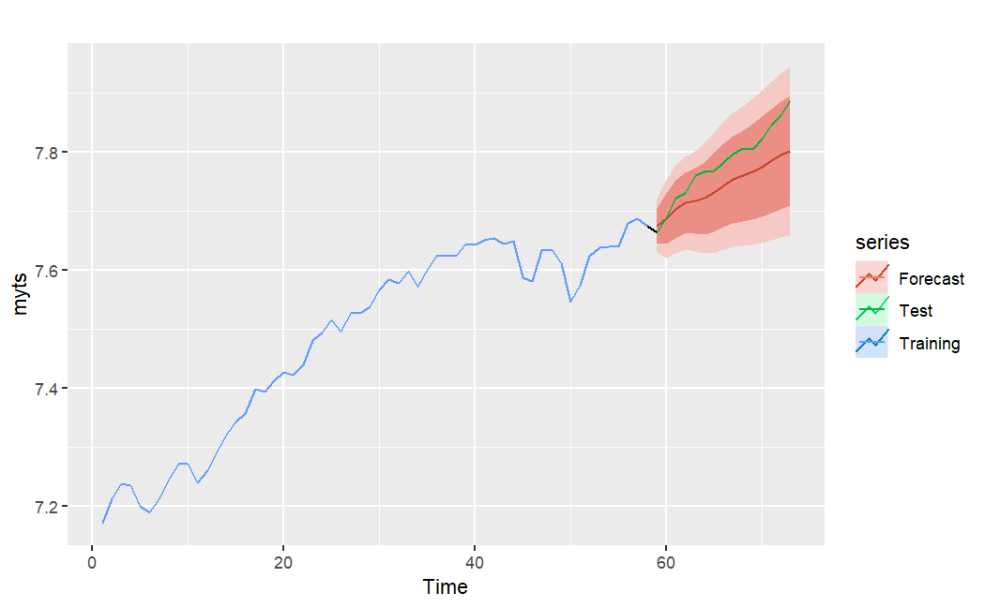
Length of time
One month(30): ARIMA (2,1,2)
Ljung-Box test
data: Residuals from ARIMA(2,1,2) with drift
Q* = 9.1291, df = 6, p-value = 0.1664
Model df: 4. Total lags used: 10
ME RMSE MAE MPE MAPE MASE ACF1 Theil's U
Training set 0.0004721178 0.02190386 0.01722273 0.007072524 0.2300238 0.8446693 0.006660298 NA
Test set 0.0388287037 0.04547456 0.04033658 0.496753370 0.5164284 1.9782615 0.604087687 2.45279

Slide 44
average
the third part explores the influence of data averaging on the model's performance. Two weekly datasets from 2012 to 2017 were utilized - one created by selecting data every seven days and the other by averaging the data over each week.

Slide 45
averaging
One week: ARIMA (1,1,1)
Ljung-Box test
data: Residuals from ARIMA(1,1,1) with drift
Q* = 12.448, df = 8, p-value = 0.1323
Model df: 2. Total lags used: 10
ME RMSE MAE MPE MAPE MASE ACF1 Theil's U
Training set 0.0001713824 0.02012570 0.01526111 0.002466202 0.2039130 0.9591801 0.008511103 NA
Test set 0.0319201239 0.04008905 0.03608085 0.407990798 0.4623216 2.2677271 0.796134121 3.165462

Slide 46
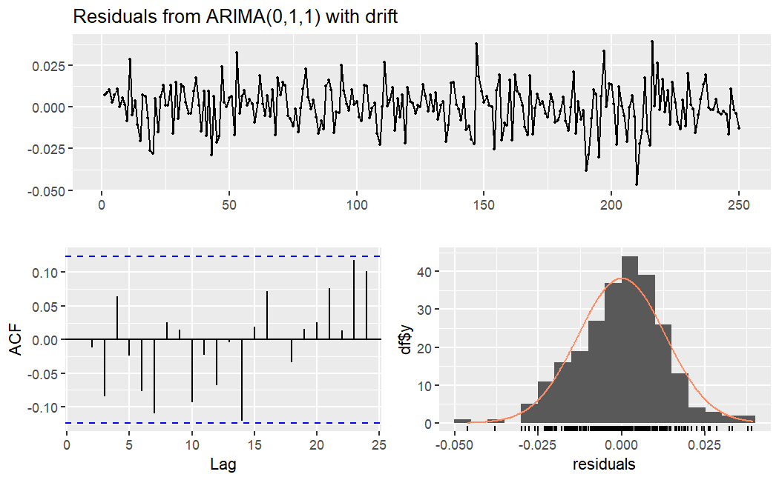
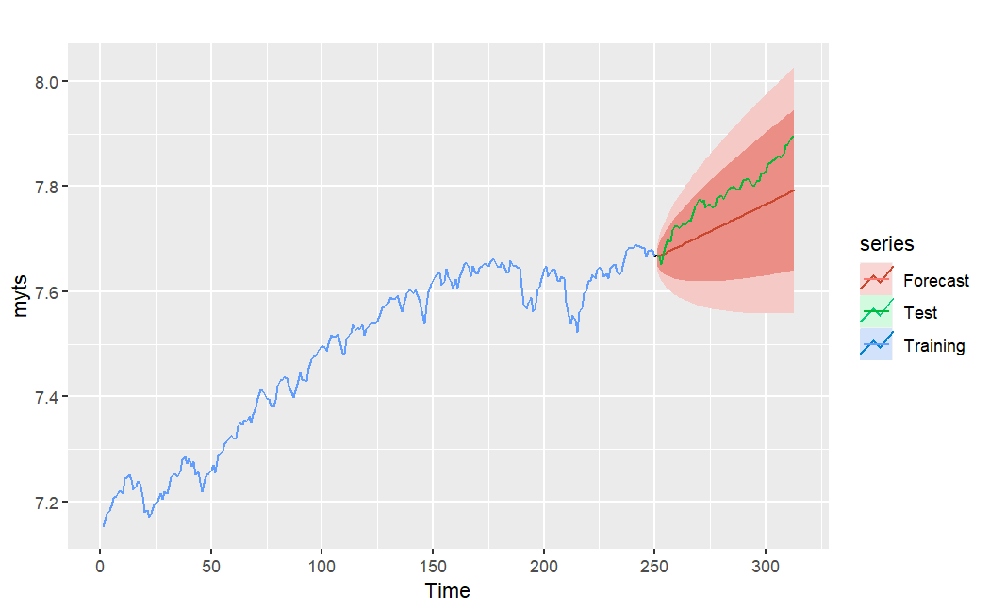
averaging
average: ARIMA (0,1,1)
Ljung-Box test
data: Residuals from ARIMA(0,1,1) with drift
Q* = 10.189, df = 9, p-value = 0.3354
Model df: 1. Total lags used: 10
ME RMSE MAE MPE MAPE MASE ACF1 Theil's U
Training set 2.464104e-05 0.01310248 0.01010023 0.0004639407 0.1350363 0.9529594 0.001821072 NA
Test set 5.429537e-02 0.05926211 0.05496389 0.6954121511 0.7041479 5.1858576 0.883141483 7.104924

Slide 47
03
Conclusion
7.1 Summary of Findings 7.2 Implications

Slide 48
Thanks for watching :)

Slide 49
Reference
Yahoo Finance. (2023, July 17). S&P 500 Index (^GSPC) Stock Price, News, Quote & History. Retrieved July 17, 2023, from https://finance.yahoo.com/quote/%5EGSPC/
Yahoo Finance. (2023, July 17). Dow Jones Industrial Average (^DJI) Stock Price, News, Quote & History. Retrieved July 17, 2023, from https://finance.yahoo.com/quote/%5EDJI?p=%5EDJI
Yahoo Finance. (2023, July 17). NASDAQ Composite (^IXIC) Stock Price, News, Quote & History. Retrieved July 17, 2023, from https://finance.yahoo.com/quote/%5EIXIC/

Slide 50
Appendices
#following code use python to grab the stock index data from Yahoo Finance
import pandas as pd
import yfinance as yf
start_date = "2012-01-01"
end_date = "2017-12-31"
spx=yf.download('^GSPC',start=start_date, end=end_date)
data=spx.reset_index()
three_years_data = data[data['Date'] > data['Date'].max() - pd.DateOffset(years=3)]
two_years_data = data[data['Date'] > data['Date'].max() - pd.DateOffset(years=2)]
freq_seven_data = data.iloc[::7, :]
freq_seven_mean_data = data.resample('7D', on='Date').mean()
freq_30_data = data.resample('30D', on='Date').mean()
five_years_data = data
three_years_data.to_csv('process/SPX_3years.csv')
two_years_data.to_csv('process/SPX_2years.csv')
freq_seven_data.to_csv('process/SPX_freq7.csv')
freq_seven_mean_data.to_csv('process/SPX_freq7_mean.csv')
five_years_data.to_csv('process/SPX_5years.csv')
freq_30_data.to_csv('process/SPX_freq30.csv')
NASDAQ=yf.download('^IXIC', start=start_date, end=end_date)
DJI=yf.download('DJI', start=start_date, end=end_date)
NASDAQ.to_csv('data/NASDAQ.csv')
DJI.to_csv('data/DJIA.csv')
spx.to_csv('data/SPX.csv')

Slide 51
Appendices
#following code use R and the data from code_1 to generate plot
library(fpp2)
library(rmarkdown)
library(itsmr)
library(readr)
spx.y5<-read_csv("process/SPX_5years.csv")
spx.y2<-read_csv("process/SPX_2years.csv")
spx.y3<-read_csv("process/SPX_3years.csv")
spx.f7<-read_csv("process/SPX_freq7.csv")
spx.f7m<-read_csv("process/SPX_freq7_mean.csv")
spx.f30<-read_csv("process/SPX_freq30.csv")
na<-read_csv("data/NASDAQ.csv")
dji<-read_csv("data/DJIA.csv")
spx<-read_csv("data/SPX.csv")
#following code use spx as example
data<-spx
data.ts<-ts(data[,"Close"])
data.log<-ts(log(data[,"Close"]))
data.diff<-diff(data.ts)
data.logd<-diff(data.log)
test(data.ts)
test(data.diff)
test(data.log)
test(data.logd)
data_mean<-mean(data.logd)
data_var<-var(data.logd)
data_mean
data_var
len<-length(data.log)
t<-floor(len*0.8)
myts <- ts(data.log)
myts.train <- window(myts,end=t)
myts.test <- window(myts,start=t+1)
fc <- auto.arima(myts.train)
future <- forecast::forecast(fc, h=(len-t))
autoplot(myts) +
autolayer(myts.train, series="Training") +
autolayer(myts.test, series="Test")
autoplot(future)
p <- autoplot(myts) +
autolayer(myts.train, series="Training") +
autolayer(future, series="Forecast")
p + autolayer(myts.test, series="Test")
checkresiduals(fc)
accuracy(future,myts.test)

Slide 52
Thanks!

