Slide 1
Analysis of Representative Stock Indexes in China and the United States on Time Series Forecasting
Group 2:
Mia Wang, Eric Gao, Cecilia Wang, Rona Zhang

Slide 2
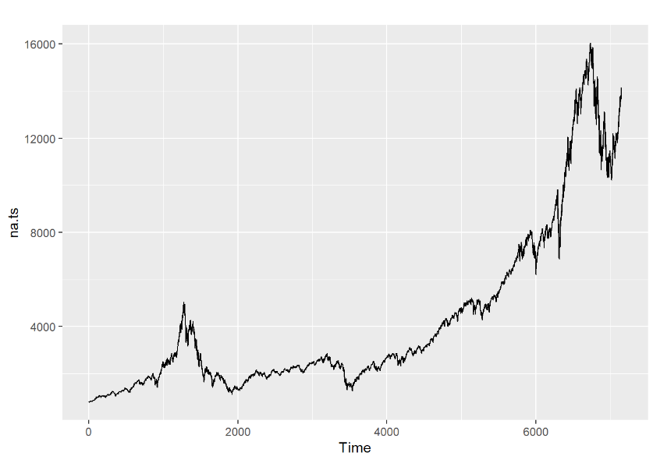
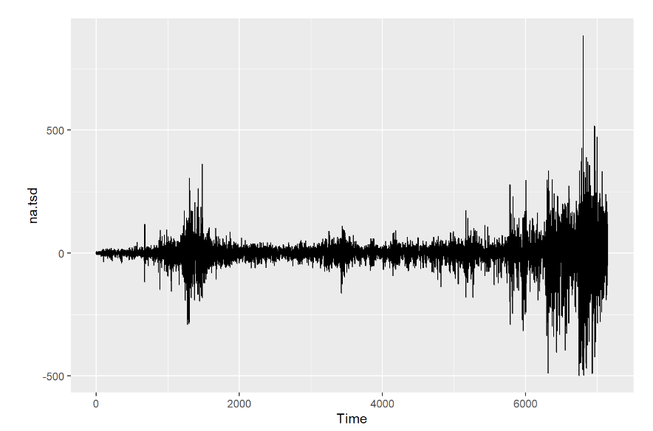
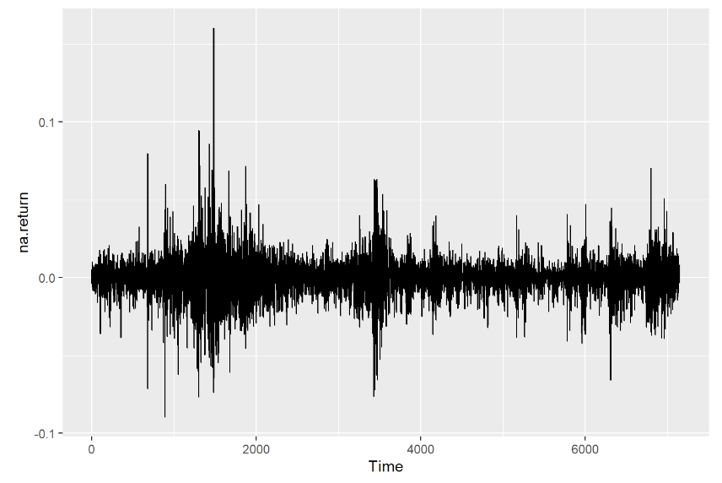
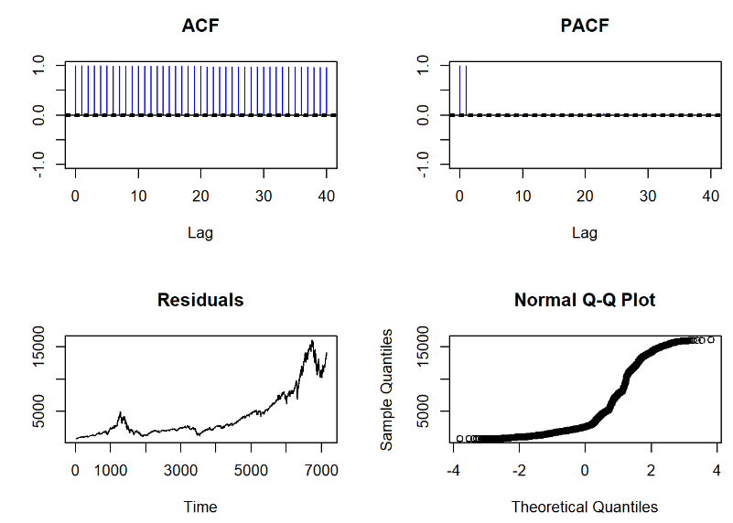
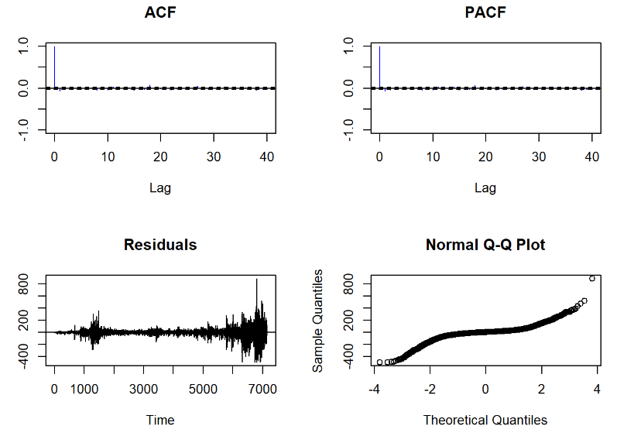
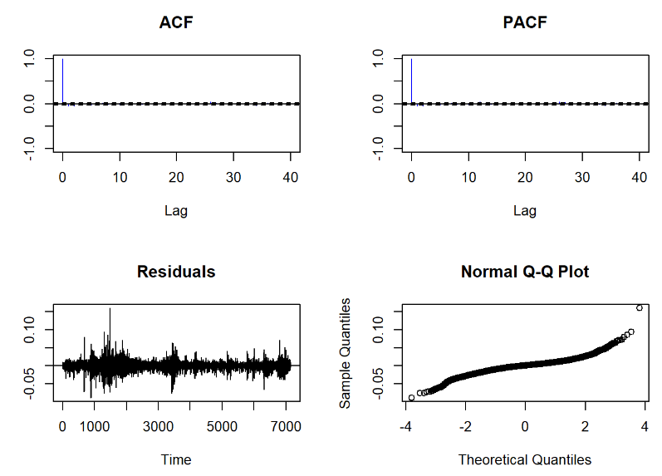
US Stock Market: NASDAQ

Slide 3
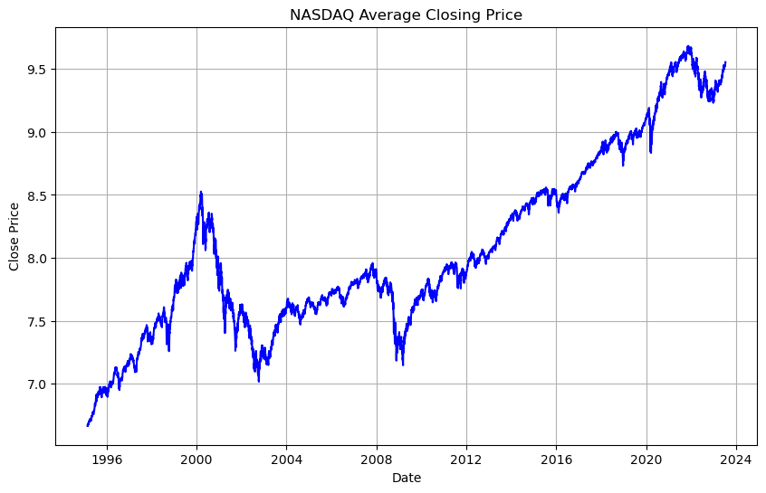
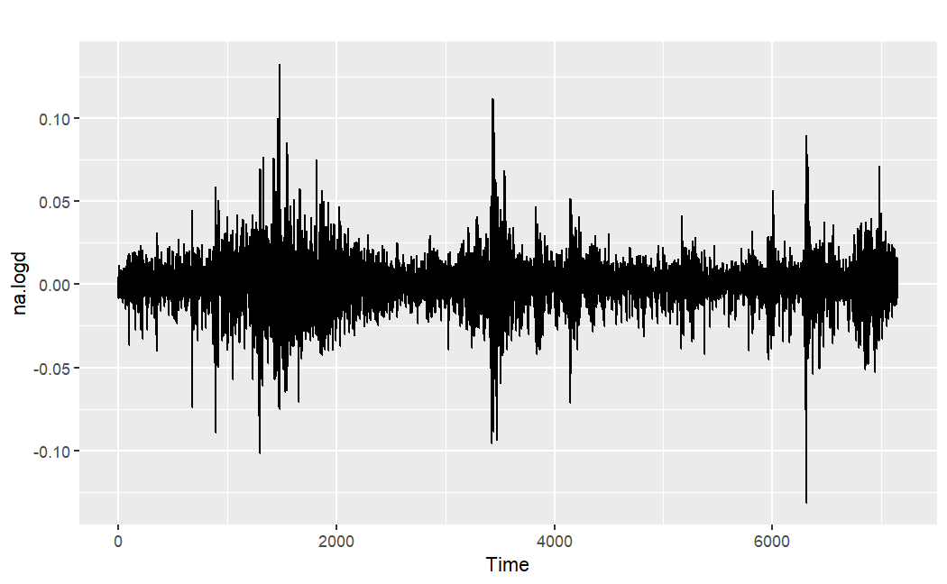
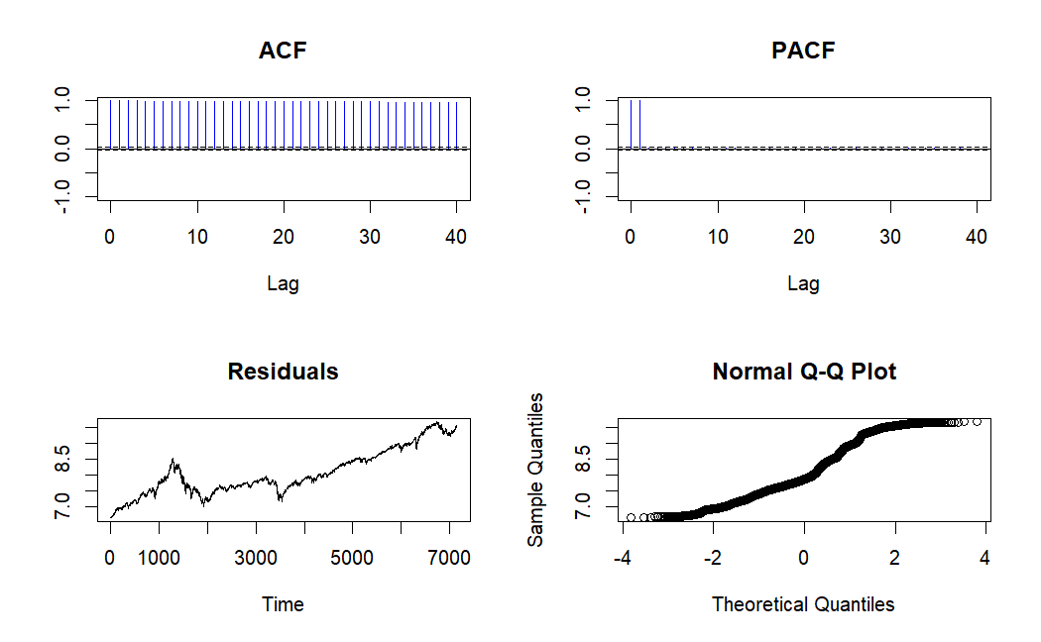
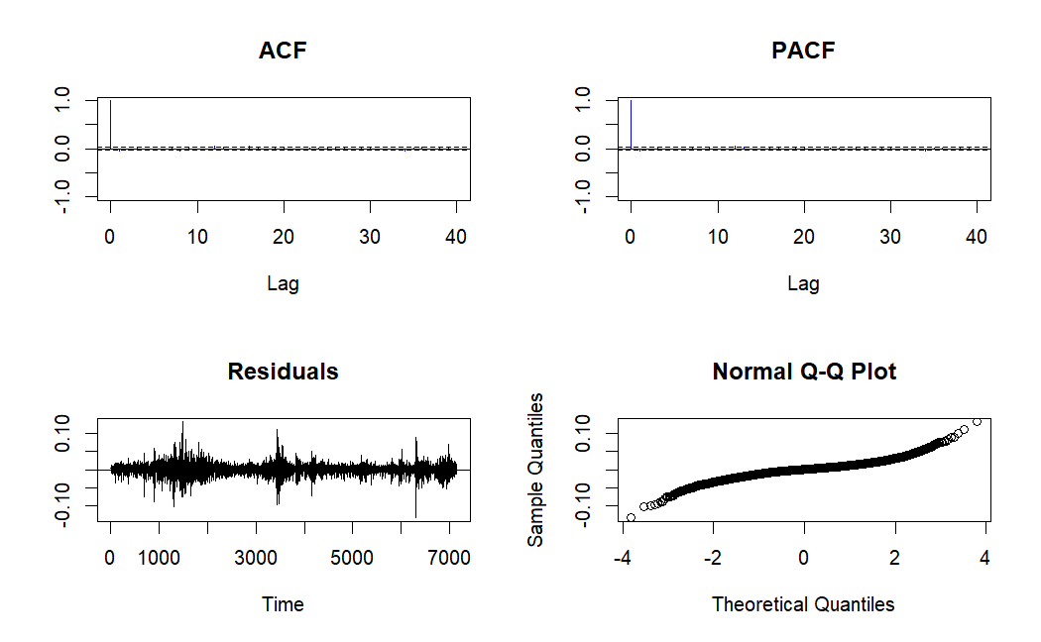
US Stock Market: NASDAQ

Slide 4
01
Executive summary
1.1 Project Overview 1.2 Relevant Theories/Models

Slide 5
02
Introduction
2.1 Background of the Study 2.2 Motivation of the Research 2.3 Scope of the Report

Slide 6
03
Methodology
3.1 Research Design 3.2 Data Collection Methods 3.3 Data Analysis Techniques

Slide 7
04
Forecast and Analysis
4.1 Presentation of Data 4.2 Detailed Analysis

Slide 8
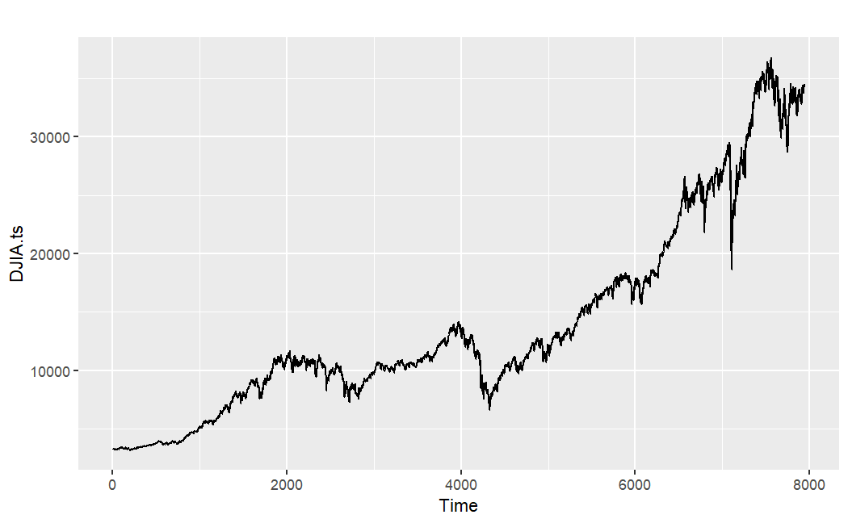
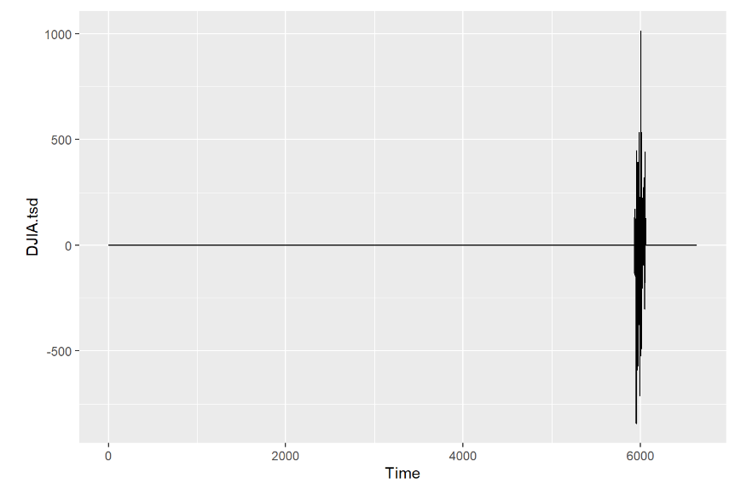
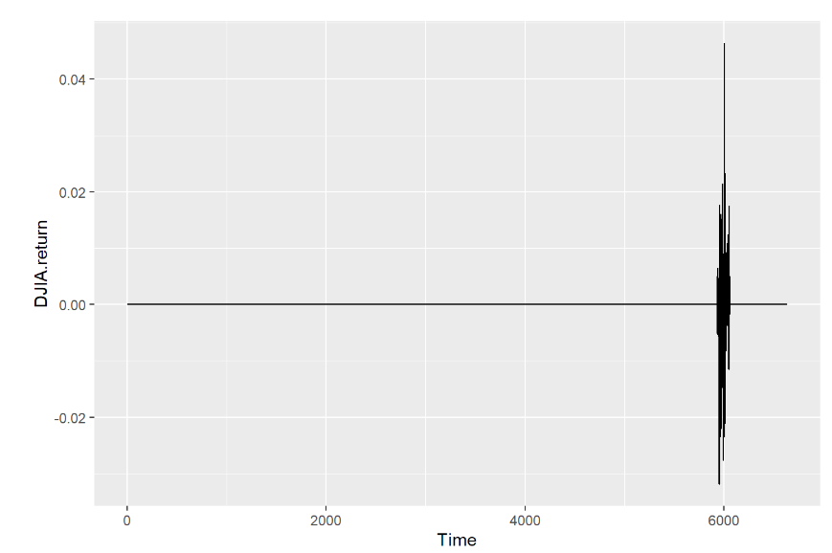
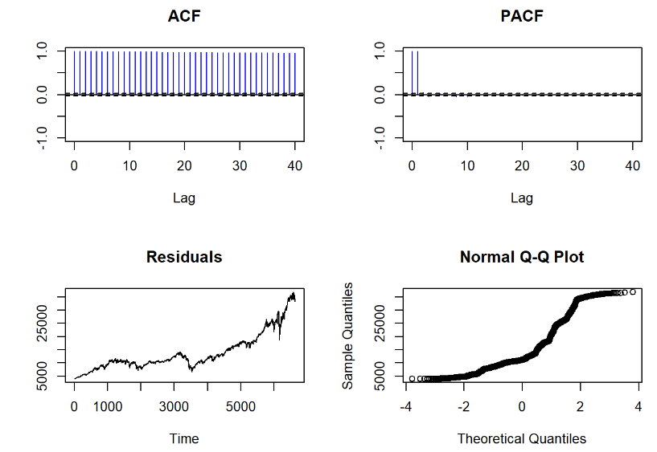
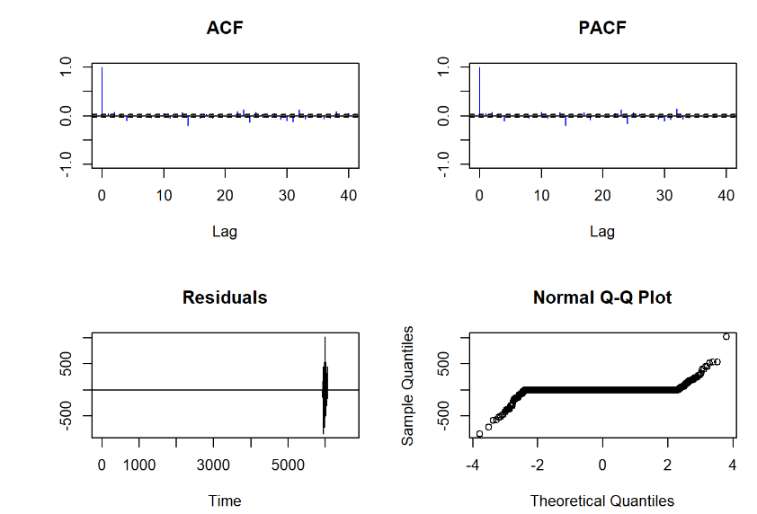
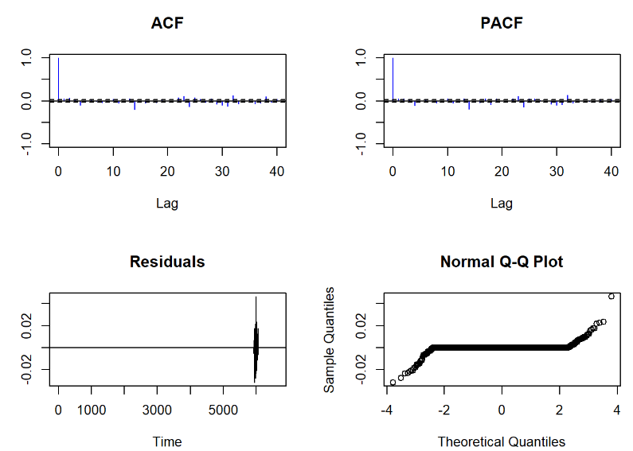
US Stock Market: DJIA

Slide 9
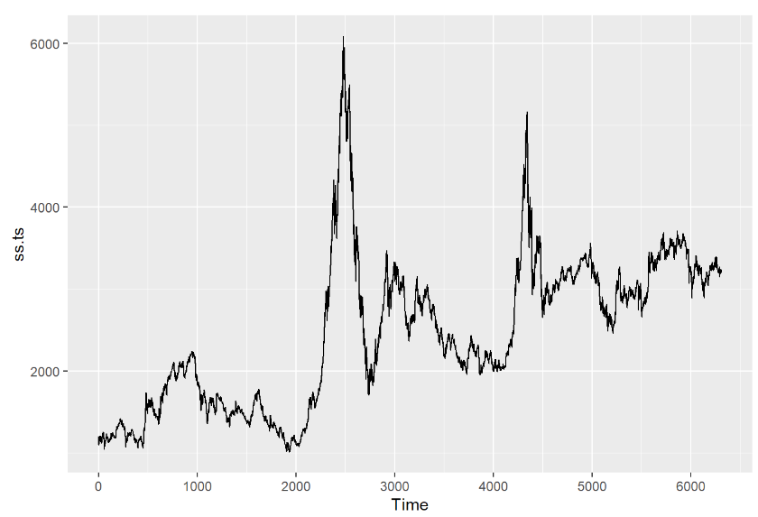
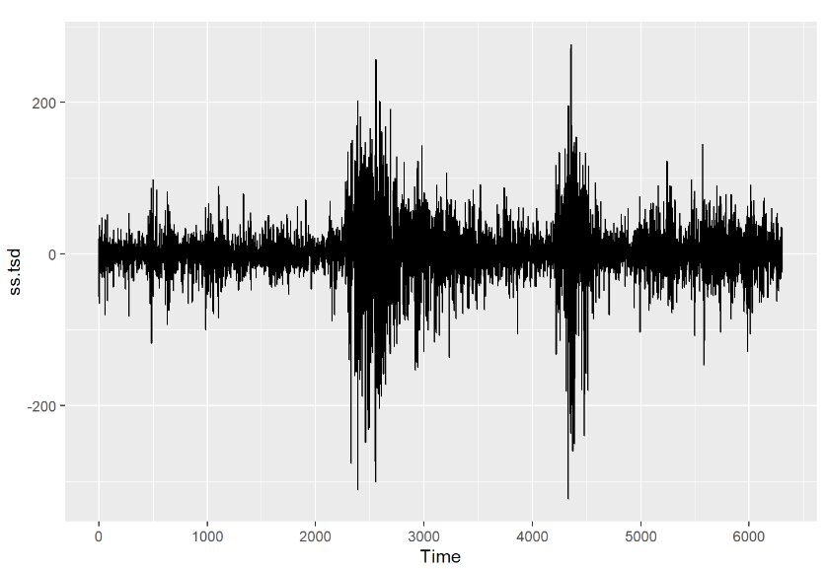
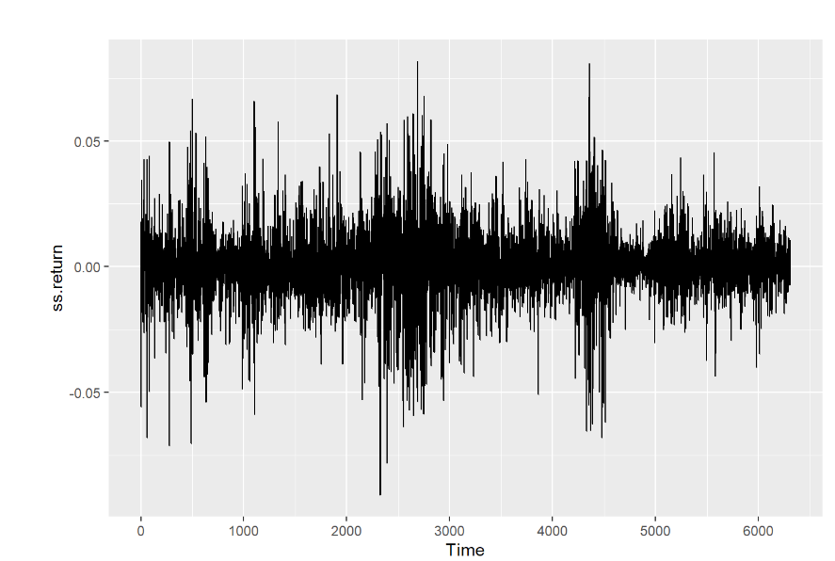
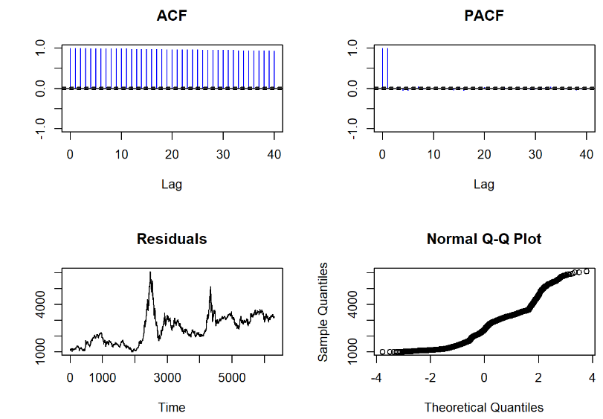
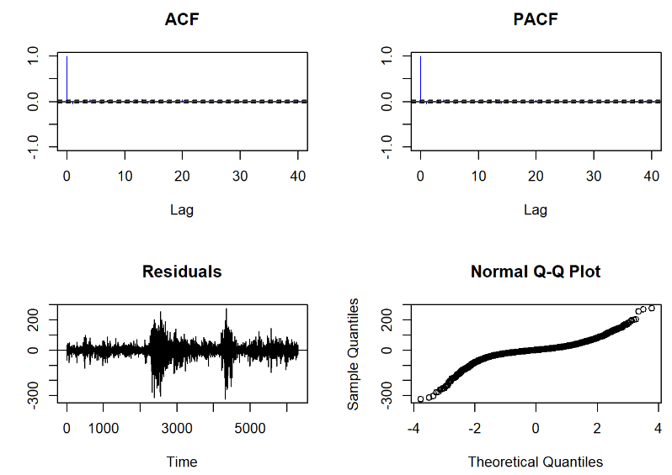
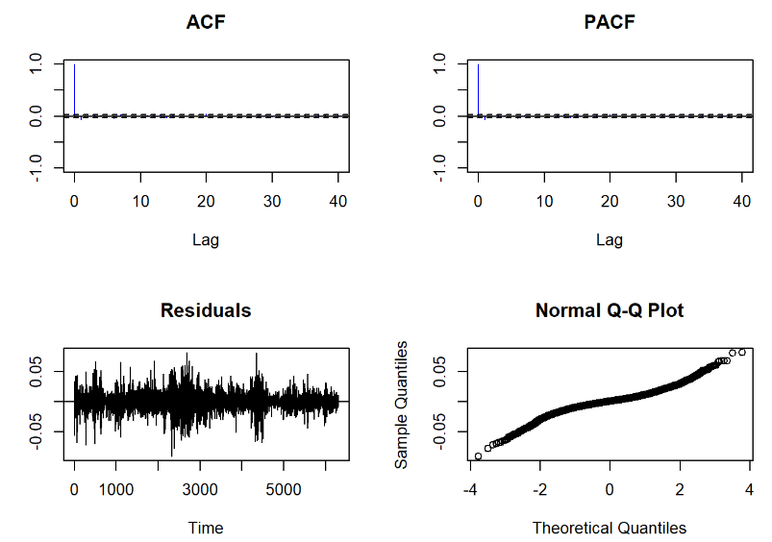
China Stock Market: Shanghai Composite Index

Slide 10
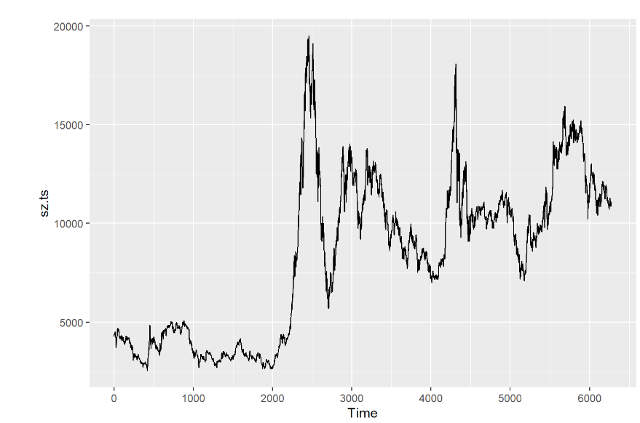
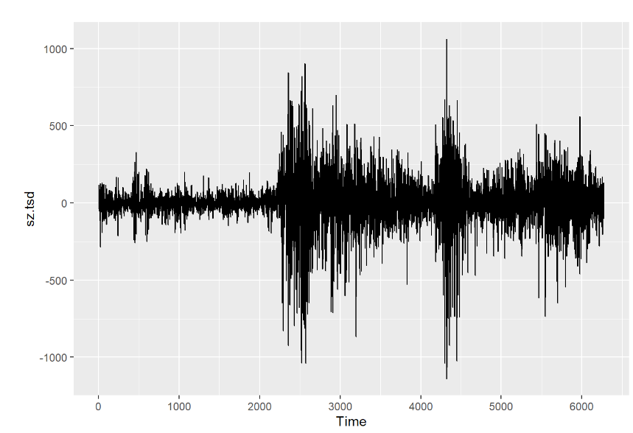
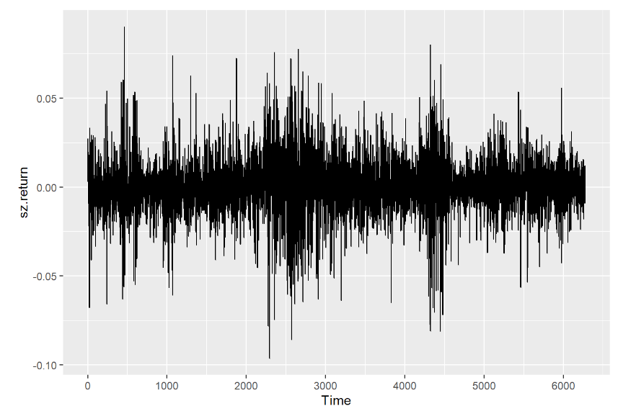
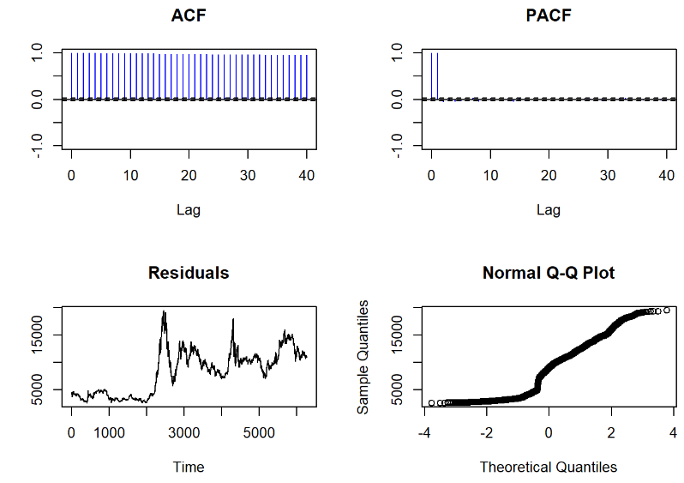
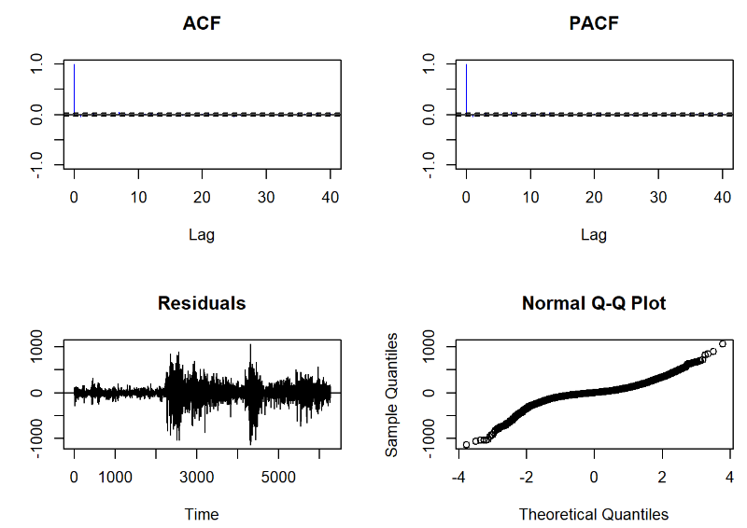
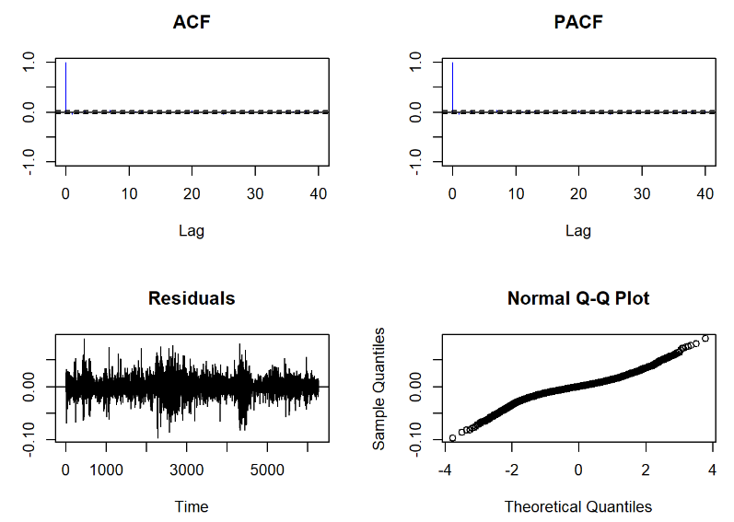
China Stock Market: SZSE Component Index

Slide 11
graph

Slide 12
graph

Slide 13
05
Discussion
5.1 Interpretation of Findings 5.2 Comparison of the ETS Model and ARIMA Model

Slide 14
06
Recommendations
6.1 Suggested Actions 6.2 Future Research Directions

Slide 15
07
Conclusion
7.1 Summary of Findings 7.2 Implications

Slide 16
Reference
Yahoo Finance. (2023, July 17). Global X Dow 30 Covered Call ETF (DJIA) Stock Price, News, Quote & History. Retrieved July 17, 2023, from https://finance.yahoo.com/quote/DJIA?p=DJIA&.tsrc=fin-srch
Yahoo Finance. (2023, July 17). SSE Composite Index (000001.SS) Charts, Data & News. Yahoo Finance. Retrieved July 17 ,2023 from https://finance.yahoo.com/quote/000001.SS?p=000001.SS&.tsrc=fin-srch
Galaxy night panoramic

Slide 17
Appendices
Panoramic view of sunset
Galaxy night view
Free photo galaxy night view

Slide 18
Thanks!
Q&A

Slide 20
Table of contents
01
02
03
Section name
Section name
Section name
Jupiter is a gas giant and the biggest planet in the Solar System. It's the fourth-brightest object in the night sky. It was named after the Roman god of the skies and lightning
Venus has a beautiful name and is the second planet from the Sun. It’s terribly hot and its atmosphere is poisonous. It’s the second-brightest natural object in the night sky
Saturn is a gas giant and has several rings. It's composed mostly of hydrogen and helium. It was named after the Roman god of wealth and agriculture. It’s the sixth planet from the Sun

Slide 21
Contents
1. Executive summary | 1.1 Project Overview 1.2 Relevant Theories/Models
2. Introduction | 2.1 Background of the Study 2.2 Motivation of the Research 2.3 Scope of the Report
3. Methodology | 3.1 Research Design 3.2 Data Collection Methods 3.3 Data Analysis Techniques
4. Forecast and Analysis | 4.1 Presentation of Data 4.2 Detailed Analysis
5. Discussion | 5.1 Interpretation of Findings 5.2 Comparison of the ETS Model and ARIMA Model
6. Recommendations | 6.1 Suggested Actions 6.2 Future Research Directions
7. Conclusion | 7.1 Summary of Findings 7.2 Implications
8. Reference
9. Appendices

Slide 22
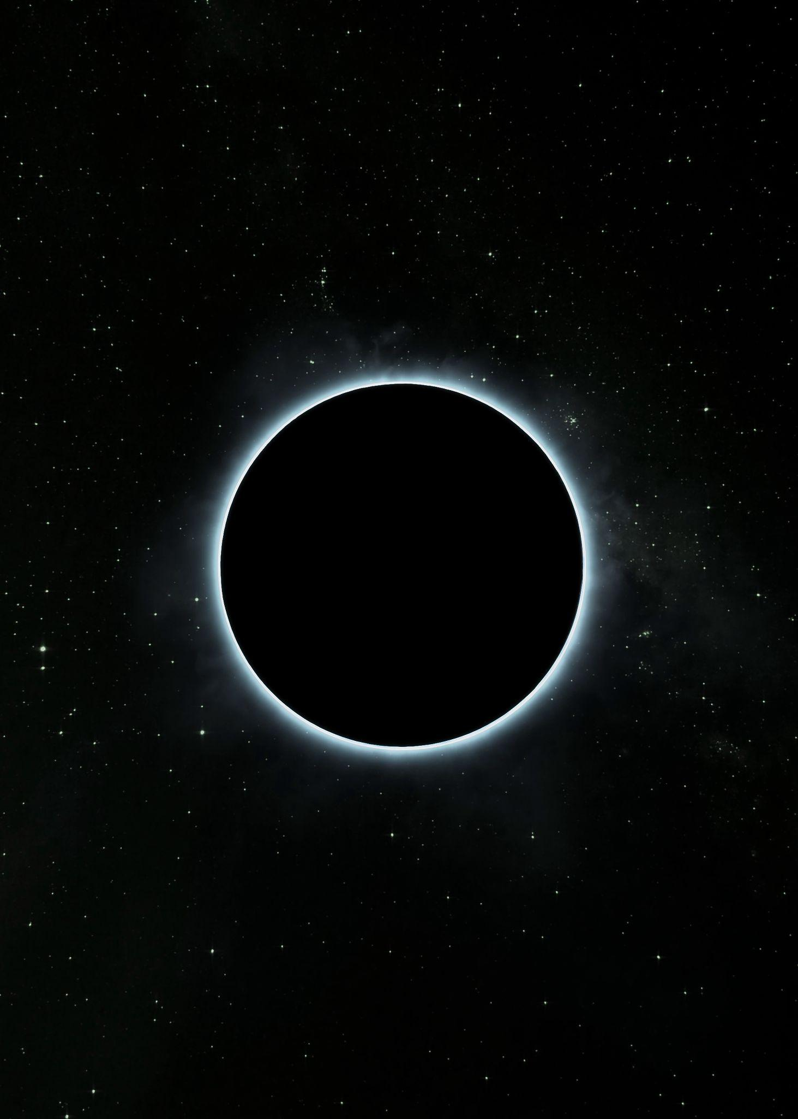
The slide title goes here!
Mercury is the closest planet to the Sun and the smallest one in the entire Solar System. This planet’s name has nothing to do with the liquid metal, since Mercury was named after the Roman messenger god. Despite being closer to the Sun than Venus, its temperatures aren’t as terribly hot as that planet’s. Its surface is quite similar to that of Earth’s Moon, which means there are a lot of craters and plains
Speaking of craters, many of them were named after artists or authors who made significant contributions to their respective fields. Mercury takes a little more than 58 days to complete its rotation, so try to imagine how long days must be there! Since the temperatures are so extreme and the solar radiation is so high, Mercury has been deemed to be non-habitable for humans

Slide 23
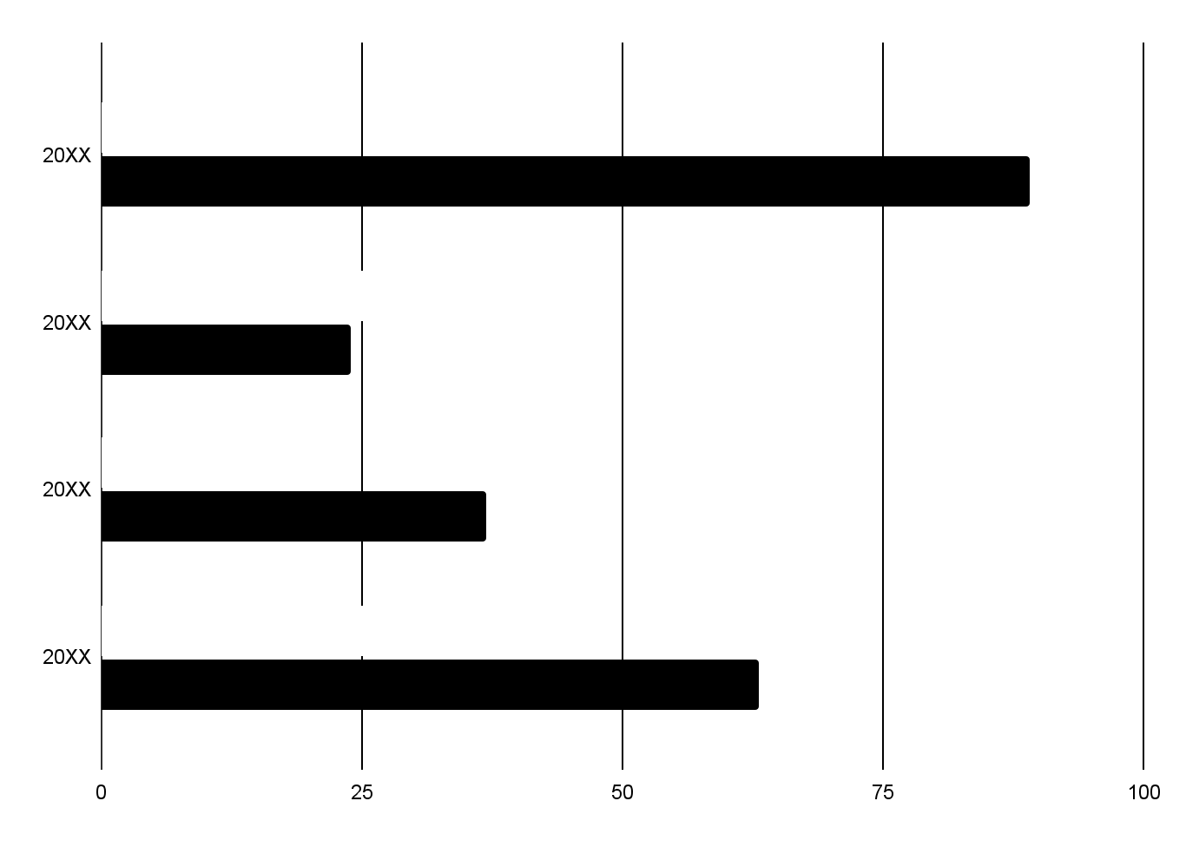
You can use this graph
Period 1
Venus has a beautiful name and is the second planet from the Sun. It’s terribly hot, even hotter than Mercury, and its atmosphere is extremely poisonous
Period 2
Jupiter is a gas giant and the biggest planet in the Solar System. It's the fourth-brightest object in the night sky. It was named after the Roman god of the skies and lightning
Follow the link in the graph to modify its data and then paste the new one here. For more info, click here

Slide 24
—Someone Famous
“This is a quote, words full of wisdom that someone important said and can make the reader get inspired.”

Slide 25
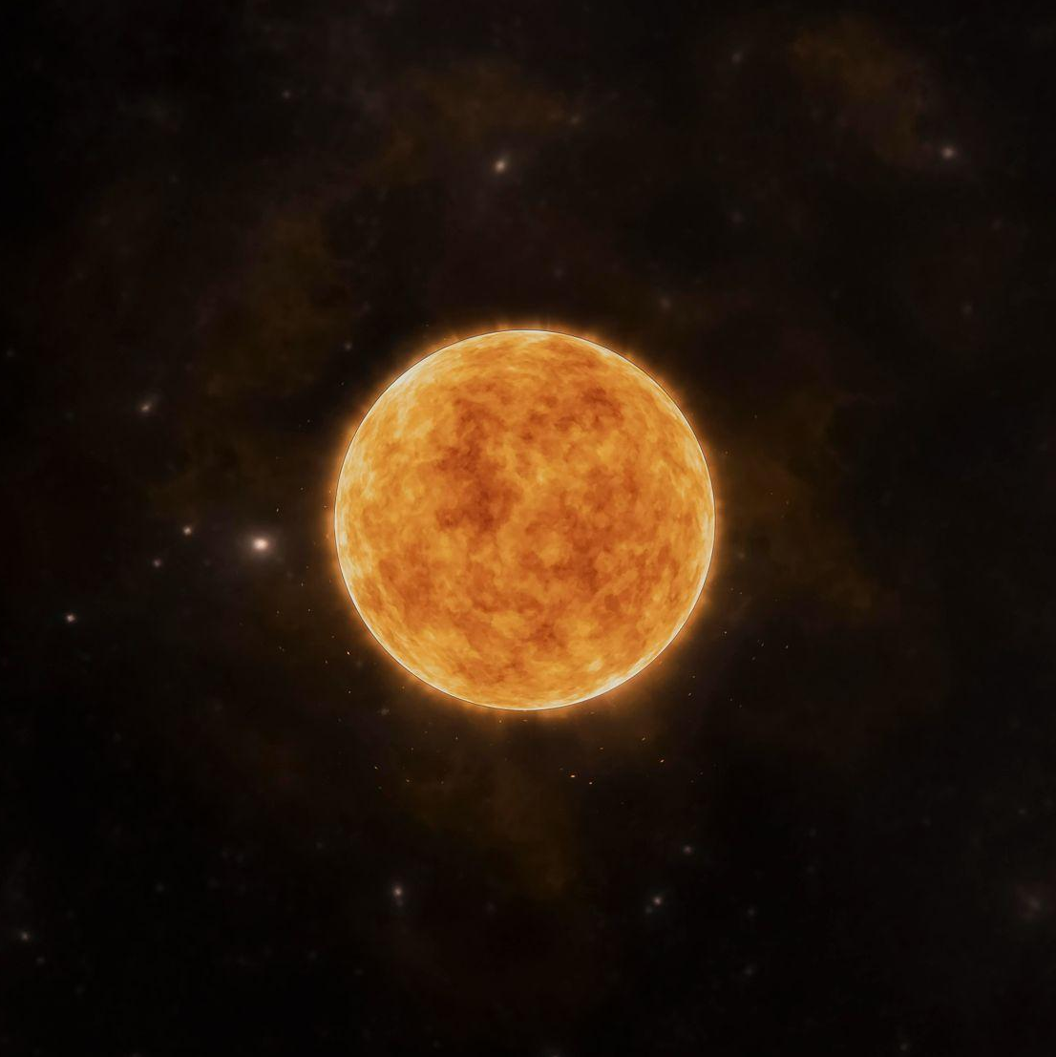
You can use bullet points
Venus has a beautiful name and is the second planet from the Sun. It’s terribly hot, even hotter than Mercury, and its atmosphere is extremely poisonous. It’s the second-brightest natural object in the night skyEarth is the third planet from the Sun and the only one that harbors life in the Solar System
Jupiter is a gas giant and the biggest planet in the Solar System. It’s the fourth-brightest object in the night sky. It was named after the Roman god of the skies and lightning
Mercury is the smallest planet in the Solar System. It was named after the Roman messenger god
Despite being red, Mars is actually a cold place. It’s full of iron oxide dust, which gives the planet its reddish cast

Slide 26
Divide the content
Jupiter and Mars
Venus and Mercury
Jupiter is a gas giant and the biggest planet in the Solar System. It's the fourth-brightest object in the night sky. It was named after the Roman god of the skies and lightning
Despite being red, Mars is actually a cold place. It's full of iron oxide dust, which gives Mars its reddish cast
Venus has a beautiful name and is the second planet from the Sun. It’s terribly hot, even hotter than Mercury, and its atmosphere is extremely poisonous. It’s the second-brightest natural object in the night sky after the Moon
Mercury is the closest planet to the Sun and the smallest one of them all

Slide 27
Infographics are always useful
01
Venus has a beautiful name and is the second planet from the Sun. It’s terribly hot, even hotter than Mercury, and its atmosphere is poisonous
02
Earth is the third planet from the Sun and the only one that harbors life in the Solar System. All humans live on this planet. It’s also known as the Blue Planet
03
Jupiter is a gas giant and the biggest planet in the Solar System. It’s the fourth-brightest object in the night sky. It was named after the Roman god of the skies and lightning
04
Saturn is a gas giant and has several rings. It’s composed mostly of hydrogen and helium. It was named after the Roman god of wealth and agriculture

Slide 28
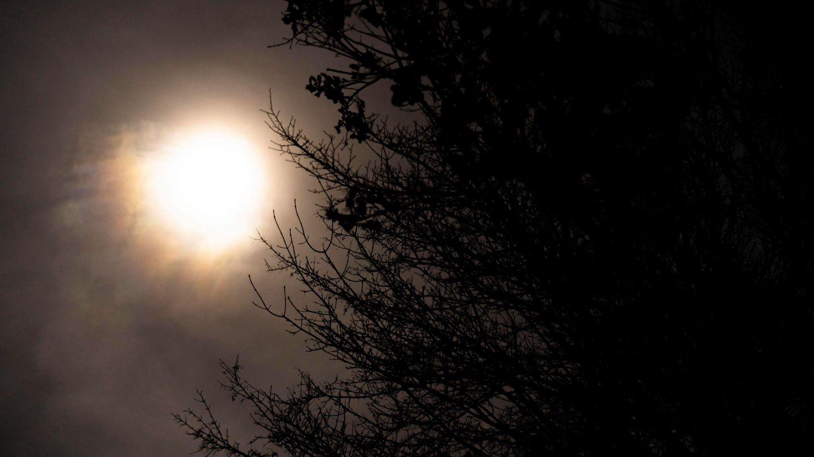
A picture is worth a thousand words

Slide 29
Long text slide
Mercury is the closest planet to the Sun and the smallest of them all. This planet’s name has nothing to do with the liquid metal, since Mercury was named after the Roman messenger god. Despite being closer to the Sun than Venus, its temperatures aren’t as terribly hot as that planet’s. Its surface is quite similar to that of Earth’s Moon, which means there are a lot of craters and plains. Speaking of craters, many of them were named after artists or authors who made significant contributions to their respective fields. Mercury takes a little more than 58 days to complete its rotation, so try to imagine how long days must be there! Since the temperatures are so extreme, albeit not as extreme as on Venus, and the solar radiation is so high, Mercury has been deemed to be non-habitable for humans
Mercury is the closest planet to the Sun and the smallest of them all. This planet’s name has nothing to do with the liquid metal, since Mercury was named after the Roman messenger god. Despite being closer to the Sun than Venus, its temperatures aren’t as terribly hot as that planet’s. Its surface is quite similar to that of Earth’s Moon, which means there are a lot of craters and plains. Speaking of craters, many of them were named after artists or authors who made significant contributions to their respective fields. Mercury takes a little more than 58 days to complete its rotation, so try to imagine how long days must be there! Since the temperatures are so extreme, albeit not as extreme as on Venus, and the solar radiation is so high, Mercury has been deemed to be non-habitable for humans

