Slide 1

StableSwap
Rongze GAO
Curve's StableSwap algorithm for a two-asset stablecoin pool (USDC/USDT, 6 decimals)
UPDATED: August 19, 2025

Slide 2
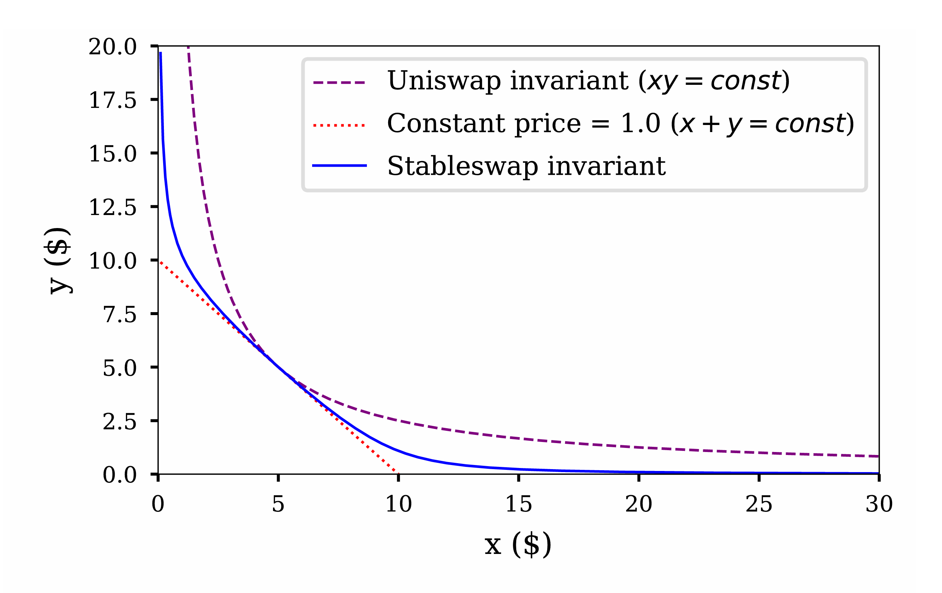


Research Background
1.
Research Background
Mathematical Principles
2.
3.
Library Demo and API
Code Analysis
XY=K
4.
X+Y=K
5.
Issues and Feedback
Citations, References, and Appendix
6.
BACKGROUND | PRINCIPLES | DEMO | CODE | ISSUES | REFERENCES

Slide 3



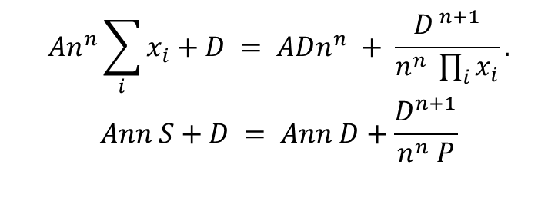

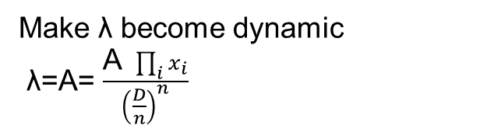

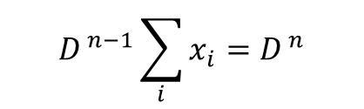
Mathematical Principles
Align the two in terms of dimensions
$\text{λ}\text{⋅}D^{ n−1}\sum_{i}{x_{i}}+\prod_{i}{x_{i}}={\text{λ}D}^{ n}$+ ${\left(\frac{D}{n}\right)}^{n}$
Make λ become dynamic
λ=A= $\frac{\text{A} \prod_{i}{x_{i}}}{{\left(\frac{D}{n}\right)}^{n}}$
X is balance vector (x,y)
$$P=\prod_{i=0}^{n−1}{x_{i}}$$
$$D^{ n−1}\sum_{i}{x_{i}}=D^{ n}$$
$$An^{n}\sum_{i}{x_{i}}+D = ADn^{n} + \frac{D^{ n+1}}{n^{n} \prod_{i}{x_{i}}}.$$
$$Ann S+D = Ann D+\frac{D^{n+1}}{n^{n} P}$$
$$\prod_{i}{x_{i}}={\left(\frac{D}{n}\right)}^{n}$$
$$S=\sum_{i=0}^{n−1}{x_{i}}$$
BACKGROUND | PRINCIPLES | DEMO | CODE | ISSUES | REFERENCES

Slide 4
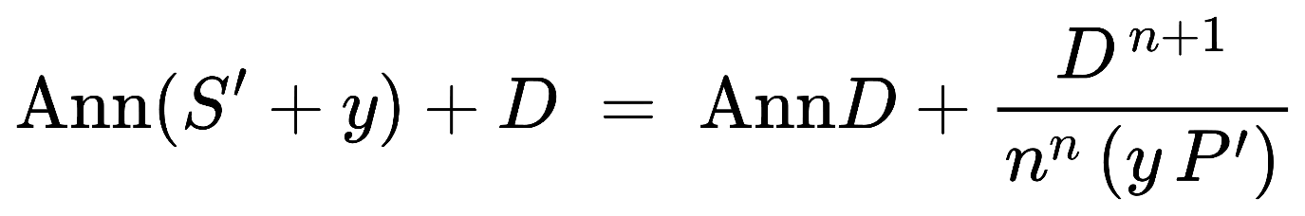
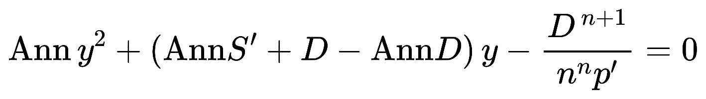

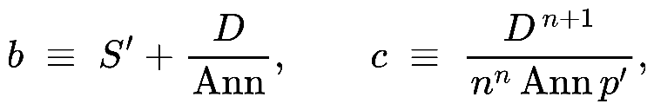
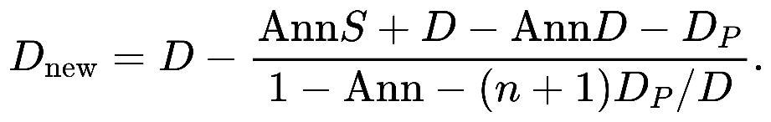
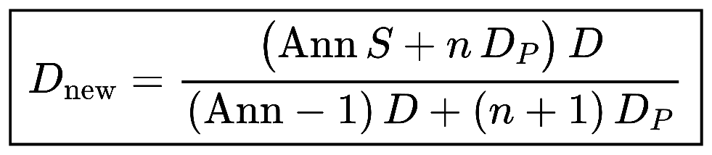
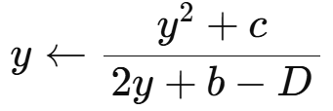

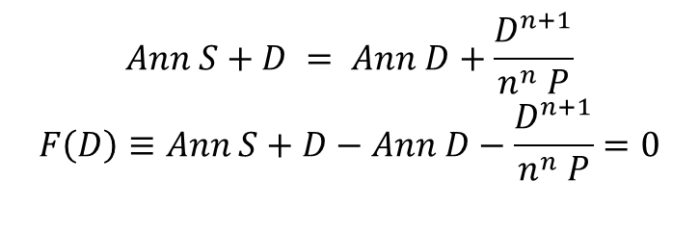
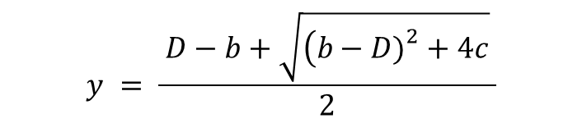
Mathematical Principles
Implicit root-finding problem
$\frac{D^{n+1}}{n^{n} P}$=Dp
Stable D and cal y
$$Ann S+D = Ann D+\frac{D^{n+1}}{n^{n} P}$$
$$F\left(D\right)≡Ann S+D−Ann D−\frac{D^{n+1}}{n^{n} P}=0$$
Newton’s method
quadratic function
A single Newton step is
$$y = \frac{ D−b+\sqrt{\left(b−D{\left.)\right.}^{2}+4c\right.} }{2}$$
f(y)=y^2 + (b - D)y - c = 0
closed-form
BACKGROUND | PRINCIPLES | DEMO | CODE | ISSUES | REFERENCES

Slide 5
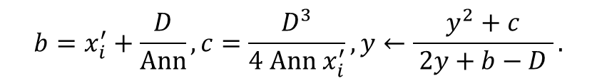
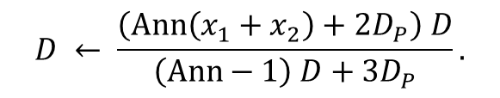
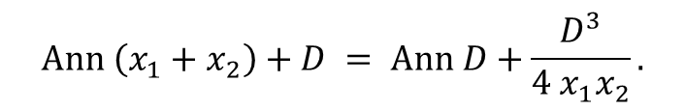
Mathematical Principles
$$Ann \left(x_{1}+x_{2}\right)+D = Ann D+\frac{D^{3}}{4 x_{1}x_{2}}.$$
$$D ← \frac{\left(Ann\left(x_{1}+x_{2}\right)+2D_{P}\right) D}{\left(Ann−1\right) D+3D_{P}}.$$
$$b=x_{i}^{′}+\frac{D}{Ann}, c=\frac{D^{3}}{4 Ann x_{i}^{′}}, y←\frac{y^{2}+c}{ 2y+b−D }.$$
BACKGROUND | PRINCIPLES | DEMO | CODE | ISSUES | REFERENCES

Slide 6
Library Demo and API
accelerated growth in revenue and profitability: Market share expansion
BACKGROUND | PRINCIPLES | DEMO | CODE | ISSUES | REFERENCES

Slide 7
Code Analysis
Revenue Projection
Revenue Compared to Peers
PROFITABILITY INDICATORS
Gross margin (%) | 15.5% | 19.9% | 14.9% | 13.4% | 10.4% | 13.7% | 15.0% | 13.8% | 13.2% | 12.6% | 11.6% | 9.9%
EBITDA margin (%) | — | — | — | 9.7% | 7.1% | 8.7% | 10.1% | 8.9% | 8.4% | 7.8% | 6.8% | 5.1%
EBIT margin (%) | 2.9% | 6.6% | 6.2% | 5.5% | 3.6% | 5.2% | 6.6% | 5.4% | 4.9% | 4.3% | 3.3% | 1.6%
NI margin (%) | 1.1% | 4.7% | 3.1% | 2.9% | 3.6% | 5.6% | 7.4% | 6.7% | 6.5% | 5.9% | 5.4% | 4.7%
ROE (%) | 3.6% | 15.3% | 8.3% | 8.4% | 11.0% | 20.4% | 21.9% | 19.2% | 19.1% | 15.4% | 12.7% | 9.8%
ROA (%) | 0.8% | 3.1% | 2.1% | 1.6% | 2.8% | 4.9% | 6.6% | 6.4% | 6.6% | 6.4% | 6.1% | 5.4%
Source: Team Analysis, Choice
BACKGROUND | PRINCIPLES | DEMO | CODE | ISSUES | REFERENCES

Slide 8
Issues and Feedback
DCF TARGET: ¥ 11.31
Cost of debt
6.29%
Cost of equity
5.25%
WACC
5.2%
Terminal growth
2.25%
Upside: 11.9%
Terminal Growth Rate |  |  |  |  |  |  |  | Terminal Growth Rate
 |  | 1.75% | 2.00% | 2.25% | 2.50% | 2.75% |  |  |  | 0.50% | 1.00% | 1.50% | 2.00% | 2.50%
WACC | 4.2% | ¥14.7 | ¥16.1 | ¥18.0 | ¥20.5 | ¥22.7 |  | WACC | 7.00% | 30% | 42% | 59% | 81% | 101%
 | 4.7% | ¥11.9 | ¥12.8 | ¥14.0 | ¥15.4 | ¥17.2 |  |  | 7.50% | 5% | 13% | 24% | 36% | 52%
 | 5.2% | ¥9.9 | ¥10.6 | ¥11.3 | ¥12.2 | ¥13.3 |  |  | 8.00% | -12% | -6% | 0% | 8% | 18%
 | 5.7% | ¥8.5 | ¥8.9 | ¥9.5 | ¥10.1 | ¥10.8 |  |  | 8.50% | -25% | -21% | -16% | -11% | -4%
 | 6.2% | ¥7.3 | ¥7.7 | ¥8.1 | ¥8.5 | ¥9.0 |  |  | 9.00% | -35% | -32% | -28% | -25% | -20%
Source: Team Analysis
BACKGROUND | PRINCIPLES | DEMO | CODE | ISSUES | REFERENCES

Slide 9


Citations, References, and Appendix
Probability | High |  | MR1
 | Medium |  | PR1
 | Medium | MR3 |  | OR2 | PR2
 |  |  |  | OR1 |  | MR2
 | Low
 |  | Low |  | Moderate |  | High
 |  | Impact
MR1 Competition Risk
Mitigating
1. Maintain its commitment R&D
Factors
2. Focus on enhancing brand awareness and cultivating customer loyalty
Valuation
Downward pressure on pricing
Impact
Reduce margins
Impact: - 23% from target price (a share price of ¥ 8.73)
Source: Team Analysis, Bloomberg
BACKGROUND | PRINCIPLES | DEMO | CODE | ISSUES | REFERENCES

