Slide 1

StableSwap
Rongze GAO
Curve's StableSwap algorithm for a two-asset stablecoin pool (USDC/USDT, 6 decimals)
August 22, 2025

Slide 2
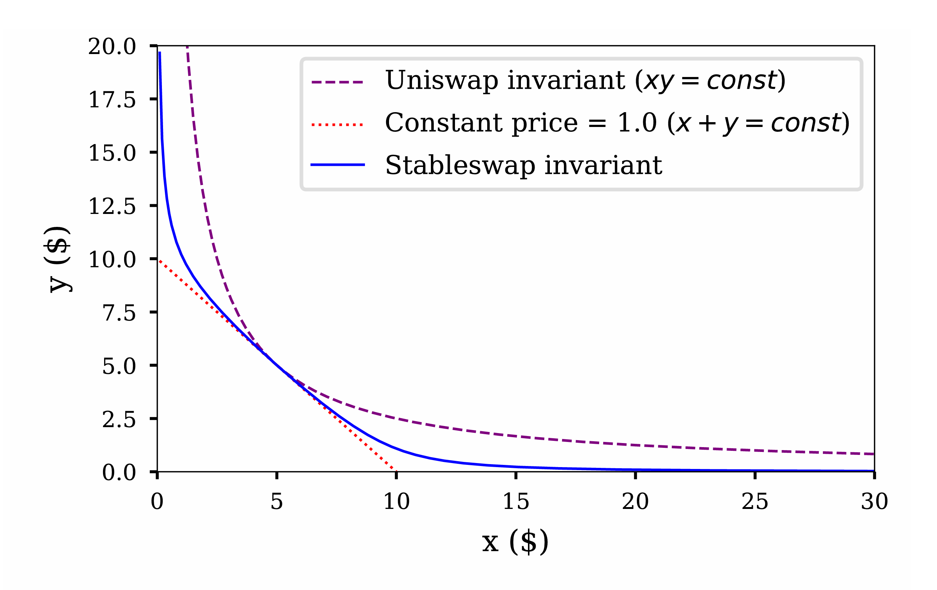


Research Background
1.
Research Background
Mathematical Principles
2.
3.
Library Demo and API
Code Analysis
XY=K
4.
X+Y=K
5.
Issues and Feedback
Citations, References, and Appendix
6.
BACKGROUND | PRINCIPLES | DEMO | CODE | ISSUES | REFERENCES

Slide 3



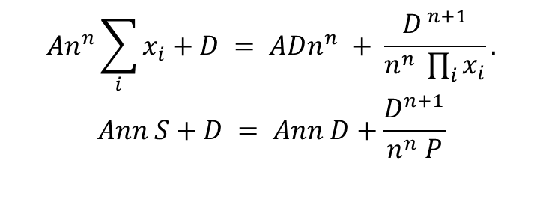

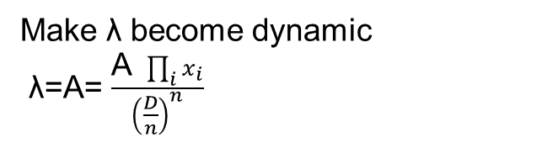

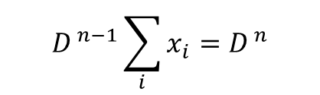
Mathematical Principles
Align the two in terms of dimensions
$\text{λ}\text{⋅}D^{ n−1}\sum_{i}{x_{i}}+\prod_{i}{x_{i}}={\text{λ}D}^{ n}$+ ${\left(\frac{D}{n}\right)}^{n}$
Make λ become dynamic
λ=A= $\frac{\text{A} \prod_{i}{x_{i}}}{{\left(\frac{D}{n}\right)}^{n}}$
X is balance vector (x,y)
$$D^{ n−1}\sum_{i}{x_{i}}=D^{ n}$$
$$P=\prod_{i=0}^{n−1}{x_{i}}$$
$$An^{n}\sum_{i}{x_{i}}+D = ADn^{n} + \frac{D^{ n+1}}{n^{n} \prod_{i}{x_{i}}}.$$
$$Ann S+D = Ann D+\frac{D^{n+1}}{n^{n} P}$$
$$\prod_{i}{x_{i}}={\left(\frac{D}{n}\right)}^{n}$$
$$S=\sum_{i=0}^{n−1}{x_{i}}$$
D<=S,P<=(D/n)^n
BACKGROUND | PRINCIPLES | DEMO | CODE | ISSUES | REFERENCES

Slide 4
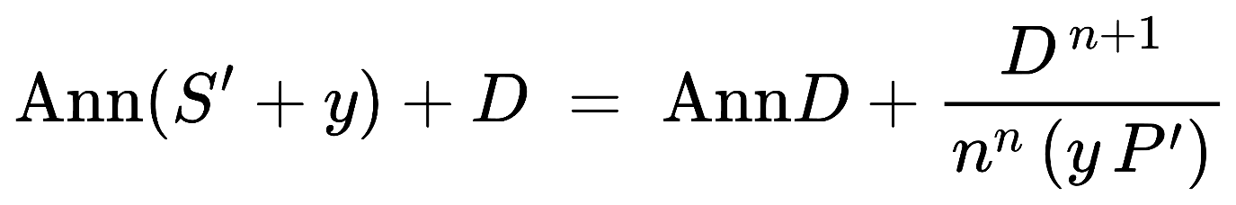
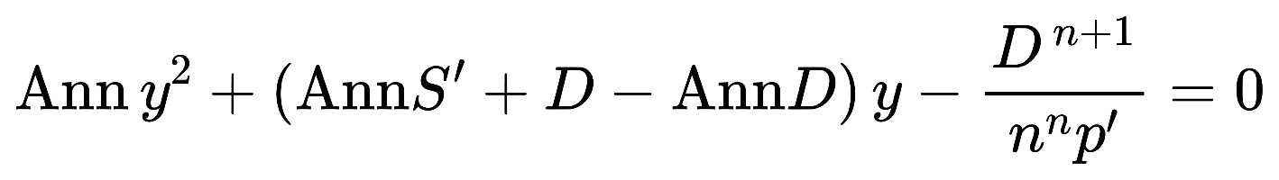
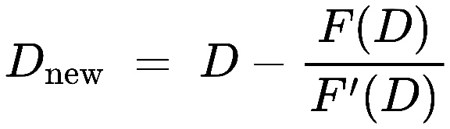
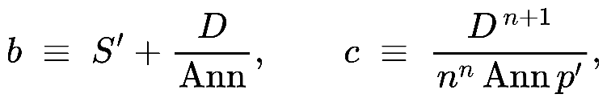
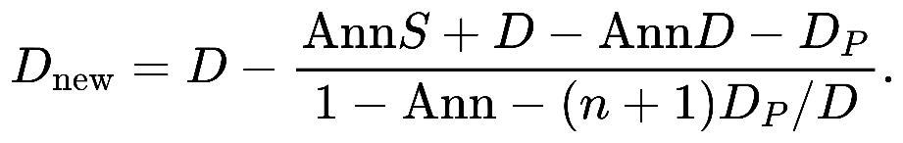
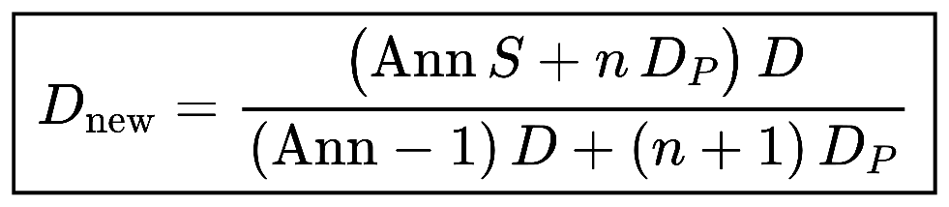
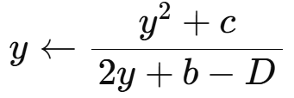

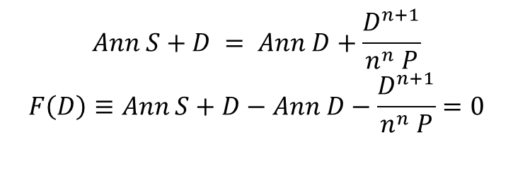
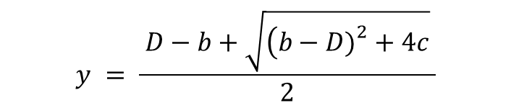
Mathematical Principles
Implicit root-finding problem
Stable D and cal y
$\frac{D^{n+1}}{n^{n} P}$=Dp
$$Ann S+D = Ann D+\frac{D^{n+1}}{n^{n} P}$$
$$F\left(D\right)≡Ann S+D−Ann D−\frac{D^{n+1}}{n^{n} P}=0$$
Newton’s method
quadratic function
A single Newton step is
$$y = \frac{ D−b+\sqrt{\left(b−D{\left.)\right.}^{2}+4c\right.} }{2}$$
f(y)=y^2 + (b - D)y - c = 0
closed-form
BACKGROUND | PRINCIPLES | DEMO | CODE | ISSUES | REFERENCES

Slide 5
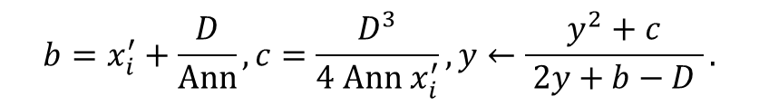
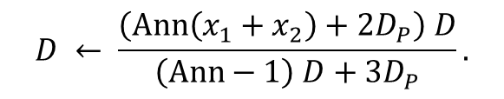
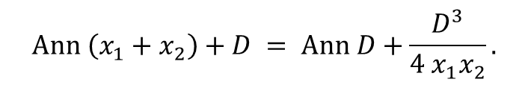
Mathematical Principles
$$Ann \left(x_{1}+x_{2}\right)+D = Ann D+\frac{D^{3}}{4 x_{1}x_{2}}.$$
$$D ← \frac{\left(Ann\left(x_{1}+x_{2}\right)+2D_{P}\right) D}{\left(Ann−1\right) D+3D_{P}}.$$
$$b=x_{i}^{′}+\frac{D}{Ann}, c=\frac{D^{3}}{4 Ann x_{i}^{′}}, y←\frac{y^{2}+c}{ 2y+b−D }.$$
BACKGROUND | PRINCIPLES | DEMO | CODE | ISSUES | REFERENCES

Slide 6
Library Demo and API
Unit Testing
Integration Testing
System Testing
pub struct StableSwapPool {
pub reserves: [u64; 2],
pub amplification_coefficient: u64, // A
pub fee_bps: u16, // input-side fee in bps
}
impl StableSwapPool {
pub fn new(reserves: [u64; 2], amp: u64) -> Self;
pub fn get_dy(&self, i: usize, j: usize, dx: u64) -> Result<u64, SwapError>;
pub fn get_d(&self) -> u64;
pub fn calculate_slippage_bps(&self, amount: u64) -> u16;
}
/// Constant-product baseline (no fee)
pub fn constant_product_dy(reserves: [u64;2], i: usize, j: usize, dx: u64) -> Option<u64>;
accelerated growth in revenue and profitability: Market share expansion
BACKGROUND | PRINCIPLES | DEMO | CODE | ISSUES | REFERENCES

Slide 7
Code Analysis
Rust-Developer-Test-Assignment_StableSwap-Implementation/src/lib.rs at main · zeron-G/Rust-Developer-Test-Assignment_StableSwap-Implementation
BACKGROUND | PRINCIPLES | DEMO | CODE | ISSUES | REFERENCES

Slide 8

Issues and Feedback
Decoupling will lead to accelerated slippage
and hasten the death spiral
It only includes the identification
and feedback of four basic types of errors.
The current library only supports the dual-token model for now.
BACKGROUND | PRINCIPLES | DEMO | CODE | ISSUES | REFERENCES

Slide 9
Citations, References, and Appendix
Adams, H., Zinsmeister, N., & Robinson, D. (2020). Uniswap v2 core Uniswap Labs. https://app.uniswap.org/whitepaper.pdf
Adams, H., Zinsmeister, N., Salem, M., Keefer, R., & Robinson, D. (2021). Uniswap v3 core Uniswap Labs. https://app.uniswap.org/whitepaper-v3.pdf
Egorov, M. (2019). StableSwap: An efficient mechanism for stablecoin liquidity. Curve Finance. https://berkeley-defi.github.io/assets/material/StableSwap.pdf (see also Curve’s whitepaper index: https://docs.curve.finance/references/whitepaper)
RareSkills. (2025). get_D() and get_y() in Curve StableSwap. https://rareskills.io/post/curve-get-d-get-y
SolanaFM. (2025). USDT (USDT) — Solana token details (decimals: 6). https://solana.fm/address/Es9vMFrzaCERmJfrF4H2FYD4KCoNkY11McCe8BenwNYB
Solana Foundation. (n.d.). Create a token mint (SPL tokens). https://solana.com/docs/tokens/basics/create-mint
Solscan. (2025). USDC (USDC) — Solana token page (decimals: 6). https://solscan.io/token/EPjFWdd5AufqSSqeM2qN1xzybapC8G4wEGGkZwyTDt1v
Uniswap Labs. (2025). How Uniswap works (Docs). https://docs.uniswap.org/contracts/v2/concepts/protocol- overview/how-uniswap-works
BACKGROUND | PRINCIPLES | DEMO | CODE | ISSUES | REFERENCES

