Slide 1

StableSwap
Rongze GAO
Curve's StableSwap algorithm for a two-asset stablecoin pool (USDC/USDT, 6 decimals)
UPDATED: August 19, 2025

Slide 2
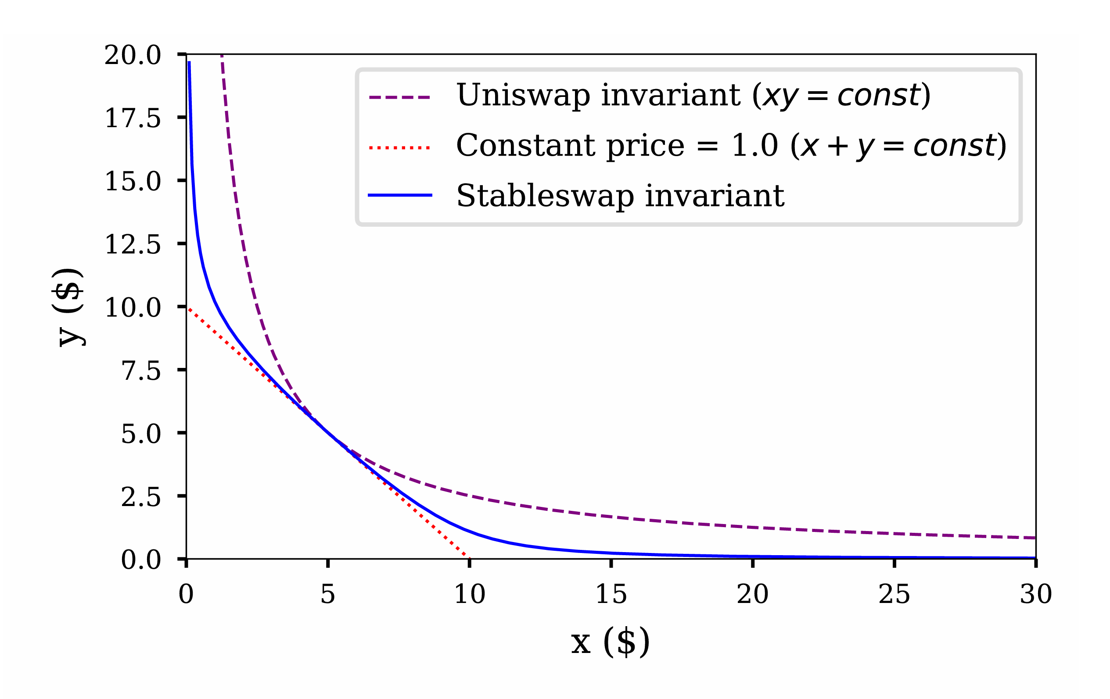


Research Background
1.
Research Background
Mathematical Principles
2.
3.
Library Demo and API
Code Analysis
XY=K
4.
X+Y=K
5.
Issues and Feedback
Citations, References, and Appendix
6.
BACKGROUND | PRINCIPLES | DEMO | CODE | ISSUES | REFERENCES

Slide 3



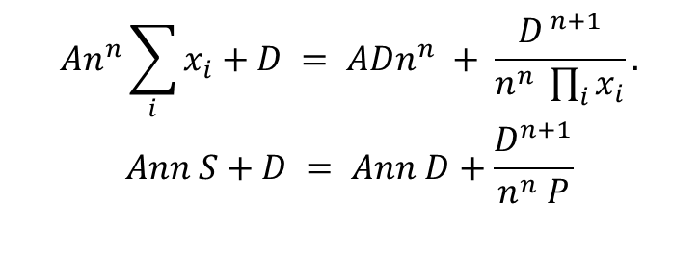

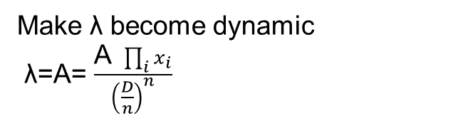

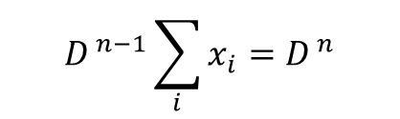
Mathematical Principles
Align the two in terms of dimensions
$\text{λ}\text{⋅}D^{ n−1}\sum_{i}{x_{i}}+\prod_{i}{x_{i}}={\text{λ}D}^{ n}$+ ${\left(\frac{D}{n}\right)}^{n}$
Make λ become dynamic
λ=A= $\frac{\text{A} \prod_{i}{x_{i}}}{{\left(\frac{D}{n}\right)}^{n}}$
X is balance vector (x,y)
$$P=\prod_{i=0}^{n−1}{x_{i}}$$
$$D^{ n−1}\sum_{i}{x_{i}}=D^{ n}$$
$$An^{n}\sum_{i}{x_{i}}+D = ADn^{n} + \frac{D^{ n+1}}{n^{n} \prod_{i}{x_{i}}}.$$
$$Ann S+D = Ann D+\frac{D^{n+1}}{n^{n} P}$$
$$\prod_{i}{x_{i}}={\left(\frac{D}{n}\right)}^{n}$$
$$S=\sum_{i=0}^{n−1}{x_{i}}$$
BACKGROUND | PRINCIPLES | DEMO | CODE | ISSUES | REFERENCES

Slide 4
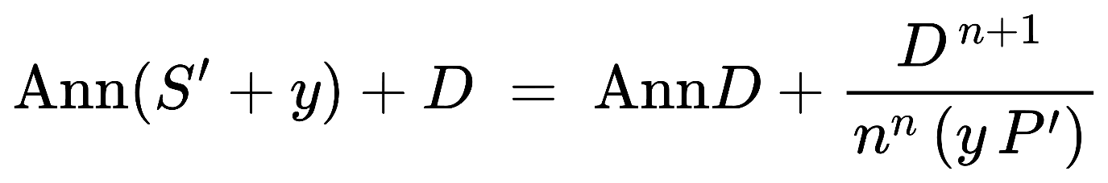
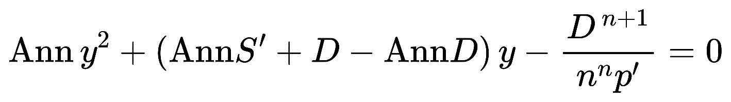
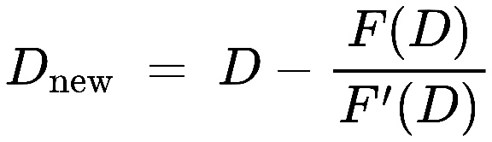
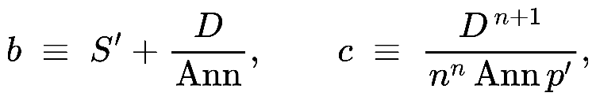
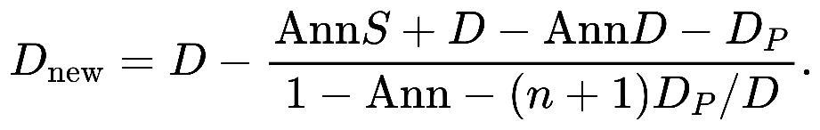
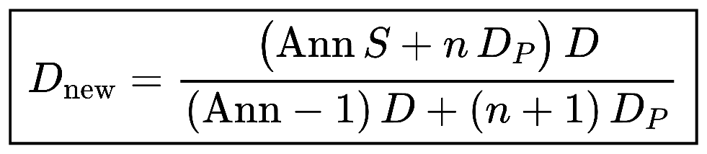
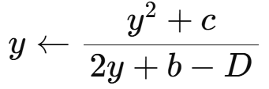

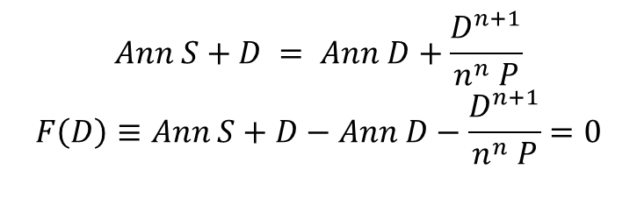
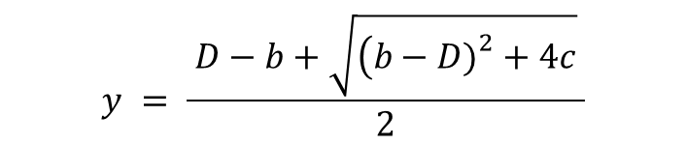
Mathematical Principles
Implicit root-finding problem
$\frac{D^{n+1}}{n^{n} P}$=Dp
Stable D and cal y
$$Ann S+D = Ann D+\frac{D^{n+1}}{n^{n} P}$$
$$F\left(D\right)≡Ann S+D−Ann D−\frac{D^{n+1}}{n^{n} P}=0$$
Newton’s method
quadratic function
A single Newton step is
$$y = \frac{ D−b+\sqrt{\left(b−D{\left.)\right.}^{2}+4c\right.} }{2}$$
f(y)=y^2 + (b - D)y - c = 0
closed-form
BACKGROUND | PRINCIPLES | DEMO | CODE | ISSUES | REFERENCES

Slide 5
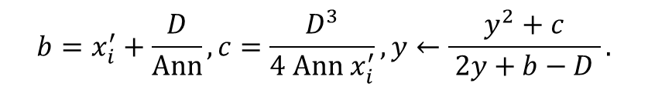
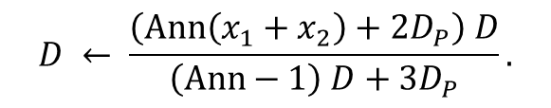
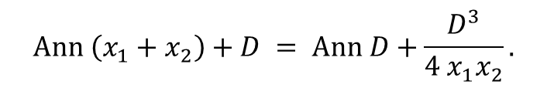
Mathematical Principles
$$Ann \left(x_{1}+x_{2}\right)+D = Ann D+\frac{D^{3}}{4 x_{1}x_{2}}.$$
$$D ← \frac{\left(Ann\left(x_{1}+x_{2}\right)+2D_{P}\right) D}{\left(Ann−1\right) D+3D_{P}}.$$
$$b=x_{i}^{′}+\frac{D}{Ann}, c=\frac{D^{3}}{4 Ann x_{i}^{′}}, y←\frac{y^{2}+c}{ 2y+b−D }.$$
BACKGROUND | PRINCIPLES | DEMO | CODE | ISSUES | REFERENCES

Slide 6
Library Demo and API
pub struct StableSwapPool {
pub reserves: [u64; 2],
pub amplification_coefficient: u64, // A
pub fee_bps: u16, // input-side fee in bps
}
impl StableSwapPool {
pub fn new(reserves: [u64; 2], amp: u64) -> Self;
pub fn get_dy(&self, i: usize, j: usize, dx: u64) -> Result<u64, SwapError>;
pub fn get_d(&self) -> u64;
pub fn calculate_slippage_bps(&self, amount: u64) -> u16;
}
/// Constant-product baseline (no fee)
pub fn constant_product_dy(reserves: [u64;2], i: usize, j: usize, dx: u64) -> Option<u64>;
accelerated growth in revenue and profitability: Market share expansion
BACKGROUND | PRINCIPLES | DEMO | CODE | ISSUES | REFERENCES

Slide 7
Code Analysis
BACKGROUND | PRINCIPLES | DEMO | CODE | ISSUES | REFERENCES

Slide 8
Issues and Feedback
Source: Team Analysis
BACKGROUND | PRINCIPLES | DEMO | CODE | ISSUES | REFERENCES

Slide 9
Citations, References, and Appendix
Adams, H., Zinsmeister, N., & Robinson, D. (2020). Uniswap v2 core Uniswap Labs. https://app.uniswap.org/whitepaper.pdf
Adams, H., Zinsmeister, N., Salem, M., Keefer, R., & Robinson, D. (2021). Uniswap v3 core Uniswap Labs. https://app.uniswap.org/whitepaper-v3.pdf
Egorov, M. (2019). StableSwap: An efficient mechanism for stablecoin liquidity. Curve Finance. https://berkeley-defi.github.io/assets/material/StableSwap.pdf (see also Curve’s whitepaper index: https://docs.curve.finance/references/whitepaper)
RareSkills. (2025). get_D() and get_y() in Curve StableSwap. https://rareskills.io/post/curve-get-d-get-y
SolanaFM. (2025). USDT (USDT) — Solana token details (decimals: 6). https://solana.fm/address/Es9vMFrzaCERmJfrF4H2FYD4KCoNkY11McCe8BenwNYB
Solana Foundation. (n.d.). Create a token mint (SPL tokens). https://solana.com/docs/tokens/basics/create-mint
Solscan. (2025). USDC (USDC) — Solana token page (decimals: 6). https://solscan.io/token/EPjFWdd5AufqSSqeM2qN1xzybapC8G4wEGGkZwyTDt1v
Uniswap Labs. (2025). How Uniswap works (Docs). https://docs.uniswap.org/contracts/v2/concepts/protocol- overview/how-uniswap-works
Source: Team Analysis, Bloomberg
BACKGROUND | PRINCIPLES | DEMO | CODE | ISSUES | REFERENCES

