Slide 1
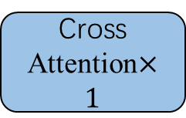
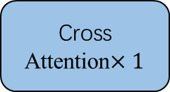

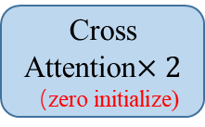
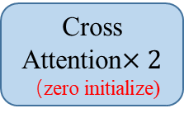


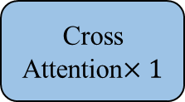
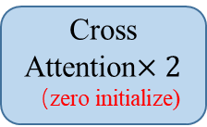
Reference Set
pos1
pos1
pos1
(B, H, W, 1024)
(B, H, W, 1024)
(B, H, W, 1024)
Reference
feature (scale1)
pos2
Reference
feature (scale2)
pos2
Reference
feature (scale3)
pos2
k
k
k
……
……
posN
posN
posN
k
v
v
k
v
v
k
v
v
Reference
image
Q
$Q^{′}$
Q
$Q^{′}$
Q
$Q^{′}$
Cross Attention$×2$
（zero initialize)
Cross Attention$×1$
Cross Attention$×2$
（zero initialize)
Cross Attention$×1$
Cross Attention$×2$
（zero initialize)
Cross Attention$×1$
DINOv2
Query
image
Conv[BN[Concat[Prediction average, Multi-scale feature]]]

Slide 2
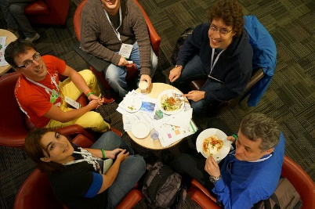
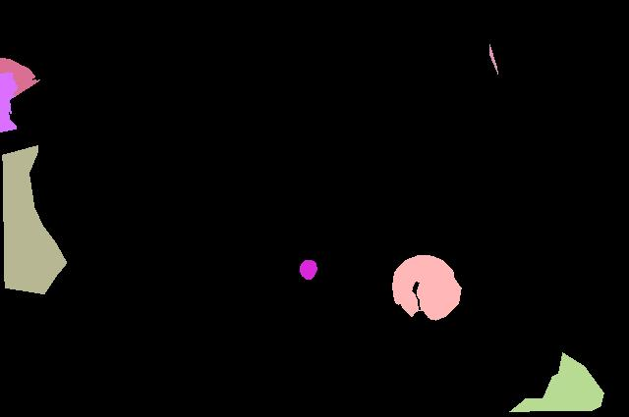
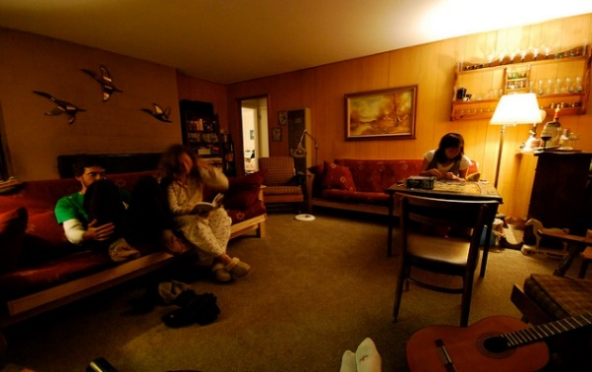
解决方案
Reference set
Segmentation prediction
prompt1
Dice loss + BCE loss
prompt2
Dice loss + BCE loss
……
……
promptN
Dice loss + BCE loss
……
Query image

Slide 3
 | dataset_name | class
CT (10) | AbdomenCT-1K | Abdominal organ segmentation (overlap with KiTS, MSD)
 | AMOS | Abdominal organ segmentation
 | BTCV | Abdominal Organs
 | CHAOS | Abdominal organs (liver, kidneys, spleen)
 | KiTs | Kidney and kidney tumor
 | LiTs | Liver Tumor
 | LUNA | Lungs
 | MSD | Large-scale collection of 10 Medical Segmentation Datasets
 | SegTHOR | Thoracic organs (heart, trachea, esophagus)
 | WORD | Organ segmentation

Slide 4
Microscopy/Ultrasound/CMR/Optical camera/X-Ray (9) | BBC003 | Mouse embryos
 | BUS | Breast tumor
 | CAMUS | Four-chamber and Apical two-chamber heart
 | CdeMris | Human Left Atrial Wall
 | DRIVE | Blood vessels in retinal images
 | IDRID | Diabetic Retinopathy
 | PanDental | Mandible and Teeth
 | STARE | Blood vessels in retinal images
 | WBC | White blood cell and nucleus

Slide 5
 | dataset_name | class_name
MRI（7） | ACDC | Left and right ventricular endocardium
 | AMOS | Abdominal organ segmentation
 | BRATS | Brain tumors
 | CHAOS | Abdominal organs (liver, kidneys, spleen)
 | MSD | Large-scale collection of 10 Medical Segmentation Datasets
 | PROMISE12 | Prostate
 | SPineWeb | Vertebrae

Slide 6
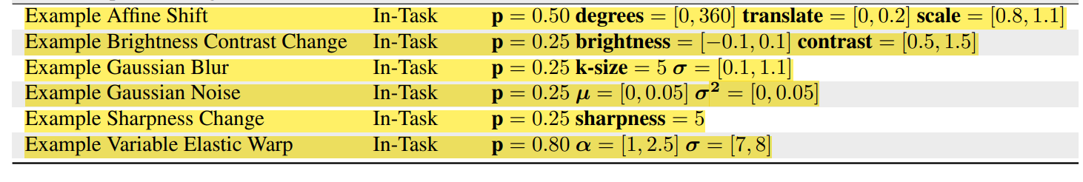
Data Augmentation
Training Strategy
按照数据集的方式采样，每次随机选取一个数据集，再从数据集中抽取一张图像训练。

Slide 7

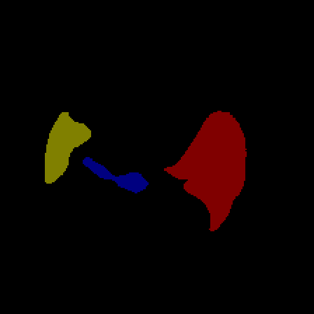
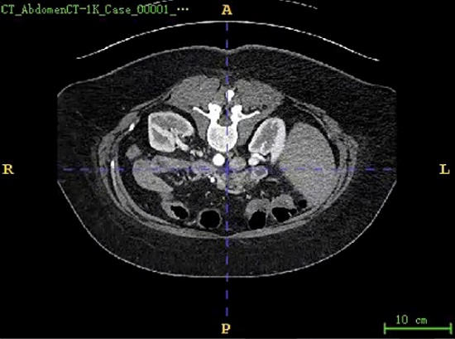
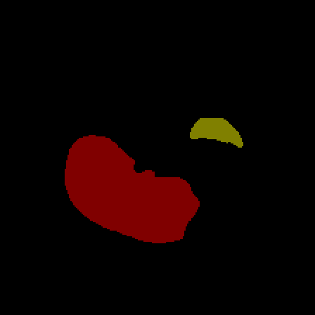


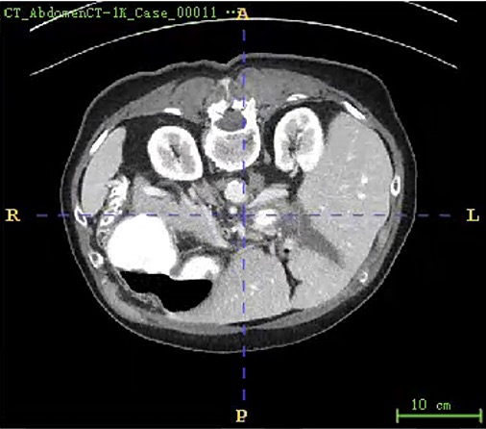
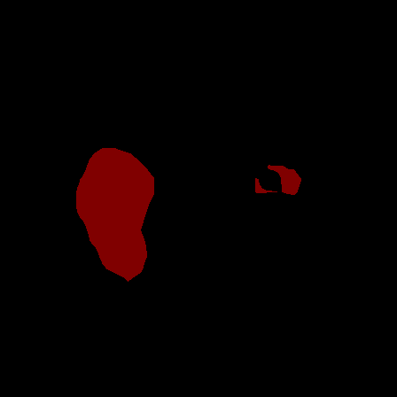
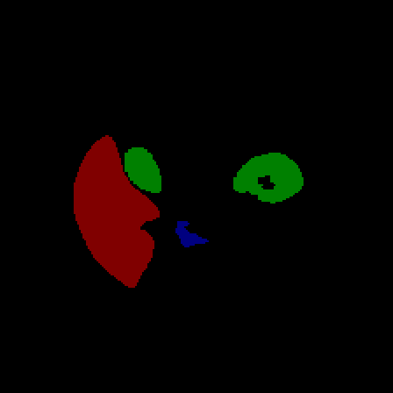
腹部多器官分割数据集-CT_AbdomenCT-1K-(5分类）
prediction-1
mask-1
prompt - Mask
prediction-2
mask-2
prediction-3
mask-3

Slide 8


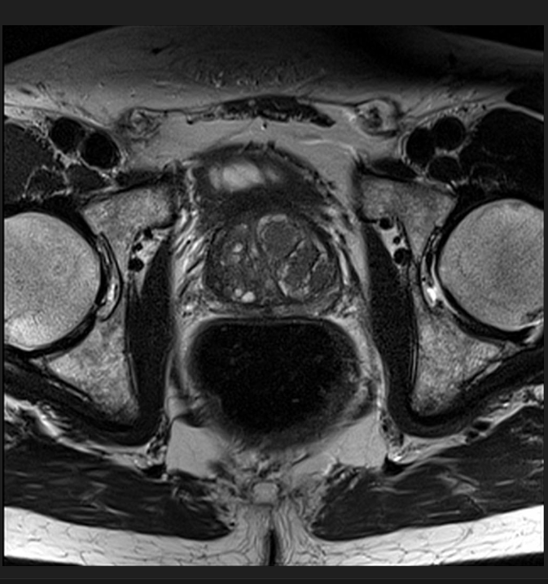

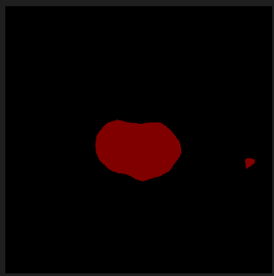

前列腺分割数据集-Task05_Prostate-（2分类）
prediction-1
mask-1
prompt - Mask
prediction-2
mask-2

Slide 9
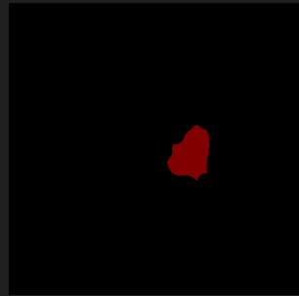


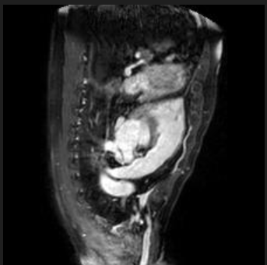


左心房分割数据集-MSDHEART-（2分类）
prediction-1
mask-1
prompt - Mask
prediction-2
mask-2

Slide 10



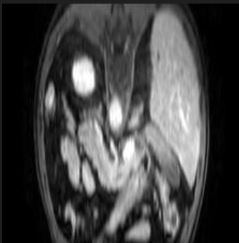

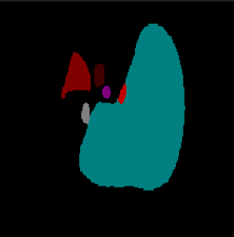
腹部多器官分割数据集- AMOS-（16分类）
prediction-1
mask-1
prompt - Mask
prediction-2
mask-2

Slide 11

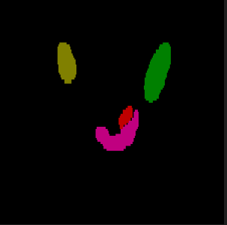
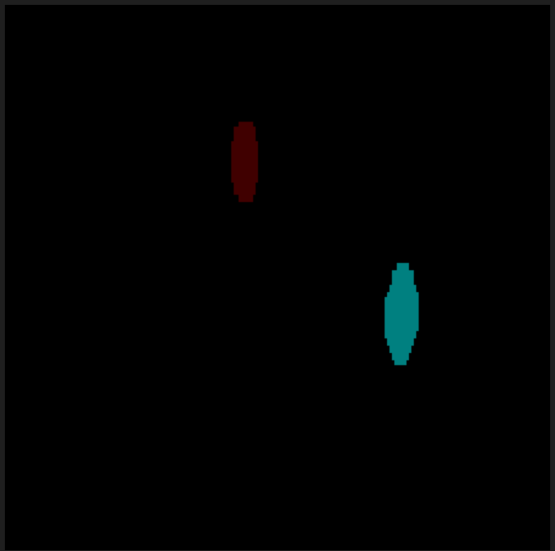


prediction-1
mask-1
prompt - Mask
prediction-2
mask-2

Slide 12


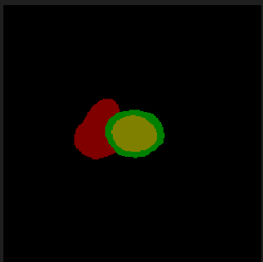
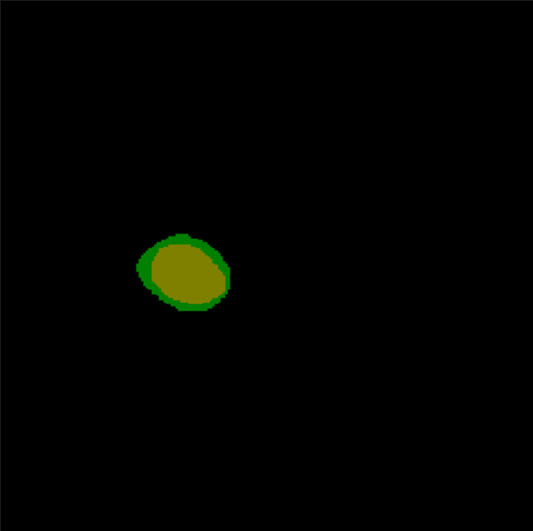
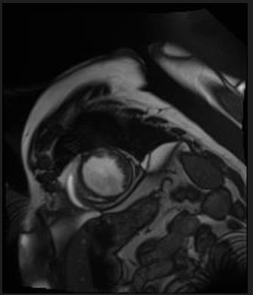


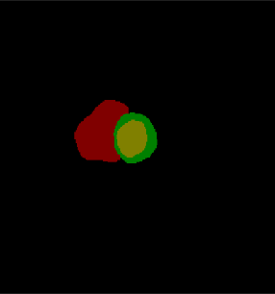
心脏分割数据集-ACDC-（4分类）
Channel-2
Channel-3
GT
prompt - Mask
Channel-2
Channel-3
GT

Slide 13
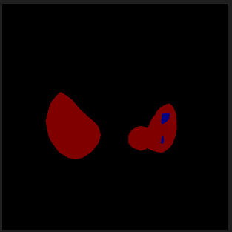
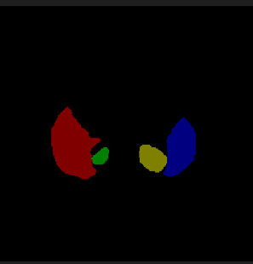

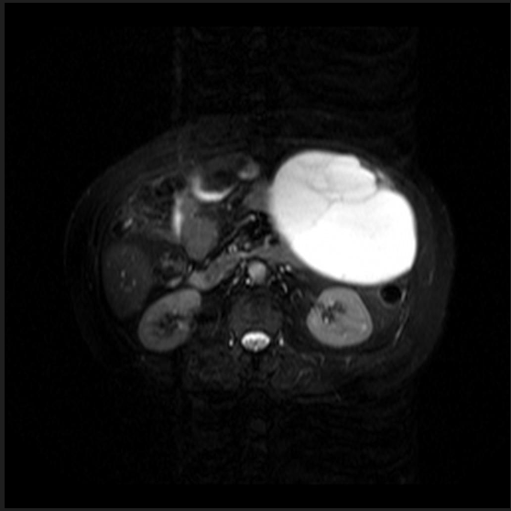
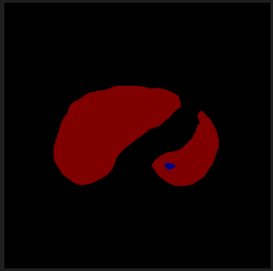

腹部多器官分割数据集- CHAOS-（5分类）
prediction-1
mask-1
prompt - Mask
prediction-2
mask-2

Slide 14
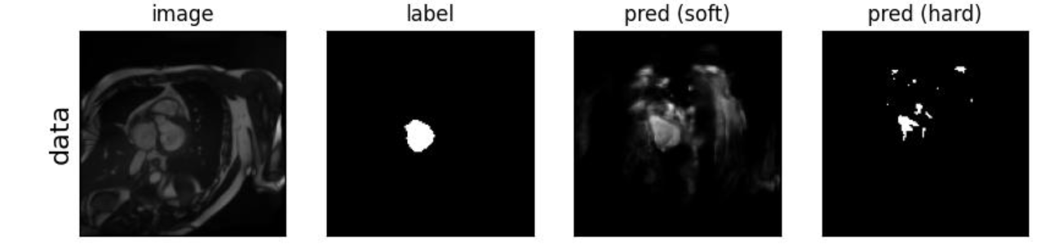
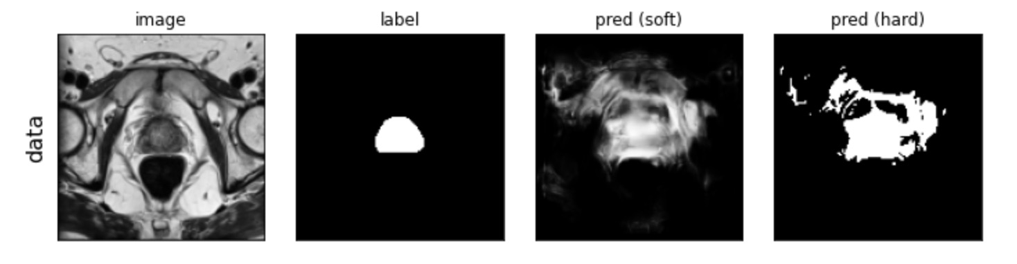
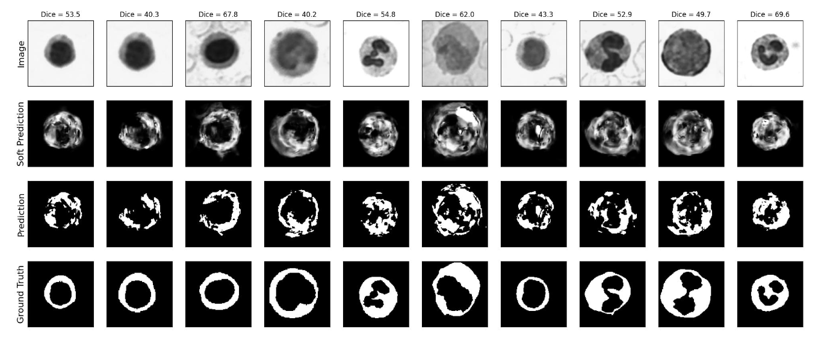
Universeg with Support Size=1
ACDC dataset
Prostate dataset
WBC dataset

Slide 15
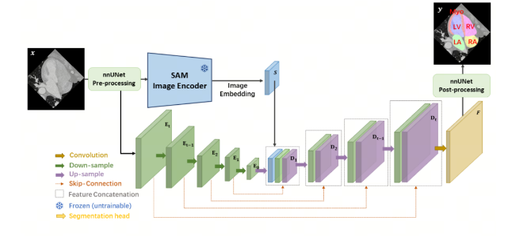

Slide 16
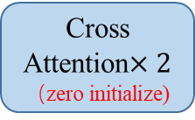
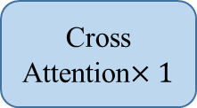
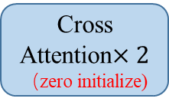



Query
image
Query path
Support path
Support
image
Prompt pool
DINOV2
（B,256,128,128）
p1
p3
Stage1
Cross Attention$×2$
（zero initialize)
Cross Attention$×1$
（B,10,128,128）
Upsample+Conv
…
p2
pn
（B,512,64,64）
p1
p3
Cross Attention$×2$
（zero initialize)
Cross Attention$×1$
（B,10,64,64）
Stage2
Upsample+Conv
p2
pn
（B,1024,32,32）
Cross Attention$×2$
（zero initialize)
p1
p3
（B,10,32,32）
Stage3
Cross Attention$×1$
p2
pn
（B,10,448,448）

Slide 17
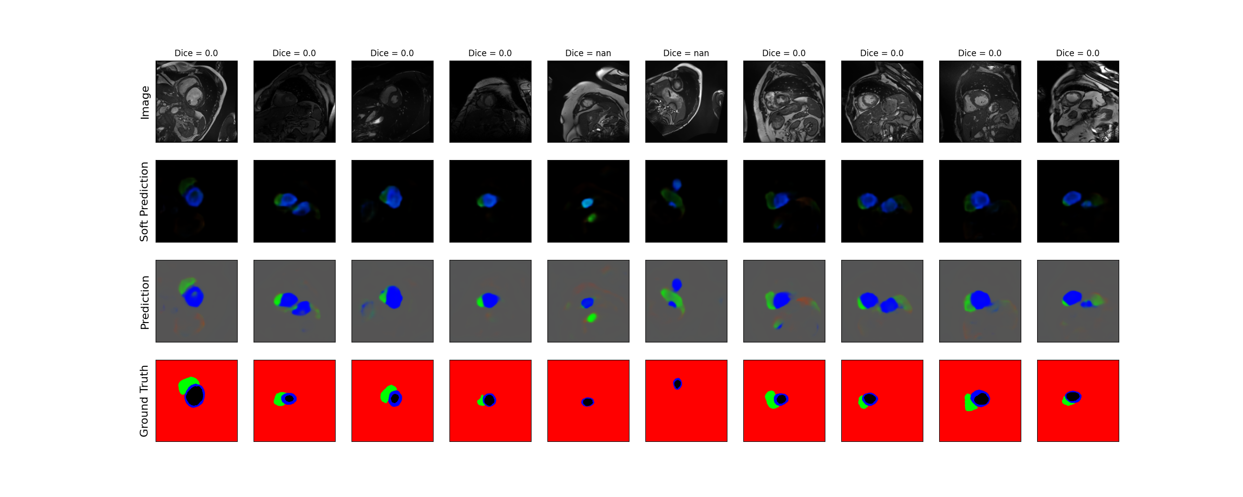
多尺度训练 (448 * 448, 896 * 896, 224 * 224)

Slide 18
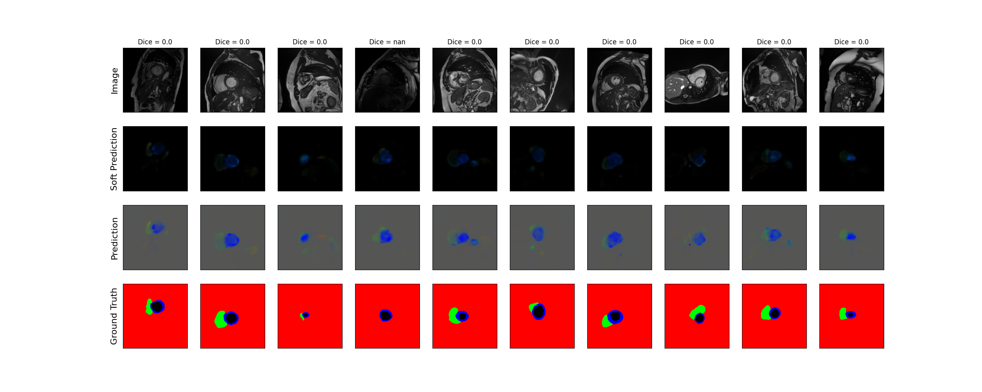

Slide 19

以WBC数据集作为保存模型的判断标准，在WBC数据集上表现好的时候保存
增加训练的迭代次数
增加monuseg数据集，

Slide 20


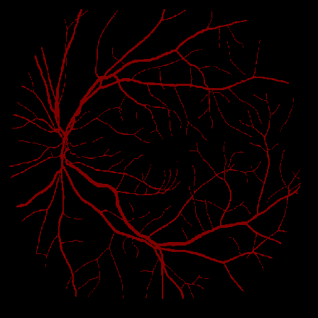
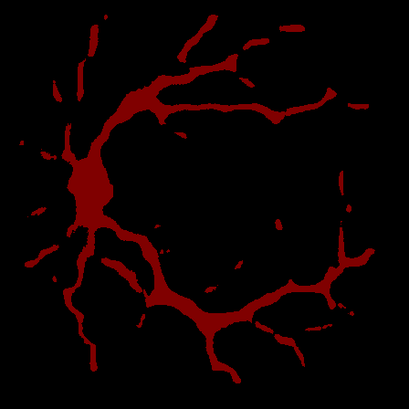


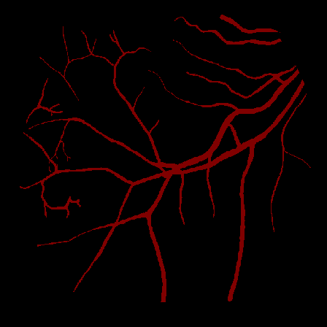
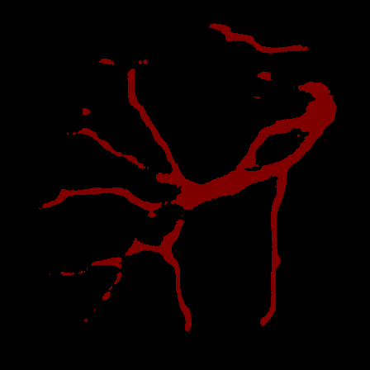
Ground Truth
Prediction
Ground Truth
Prediction

Slide 21


Ground Truth
Prediction

Slide 22
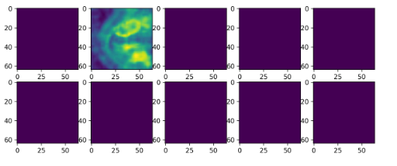
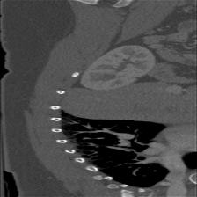
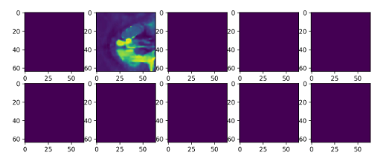
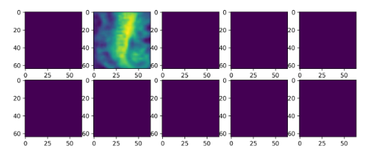
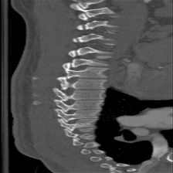







Slide 23




