Slide 1
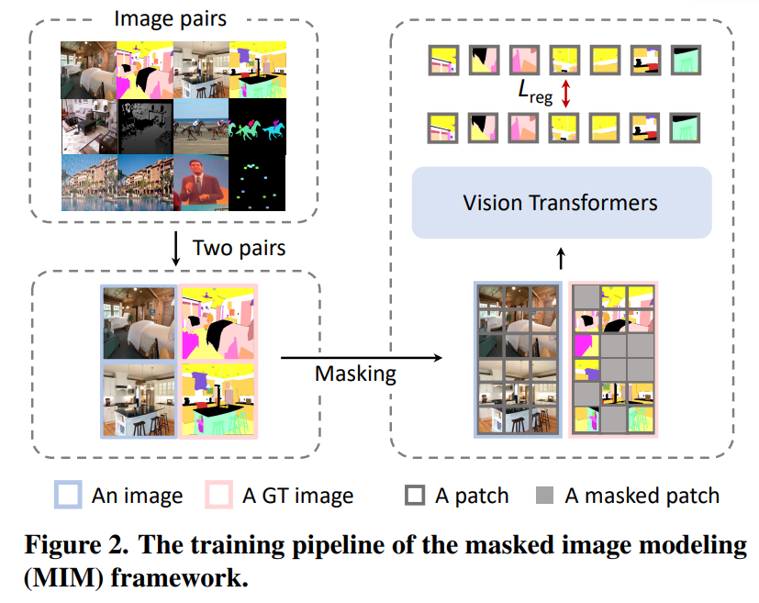
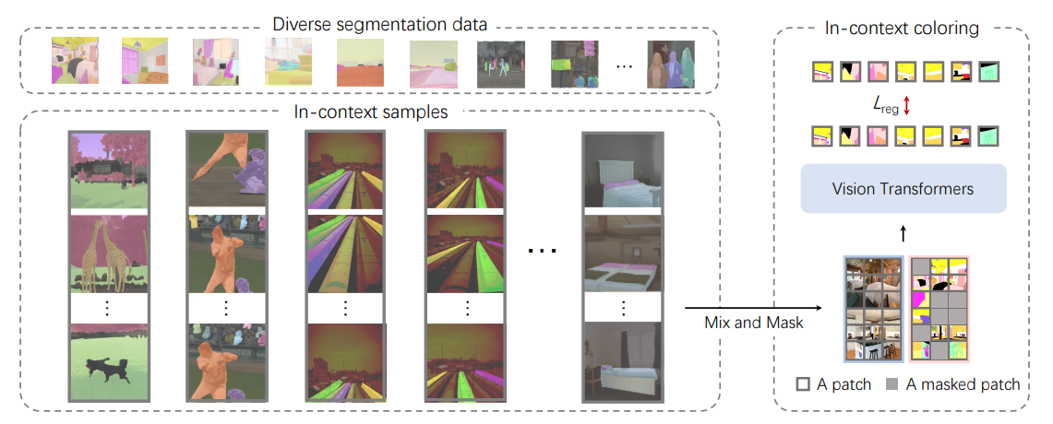
目标
多类别跨样本的提示分割
Painter/SegGPT
Painter: 把mask按照对应的类别映射到了一个三维的色彩空间，并且对应关系不变/ MAE网络结构+L1/L2 loss
SegGPT: 训练时把颜色和类别的关系随机打乱 / MAE网络结构+L1/L2 loss
Fig.1. Painter
Fig.2. SegGPT

Slide 2
解决方案
Reference Set
pos1
pos1
pos1
(B, H, W, 1024)
(B, H, W, 1024)
(B, H, W, 1024)
Reference
feature (scale1)
pos2
Reference
feature (scale2)
pos2
Reference
feature (scale3)
pos2
……
……
……
Neg
Neg
Neg
k
v
k
v
k
v
Reference image
Q
Q
Q
DINOv2
Cross Attention
Cross Attention
Cross Attention
Query image
Fusion Module (Conv blocks)

Slide 3
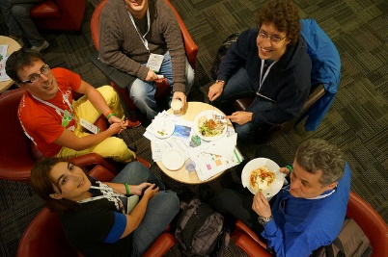
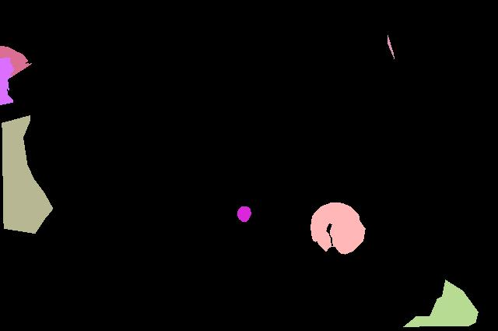
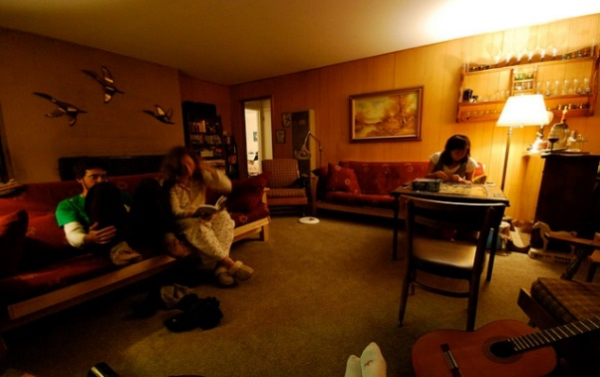
解决方案
Reference set
Segmentation prediction
prompt1
Dice loss + BCE loss
prompt2
Dice loss + BCE loss
……
……
promptN
Dice loss + BCE loss
……
Complementary set
neg_pred
Cross Entropy loss
Query image

Slide 4













Positive prompts
Targets

Slide 5










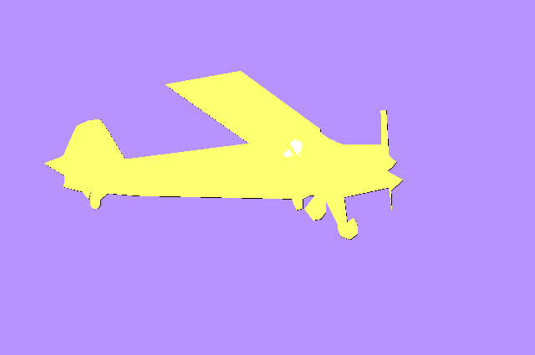


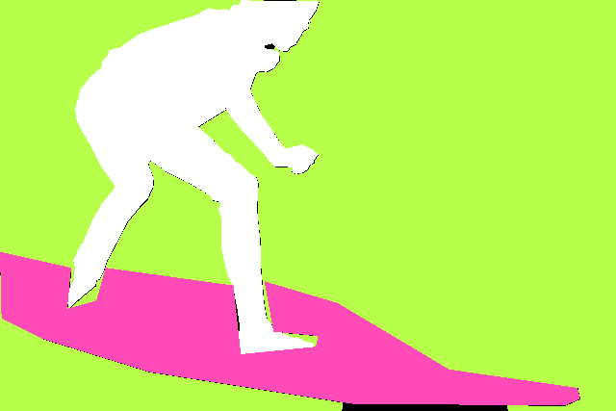
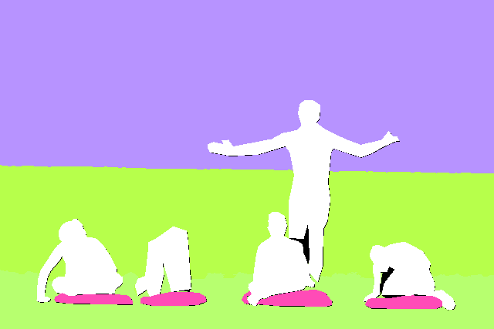



Prompt image
Query image
Predictions in different channels

Slide 6


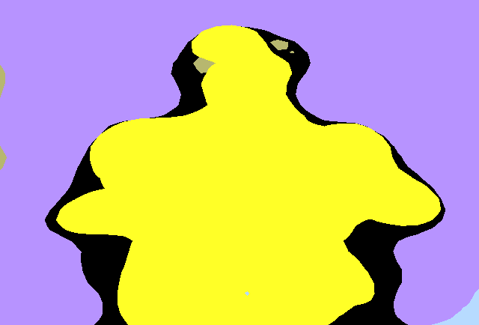
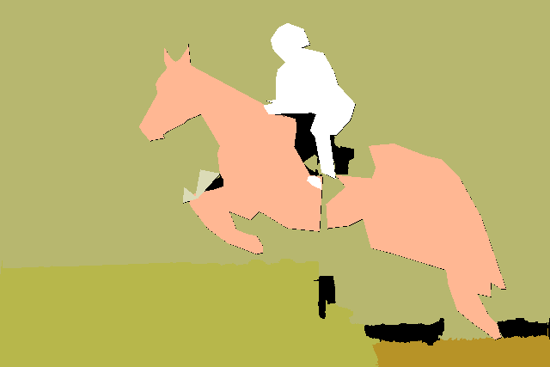

Query图分割mask
提示图分割mask

Slide 7





Prompt
Channel 1
Channel 2
Channel 3
Query

Slide 8



Prompt
Channel 1
Channel 2
Channel 3
Query

Slide 9


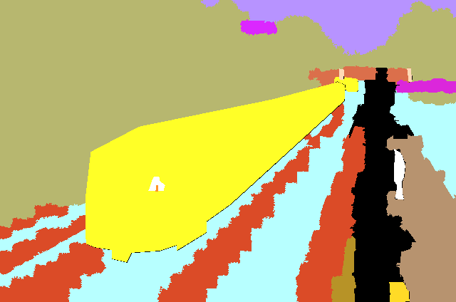


Prompt
Channel 1
Channel 2
Channel 3
Query

Slide 10
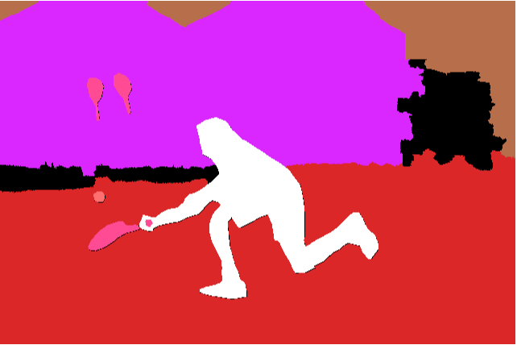




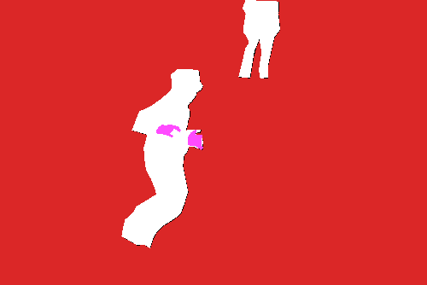
Prompt
channel 1
channel 2
channel 3
channel 6
Query

Slide 11



Query
Prompt

Slide 12





Query
Prompt

Slide 13
cls1
Sim=0.1
cls1
0.1
cls1
0.1
第一个通道大于0.5，被判断为第一个类别
query
cls1
0.1
Query图像中某个点
cls1
0.1
cls1
0.1
……………
cls2
0.1
reference图像中的点

Slide 14
Q

Slide 15

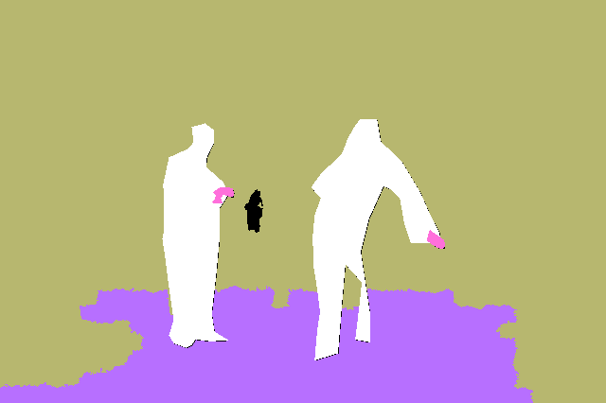
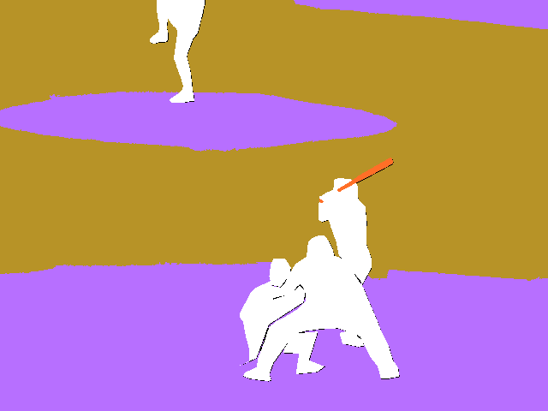

query图像mask
提示图像mask

Slide 17
模型学到的1. 输入的mask是起作用的
2. 会不会只学到了把输出结果分层的能力

Slide 18



Slide 19




Slide 20







Slide 21





Slide 22
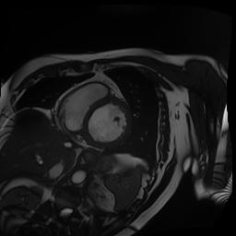
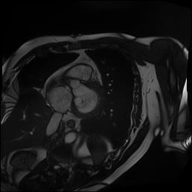
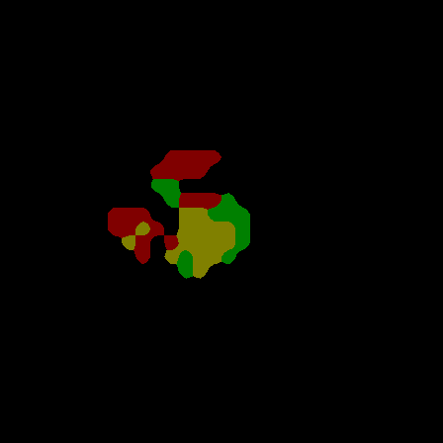
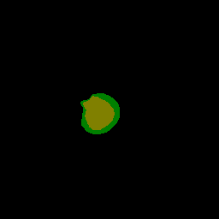
reference
query

Slide 23


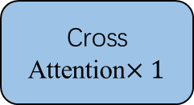
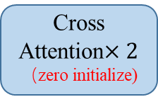
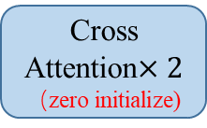
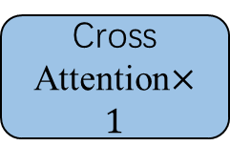

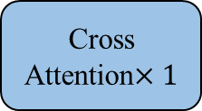
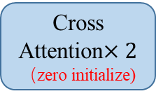
解决方案
Reference Set
pos1
pos1
pos1
(B, H, W, 1024)
(B, H, W, 1024)
(B, H, W, 1024)
Reference
feature (scale1)
pos2
Reference
feature (scale2)
pos2
Reference
feature (scale3)
pos2
k
k
k
……
……
……
posN
posN
posN
k
v
v
k
v
v
k
v
v
Reference
image
Q
$Q^{′}$
Q
$Q^{′}$
Q
$Q^{′}$
Cross Attention$×2$
（zero initialize)
Cross Attention$×1$
Cross Attention$×2$
（zero initialize)
Cross Attention$×1$
Cross Attention$×2$
（zero initialize)
Cross Attention$×1$
DINOv2
Query
image
Conv[BN[Concat[Prediction average, Multi-scale feature]]]

Slide 24
Scale1: (b, cls, h, w)
Scale2: (b, cls, h, w)
Scale3: (b, cls, h, w)
Cls_embeddings
mask_embeddings
Compute similarity
attention_masks

