Slide 1
Objective
Multi-class cross-sample prompt segmentation
Query Image
Interact
Query Prediction
Prompt Image
Prompt Mask

Slide 2


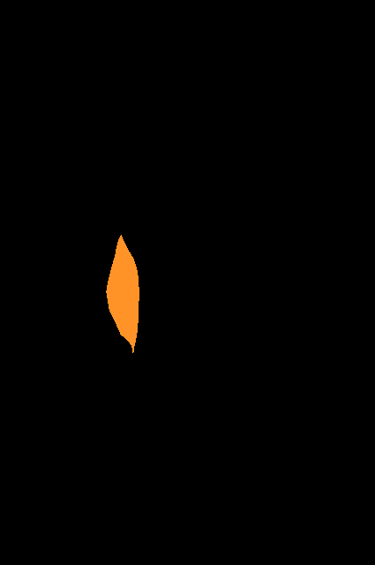


Prompt
Channel 1
Channel 2
Channel 3
Query

Slide 3


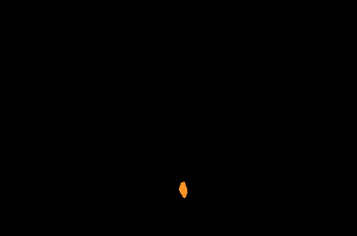


Prompt
Channel 1
Channel 2
Channel 3
Query

Slide 4
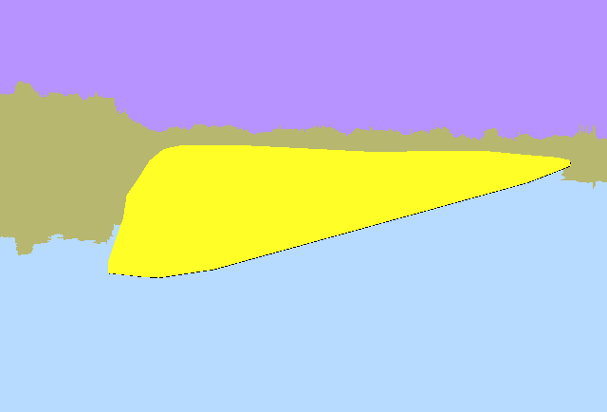


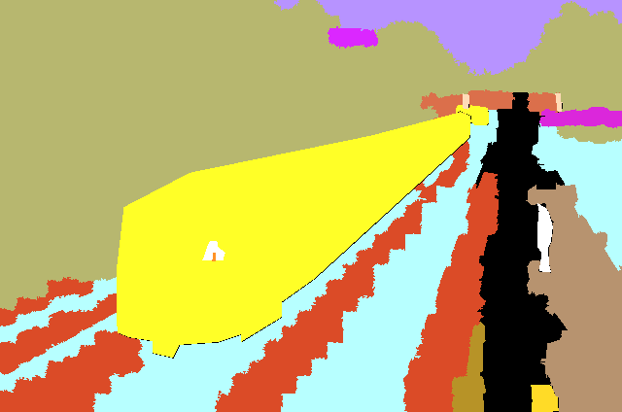
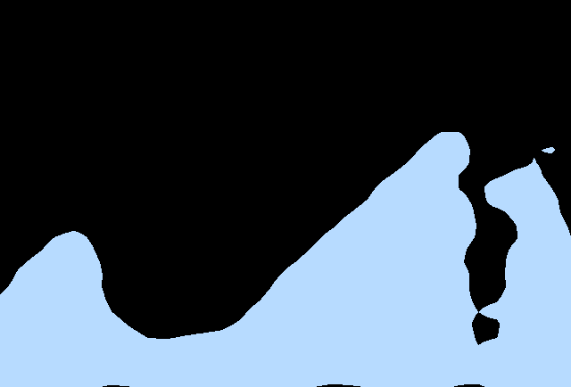
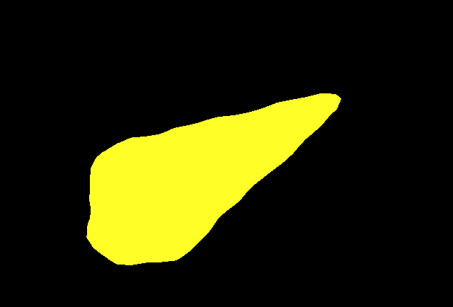
Prompt
Channel 1
Channel 2
Channel 3
Query

Slide 5
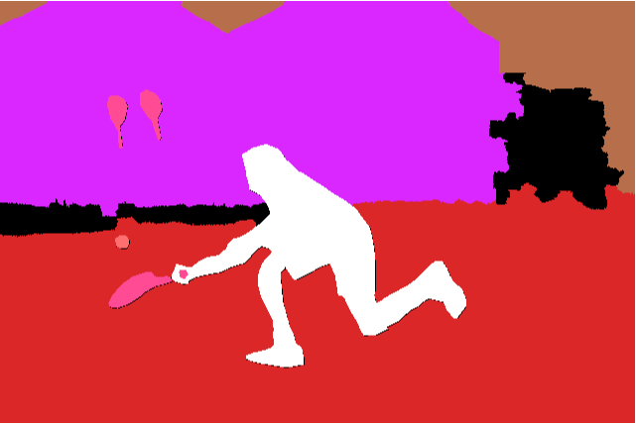


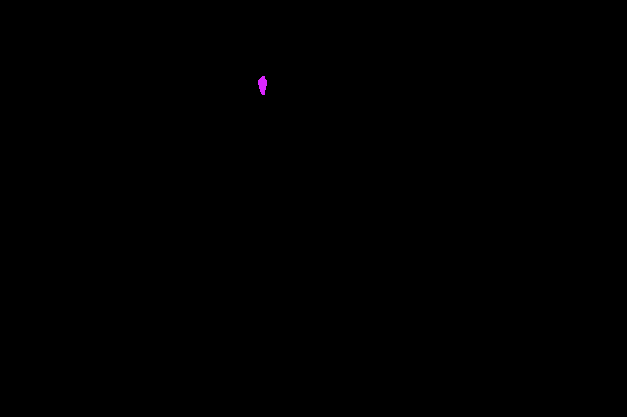

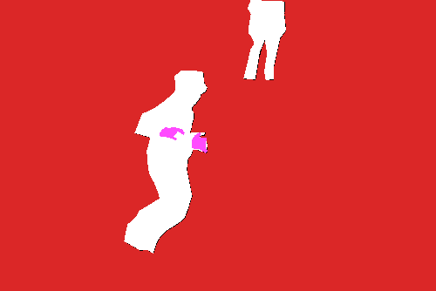
Prompt
channel 1
channel 2
channel 3
channel 6
Query

Slide 6


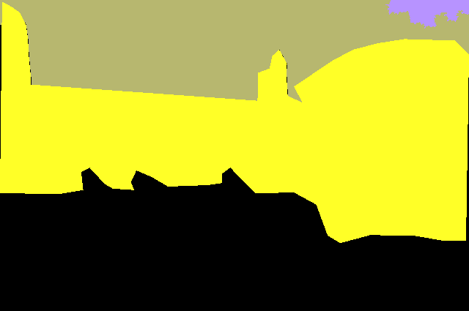

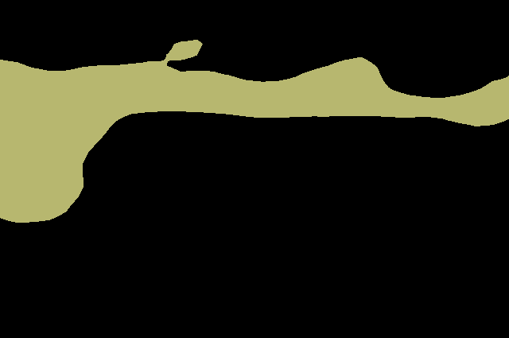
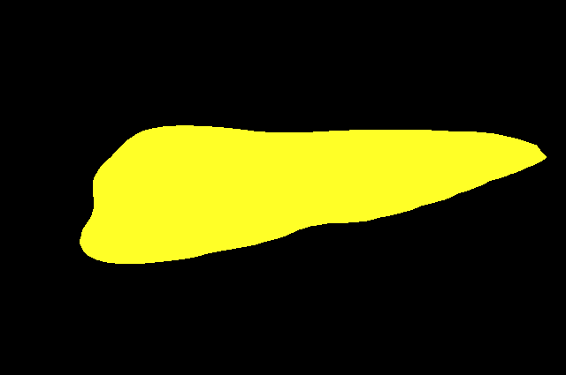
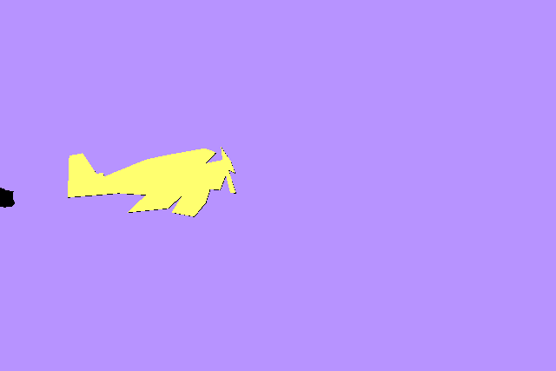
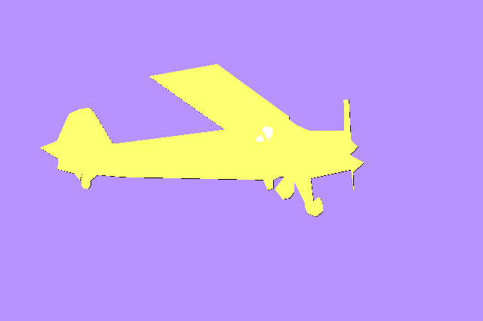
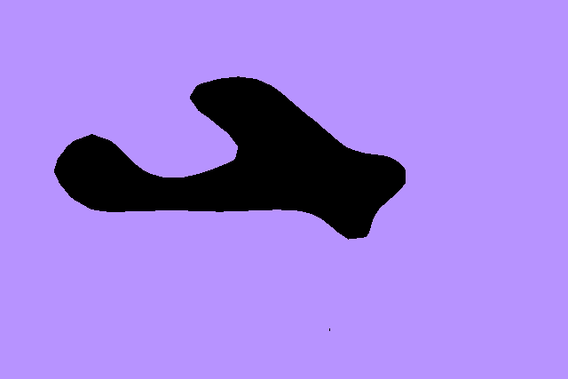
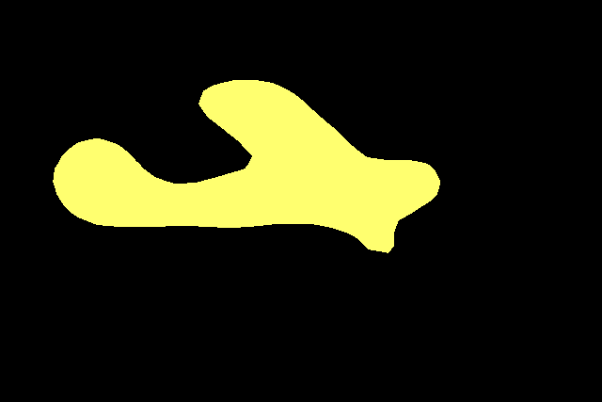
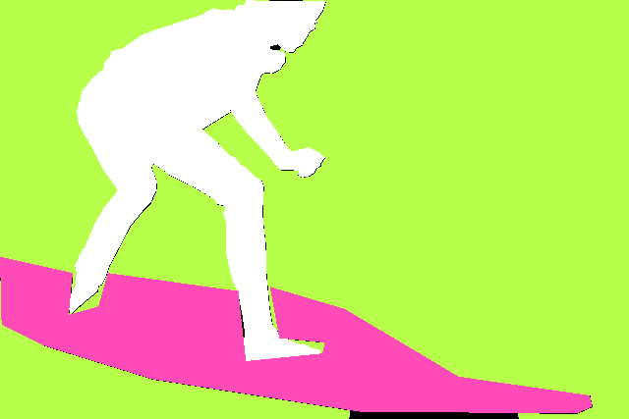
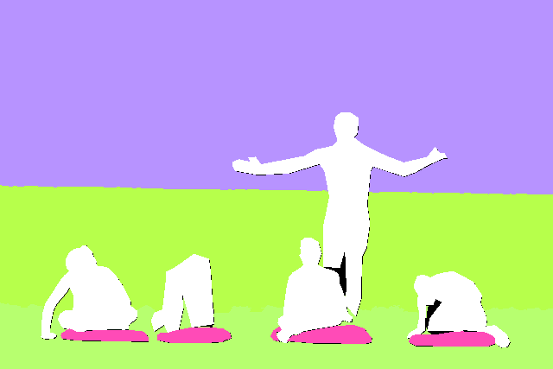

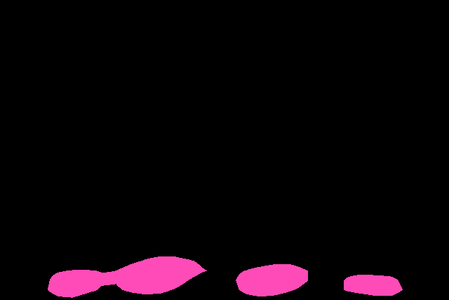

Prompt image
Query image
Predictions in different channels

Slide 7
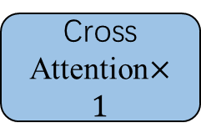
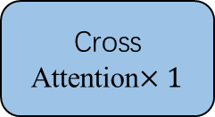

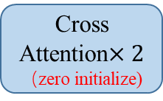
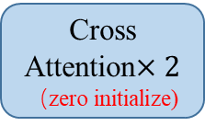


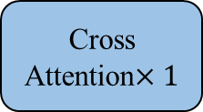
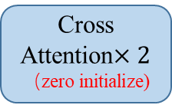
Reference Set
pos1
pos1
pos1
(B, H, W, 1024)
(B, H, W, 1024)
(B, H, W, 1024)
Reference
feature (scale1)
pos2
Reference
feature (scale2)
pos2
Reference
feature (scale3)
pos2
k
k
k
……
……
posN
posN
posN
k
v
v
k
v
v
k
v
v
Reference
image
Q
$Q^{′}$
Q
$Q^{′}$
Q
$Q^{′}$
Cross Attention$×2$
（zero initialize)
Cross Attention$×1$
Cross Attention$×2$
（zero initialize)
Cross Attention$×1$
Cross Attention$×2$
（zero initialize)
Cross Attention$×1$
DINOv2
Query
image
Conv[BN[Concat[Prediction average, Multi-scale feature]]]

Slide 8
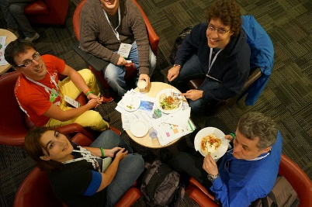
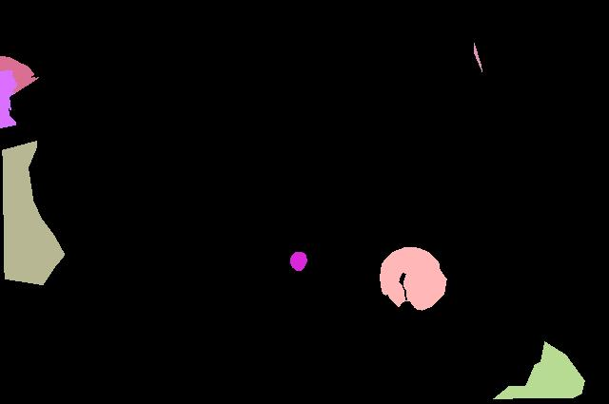
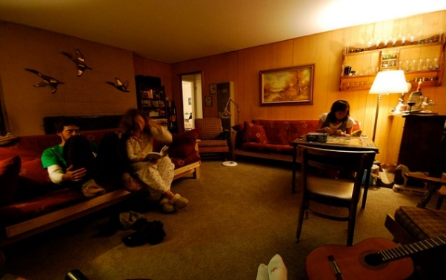
Reference set
Segmentation prediction
prompt1
Dice loss + BCE loss
prompt2
Dice loss + BCE loss
……
……
promptN
Dice loss + BCE loss
……
Query image

Slide 9
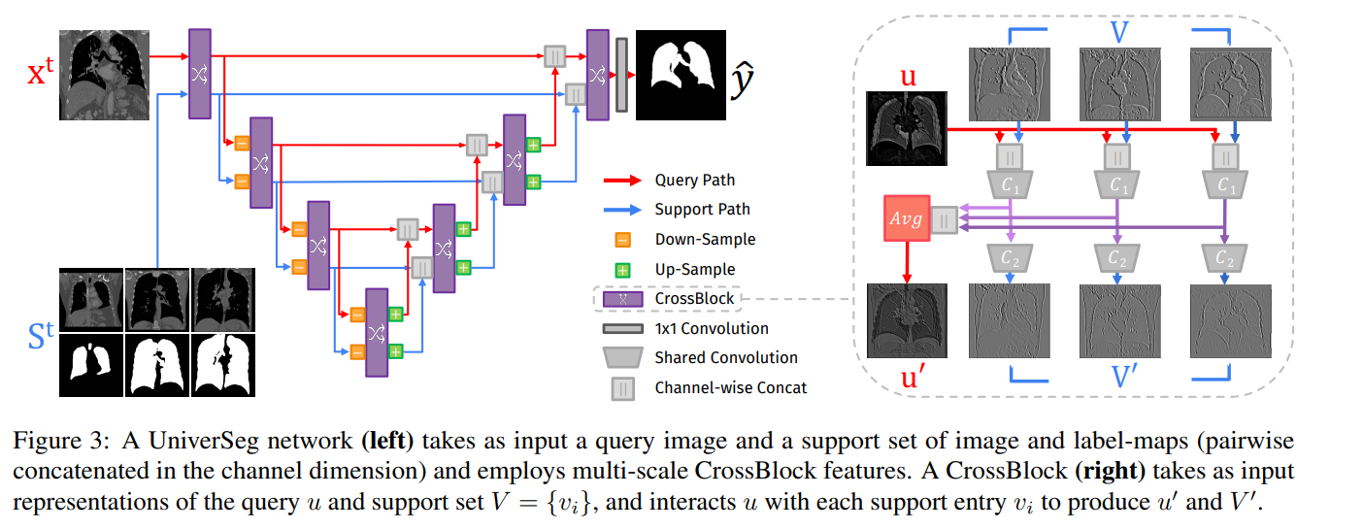
Motivation– UniverSeg: Universal Medical Image Segmentation

Slide 10
 | dataset_name | class
CT (10) | AbdomenCT-1K | Abdominal organ segmentation (overlap with KiTS, MSD)
 | AMOS | Abdominal organ segmentation
 | BTCV | Abdominal Organs
 | CHAOS | Abdominal organs (liver, kidneys, spleen)
 | KiTs | Kidney and kidney tumor
 | LiTs | Liver Tumor
 | LUNA | Lungs
 | MSD | Large-scale collection of 10 Medical Segmentation Datasets
 | SegTHOR | Thoracic organs (heart, trachea, esophagus)
 | WORD | Organ segmentation

Slide 11
 | dataset_name | class_name
Microscopy/Ultrasound/CMR/Optical camera/X-Ray (9) | BBC003 | Mouse embryos
 | BUS | Breast tumor
 | CAMUS | Four-chamber and Apical two-chamber heart
 | CdeMris | Human Left Atrial Wall
 | DRIVE | Blood vessels in retinal images
 | IDRID | Diabetic Retinopathy
 | PanDental | Mandible and Teeth
 | STARE | Blood vessels in retinal images
 | WBC | White blood cell and nucleus

Slide 12
 | dataset_name | class_name
MRI（7） | ACDC | Left and right ventricular endocardium
 | AMOS | Abdominal organ segmentation
 | BRATS | Brain tumors
 | CHAOS | Abdominal organs (liver, kidneys, spleen)
 | MSD | Large-scale collection of 10 Medical Segmentation Datasets
 | PROMISE12 | Prostate
 | SPineWeb | Vertebrae

Slide 13
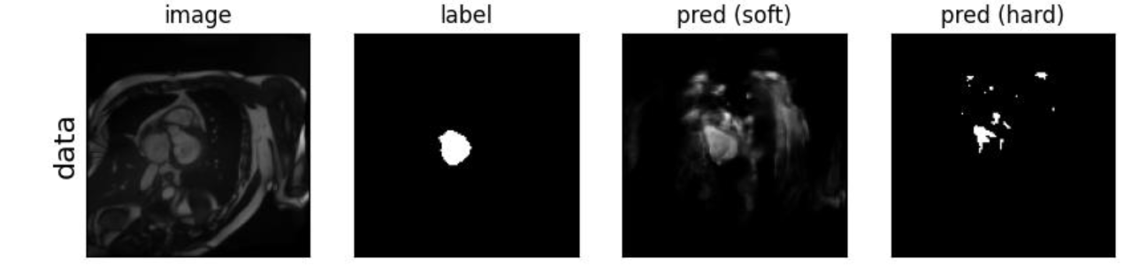
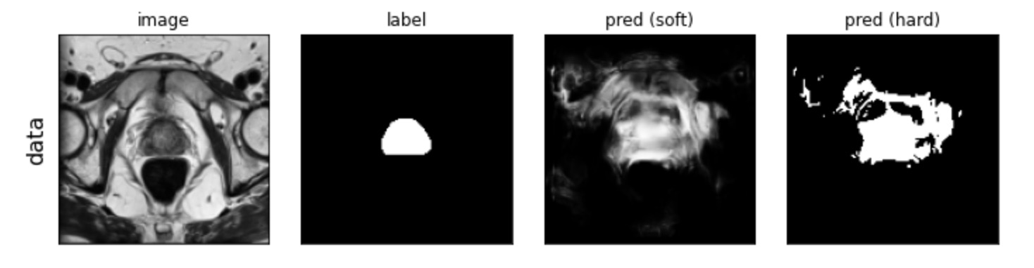
Training Process
Inference Process
Support set size = 16
Support set size should be larger than 1.
For multi-targets segmentation tasks, only one category is supported per inference.
ACDC dataset
Prostate dataset

Slide 14
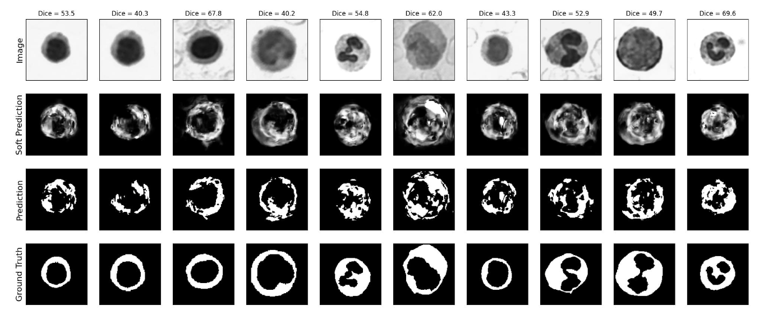
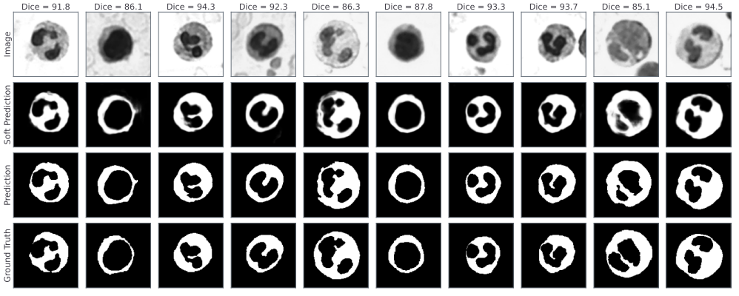
WBC dataset
With support_size=1
WBC dataset
With support_size=8

Slide 15
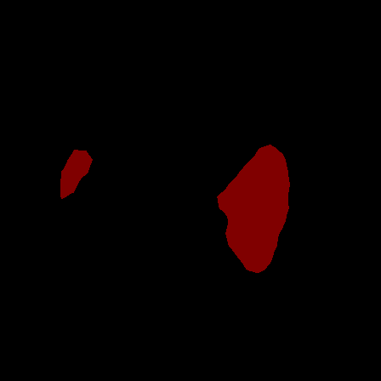
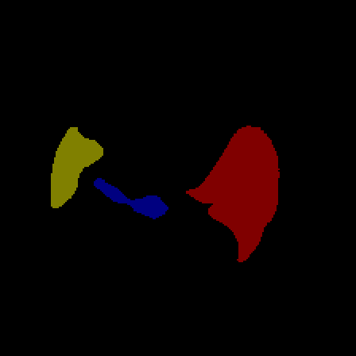
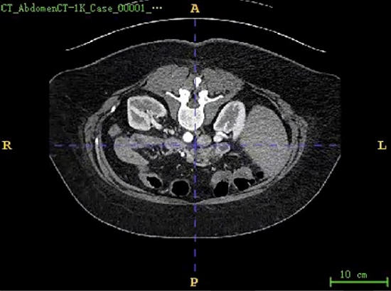
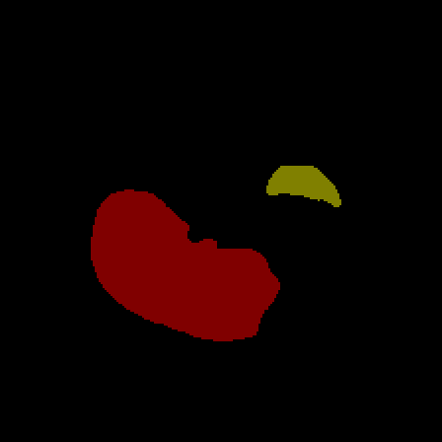
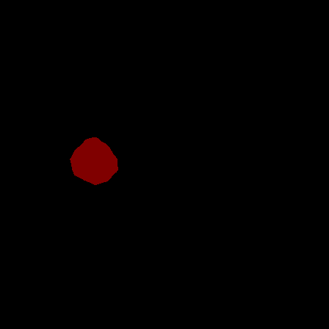
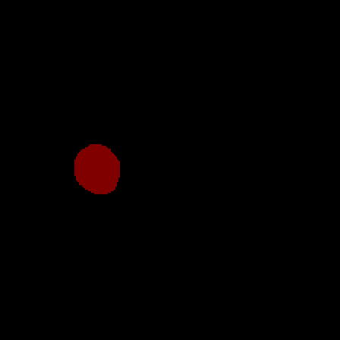
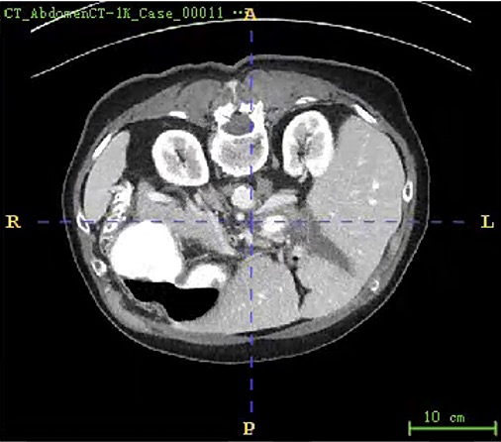
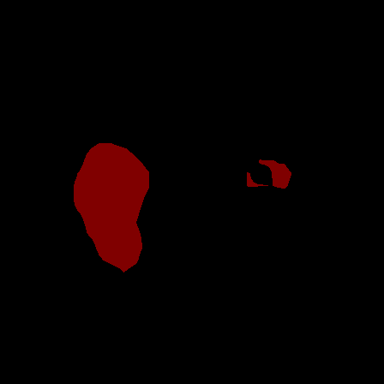
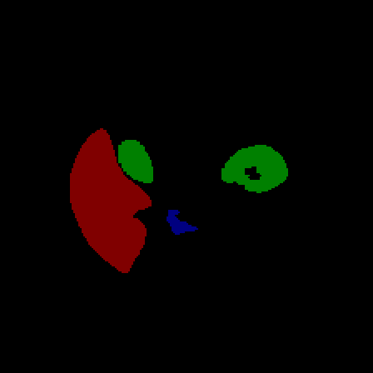
腹部多器官分割数据集-CT_AbdomenCT-1K-(5分类）
prediction-1
mask-1
prompt - Mask
prediction-2
mask-2
prediction-3
mask-3

Slide 16
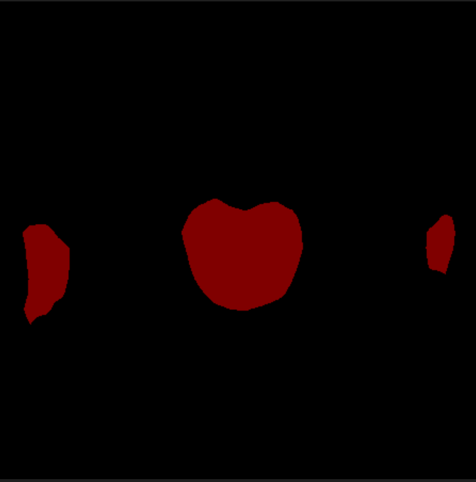

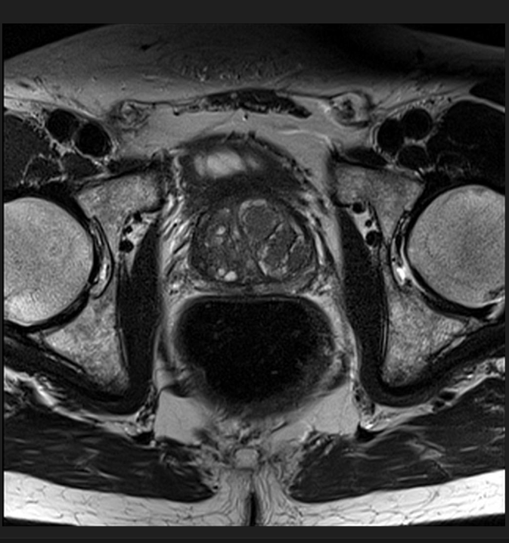
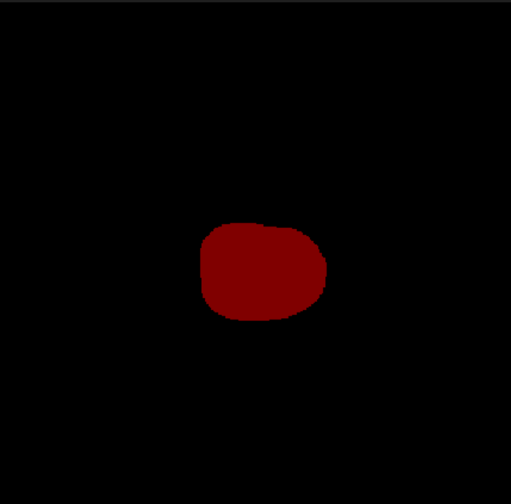
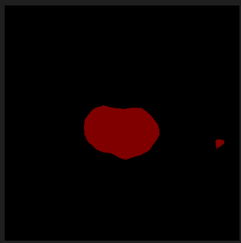
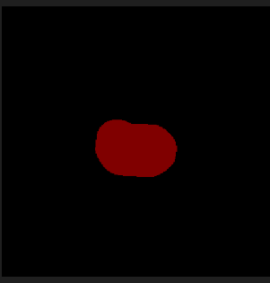
前列腺分割数据集-Task05_Prostate-（2分类）
prediction-1
mask-1
prompt - Mask
prediction-2
mask-2

Slide 17
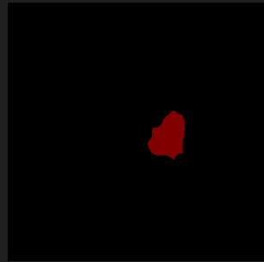
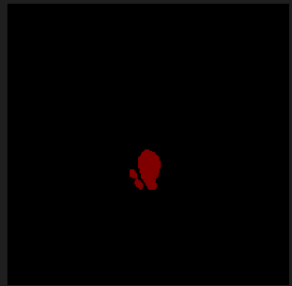
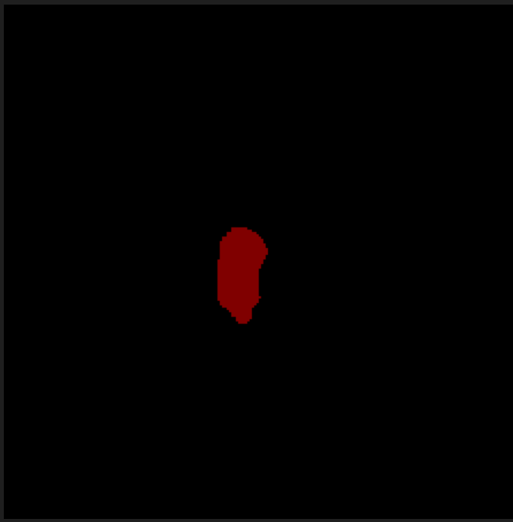



左心房分割数据集-MSDHEART-（2分类）
prediction-1
mask-1
prompt - Mask
prediction-2
mask-2

Slide 18






腹部多器官分割数据集- AMOS-（16分类）
prediction-1
mask-1
prompt - Mask
prediction-2
mask-2

Slide 19





prediction-1
mask-1
prompt - Mask
prediction-2
mask-2

Slide 20








心脏分割数据集-ACDC-（4分类）
Channel-2
Channel-3
GT
prompt - Mask
Channel-2
Channel-3
GT

Slide 21






腹部多器官分割数据集- CHAOS-（5分类）
prediction-1
mask-1
prompt - Mask
prediction-2
mask-2

Slide 22






Overall Architecture for Medical Image Segmentation-(Query & Localization Network）
Query path
Support path
Query
image
Support
image
Prompt pool
DINOV2
（B,512,64,64）
p1
p3
Cross Attention$×2$
（zero initialize)
Cross Attention$×1$
…
（B,10,64,64）
Stage1
Upsample+Conv
p2
pn
（B,512,64,64）
p1
p3
Cross Attention$×2$
（zero initialize)
Cross Attention$×1$
（B,10,64,64）
Stage2
Upsample+Conv
p2
pn
（B,1024,32,32）
Cross Attention$×2$
（zero initialize)
Cross Attention$×1$
p1
p3
（B,10,32,32）
Stage3
p2
pn

Slide 23









Overall Architecture for Medical Image Segmentation-(Refiner Network)
（B,10,64,64）
64 $×64$
$$T_{j}^{1}$$
（B,10,64,64）
64 $×64$
$$T_{j}^{2}$$
32 $×32$
（B,10,32,32）
$$T_{j}^{3}$$
$$T_{j}^{cat}$$
$${\tilde{T}}_{j}^{cat}$$
$$\tilde{f}$$
Fusion

Slide 24





Prediction
GT
Prompt - mask
Channel-1
Channel-2

