Slide 1
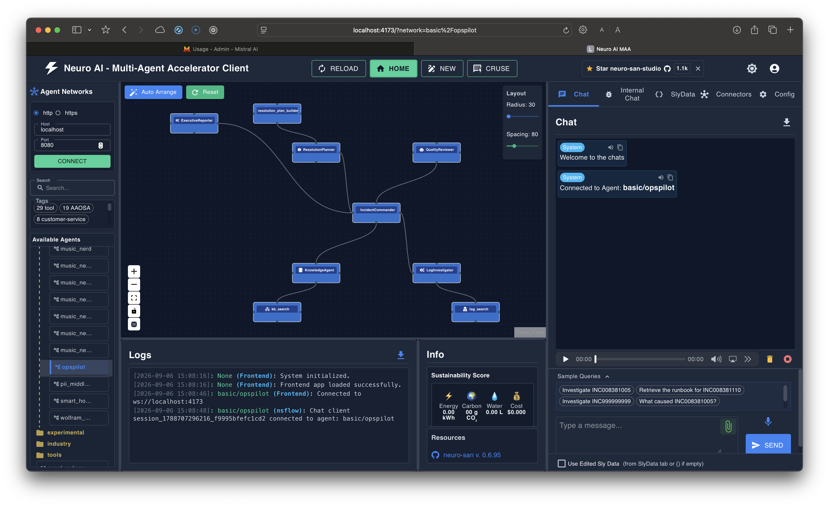
OPSPILOT
AI Incident War Room
Grounded multi-agent investigation for faster, safer operational response
A Neuro SAN Studio project
Synthetic incidents, local logs, runbooks, and an evidence-bounded response path
Arunkumar Muthukumarasamy | 417163
OpsPilot network view
OpsPilot | Neuro SAN Studio
AI Incident War Room

Slide 2
01 | PROBLEM STATEMENT
01
Incident response is a correlation problem
Critical context is spread across logs, runbooks, and human memory.
SEARCH
CORRELATE
DECIDE
Find the right log lines across noisy operational files and timelines.
Connect symptoms to the right documented runbook and failure pattern.
Know whether the available evidence is sufficient to recommend next steps.
The cost of a weak handoff
Design goal
•
Triage slows down when evidence is gathered manually.
Make the investigation explainable, reviewable, and fail-closed when evidence is missing.
•
Runbook guidance can be missed or applied out of context.
•
Unsupported certainty is dangerous during an active incident.
OpsPilot | Neuro SAN Studio
AI Incident War Room

Slide 3
02 | OPSPILOT SOLUTION
02
A digital war room with a clear evidence boundary
Specialists do one job each; the commander turns their outputs into an operational narrative.
Four stages, one accountable response
01
Observe
Incident record + local log evidence
02
Understand
Matching KB and documented cause
03
Prepare
Traceable recovery and validation actions
04
Review
Grounding check + stakeholder summary
The response is not just an answer. It is a chain of evidence, guidance, review, and communication.
Source: local OpsPilot fixtures and registry
AI Incident War Room

Slide 4
03 | ARCHITECTURE
03
From request to evidence-bounded response
Validation is the gate; local coded tools are the evidence boundary.
USER REQUEST
COORDINATION
SPECIALISTS
SOURCES
LogInvestigator
local logs
Incident request
IncidentCommander
KnowledgeAgent
Markdown KB
ResolutionPlanner
reviewed plan
QualityReviewer
summary
ExecutiveReporter
exec summary
Fail-closed rule: validate the incident before downstream investigation begins.
Architecture reflects the active basic/opspilot registry
AI Incident War Room

Slide 5
04 | AGENT NETWORK
04
Six roles, one operating picture
The active registry exposes the full network; each specialist has a bounded responsibility.
IncidentCommander
Coordinates validation, delegation, and the user-facing response.
LogInvestigator
Retrieves source-referenced operational evidence.
KnowledgeAgent
Finds documented runbooks and their key fields.
ResolutionPlanner
Structures recovery and validation actions.
QualityReviewer
Checks completeness and grounding.
ExecutiveReporter
Prepares the stakeholder summary.
Screenshot: active six-agent registry
AI Incident War Room

Slide 6
05 | CODED TOOLS
05
Deterministic tools make the investigation auditable
The model synthesizes; local tools retrieve and structure bounded evidence.
incident_validator
log_search
Gate the workflow
Known incident? Unknown -> stop
Retrieve evidence
Files + line references Bounded matches
kb_search
resolution_plan_builder
Find knowledge
Title + cause + steps Parsed KB fields
Structure guidance
Recovery + validation Trace to KB source
Proof point
Focused OpsPilot tests: 38 passed. Coverage includes retrieval, grounding, registry structure, validation, and KB-traceable plan construction.
Tools are local; complete workflow uses the configured LLM for synthesis
AI Incident War Room

Slide 7
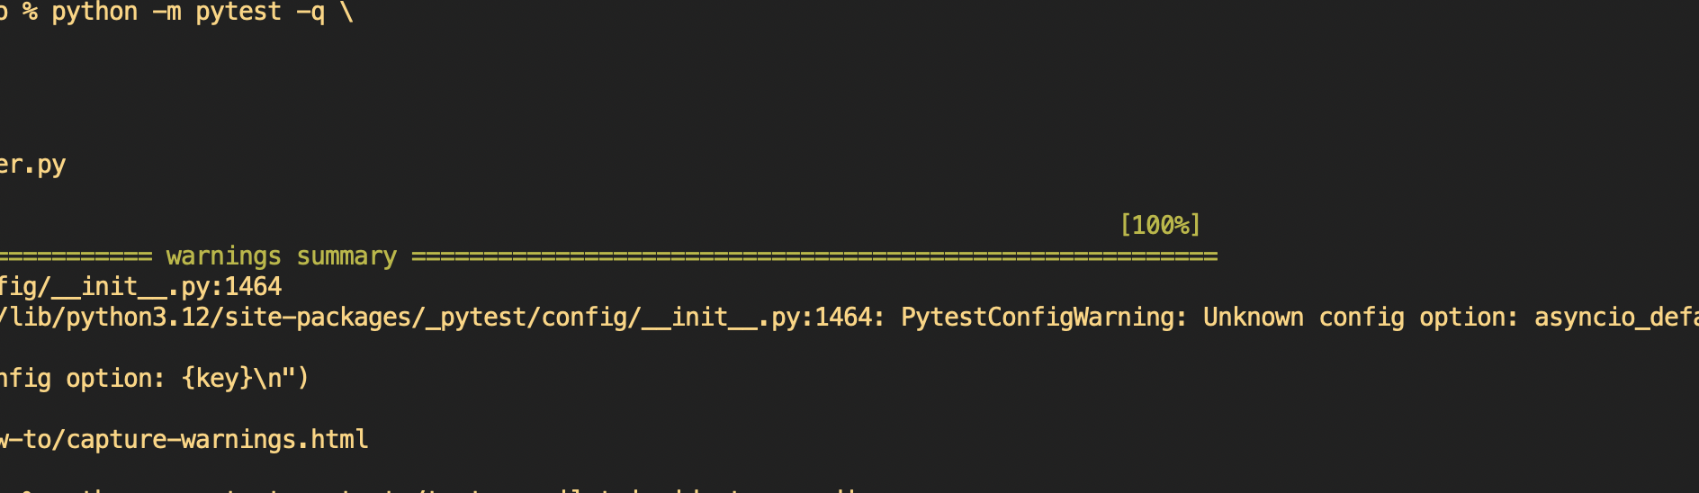
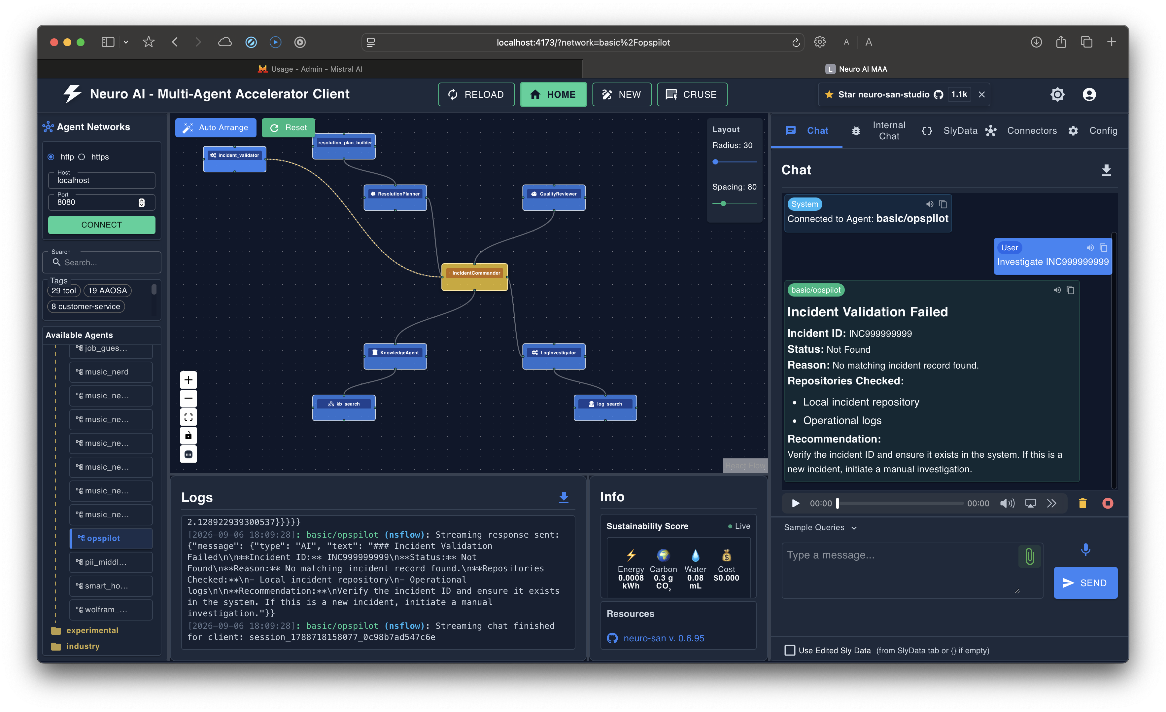
06 | LIVE DEMO FLOW
06
A three-query story that shows capability and restraint
Start with a grounded investigation, then show direct retrieval and the no-match path.
01
Full war-room flow
02
Intent-aware route
03
Responsible no-match
Investigate INC008381005
Retrieve runbook for INC008381110
Investigate INC999999999
Logs -> KB-1023 -> plan -> review -> summary
KnowledgeAgent -> KB-1101
Validator -> Not Found -> further investigation
Captured from a local OpsPilot run
AI Incident War Room

Slide 8
07 | RESPONSIBLE AI & GROUNDING
07
The system is designed to say 'not enough evidence'
Guardrails protect the incident response process from plausible but unsupported conclusions.
Grounding rules
•
Validate incident IDs against local source data first.
•
Keep observed log evidence separate from KB recommendations.
•
Treat recovery actions as plans for human review, not executed remediation.
•
Never turn missing evidence into a cause, status, plan, or confidence claim.
•
Unknown incidents return REQUIRES FURTHER INVESTIGATION.
INC999999999 -> Not Found -> no downstream investigation
Responsible-AI claims align with EVIDENCE_AUDIT.md
AI Incident War Room

Slide 9
08 | BUSINESS IMPACT
08
Turn incident response into a repeatable operating capability
OpsPilot improves the path from signal to decision without pretending the machine has authority it does not have.
FASTER
Initial triage
CONSISTENT
Runbook use
Reduce manual searching across logs and runbooks.
Bring documented guidance into the same workflow every time.
EXPLAINABLE
Root-cause narrative
SAFER
Operational decisions
Show how evidence supports the conclusion and the next action.
Surface evidence gaps before unsupported recommendations spread.
The outcome
A faster first response, a clearer audit trail, and a disciplined handoff to human operators.
Current scope: synthetic local data; no production remediation, incident-system updates, or recovery verification.
OpsPilot | Neuro SAN Studio
AI Incident War Room

