Slide 1
Introduction to design Pattern by zero

Slide 2
Agenda
Introduction
OOP Principle
Relationship of Design Pattern
Classification
Examples for 23 Design Patterns
Reference
Summary

Slide 3
Introduction

Slide 4
OOP principle
OCP – Open-Closed Principle
LSP – Liskov Substitution Principle
DIP – Dependence Inversion Principle
ISP – Interface Segregation Principle
CRP – Composite Reuse Principle
LOD or LKP – Law of Demeter/Least Knowledge Principle
SRP – Single Responsibility Principle

Slide 5
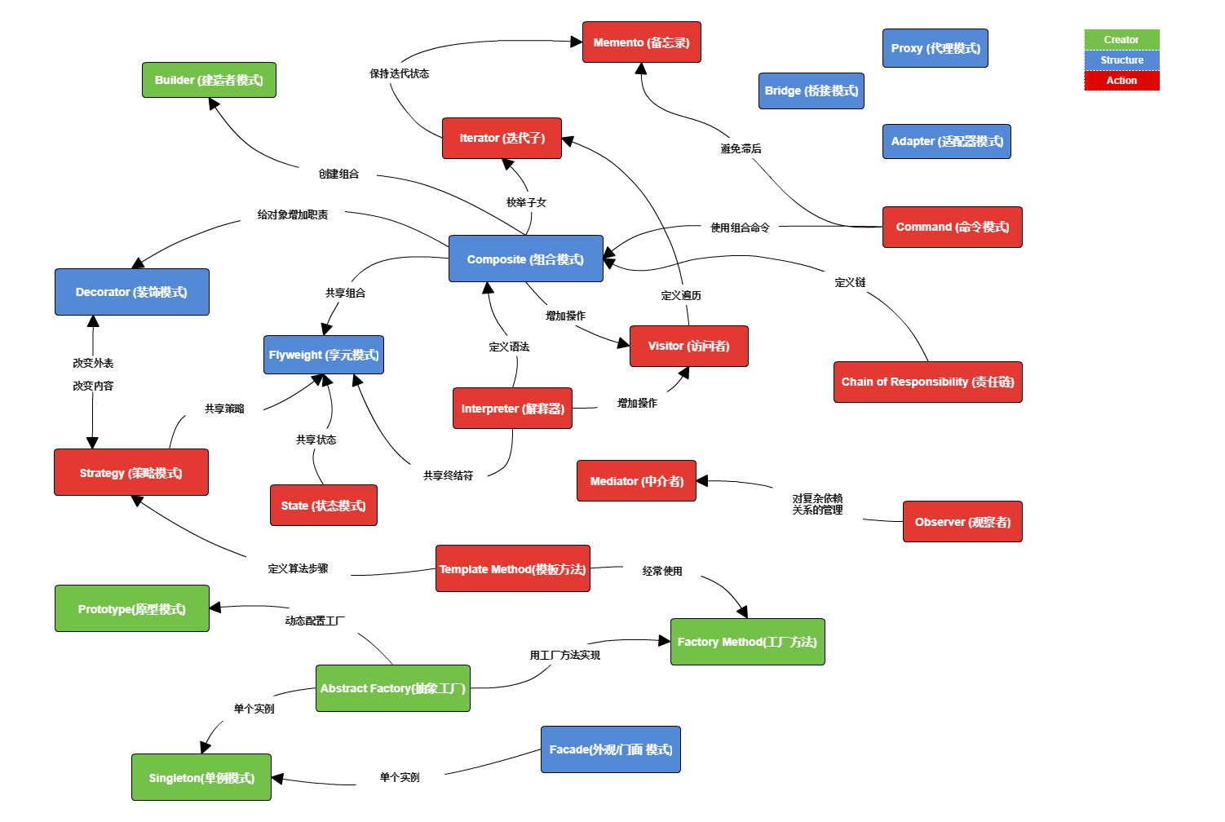
Relationships

