Slide 1


OLIST E-COMMERCE ANALYTICS
Delivery Performance Optimization
NTU SCTP DSAI COHORT 5 | TEAM 2 Ethan, Reeve, Tony, Nainar, Tom, Shicong

Slide 2

EXECUTIVE SUMMARY
Core Purpose
Strategic Focus
Identify operational bottlenecks in Olist's fulfillment process by isolating seller processing lag from carrier transit variance.
Targeting outlier management (e.g., severe delays in Rio de Janeiro) and improving delivery estimation accuracy to reduce customer churn.
Value Proposition: Empowering operations through SLA optimization and enhanced partner accountability.

Slide 3






TIMELINE PERFORMANCE METRICS
Early Delivery
Late Delivery
On-Time
90.62%
6.59%
2.78%
Suggests over-pessimistic estimation bias at checkout to protect reputation.
Baseline failure rate driving negative reviews and high support tickets.
Deliveries landing precisely inside the final committed SLA window.

Slide 4
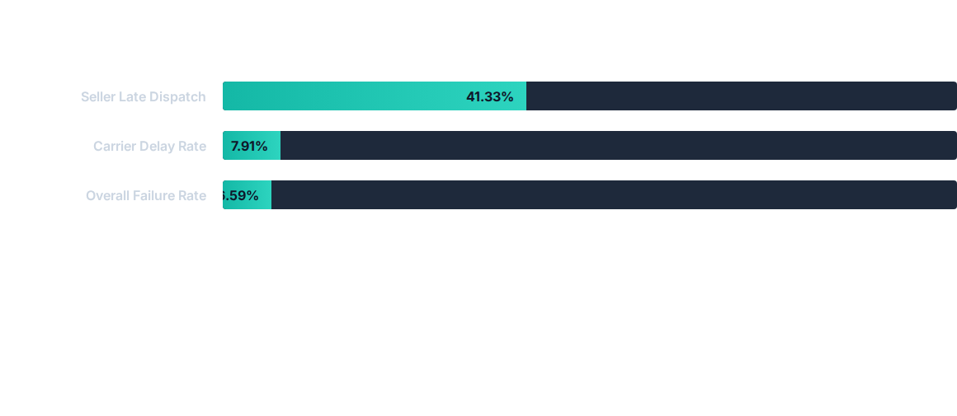
DELAY RATE BREAKDOWN
Insight: Operational red flag at the warehouse level. Over 40% of delays occur before the carrier receives the package, highlighting inventory picking lags.

Slide 5

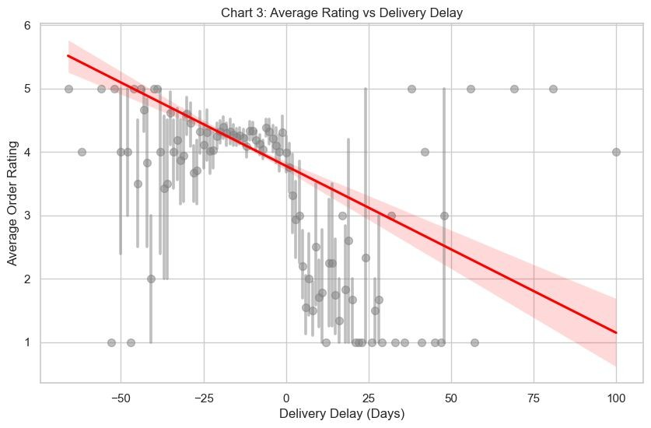
DELAY IMPACT ON SATISFACTION
Inverse Correlation
Data proves a direct relationship: as delivery delay increases, customer ratings decrease exponentially.
Outliers (+40 days) are highly correlated with 1-star reviews.
Platform churn is driven by catastrophic delivery failures.

Slide 6

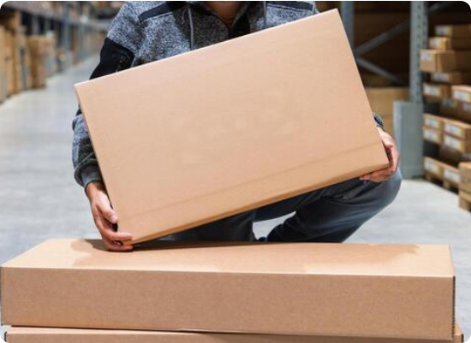

PERSISTENT SYSTEMIC RISK
Parallel Percentile Gaps
Despite massive volume growth (2016-2018), delivery delay percentiles moved in perfect sync. This proves a predictable, hardcoded software issue rather than random seller mistakes.
Reliability Gap: Current estimates have wide ranges, preventing a predictable promise for premium consumer experiences.

Slide 7
CATEGORY SPECIFIC TRENDS
Bulky vs. Tech Goods
Product categories maintain acceptable median times but suffer from catastrophic outlier delays (+40 to +70 days).
•
Furniture/Decor: Mishandling of heavy items.
•
IT Accessories: Inventory stockouts where labels are printed prematurely.
•
Sports/Leisure: High transit volatility.
Action: Rebuild the core delivery calculator.

Slide 8

Technical Walkthrough
Data Engineering & Pipeline Architecture

Slide 9



MEDALLION DATA ARCHITECTURE
BRONZE
SILVER
GOLD
Raw Ingestion
Conformed Star
Semantic Layer
Independent stream objects tracking exact data sources (orders_stream, products_stream).
Standardized business entities (dim_seller) and atomic transaction facts (fct_order).
Business-ready Views powering Sales Predictions and Delivery Optimization.

Slide 10
RISKS AND MITIGATION STRATEGY
Identified Risk | Impact / Cause | Mitigation Plan
Data Decay | Loss of historical context (SCD) | SCD Type 2 implementation with valid_from/to markers.
Traffic Congestion | Full table replication bottlenecks | Migration to Incremental Replication for high-volume logs.
Manual Dependency | Stale data & human error | Roadmap deployment of Dagster/Airflow orchestration.
Misattribution | Unfair partner penalties | Decoupling Seller Lag from Carrier Transit Variance.

Slide 11
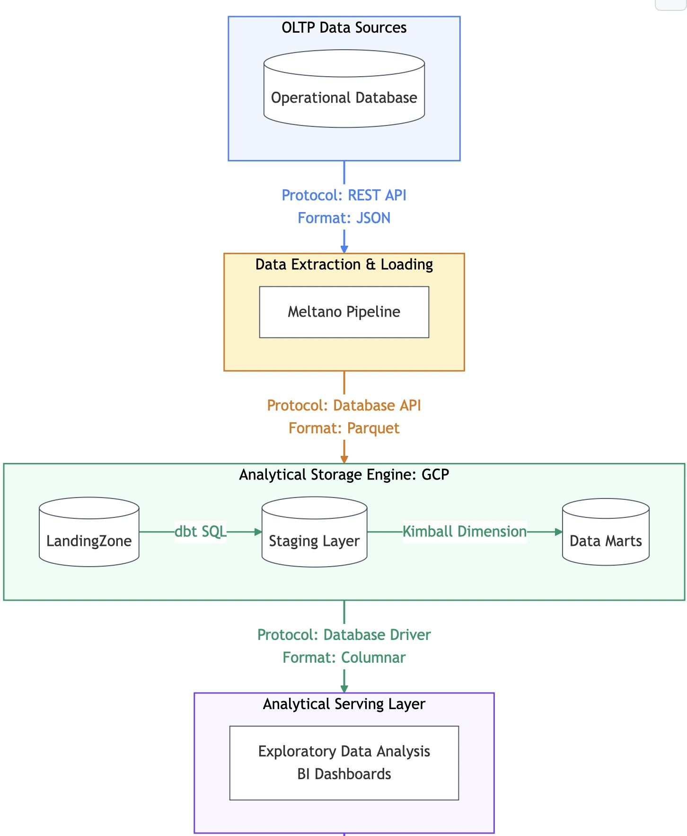
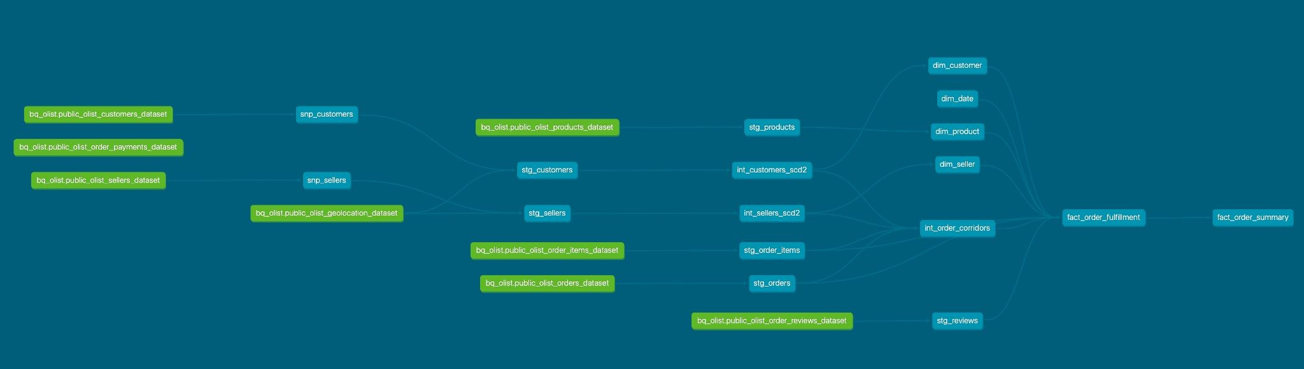
DATA ENGINEERING
Data Ingestion & Storage: Establishing the landing zone for raw operational data into the warehouse layer.
Data Warehouse Design: Enforcing the Kimball framework by designing dedicated Fact and Dimension tables and arrive at star schema.
ELT Pipeline (dbt): Processing, cleaning, and normalizing data into Staging models before building the final Data Mart layer.

Slide 12






SUMMARY OF STRATEGIC ACTIONS
CFO Office
Logistics Ops
Data Science
Approve budget for Outlier Management and revised estimation models to address pessimistic bias.
Investigate systemic bottlenecks in State RJ and audit partners mishandling bulky goods.
Identify failure modes for extreme delays and decouple handover timestamps from transit times.

Slide 13

Questions?
Thank you for your attention.
github.com/zeroonyx/project-repo

