Slide 1
Capstone Project
The Battle of Neighborhoods

Slide 2
Recommend the best places
Recommend towns by preference
Recommend groups of similar towns
People not only choose where to live through house prices, they can also pursue the right environment!

Slide 3
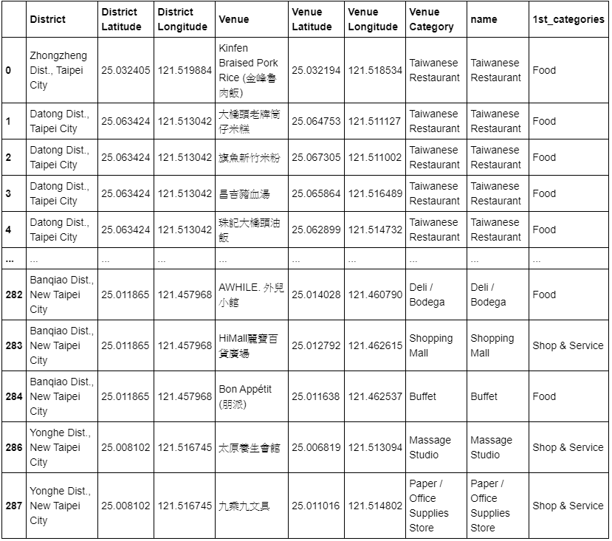
Data collection
Township latitude and longitude information
Classification of township locations

Slide 4
K-means clustering
Find similar cities
Use fewer kernels to have more towns in a single group

Slide 5
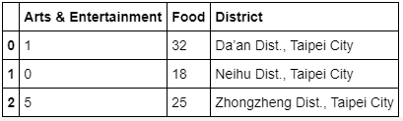
Result
Select the towns with the highest frequency of favorite locations
Recommend entire clusters to users

