Slide 1
Document Type Definition (DTD)
Define the legal building blocks of an XML document.

Slide 2
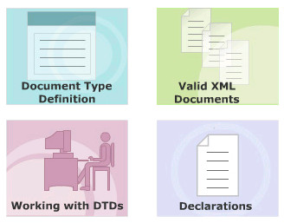
Module Introduction
Welcome to the module, Document Type Definitions (DTDs).
This module focuses on how to create DTDs for XML files.
In this module, topics such as DOCTYPE declarations, types of DTDs, wellformedness and validity of XML files, declaration of elements, attributes, and entities in a DTD are also covered.
In this module, you will learn about:
  Document Type Definition
  Working with DTDs
  Valid XML Documents
  Declarations

Slide 3
#1 - Document Type Definition
Define what is meant by a DTD
Identify the need for a DTD

Slide 4
What is a DTD?
Non XML document made up of element, attribute and entity declarations.
Defined for the elements, attributes and entities belong to the XML document and the way elements relate to one another
Helps XML parsers to validate the XML document.
Helps authors to set default values for element attributes.
The document's tree structure can be determined based on the DTD

Slide 5
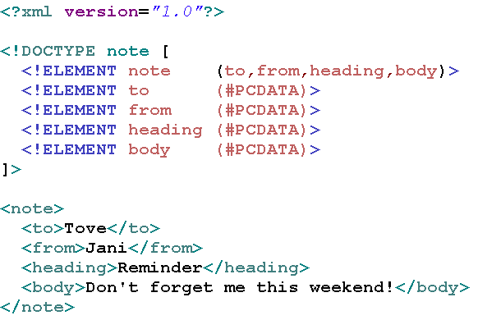
Example of using DTD in XML document

Slide 6
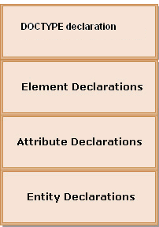
Structure of a DTD
DOCTYPE declaration
  Specifies name of that DTD and either its content or location
ELEMENT declaration
  Specifies the name of the element, the content which that element can contain
ATTRIBUTE declaration
  Specifies the element that owns the attributes, the attribute name, its type and its default values (if any)
ENTITY declaration
  Specifies the name of the entity and either its value or location of its values.

Slide 7
$1 - DOCTYPE Declarations
Placed in the XML document's prolog
Syntax: “<!DOCTYPE ………. >”
“….”:
  root element name + “[“ + DTD itself + “]”
  root element name + SYSTEM keyword + “URL of DTD file”

Slide 8
Example of Internal DTD declaration
Syntax:
  <!DOCTYPE root-element [element-declarations]>

Slide 9
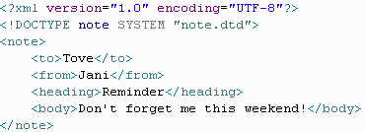

Example of External DTD Declaration
Syntax:
<!DOCTYPE root-element SYSTEM "filename“>
note.dtd

Slide 10
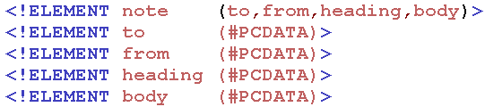
$2 - Elements Declaration
Syntax:
  <!ELEMENT element–name element–rule>

Slide 11
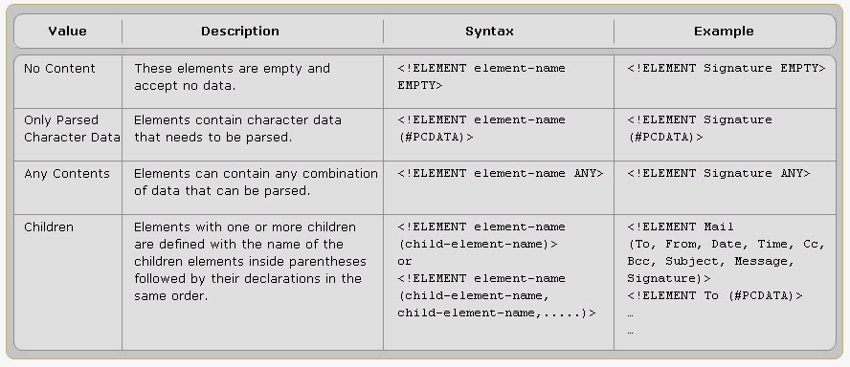
Element Rules

Slide 12
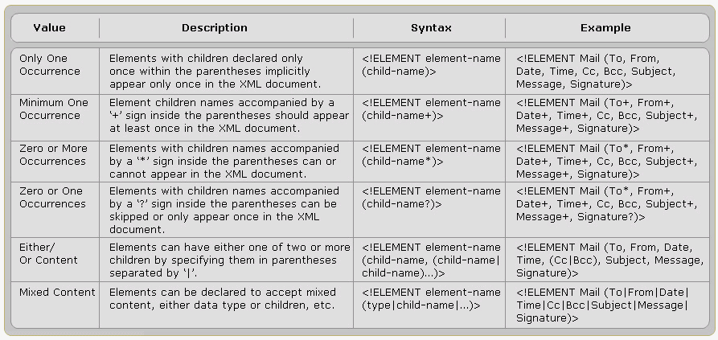
Element Rules cont…

Slide 13
Declaring Mixed Content Element
An element can have a mixed combination of child elements.
Example:
  <!ELEMENT note (to+, from, header, message*,#PCDATA)>
The sub elements and subgroups can be declared in Sequence or Choice.

Slide 14
Declaring Sequence
Element A consists of a single element B.
  <!ELEMENT A (B)>
Element A consists of element B followed by element C
  <!ELEMENT A (B, C)>
Element A consists of a single element B.
  <!ELEMENT A (B)>
Element A consists of element B followed by element C
  <!ELEMENT A (B, C)>

Slide 15
Declaring Choice
Element A consists of either element B or element C.
  <!ELEMENT A (B | C)>
Element A consists of a choice, including a sequence subgroup.
  <!ELEMENT A (B | C | (D, E))>

Slide 16
$3 - Attributes Declaration
<!ATLIST element-name attribute-name attribute-type default-value>
element-name:
  The element the attribute belong to
attribute-name:
  The name of the attribute
attribute-type:
  Type of data the attribute can accept
default-value:
  Default value for the attribute

Slide 17
attribute-type
Type | Description
CDATA | The value is character data
(en1|en2|..) | The value must be one from an enumerated list
ID | The value is a unique id
IDREF | The value is the id of another element
IDREFS | The value is a list of other ids
NMTOKEN | The value is a valid XML name
NMTOKENS | The value is a list of valid XML names
ENTITY | The value is an entity
ENTITIES | The value is a list of entities
NOTATION | The value is a name of a notation
xml: | The value is a predefined xml value

Slide 18
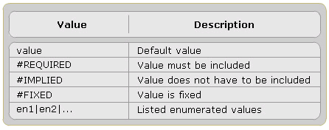
Attribute default-value

Slide 19
Example of using Attribute default-value
#REQUIRED
  DTD: <!ATTLIST person number CDATA #REQUIRED>
  Valid XML: <person number="5677" />
  Invalid XML: <person />
#FIXED
  DTD: <!ATTLIST sender company CDATA #FIXED "Microsoft">
  Valid XML: <sender company="Microsoft" />
  Invalid XML: <sender company="W3Schools" />
Enumerated Attribute Values
  DTD: <!ATTLIST payment type (check|cash) "cash">
  Valid XML: <payment type="check" />, <payment type="cash" />

Slide 20
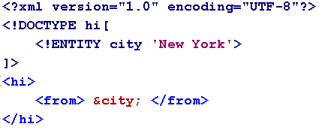
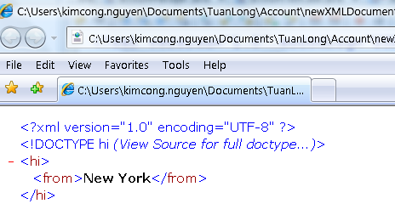
$4 – Entities Declaration
<!ENTITY entity-name "entity-value">
Entity Reference: &entity-name; (‘&’ + entity-name + ‘;’)

Slide 21
Define a DTD process
Declare all the possible elements
Specify the permissible element children if any
Set the order in which element must be appear
Declare all the possible element attributes
Set the attribute data types and values
Declare all the possible entities

Slide 22
#3 – Valid XML Document
XML with correct syntax is "Well Formed" XML.
XML validated against a DTD is "Valid" XML.

Slide 23
Well Formed XML Documents
A "Well Formed" XML document has correct XML syntax.
  XML documents must have a root element
  XML elements must have a closing tag
  XML tags are case sensitive
  XML elements must be properly nested
  XML attribute values must be quoted

Slide 24
Valid XML Documents
A "Valid" XML document is:
  A "Well Formed" XML document
  Conforms to the rules of a Document Type Definition (DTD)

Slide 25
That’s about all for today!
Document Type Definition
Working with DTD
Valid XML Documents
Declarations
  Doctype
  Element
  Attribute
  Entity
Thank you all for your attention and patient !

