Slide 1
CST2335 Graphical Interface programming
Debugging in Android Studio

Slide 2
Debugging
Being able to diagnose a problem is very important. Debugging means your ability to figure out why a problem is not working, and to fix it.
The main tools for debugging are breakpoints, the variables viewer, and the Logcat window.

Slide 3
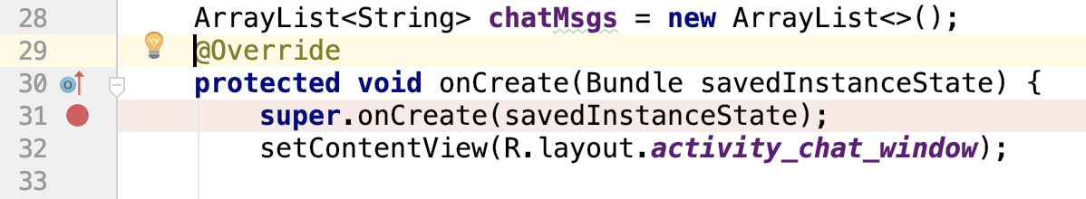
Set a Breakpoint
Breakpoints can only be set in Java. You can not debug XML, since they are not instructions. To set a breakpoint, click your mouse on the left part of the editor window:

Slide 4

Debug versus Run
You will only hit a breakpoint if you use Debug.
If you press Run, you will not get any crash information if your application crashes. You should never use Run this semester. Always use Debug!
Debug
Run
YES!
NO!

Slide 5
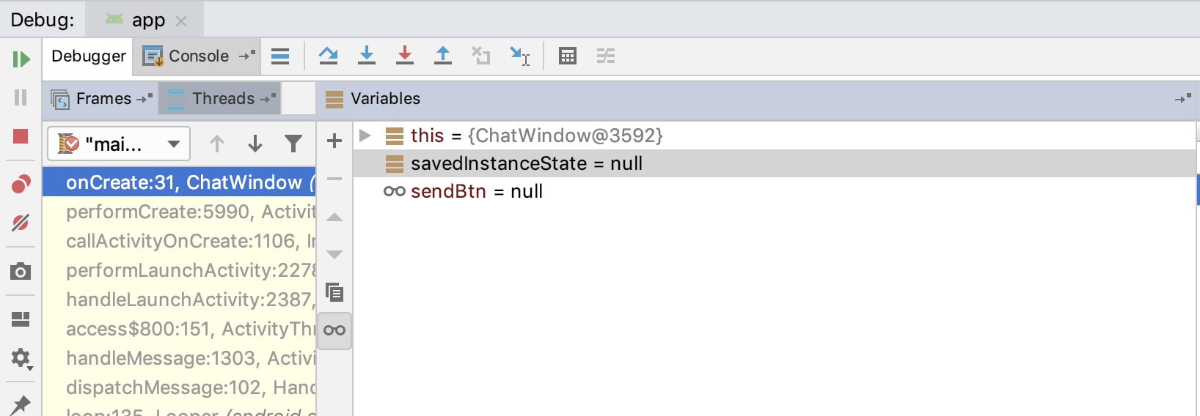
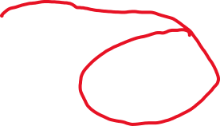

Variables Window
This window at the bottom of Android Studio shows the current call stack, and the variables in scope at that point.
The variables currently in scope
Call Stack. This shows what functions you are in

Slide 6
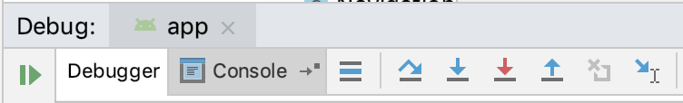
Inspecting your code
In order to inspect your code to find your problem, you have to move line by line and make sure that the variables are set to what they are supposed to be.
Step over – this moves to the next line of code and stops.
Step into – if the line of code you are at is a function, the debugger will enter that function and stop at the first line.
Step out – the program will finish the current function and stop at the next line of the calling function.
Resume – the program runs until the next breakpoint

Slide 7
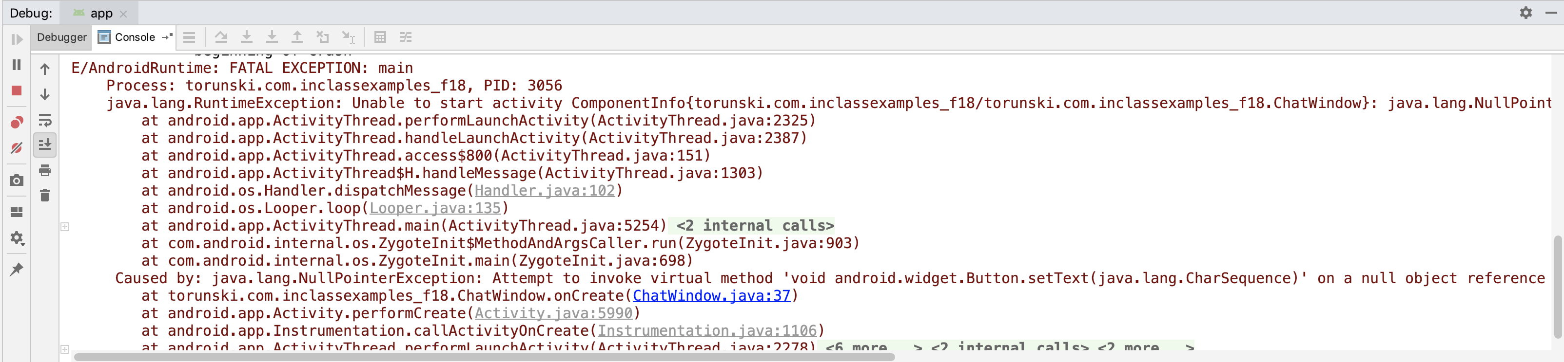
Program Crashes
Look at the Debug Console for the stack trace. The top line says what exception crashed the application.
The file in blue is which of your files caused the exception, and what line.. The other java files are which functions your were in.

Slide 8
How to diagnose
Put a breakpoint at the top of the function that caused the exception. From the previous slide, see what function is at line 37 of ChatWindow.java. Put a breakpoint at the first line of code and step over line by line and see which line caused the exception.
You can also surround the code with a Try/Catch block to deal with the exception let the program continue functioning.

Slide 9
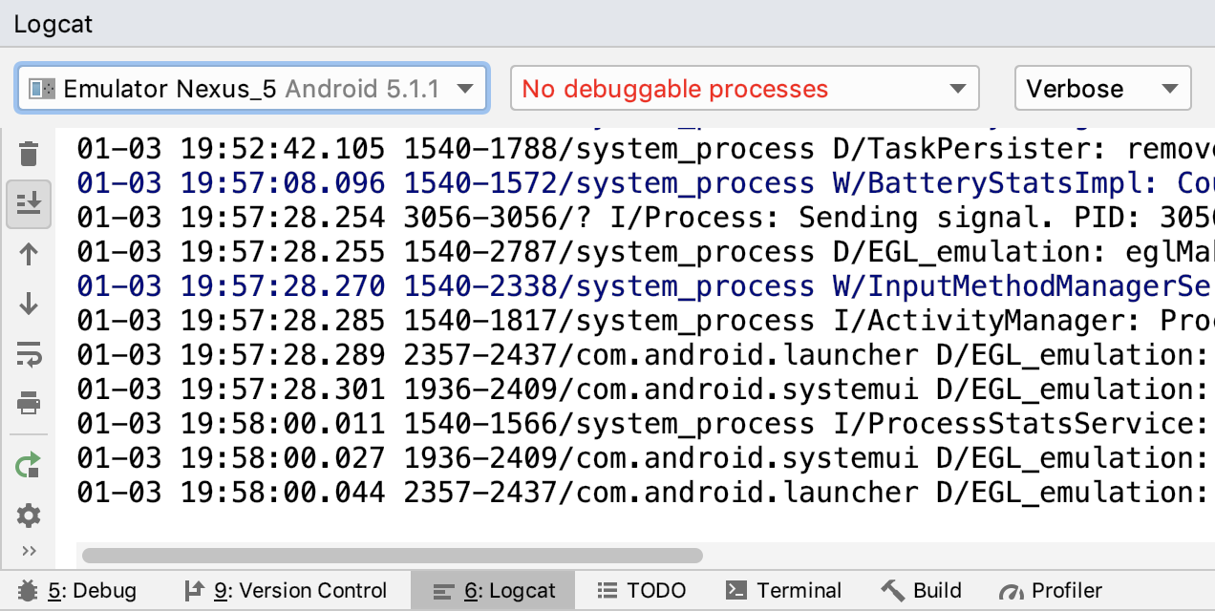
Logcat
You can also put Log.i(String tag, String message) function calls to print out information to the log console.

Slide 10
Logcat
You can filter unwanted messages by the priority.
Log.v - verbose
Log.d - debug
Log.i - info
Log.w - warn
Log.e - error

Slide 11
Application start
If you still can’t find the problem, put a breakpoint on the first line of the onCreate() function. It is the first function that is called on an Activity.

Slide 12
This semester
You have to become good at debugging. You will not get a job unless you know how to debug a program.
Whenever you ask for help during the lab, you are expected to first know what exception caused the crash, and what line in what file caused it.
The put a breakpoint on that line and inspect the variables. If you still can’t figure it out, then we will help you.
If you use Run instead of Debug, then we will not help you.

