Slide 1
CST2335 Graphical Interface programming
Extra material
NavigationDrawer (Sliding Menu)

Slide 2
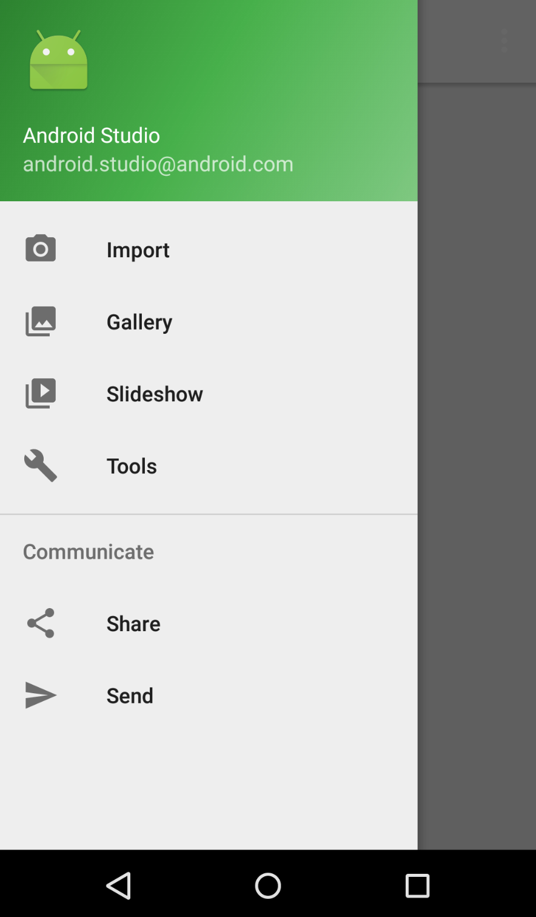
Introduction
This week, you will learn how create a NavigationDrawer and add menu items for selection.
This needs Android version 22 or newer.

Slide 3
Add Libraries
Create a new AppCompatActivity, not Activity!!
in the app/build.gradle, add in the section:
dependencies {
implementation 'com.android.support:appcompat-v7:22.2.1‘
implementation 'com.android.support:design:22.2.1'
… }
There might be “compile” instead of “implementation” so put compile instead. Leave the other items in the dependencies{ } that are there. They are important!
Your new AppCompatActivity must implement NavigationView.OnNavigationItemSelectedListener

Slide 4
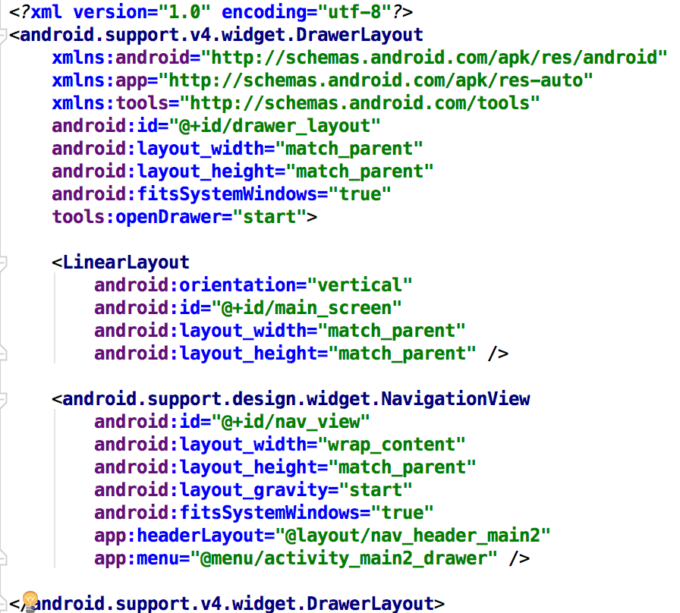
DrawerLayout
A DrawerLayout takes two sub-items. The first is the main screen, the second is the layout for the NavigationView (Sliding Menu).

Slide 5
NavigationView
NavigationViews have a Header, and a Menu.
The Header is pictures/explanation.
The Menu are selectable MenuItems

Slide 6
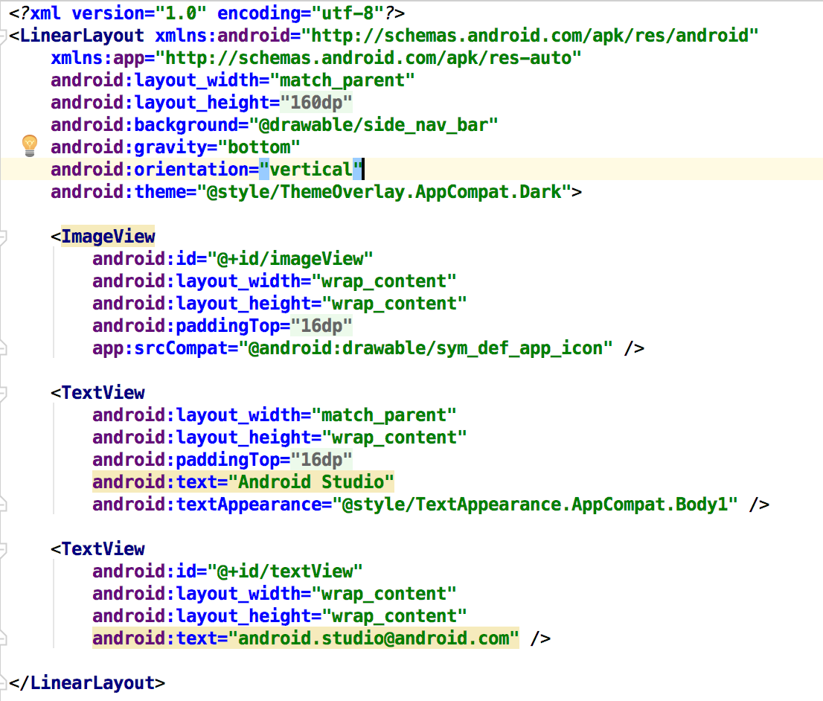

Header
The header can be any layout (LinearLayout, RelativeLayout), containing Text, Images, etc.

Slide 7
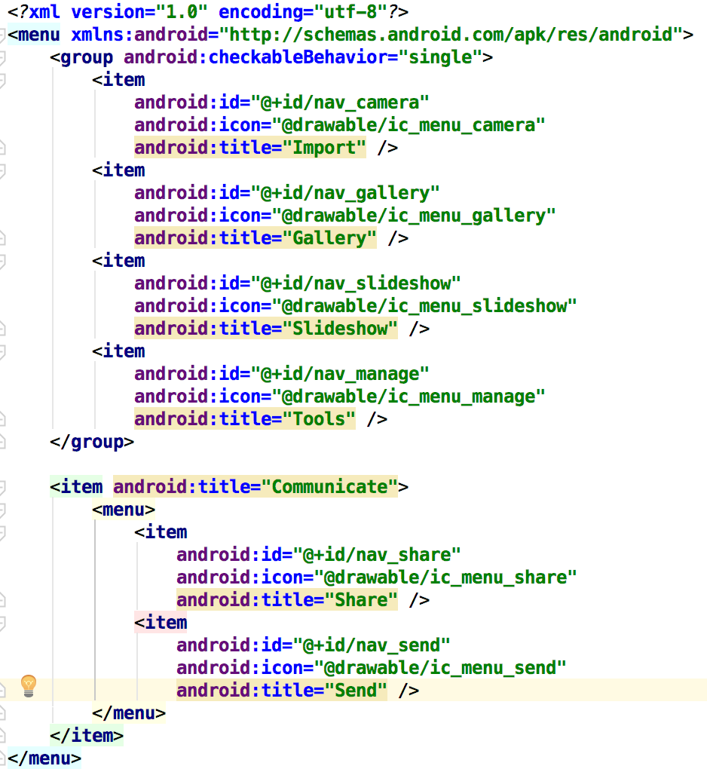
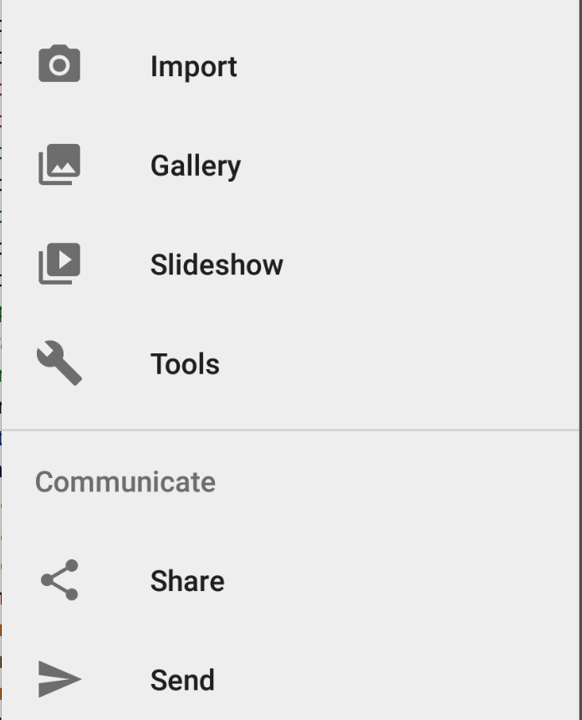
Menu
The selectable menu items are just like the Toolbar:

Slide 8
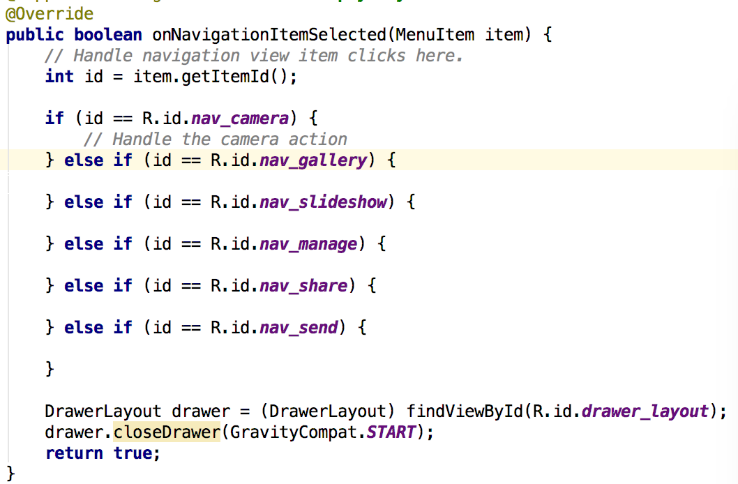
Activity functions
boolean onNavigationItemSelected(MenuItem item) - This function responds to anNavigationItem selection:
Add cases for each ID of items
from your XML menu
Close the drawer

Slide 9
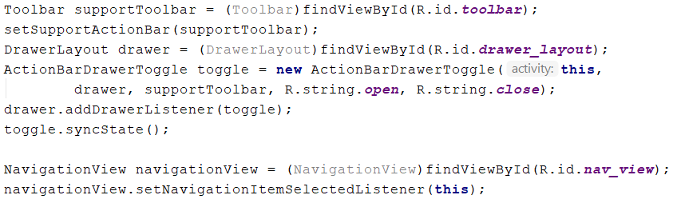
ToolBar integration
You need a Toolbar on your display to show the Drawer toggle button. In your onCreate function, add this code:
This code registers for NavigationItem Selection events

Slide 10
Example
Use AndroidStudio: File -> New -> Activity -> NavigationDrawerActivity
The screenshots and examples in these slides are taken from the code generated by AndroidStudio.

Slide 11
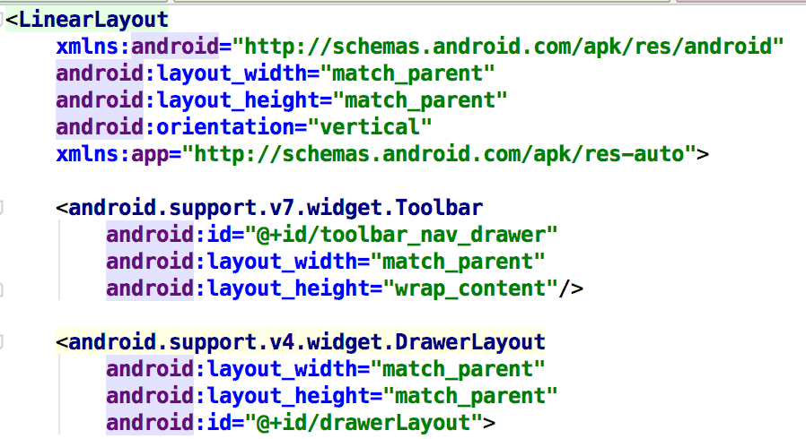
Toolbar placement
Add android:theme="@style/Theme.AppCompat.Light.NoActionBar“ to your AppCompatActivity in AndroidManifest.xml
Make sure the Toolbar is placed outside the DrawerLayout, or the Navigation drawer will open on top of the Toolbar:

Slide 12
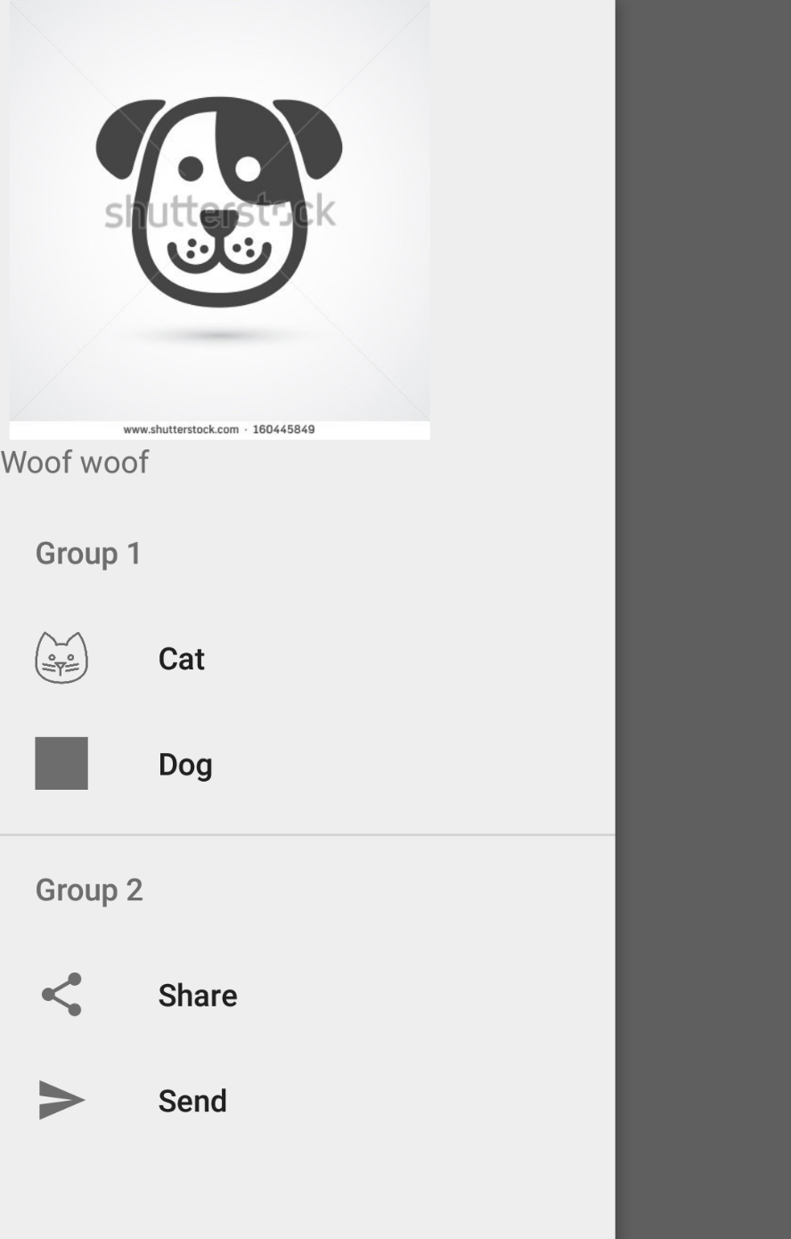
Now it should work

Slide 13
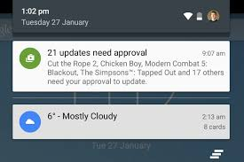
Notifications
Android has a Notification manager (Singleton)
NotificationCompat.Builder mBuilder =
new NotificationCompat.Builder(this, "Channel_name")
.setSmallIcon(R.drawable.notification_icon)
.setAutoCancel(true)
.setContentTitle("My notification")
.setContentText("Hello World!");
There should also be an Intent to launch an Activity if you click the Notification:
Intent resultIntent = new Intent(this, ResultActivity.class);

Slide 14
Notifications
Tie the two together:
PendingIntent resultPendingIntent = PendingIntent.getActivity( this, 0, resultIntent, PendingIntent.FLAG_UPDATE_CURRENT);
mBuilder.setContentIntent(resultPendingIntent);
Then launch the Notification:
int mNotificationId = 001;
NotificationManager mNotifyMgr = (NotificationManager) getSystemService(NOTIFICATION_SERVICE);
mNotifyMgr.notify(mNotificationId, mBuilder.build());
When the user clicks the notification, the Intent will transition to the new Activity.

Slide 15
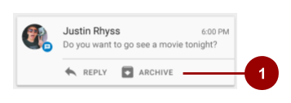
Notification Actions
You can add options to a notification:
mBuilder.addAction(R.drawable.car, "Get Directions", mapPendingIntent);
The first parameter is the icon. Icons are deprecated in Android 23 and newer.
The second parameter is a short title
The third parameter is a pending intent to go to another screen

Slide 16
Notifications on Watch or Auto
You need an “Extender” to redirect the Notification to Wear:
NotificationCompat.WearableExtender wearableExtender = new NotificationCompat.WearableExtender(). setHintHideIcon(true).setBackground(mBitmap);
For Android Auto:
NotificationCompat.CarExtender carExtender = new NotificationCompat.CarExtender(). setColor(R.id.colorAccent).setIcon(mBitmap);
Add the “redirect” to the builder() function:
new NotificationCompat.Builder(this).extend(wearableExtender).build();

Slide 17
Themes
You can customize your theme with different colours.
Find styles.xml in the values folder and open the file.
In the top right, click on “Open Editor”.
You can add new colours in colors.xml, then refer to them by using:
@color/colorName
For the Toolbar, edit android:colorPrimary
For button backgrounds, edit android:colorAccent
For the phone status bar, edit android:statusBarColor
For text color, edit android:textColorPrimary

