Slide 1
CST2335 Graphical Interface programming
Extra material
Publishing an Application

Slide 2
Introduction
There are extra steps involved if you want to publish an Android application to the Google Marketplace:
Remove all Log.() debug calls from your code.
In the Build.gradle file, provide android:versionCode and android:versionName
Digitally sign your application with a developer key.
Sign your apk in a Release build. Right-click on your “app” folder, and select “Open Module Settings”

Slide 3
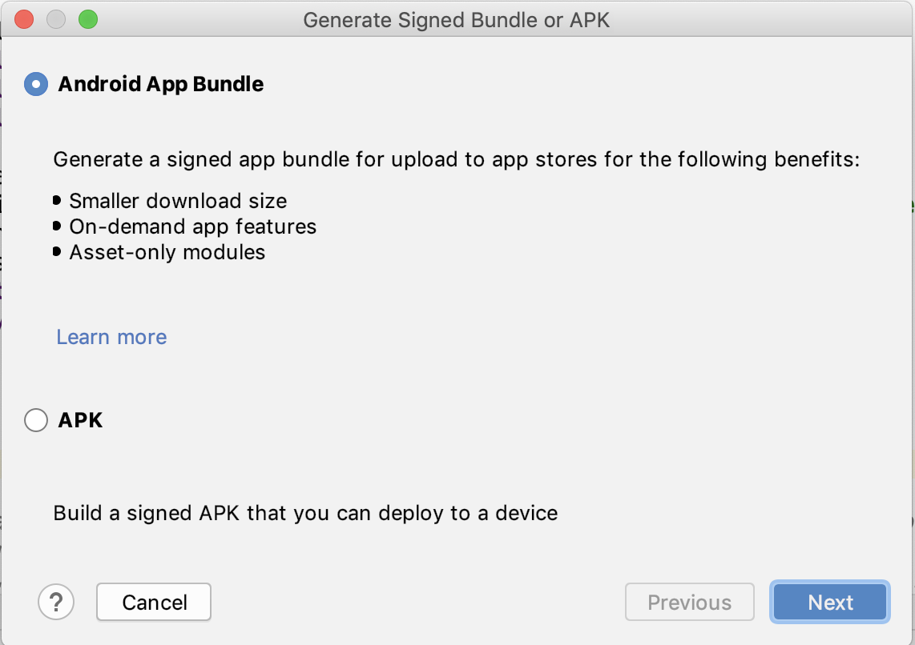
Create key store
You need to create a cryptographic key on your computer to digitally sign your apk file. In the Build menu, select Build -> Generate Signed Bundle / APK
Select Android App Bundle

Slide 4
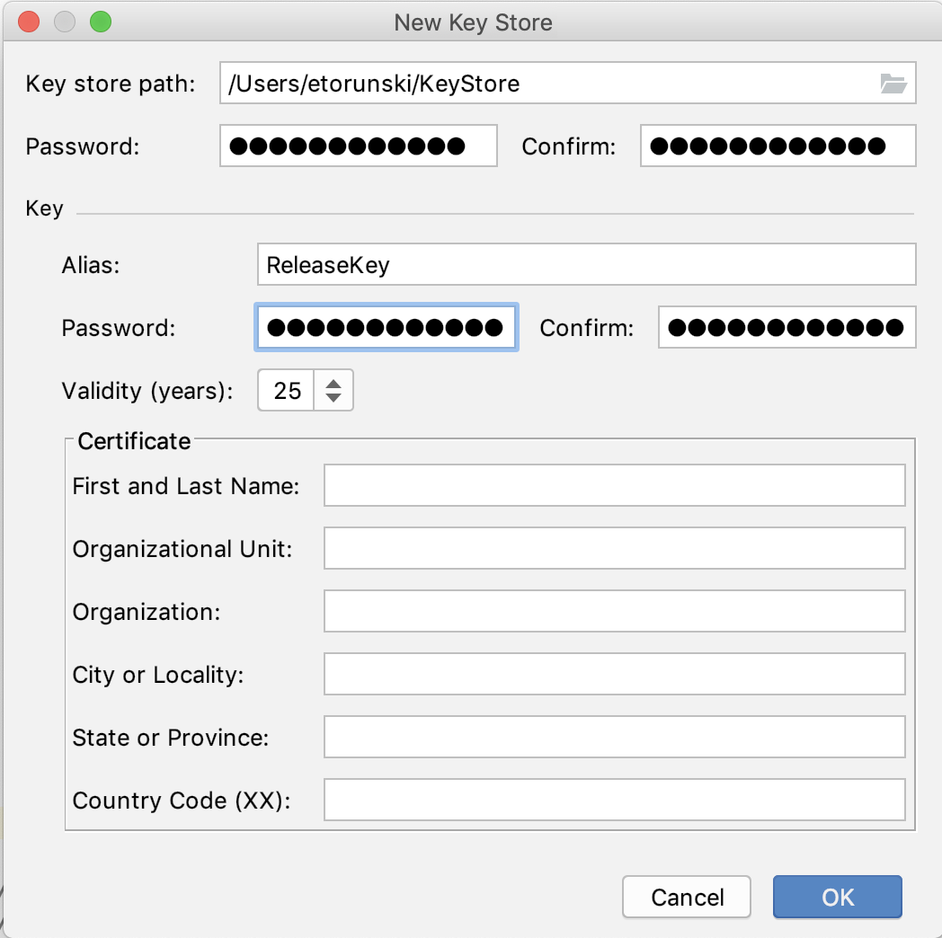
Create a Key
The Key store path is a file to store your key. It should be password protected so that no one else can read it.
You can have several keys in the
file so give this key an Alias (name).
The key is also password protected.
Normally, you also give some
information on the key’s creator,
and set the validity of the key in years

Slide 5
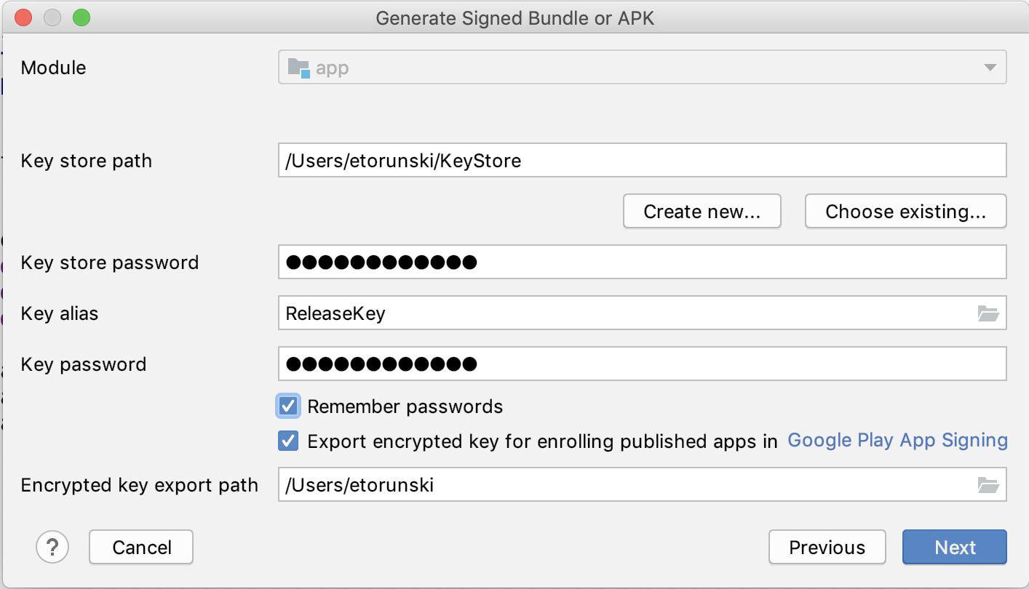
Passwords
Android studio will now generate the keystore file for signing your application. If you have a bad memory, select “Remember passwords”

Slide 6
Build Variants
You can specify if you want to sign both debug or release builds. The Release build is what will get sent to the google marketplace.
Android Studio will then generate a signed APK for upload into the marketplace.

Slide 7
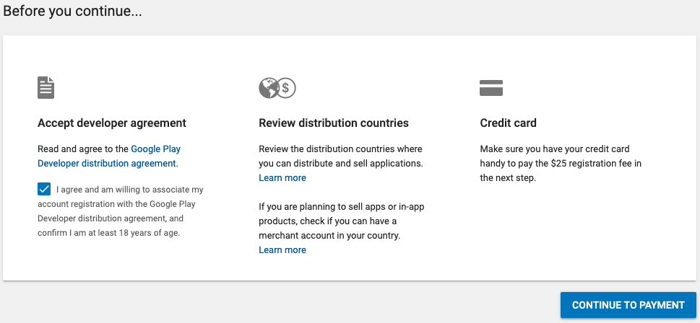
Enrolling in Marketplace
Google needs to know who the author of the application is. You must sign in with a gmail account.
You also have to accept the license agreement, and pay $25 to register the application.
The next step is to pay
with a credit card. This is
to register as a developer.

Slide 8
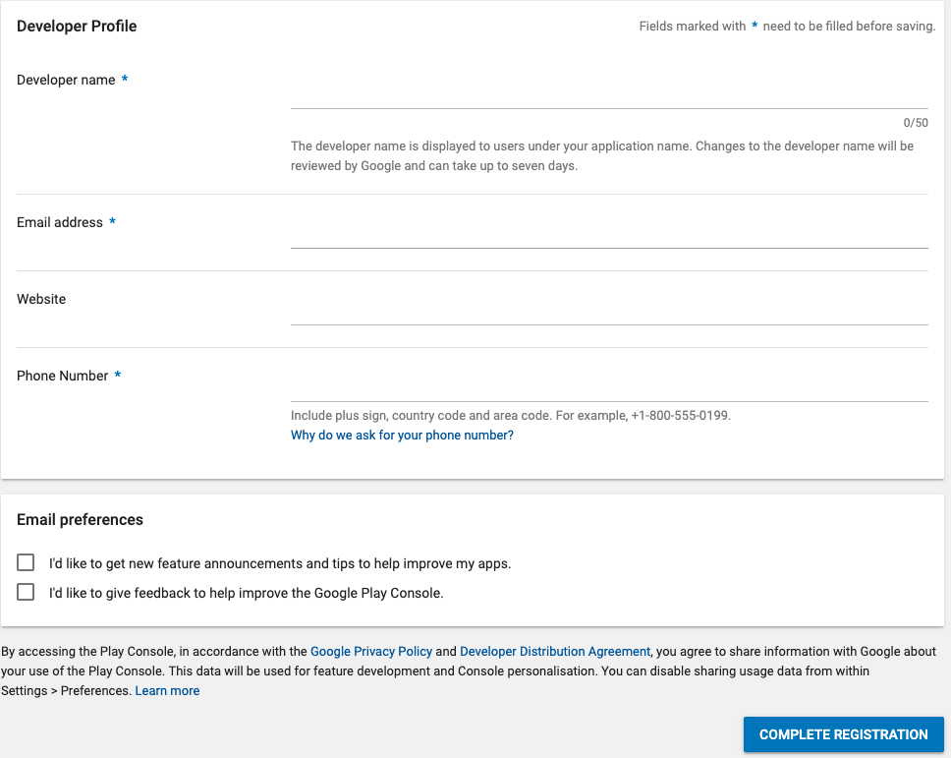
Enrolling in Marketplace

Slide 9
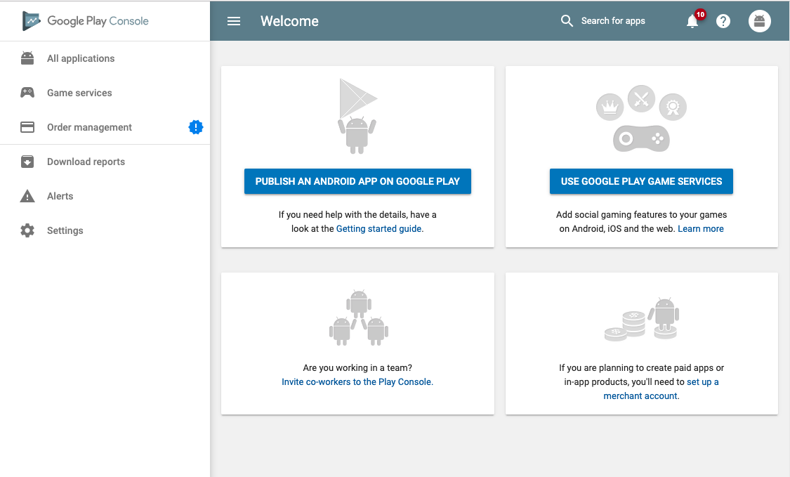
Now you create the app on the marketplace

Slide 10
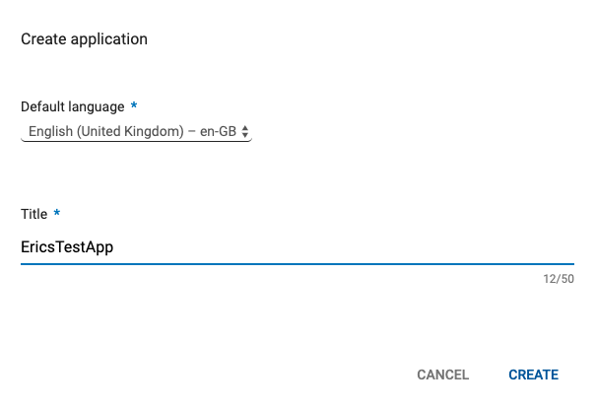
Now you create the app on the marketplace

Slide 11
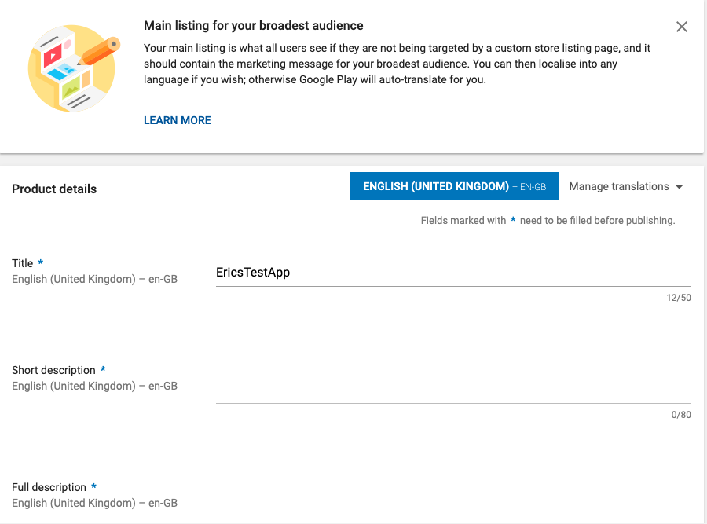
Marketing Information
Tell customers about your application.

Slide 12
Marketing Information
Tell customers about your application.

Slide 13
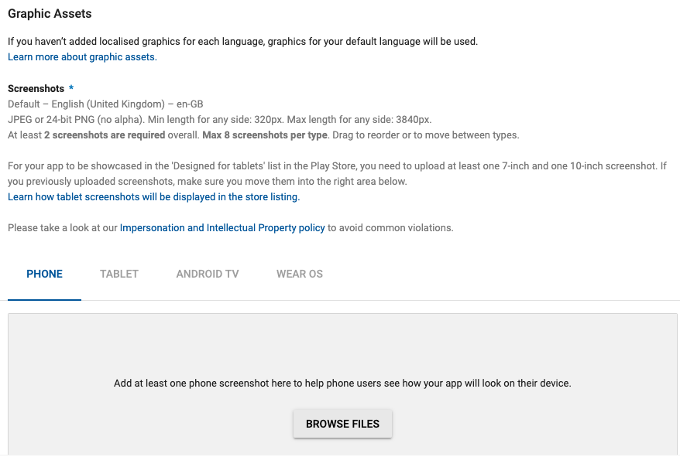
Screenshots
Upload some
screenshots so customers
can decide if they like your
Application. If you support
several devices, upload a
screenshot for each.

Slide 14
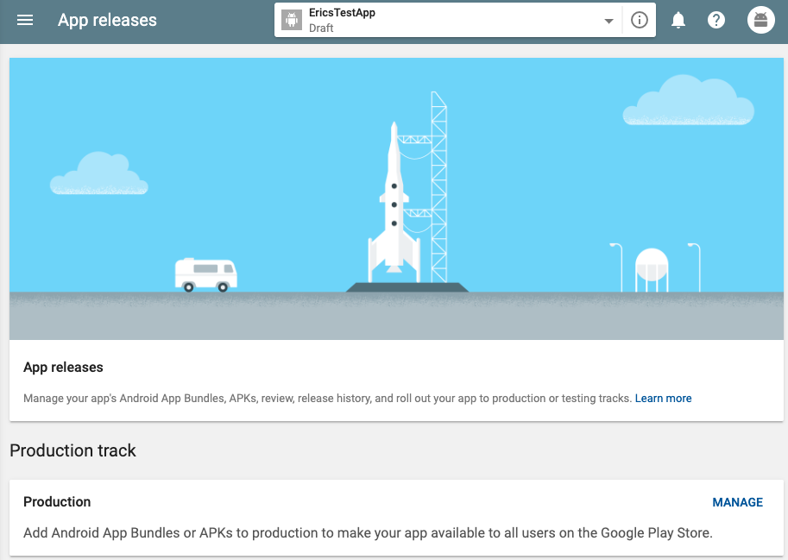
Upload APK
Under App Releases, upload an APK that will be sent to the marketplace.

Slide 15
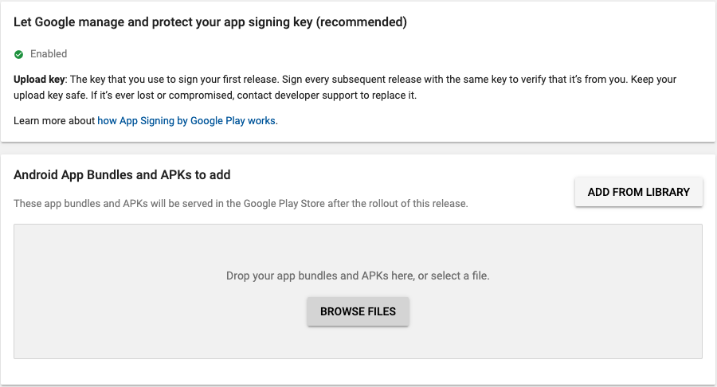
Create Release version
You have to find the apk that was created by Android Studio:

Slide 16
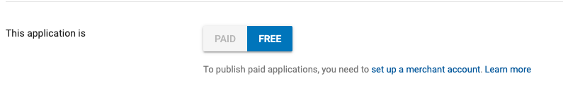
App Price and Availability
You have to specify how much to charge for the application:

Slide 17
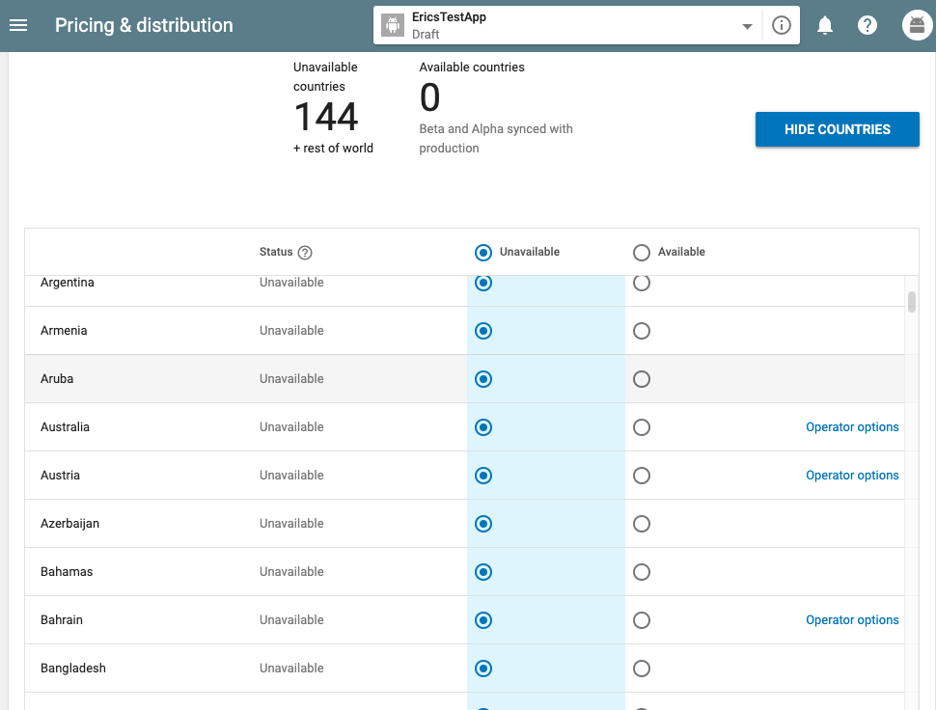
App Price and Availability
You have to specify which countries to sell it in:

Slide 18
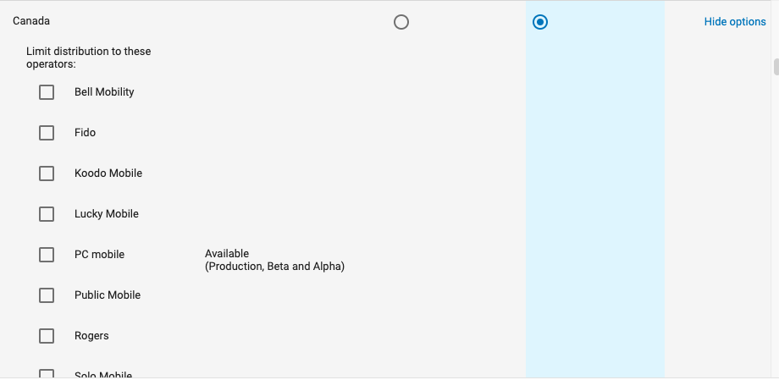
App Price and Availability
You can also limit it to customers of certain cell phone companies:

Slide 19
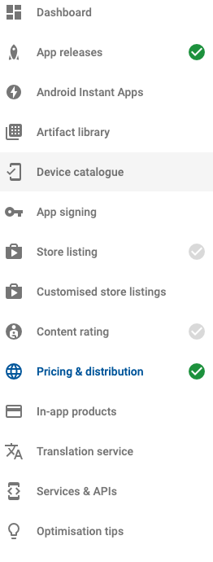
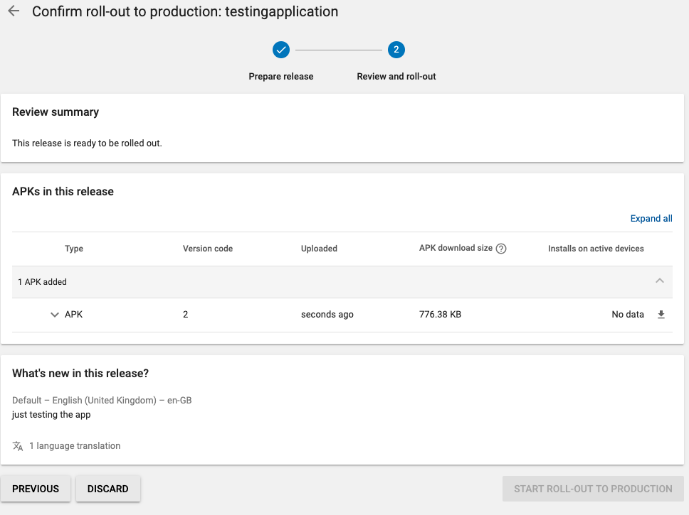
Deploy your application
Once the signed apk is uploaded, and all of the marketplace information is set, you can roll out your application:
All of the checkboxes
must be green:

