Slide 1
CST2335 Graphical Interface programming
Unit Testing in Android

Slide 2
Unit testing
When you write software, you need to test that it works properly. Also, you should test your software continually to test that your code still works throughout the development and that nothing has changed your code’s behavior.
In unit testing, you write tests to make sure that your code is working as expected. When you call a function, you check that it returns the expected value.

Slide 3
Unit testing
Unit tests are a collection of functions that run automated tests and return the results at the end. Ideally, when you finish coding at the end of the day, you run all the unit tests to check that nothing has broken your code.
JUnit has become the standard testing framework for Java. It has been ported to many different languages. (C++, Kotlin, Swift, etc.)

Slide 4
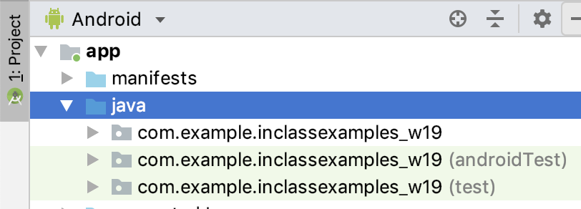
AndroidStudio unit tests
Normal Java Code
Unit tests in Emulator
Unit tests in Java

Slide 5
Testing interactions
AndroidStudio can record the user clicking on buttons and typing in fields. It uses the Espresso test framework to record what you do on an interface and can repeat it.
In AndroidStudio, click on Run -> Record Espresso Test.
Click a button or enter some text, and then make an assertion that the UI has reacted appropriately.
When running the tests, AndroidStudio will launch the emulator and interact with the UI using the same actions that were recorded.

Slide 6
Testing interactions
When you are done your interaction, click “Add Assertion” to test that your application is working properly.
You can pick what element you are testing. Normally, this is “Select an element from the screenshot”, but you can select the element id from the menu.
Add your assertion of what the output should be, and then click “Save Assertion”. This will create a JUnit test class.

Slide 7
What to test
Ideally, every function should be tested. Within a function, each code execution path should be tested. This means that every possible way of executing a function should be tested.
Every if / else if path
Every switch / case statement

Slide 8
How to test
Switch AndroidStudio to the "Android" project view.
In the Java folder, look at the package with (androidTest) after the name. Create any class to write the test cases. Normally you have one test class for every actual class. It’s called the ”class under test”
The class should have “@RunWith(AndroidJUnit4::class)” before the class declaration. It tells AndroidStudio to use the JUnit library

Slide 9
How to test
Normally, you want to test that the output of a button click matches some output. To get a GUI element, use:
View obj = onView(allOf(withId(R.id.objectID)))
To verify the output, use:
obj.check(matches(withText("Expected text")));
You can get the Activity under test using:
mActivityTestRule.getActivity()
for finding views by id.

Slide 10
Test cases
Each function in the class under test should have a function that test it. Actually, there should be a test cases for every code execution path in each function.
A Test case is a function that has the @Test annotation before the function declaration. This tells JUnit to run this test case and store the result.
Every test case should have some version of Assert.assert(Exptected, Actual). If the expected object isn’t the same as the actual object, then AndroidStudio reports a test failure.

Slide 11
Assertion
Assertions are the building blocks of test cases. You are telling JUnit to check that something is true. If it’s not true then your code has failed and it should be reported.
There are many versions of the Assert( ) function:
assertEqual( expected, actual )
assertNotEqual( expected, actual )
assertNull( variableThatIsNull )
assertNotNull( variableThatIsNotNull )
assertArrayEquals( expectedArray, actualArray )

Slide 12
Assertion
Each version of assert function also has a version that takes a string message to print if the assert fails
Assume failMessage is a String
assertEqual( failMessage, expected, actual )
assertNotEqual( failMessage, expected, actual )
assertNull( failMessage, variableThatIsNull )
assertNotNull(failMessage, variableThatIsNotNull )
assertArrayEquals( expectedArray, actualArray )

Slide 13
Set up and tear down
If you need to initialize variables or open network connections before each test, JUnit has set-up and tear-down functions that are called before each test case.
The set-up function has @Before annotation before the function declaration. The tear-down function has @After.

Slide 14
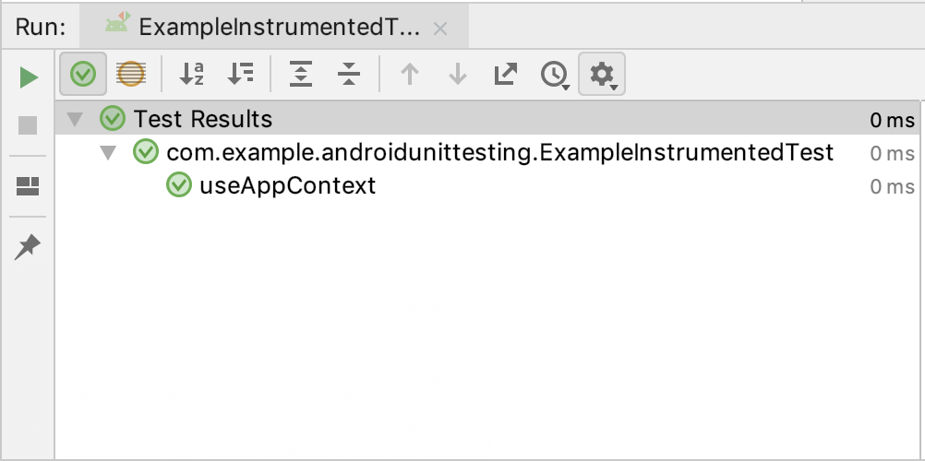
Running the tests
Right-click on the androidTest class, and click “Run ExampleInstrumentedTest”. It will launch an emulator and run the tests. If everything passed, you will see a summary:
A test fails if any of the
Assert statements fail

Slide 15
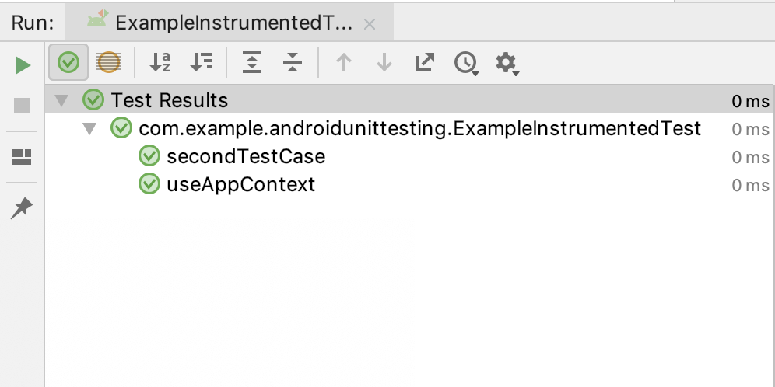
Create a second test function
Create a second function in the test class. Don’t forget to add the @Test annotation or it won’t get run.
Add some assertions,
and see that the
second Test function
reports as passing:

Slide 16
More information on Espresso
https://developer.android.com/studio/test/espresso-test-recorder
https://developer.android.com/training/testing/ui-testing/espresso-testing
https://www.youtube.com/watch?v=JRkDVvB106k

