Slide 1
CST2335 Graphical Interface programming
Extra material
Wear and TV applications

Slide 2
Introduction
Android wear applications are just like normal applications except they are on a watch.
There are two layouts: layout-round and layout-notround
You can just use layout for square interfaces.
To change an android application to a watch application, add this to AndroidManifest.xml:
<uses-feature android:name="android.hardware.type.watch"/>

Slide 3
Square, Round and Chin interfaces
A round interface extends past the radius of the circle:
More info:
https://developer.android.com/training/wearables/ui/layouts
Square
Circle
Chin

Slide 4
BoxInsetLayout
A BoxInsetLayout will give a square layout on either device:
Square
Circle
Square

Slide 5
Use a single layout
<android.support.wear.widget.BoxInsetLayout xmlns:android="http://schemas.android.com/apk/res/android" xmlns:app="http://schemas.android.com/apk/res-auto" android:layout_height="match_parent" android:layout_width="match_parent" android:padding="15dp"> </android.support.wear.widget.BoxInsetLayout>

Slide 6
Launch app from watch
Check if your app is installed on the paired phone:
https://github.com/googlesamples/android-WearVerifyRemoteApp

Slide 7
TV Application
TV applications are the same as normal applications only with a fixed screen ratio (1920x1080). 4K tv is 3840x2160.
TV applications are mainly for navigating videos. The interfaces are really basic since there is no keyboard. The only input is the direction pad (D-pad).

Slide 8
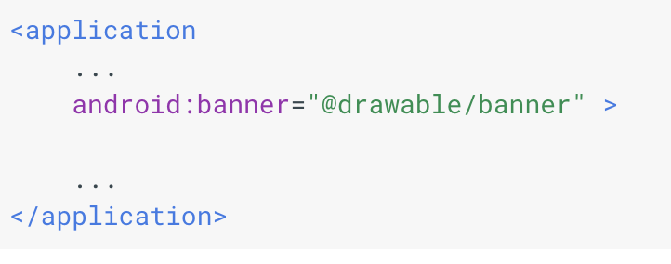
TV Application
Create a TV application using the new project wizard.
In the manifest, specify that the TV doesn’t have touch input:
<uses-feature android:name="android.hardware.touchscreen" android:required="false" />
Provide a homescreen banner:
This banner can be localized
using the right drawable folder

Slide 9
Android TV application
From the files generated, delete all the files, except MainActivity.kt and activity_main.xml. Delete everything in activity_main.xml
Add some buttons and other widgets.
Some TVs cut off part of the video to scale the image properly. You should add a buffer zone around the edge of the screen:
android:layout_marginTop="27dp"
android:layout_marginBottom="27dp"
android:layout_marginLeft="48dp"
android:layout_marginRight="48dp"

Slide 10
Android TV application
In the layout, add buttons, listViews. You should handle d-pad navigation: up, down, left, right.
android:nextFocusDown="@id/item1"
android:nextFocusUp="@id/item2”
android:nextFocusRight="@id/item3”
android:nextFocusLeft="@id/item4”

Slide 11
Video player
A VideoView is a widget that plays videos. In a layout, add <VideoView>. In Java:
VideoView player =(VideoView) findViewById(R.id.videoView);
mediaController = new MediaController(this);
mediaController.setAnchorView(player);
mediaController.setMediaPlayer(player);
player.setMediaController(mediaController);
player.setVideoURI(Uri.parse("https://archive.org/download/ElephantsDream/ed_1024_512kb.mp4"));
player.setOnPreparedListener( video ->{
player.seekTo(position);
if(position == 0). player.start();
});

Slide 12
Create test application
Create a blank TV application. Follow these steps in the tutorial:
http://corochann.com/android-tv-application-hands-on-tutorial-1-45.html

