Slide 1
CST2335 Graphical Interface programming
Week 2
Layouts and Widgets

Slide 2
Introduction
This week, you will learn how to create GUI objects, and how layouts position these objects.
These include: LinearLayout, GridLayout, RelativeLayout, Button, ImageButton, EditText, Checkbox
We will briefly cover Lambda functions
How to import XML widgets into Java using the function:
findViewById()

Slide 3
Example Code
This presentation will use example code that I have posted on GitHub. To get the code, you have to start AndroidStudio.
Once AndroidStudio has started, go to the menus: “File” -> “New” -> “Project from Version Control” -> “Git”
It will ask for the URL of the project to clone. Copy and paste this in the URL field:
https://github.com/etorunski/InClassExamples_W19.git

Slide 4
XML - review
XML is similar to HTML, except for the following:
Every opening tag must have a closing tag.
Tags must be properly nested: <A> <B> </B> </A>
There is a short form for both opening and closing tag: <A /> is the same as <A> </A>, as long as there is only whitespace between the tags. This is an example for tags with parameters: <A param1=“value1” param2=“value2” />
Tag names are case sensitive! <Button> </button> will not work.

Slide 5
XML
XML languages have no set standard tags. You can use XML to create your own language. How do you know what tags are required? Either XML schemas, or Document Type Definitions (DTD) specify what tags belong in your document.
All of the tags in Android have namespaces to specify what document defines the tags. It’s like an import statement in Java. In the root tag of the document, there is an xmlns: declaration. It declares a namespace, and says where to download the syntax for those tags.

Slide 6
XML Namespaces
The root tag is the first tag in the document after <?XML version="1.0" encoding="utf-8”?>
The root tag might have:
xmlns:android="http://schemas.android.com/apk/res/android"
xmlns:app="http://schemas.android.com/apk/res-auto"
xmlns:tools="http://schemas.android.com/tools"
After these namespaces have been imported, you can use the android parameters such as:
android:text="Hello"
android:layout_height="match_parent"

Slide 7
XML Namespaces
Look at the InClassExamples project you just cloned, and open the file activity_main.xml
The root tag is a <LinearLayout> because it is the first tag after the <?xml …?> declaration.
Look for xmlns:android=“…” in the root tag and delete it. Every parameter in the document that starts with android: should turn red because AndroidStudio no longer has the definition for the android namespace.
Click ctrl-z to undo your deletion. Now everything is back to normal because the android: namespace has been imported

Slide 8
Android Namespace
The tools: namespace is just hints for AndroidStudio. You can always delete any of the tools: parameters and namespace declaration and it won’t affect your project.
The app: namespace is for Application Backwards Compatibility classes.
When typing XML parameters, you can ignore the namespace. AndroidStudio will autofill it if you select the correct auto-completion. For example, type layout_width. Android will suggest the android: in front.

Slide 9
Android History – backward compatibility
Android was never designed for Tablets. When the iPad was released, Google was in a big hurry to deliver an Android tablet. Android 3.0 was for tablets only, and not available for phones. Android 4.0 was the first version that could run on both phones and tablets.
In order to have tablet features for phones running Android 2.0, they created AppCompatActivity to back port new features to old phones. That’s why your Activity classes extend AppCompatActivity instead of Activity.

Slide 10
Layouts and Widgets
All layouts and widgets must have a height and width
layout_width & layout_height – this layout can either take the full size of the parent: “match_parent”, or just big enough to fit the object: “wrap_content”
Layouts and Widgets should have ids: android:id=“@+id/myId”. IDs in android are used similar to how they are used in HTML: id=“myId”

Slide 11
Layouts
LinearLayout – Lays things out one after the other, in either a horizontal or vertical direction.
RelativeLayout – You can position things relative to parent, or other objects in the GUI. It is like a puzzle where you attach 1 part next to another, and keep building the GUI.
GridLayout – Define an N x M sized grid and place elements in each position

Slide 12
LinearLayout
A linear layout will arrange objects in the order they are declared. This is used for both horizontal and vertical directions, and use the android:orientation parameter to tell the difference. It can be either “horizontal” or “vertical”. If the orientation is not specified, it is horizontal by default.
The <LinearLayout> tag requires the parameters:
android:layout_width="match_parent" or = "wrap_content" android:layout_height="match_parent" or = "wrap_content"

Slide 13
LinearLayout
Look at the InClassExamples project. There is a layout file called “activity_main_linear.xml”. Go to MainActivity.java and change setContentView( ) to load R.layout.activity_main_linear :
Now debug your project and see that MainActivity has a new layout since you are loading different buttons.

Slide 14
LinearLayout - experiments
In the LinearLayout, with the orientation=vertical, set the height of button2 to be match_parent.
Button 2 takes all of the height of the page, which means that when button 3 is placed, there is no more room so it is off the bottom of the page.
Set the height of button2 back to wrap_content, and set the orientation=horizontal.
Set the width of button1 to match_parent. Button1 now takes all of the width, so button2 and button3 are off screen

Slide 15
GridLayout
GridLayout defines an n x m grid for laying out widgets. The important parameters are the columnCount and rowCount. Look at the layout file activity_main_grid.xml.
It has 3 rows and 4 columns, and there are 7 buttons. The GridLayout put the buttons from left to right to fill the first row. The next 3 buttons went on the next row.
You can hard-code the placement of a button using layout_row and layout_column. Set button 4 to have layout_row=2 and layout_column=1 and see what happens

Slide 16
GridLayout
Button 4 should now be in row 1 and column 1. All the other buttons that follow after get placed to the right until the row is full. Buttons then start filling the next row.
android:column_Weight: this specifies what percentage of space to give to that item. If two items have a weight of 1, then each will get ½ of the space. If one item has weight 1, and another has weight 2, then the first gets 1/3, and the other 2/3. In general, each gets items gets:
my weight / (all weights in column)

Slide 17
GridLayout …2
Between the <GridLayout> open and close tags, the objects in your GUI and they will be laid out in order of declaration.
You can also specify the row and column of each item directly: android:layout_column= "X"
android:layout_row="Y"
An object can span multiple grid spaces using:
android:layout_columnSpan=" "
android:layout_rowSpan=" ”
Take button7 and set layout_columnSpan=“2” and see what happens

Slide 18
Relative Layout
You can specify how objects will be laid out relative to each another item:
android:layout_toRightOf=“@+id/myId”
android:layout_toLeftOf=“@+id/objectID”
android:layout_below=“@+id/anotherID”
android:layout_above=“@+id/objectID2”
It is like putting together a puzzle, every piece you add must be relative to a previous piece.
The default placement is top left.

Slide 19
Relative Layout
You can specify how objects will be laid out relative to the screen:
android:layout_alignParentTop=“true”
android:layout_alignParentEnd=“true”
android:layout_alignParentBottom=“true”
android:layout_alignParentStart=“true”
layout_alignParentStart is the same as layout_alignParentLeft
layout_alignParentEnd is the same as layout_alignParentRight
Look at activity_main_relative.xml and play with the positions of the buttons by trying different combinations.

Slide 20
Widgets
We will use Button, ImageButton, Checkbox, Text and EditText. The rest of the widgets in Android follow the same usage patterns so you can use them if you want.
All widgets must have layout_width and layout_height parameters set. You should also set the id parameter.
The next few slides talk about the individual widgets and what special parameters they need.

Slide 21
Button
In XML, buttons also have a text parameter. It specifies the text that will show on the button:
android:text=“I\’m a button”
android:id=“@+id/button1”
In Java, in the onCreate function, after setContentView():
Button btn = (Button)findViewById(R.id.button1)
Normally you want to run code when a button is clicked, so you need to listen for click events from the button:
setOnClickListener(OnClickListener obj)

Slide 22
View.OnClickListener
If you look at the Android documentation, you will find that OnClickListener is an interface that has one function:
onClick(View v)
You can write an anonymous class that implements the onClick function:
setOnClickListener( new View.OnClickListener()
{ void onClick(View v){
// This code gets run when the button is clicked
} })

Slide 23
Lambda functions
When an interface only has 1 function, instead of writing an anonymous class, you can just write the one function without specifying the function name. The name is inferred from the interface.
Lambda functions are only supported since Java version 1.8. You have to tell AndroidStudio that your project uses version 1.8 if you want to use Lambda functions.
Make sure you are using the “Android” project view. Right-click on the “app” folder and select “Open Module Settings”

Slide 24
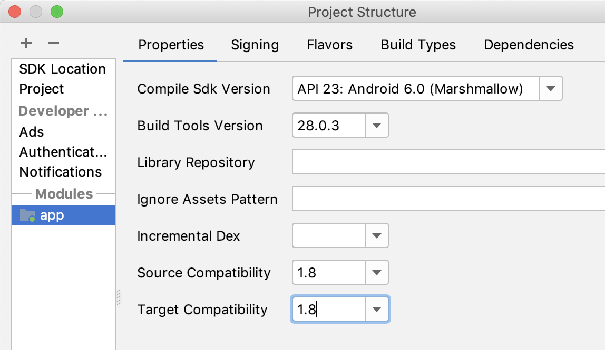
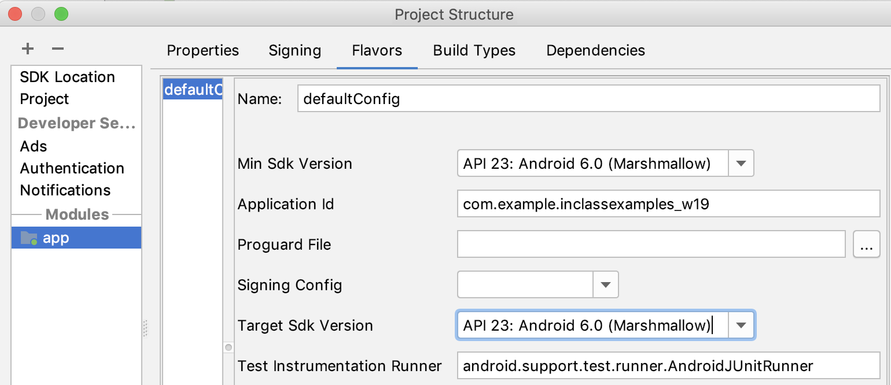
Module Settings
In Properties tab:
Set this to Android 6.0
Set this to the latest build tools
Set this to version 1.8
In Flavors tab:
Set this to Android 6.0

Slide 25
Lambda functions
setOnClickListener( new View.OnClickListener()
{ void onClick(View v) {
/* This code gets run when the button is clicked*/
} })
Becomes:
setOnClickListener( v -> { /*button is clicked*/ } )
The compiler knows that v is type View from the declaration of the setOnClickListener(OnClickListener obj ) function.

Slide 26
ImageButton
In XML, ImageButtons have a jpeg or png on them instead of text. Use android:src=“@drawable/picture_file” to specify what picture to show on the button.
In Java, ImageButtons also use an onClickHandler:
ImageButton iButton = (ImageButton)findViewById(R.id.buttonId)
iButton.setOnClickHandler( btn -> numClicks++ );
This code assumes there is an integer called numClicks

Slide 27
Text and EditText
Text is a widget that puts text on the screen. EditText is a widget that puts text on the screen but the user can edit the text. In XML, use the android:text=“@string/something”
EditText also has a hint, which is text that shows when the field is empty, but disapplears when the user starts typing:
android:hint=“@string/hint_text”
In Java, use setText( ) to set the string that is shown, or use getText( ) to get what is in the EditText
In Java, use getResources().getString( R.string.aString ) to get the right version of a string for one of the languages you support.

Slide 28
CheckBox, Switch and RadioButton
These are all buttons that can be either on, or off. The only difference is how they look. In XML, use android:checked=“true” or “false”
In Java, use isChecked() or setChecked(Boolean) to set the value:
CheckBox cb = (CheckBox)findViewById( R.id.checkbox )
cb.setChecked(true);
cb.setOnCheckChangedListener(OnCheckChangedListener )
OnCheckChangedListener is an interface that has one function:
onCheckChanged(CompoundButton cb, boolean isChecked) { }
Since there is only one function, you can use lambda functions:
setOnCheckChangedListener( (cb, isChecked) -> { } );

Slide 29
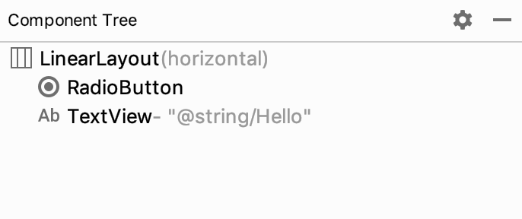
XML and Java
Whenever you create a Widget in XML, you should give it an id. Then in Java, you declare a variable for that widget, and use findViewById( ) to get the object in Java
Your XML layout can have nested layouts. A LinearLayout could have a GridLayout as its first object, and a RelativeLayout as its second object.
AndroidStudio layout designer has a
component tree which shows the
layout structure

Slide 30
Application Crashes
Your Android application will crash because of an uncaught exception. These are normally NullPointerExceptions, caused by looking for objects that are not in your layout: findViewById(R.id.something);
findViewById( ) returns null if the ID isn’t found in the view hierarchy. If you get a null pointer exception, the way to debug your application is to set a breakpoint at the start of the onCreate() function and see what is null.
Look at the PowerPoint slides for debugging for how to set breakpoints.

Slide 31
Summary
Use XML to define your layout:
<Text> and <EditText> use android:text="", and android:hint=""
Button uses android:text="", ImageButton uses android:src=""
CheckBox, RadioButton and Switch are all two-state buttons. They use android:checked.
In Java:
After setContentView( ) , use the pattern:
Widget anObject = (Widget) findViewById(R.id.objectId) ;
Text and EditText use setText() and getText()
Button and ImageButton use: setOnClickListener( e -> { } );
CheckBox, RadioButton and Switch use:
setOnCheckChanged( (btn, checked) -> { } );

