Slide 1
CST2335 Graphical Interface programming
Week 3
Application Lifecycle

Slide 2
Introduction
This week, you will learn how to start an Activity in code.
We will also learn how to pass information to other Activities at the start, and end of an Activity
This lecture is similar to Chapter 3 in the textbook, excluding fragments (pp. 47-75).
Open AndroidStudio, and select “VCS” -> “Git” -> “Pull”. Select

Slide 3
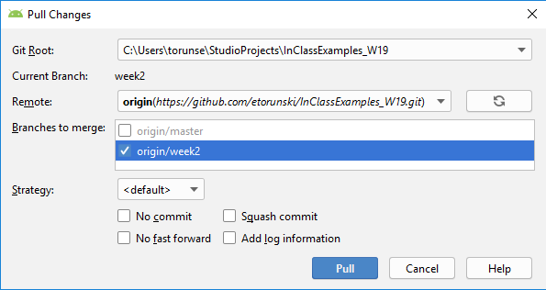
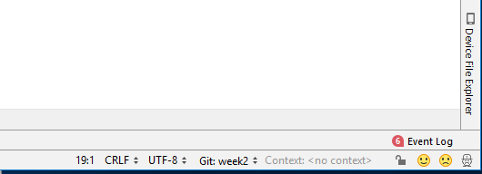
Introduction
Open AndroidStudio, and select “VCS” -> “Git” -> “Pull”. Select week2 and click the “Pull” button.
Select the week2 branch.

Slide 4
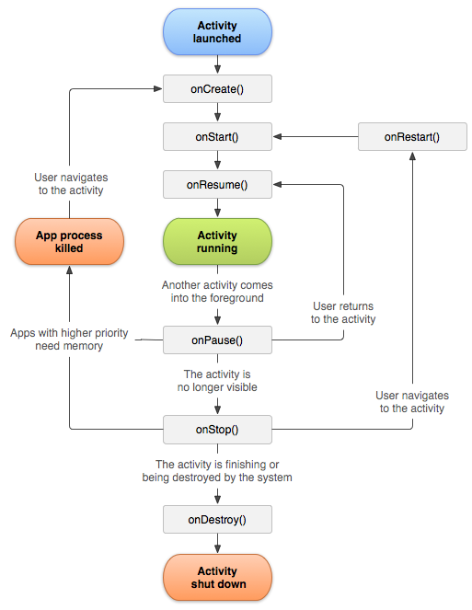
Activity Lifecycle
There are 3 functions that are called by Android when starting an Activity:
onCreate(Bundle savedInstanceState)
onStart( )
onResume( )
For stopping an activity:
onPause() – another Activity is being launched
onStop() – an activity is no longer visible.
onDestroy() – an activity is being destroyed by the system.

Slide 5
Implementing inherited functions
Open FirstActivity.java in Android studio. Type control and the letter “O” at the same time. It will show a list of all the inherited functions. Generate the functions for:
onStart, onResume, onPause, onStop, onDestroy.
Look at FirstActivity.java, and put breakpoints on each of the 6 functions. Now run the application and see what breakpoints get hit in which order. It should be:
onCreate, onStart, onResume

Slide 6
Starting / stopping Activity
The function to go to another Activity is
startActivity(Intent i)
An Intent object specifies the page where you are, and then what page you want to go:
Intent nextPage =new Intent( Activity.this, NextActivity.class);
Now to go to that page, call:
startActivity(nextPage);
In the file FirstActivity.java, look at lines 21 and 31. There are two buttons that go to two different pages.

Slide 7
Finish an Activity
finish() – this function stops an Activity and goes back to the previous Activity (back 1 page in the history)
The previous activity will call
onStart(), onResume( )
Look at SecondActivity.java, line 19. Clicking on the button with id=“previousPageButton” will go back to the previous page on the phone. It should go back to “First Page”.

Slide 8
Sending data to next page
You can attach information to an Intent object to send to the next page. The Intent class has functions:
putExtra(String name, type dataToSend); // type is int, long, String
This creates a map which reserves the dataToSend under a name.
intent.putExtra(“name”, “Eric”);
intent.putExtra(“age”, 20);
intent.putExtra(“typed”, editText.getText())
Look at line 33 in FirstActivity.java
Name | Value
name | Eric
Age | 20
typed | editText.getText()

Slide 9
Getting data from previous page
In Android, you can retrieve the Intent object that caused the transition with the function getIntent()
To get the values that were reserved under names, use getIntExtra(), getStringExtra(), getBooleanExtra(), etc.
In next activity:
intent = getIntent()
intent.getStringExtra(“name”) -> ”Eric”
intent.getIntExtra(“age”) -> 20
intent.getStringExtra(“typed”) -> whatever the user typed in editText
Name | Value
name | Eric
Age | 20
typed | editText.getText()

Slide 10
Sending data back to previous page
Before calling finish() to go back to the previous screen, you can call setResult(int resultCode, Intent dataBack)
After calling finish(), Android will go back to the previous page. If you want to send an Intent back, you have to use startActivityForResult(Intent i, int requestCode) instead of startActivity() mentioned before. When you come back to the previous page, it will call onActivityResult(int request, int result, Intent dataBack)

Slide 11
Sending data back to previous page
onActivityResult(int request, int result, Intent dataBack)
The request parameter is what you put in the startActivityForResult(Intent i, int request). This tells you what Activity just finished.
The result parameter tells you what the result was set to in the previous Activity: setResult(int result). This is used to tell what button was pushed to finish the Activity. Hitting the Android back arrow will make result == 0.

Slide 12
Activity sequence
ActivityA
startActivityForResult( Intent, requestCode) ;
onActivityResult( requestCode, resultCode, intent);
The original requestCode gets passed back to onActivityResult, as well as the resultCode, and intent.
ActivityB
onCreate(), onStart(), onResume()
setResult(resultCode, intent), finish(), onPause(), onFinish()

Slide 13
Intents
Android has pre-defined Intents for various actions. You don’t have to specify the next Activity class you will go to. You can just specify what action you want to perform and Android will offer a list of Activity object that implement that action.
You can use these to see what the default Activity on your phone for an Intent:
Intent.ACTION_CALL : launch the phone calling Activity
Intent.ACTION_VIEW : launch a web browser
MediaStore.ACTION_IMAGE_CAPTURE : take a photo

Slide 14
Intent to send email
Intent intent = new Intent(Intent.ACTION_SEND);
intent.setType("text/plain");
intent.putExtra(Intent.EXTRA_EMAIL, new String[] {"email@example.com"});
intent.putExtra(Intent.EXTRA_SUBJECT, "subject here");
intent.putExtra(Intent.EXTRA_TEXT, "body text");
startActivity(intent);

Slide 15
Intent to view web page
String url = "http://www.algonquincollege.com";
Intent i = new Intent(Intent.ACTION_VIEW);
i.setData( Uri.parse(url) );
startActivity(i);

Slide 16
Bundle
Bundle is an object for storing data by storing the data along with a String variable name, similar to an Intent.
For saving data, use functions like:
putByte(String key, Byte b),
putFloat(String key, Float f),
putIntegerArrayList(String key, ArrayList<Integer> list)
For getting data use the function you saved it with:
getByte(String key)
getFloat(String key)

Slide 17
Bundle data
Missing data: if you call getFloat("String name"), or getByte("anyName") and the name does not appear in the bundle, then it returns 0, or null.
Wrong data type: if the data type is wrong, meaning that you saved putByte("MyNumber", 5), and you call getFloat("MyNumber"), it returns 0 instead of 5.0.
You can put an entire bundle in an Intent to send to the next activity using the putExtras() function.

Slide 18
SharedPreferences
SharedPreferences provides an interface for saving data to a file on your device.
SharedPreferences prefs = getSharedPreferences(String fileName, int mode)
The String fileName specifies the name of the file, mode is the security permissions – use Context.MODE_PRIVATE
getSharedPreferences() returns a SharedPreferences object for reading and writing data.

Slide 19
Reading / writing sharedPreferences
From the sharedPreferences object, you must get the Editor object: SharedPreferences.Editor edit = prefs.edit();
The editor has putString(String key, String value), putFloat(String key, float f), putInt(String key, int i)…etc
You must call commit() when all your values have been set to save them to the file: edit.commit();
SharedPreferences has getInt(String key), getFloat(String key), etc. to read whatever data was in the file.

Slide 20
Modify example
In ThirdActivity.java, the layout has a button that says “Save”, but it doesn’t do anything yet. How can we make clicking on that button go to the Activity: SharedPreferencesExample.java?
In onCreate, find the button:
Button save = (Button)findViewById(R.id.saveButton);
Then add an onClickListener:
save.setOnClickListener ( bt -> { });
Now create an intent to go to the Activity, and call startActivity( ) to make the transition:
btn -> { startActivity( new Intent( ThirdActivity.this, SharedPreferencesExample.class) ); }

Slide 21
SharedPreferencesExample
In the onCreate, it opens a shared preferences file called “FileName.xml” and rebuilds the reservation table.
It looks what was saved under the name “ReserveName”. If the name is not found, then the second value is used instead: “Default Value”
It then puts it in the editText: typeField
When you go back, it opens a SharedPreferences Editor. Under the name “ReserveName”, it saves what you put in the edit text.
Verify what is saved by using “adb shell” in the terminal to log onto your phone. Navigate to “/data/data/your-package/shared_prefs”. The file “FileName.xml” should be there now. Type “cat FileName.xml” to show what is in your XML file.

Slide 22
Debugging Information
Android has a Log class for printing out information. It is similar to System.out.println, except it prints out to the debugger on your laptop, not on your phone.
There are several functions for printing information. You can filter these messages with your debugger:
Log.i( ) // prints out information
Log.w( ) // prints out warnings
Log.e( ) // prints out errors
Log.v( ) //prints out verbose (detailed) messages.

Slide 23
Summary
Intent object starts a transition from one page to another. You can also send data using putExtra(“Name”, value)
Call startActivity(intent) to go to the next page. If you are expecting an Intent object back from that page, use startActivityForResult(Intent i, int request).
From the next page, use setResult(Intent data, int result)
The previous page will call onActivityResult(request, result, data).
SharedPreferences write data to the disk for use later.

Slide 24
Summary
You should learn how to use these functions:
startActivity()
startActivityForResult()
setResult()
finish()
onActivityResult()
getSharedPreferences()
commit()

