Slide 1
CST2335 Graphical Interface programming
Week 6
Toolbar and Dialogs

Slide 2
Introduction
This week, you will learn how create a toolbar, and add items for a menu.
You will also learn how to create dialog boxes for getting user input, and displaying information to the user.
This code follows the “Week 6” branch of the source code examples.

Slide 3
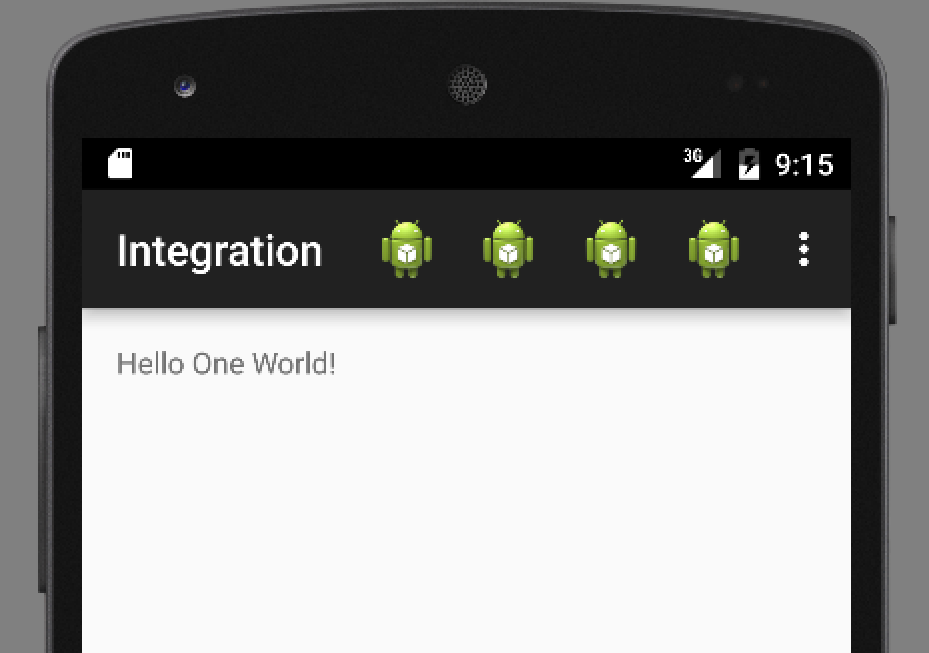
Action Bar
Menu Items
Overflow menu

Slide 4
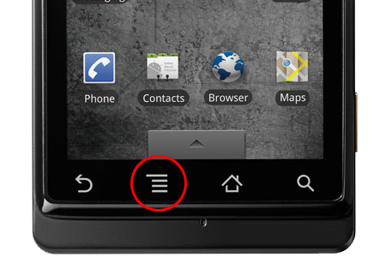
Action Bar
All Activities have an Action Bar associated with them. It is really a menu, but you can associate Icons with the menu items.
It was introduced in Android version 3. Previously, Android had a dedicated hardware button for making the menu appear.

Slide 5
ToolBar
If you aren’t using AppCompat libraries:
Add a ToolBar element to the Activity’s layout
<Toolbar
android:id="@+id/my_toolbar"
android:layout_width="match_parent"
android:layout_height="match_parent"/>
If you are, use this version of Toolbar:
<android.support.v7.widget.Toolbar
android:id="@+id/my_toolbar"
android:layout_width="match_parent"
android:layout_height="match_parent"/>

Slide 6
ToolBar
Turn off Action Bar in styles.xml: If you’re not using AppCompat:
<item name="android:windowActionBar">false</item>
<item name="android:windowNoTitle">true</item>
If you are using AppCompat:
<item name="windowActionBar">false</item>
<item name="windowNoTitle">true</item>

Slide 7
ToolBar
... In onCreate…
onCreate(savedInstanceState:Bundle) {
super.onCreate(savedInstanceState);
setContentView(R.layout.activity_my);
var myToolbar = (Toolbar)findViewById(R.id.my_toolbar);
setActionBar(myToolbar); }
The setActionBar(Toolbar tb) function causes Android to call onCreateOptionsMenu(Menu menu)

Slide 8
ToolBar
If you are using AppCompat libraries:
var myToolbar = (Toolbar)findViewById(R.id.my_toolbar);
setSupportActionBar(myToolbar);

Slide 9
Activity functions
The Activity class has 2 functions you should override:
onCreateOptionsMenu(Menu m)
onMenuItemSelected(MenuItem mi)
onCreateOptionsMenu(Menu M) //This inflates the menu from your XML layout:
@Override
public boolean onCreateOptionsMenu(Menu menu) {
// Inflate the menu items for use in the action bar
MenuInflater inflater = getMenuInflater();
inflater.inflate(R.menu.main_activity_actions, menu);
return true;
}

Slide 10
Adding items
By now, the toolbar is empty but it is integrated with the Activity. The next step is to create a <Menu> resource, and add <Item> tags to your menu.
Right-click on the res folder, and select new resource file. In the resource type, select Menu.

Slide 11
Menu Items
There are several important parts of a menu item:
android:id=“@+id/someID” // This is used later
android:icon=“@drawable/someFilename” //A PNG file to draw
android:title=“@string/text” //Text for overflow menu
android:orderInCategory=“100” //Items are drawn in order
If you are using AppCompat:
app:showAsAction=“always|ifRoom|never” //should icon be drawn?
If you are not using AppCompat:
android:showAsAction=“always|ifRoom|never”

Slide 12
Example
/res/menu/example_menu.xml
If the showAsAction=“always”, then Android looks at the icon parameter and draws the picture at the top of the screen.
If showAsAction=“never”, then Android looks at the title parameter and writes the string on the overflow menu.
The id parameter is used for when a menu item is selected. Android calls onOptionsItemSelected and passes in the item object that was clicked.

Slide 13
Activity functions
onOptionsItemSelected(MenuItem mi) - This function responds to an Item being selected:
@Override
public boolean onOptionsItemSelected(MenuItem item) {
// Handle presses on the action bar items
switch (item.getItemId()) {
case R.id.action_one:
//show a Toast
break;
case R.id.action_two:
//launch another Activity
break;
...
}
}
Add cases for each ID of items
from your XML menu

Slide 14
Toolbar Search button
Many toolbars have a search icon. You can add one to the toolbar by using actionViewClass
<item
android:id="@+id/action_search"
app:actionViewClass="android.widget.SearchView"
android:icon="@android:drawable/ic_search_category_default"
app:showAsAction="always|collapseActionView" android:title="@string/search_text_button" />

Slide 15
Toolbar Search button … 2
Many toolbars have a search icon.
... In onCreateOptionsMenu()…
getMenuInflater().inflate(R.menu.mymenu, menu);
MenuItem searchItem = menu.findItem(R.id.action_search);
SearchView sView = (SearchView)searchItem.getActionView(); sView.setOnQueryTextListener(new SearchView.OnQueryTextListener() {
@Override
public boolean onQueryTextSubmit(String query) {
}
@Override
public boolean onQueryTextChange(String newText) {
return false;
} });

Slide 16
ToolBar summary
Add a ToolBar to your Activity Layout.
In the Activity’s OnCreate, get the ToolBar and call setActionToolbar().
Create a Menu resource with Items in the menu.
In onCreateOptionsMenu(), inflate the Menu resource.
Handle each Item id in onOptionsItemSelected()

Slide 17
Dialog Boxes
Dialog boxes are fairly flexible for how you design them.
They follow the builder pattern, where you create a DialogBox, and keep chaining function calls.
The 3 important parts are:
Text – what are you telling / asking the user?
Positive Button – A button for accepting
Negative Button – A button for rejecting / canceling

Slide 18
Dialog Boxes
AlertDialog.Builder builder = new AlertDialog.Builder(getActivity());
builder.setMessage(R.string.dialog_fire_missiles)
.setPositiveButton(R.string.fire, new DialogInterface.OnClickListener() {
public void onClick(DialogInterface dialog, int id) {
// What to do on Accept
}
})
.setNegativeButton(R.string.cancel, new DialogInterface.OnClickListener() {
public void onClick(DialogInterface dialog, int id) {
// What to do on Cancel
}
});

Slide 19
Dialog Boxes
If you need a 3rd button, there is a Neutral button:
.setNeutralButton(R.string.fire, new DialogInterface.OnClickListener() {
public void onClick(DialogInterface dialog, int id) {
// What to do on Neutral button
}
})
Once a Builder has all the information, call .create() to cause Dialog to be built. After, call .show() for the Dialog to be presented:
builder.create().show();

Slide 20
Custom Dialog Boxes
You can create a specific layout resource, and inflate it for your Dialog:
LayoutInflater inflater = getActivity().getLayoutInflater();
View v = inflater.inflate(R.layout.YourLayout, null);
builder.setView( v )
You can then continue setting the Positive/Negative buttons:
.setPositiveButton( ...)
.setNegativeButton( ... )
.create() .show()

Slide 21
Toast
Toast is a message window that appears for a short while and disappears. To invoke it, call:
Toast.makeText(Context ctx, String message, int duration).show()
ctx is the activity currently on screen, message is what String to show, and duration is either Toast.LENGTH_LONG or Toast.LENGTH_SHORT

Slide 22
Snackbar
Snackbar is almost the same, except the message window appears from the bottom of the screen. To invoke it, call:
Snackbar.make(View v, String message, int duration).show()
v is a view that is visible on the screen, message is the message, and duration is one of Snackbar.LENGTH_LONG, Snackbar.LENGTH_SHORT or Snackbar.LENGTH_INDEFINITE

Slide 23
Snackbar
Snackbar also has a text message that acts as a button. To use this button, call:
setAction( String s, OnClickListener { })
When the user clicks on the String, the OnClickListener gets called.

Slide 24
Summary
ToolBars allow you to put menus at the top of your activity
There is some work involved in getting it set up, but then you can just add Menu Items to your Menu resource, and handle the case when their ID is selected in onOptionsItemSelected().
Dialog boxes allow you to quickly create custom Dialogs. You can also create your own layout and attach callbacks.

Slide 25
Android vs. Support libraries
Activity .............................AppCompatActivity
Toolbar…………………….v7.widget.Toolbar
getFragmentManager……getSupportFragmentManager
setActionbar……. ………..setSupportActionBar
nothing……..………….….Snackbar
nothing……..………….….NavigationView
In Styles.xml:
Theme ……………….…Theme.AppCompat

