Slide 1
Lets start testing
Chennai.rb meet, 18july2015

Slide 2
Lets start testing
The agenda:
The Premise
Rspec basics
Testing models
Factories with Factory-girl
Stubbing
Testing UI with Capybara
Testing javascript

Slide 3
Speaker
Abhishek Yadav
@h6165
Freelance Ruby programmer
Volunteer at Chennai.rb

Slide 4
The premise

Slide 5
The Premise
    Here: Testing == Automated testing
    Why test ?
    What about non-automated tests ?
    Who writes the tests ?
    When to start testing ?
    TDD

Slide 6
The Premise: why test?
    Verification : Does this feature work?
    Regression spotting: Something broke something else
    Specification: The machine should work this way
    Documentation: Test describes how it should behave
    Developer feedback:
      What I thought will not work
      What I thought and what client wanted are different
    Code design: Decoupling, cleaner interfaces, better OOP

Slide 7
The Premise: Manual testing
    The default
    Easy to start – needs product knowledge and common sense
    Tester.price < Developer.price (generally)
    Can cover UI-aesthetics

Slide 8
The Premise: Semi automated testing
    Need human involvement, but parts are automated
    Examples:
      Record and playback
      Export and compare
    Quicker, less boring

Slide 9
The Premise:
Automated tests: why
    Automated
    Repeatable
    Pipeline-able
    [Rspec] Easy (after initial threshold)
    [Rspec] Fun
    +
    Benefits of TDD

Slide 10
The Premise: Who writes the tests
    The developer
    'Testers should write tests, not me' is an outdated excuse, and has no place in Ruby world

Slide 11
The Premise:
When to start testing
    As early as possible
    No tests are okay for:
    Prototype level projects that may not live after 2 months
    Manual QA is simple and cheap

Slide 12
The Premise:
When to start testing
    Its too late signs:
    Regressions.
    Implementation slowness.
    Poor quality in general
    Developer stress

Slide 13
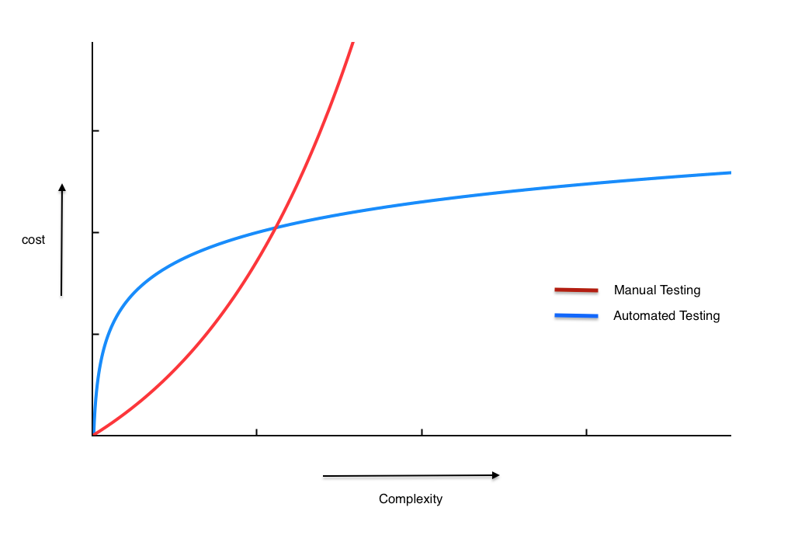
The Premise:
When to start testing
    At some point,
    cost of manual testing exceeds the cost of automated testing

Slide 14
The premise: TDD
Write test first, then the code
Needs specification beforehand as examples
Ideal fit when specs are available (software consulting with requirements)
Leads to good code design

Slide 15
The premise: TDD
This talk isn't about TDD
Its about testing, using a popular tool: rspec, generally applicable to Rails web application projects
This may be a stepping stone towards TDD

Slide 16
Rspec basics

Slide 17
Rspec Basics
    It is a test framework and a test runner
    We write test-cases using Rspec recommended syntax
    For verification, we use Rspec provided assertion methods
    We create data on our own (or using factories or fixtures) – Rspec has no involvement there

Slide 18
Rspec basics
Test-case syntax: it method:
  it 'should give 5 for 2 and 3' do
    # Invoke the code (calculator here)
    # Verify the result
  end

Slide 19
Rspec basics
The syntax: describe methods
  Encloses the test cases
  Names the thing under test
  describe 'Addition-calculator' do
      it 'gives 5 for 2 and 3' do
      end
      It 'gives 3 for 3 and 0' do
      end
  end

Slide 20
Rspec basics
The syntax: verification: expect-to-eq
    expect(result-value).to eq(expected-value)
    Example:
      Rspec.describe 'MyCalculator' do
      it 'should give 5 for 2 and 3' do
        sum = MyCalculator.add(2, 3)
        expect(sum).to eq(5)
      end
      end

Slide 21
Rspec basics
The syntax: Thats it.
There are many more methods, concepts and conveniences
But to get started, this much is just fine

Slide 22
Rspec basics
Running it:
  The code under test should have been loaded before the describe block starts
  rspec test_file.rb
Demo: 1_spec.rb

Slide 23
Rspec basics
Notes about setup:
  Proper setup requires a Gemfile with rspec in it
  Then bundle install ---binstubs
  Then bin/rspec –init creates spec_helper and spec/
  Tests are kept in a spec directory
  All test files should require the spec_helper on top

Slide 24
Rspec with Rails

Slide 25
Rspec with Rails
What can we test -
  Models
  Controllers
  Views ?
  Rake Tasks ?
  Javascript
  Overall UI ?

Slide 26
Rspec with Rails
What can we test, IMO -
  Models Yes
  Controllers Almost
  Views Maybe
  Rake Tasks Maybe
  Javascript Yes
  Browser UI Yes
  API Yes
  Note: lib/ is also Yes

Slide 27
Rspec with Rails

Slide 28
Rspec with Rails
Rules of the game:
    Rails uses MiniTest by default – choose one
    Rails has separate ENV and database for testing
    Rspec tests are in spec/ folder
    Rspec config is in spec/spec_helper and spec/rails_helper files
    spec/rails_helper is required in all test files

Slide 29
Rspec with Rails
Rules of the game:
    Tests run:
      rake for all
      bin/rspec spec for all
      bin/rspec spec/models for tests in models folder
      bin/rspec spec/models/user_spec.rb for User model
      bin/rspec spec/models/user_spec.rb:15 for test on line 15

Slide 30
Rspec with Rails
Rule of the game
    Test-db should be empty when test is not running
    Every test-case must create its data in test-db, and wipe it out when done. (Rspec does this for us)
    Every test-case must be independent. It should not share any data/variables with another test. So we can run tests in any order. (Rspec does that too)

Slide 31
Rspec with Rails
Rule of the game
    Since Models are tightly tied to ActiveRecord, model tests are not always unit test (Though this doesn't matter much)
    We try to avoid database interaction in tests, as much as possible

Slide 32
Rspec with Rails
Rule of the game:
    We run the tests on developer computers or separate test servers (called CI server too)
    We DO NOT run tests on staging or production
    [Again] We DO NOT maintain any data in test-db

Slide 33
Rspec with Rails
Demo:
  blog: post_spec

Slide 34
Rspec with Rails
Post demo:
  Creating data can get difficult
  References to other classes, what to do with them?

Slide 35
Factories with Factory girl

Slide 36
Factories with Factory girl
    Factories are one way to create data for tests
    Data creation can become difficult when there are validations
    There are other Factory gems:
      Machinist
      Fabrication

Slide 37
Factories with Factory-girl
  Rails default is Fixtures. It is:
    Data expressed in YAML files,
    Loaded in the DB at the start of test suite
    much faster than Factories
    Are global
    Must be carefully maintained with database migrations

Slide 38
Factories with Factory-girl
factory :registered_user, class: User do
sequence(:username){|n| "registered-#{n}" }
first_name 'example-fn'
last_name 'example-ln'
date_of_birth 35.years.ago
gender 'Male'
phone_number { "1234567#{rand(9)}89" }
sequence(:email) { |n| "registered#{n}@example.com" }
password 'example-password'
password_confirmation {|u| u.password }
registration_state 'registered'
company { create(:company) }
after(:create) do |user, e|
user.add_role(:general_user)
end
end

Slide 39
To be continued

