Slide 1
Black Lodge Research
Capture The Flag

Slide 2
What the hell is this?
Black Lodge Research CTF
Public outreach for hands on security experience
CTF competitions – Join the team or just play with us
Skill development – Build and practice with others
Wanna break shit? Get your learn on? Like competition? Talk shop?
Then come kick it!
Notes:
Both – go back and forth

Slide 3

Who the hell are we?
0xFED – Security Researcher
Hoc Genu – IT Professional
Just some members who want to put “hack” back in “hacker space”.
We love CTF.
Don’t worry we didn’t quit our day jobs (yet).
Please don’t feed the makers. Just Kidding.
(We like tacos (hint hint))
Notes:
Both – back and forth

Slide 4
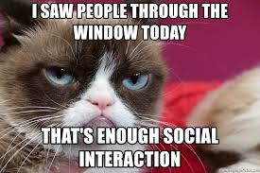
That’s enough social interaction for one day.

Slide 5
So what's this CTF thing?
Capture the Flag (CTF) is a special kind of information security competition.
You get to really hack on real things in our environment.
You can learn about various topics by doing such as Cryptography, Application exploitation, Reverse Engineering, Forensics, Web application security, etc. Just to name a few.
Team based, individual based, we do both.
Its legal and safe!
Notes:
Taylor

Slide 6
Cool! What other topics are there?
Cryptography
Wireless challenges
Crack me/keygens
Application exploitation
Web application exploitation
VoIP/SIP exploitation
Security/Hacker Trivia
Boot to root challenges
Reverse engineering
Forensic challenges
Steganography
Firmware challenges
Network attacks/challenges
Malware analysis challenges
Privilege escalation
Information disclosure
Misconfigurations
Mobile challenges (Phones, tablets)
IoT challenges
Reconnaissance challenges
The list keeps growing
Notes:
Both – different topics

Slide 7
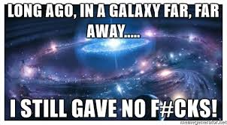
So what inspired this idea?
There was alcohol.
On a Thursday.
Really, really late at night.
Not very long ago.
In a hacker space not very far away.
Notes:
Mike

Slide 8
Someone had to do it.

Slide 9

FUCK!
That means us.
(Shit.)

Slide 10
So why do you CTF?
ITS SUPER FUN!
It can be extremely challenging
Get that learn on
Gain some experience
Build out that resume
All the cool kids are doing it
Notes:
Taylor

Slide 11

Great what do I need to get started?
Curiosity (required)
Computer (yeah kind of required too)
Source of caffeine
Source of alcohol
Tacos (recommended)
Notes:
Mike

Slide 12
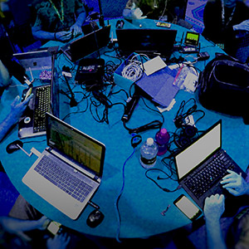
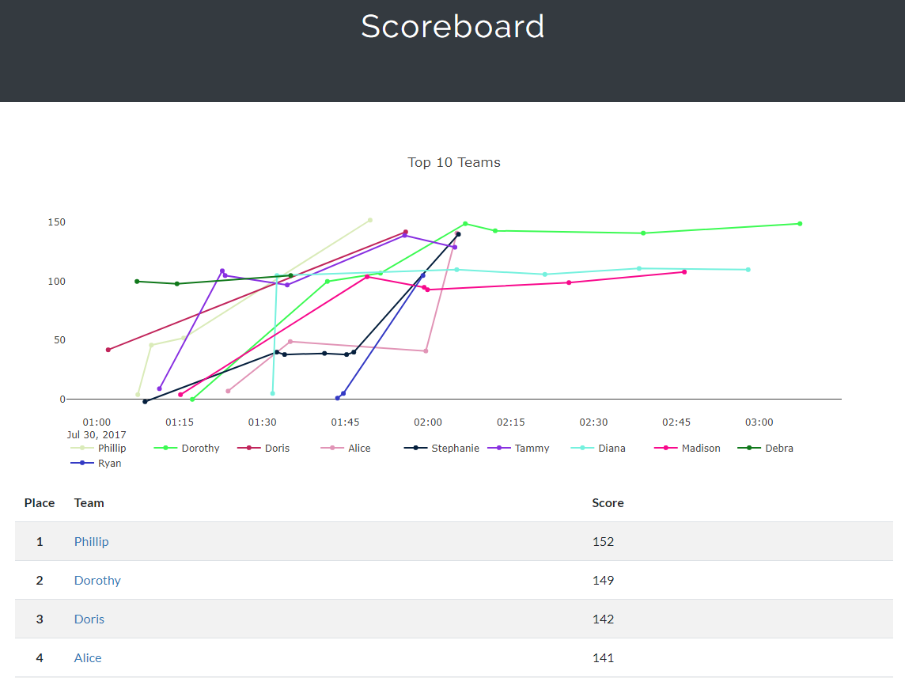
So what does a CTF actually look like?
Image shamelessly stolen from DEFCON.org
Notes:
Mike

Slide 13
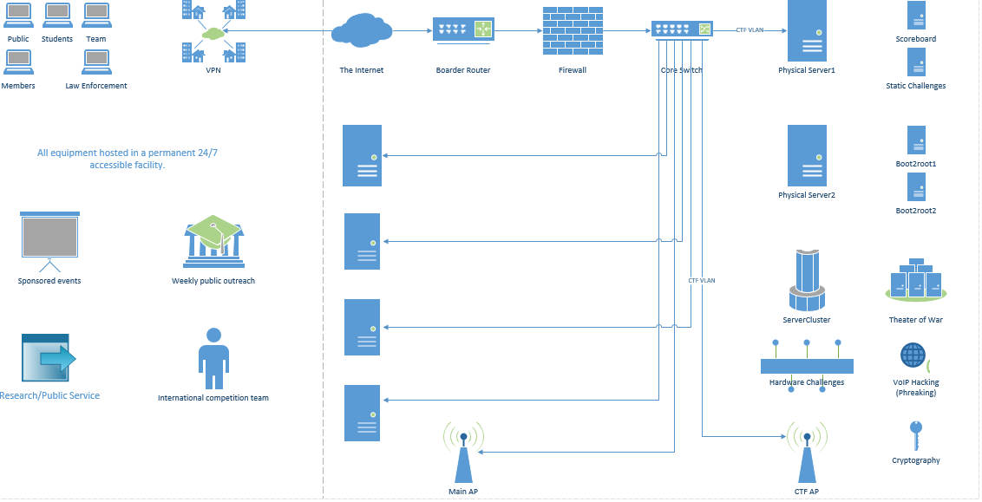

The network
Notes:
Mike

Slide 14
Scoring
Scoring for now is being done through CTFd.
It is both easier and harder to manage than you think.
Points are awarded based on difficulty.
Hints may cost you.
Notes:
Both – back and forth

Slide 15
Challenges
Creating challenges is about as challenging as solving them.
Variety is important.
Mix of static and virtualized.
Mix of shamelessly stolen borrowed and custom creations.
Notes:
Taylor start
Both

Slide 16
Organization
Education and skill development is key.
New and advanced players both need to be challenged.
Finding a time and a location is kind of a big deal.
Everyone shows up at the same place? Everyone is remote?
Notes:
Mike

Slide 17

WHY NOT BOTH?

Slide 18
Pwning from afar
Having a VPN allows for ease of management.
Greater service area.
MORE PLAYERS!
Less commuting more rooting.
Now everyone can play!
Notes:
Taylor start
Both

Slide 19
Documentation
Intro to CTF.
Brief intro to tool kits.
CTF write up style guide.
Creating a library.
Do these slides count?
Notes:
Both

Slide 20
Financials
Self funded.
Initial build out? about $1000.
Pwning with your friends? PRICELESS.
Volunteer donations made it way better. THANK YOU!
REPC and Amazon were critical.
Worth every cent.
Notes:
Mike start
Taylor chime in as needed

Slide 21

WHAT THE FUCK

Slide 22
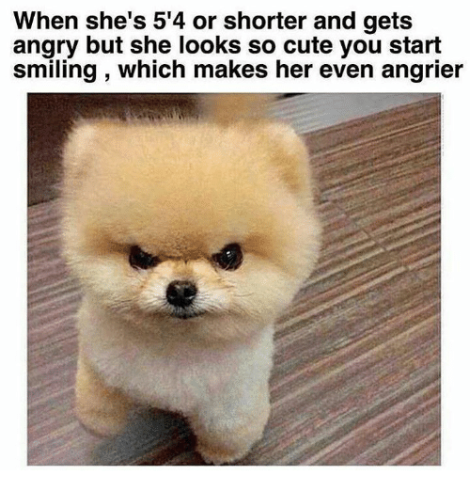
Problems we encountered
The cloud wont work.
Sooo, we need a server then, right? Don’t those cost money?
The network core.
Where did all the challenges go?
The RAID controller ate my homework.
LVM blues.
I won’t be home for dinner
(My girlfriend was kinda mad)
Notes:
Mike

Slide 23
What is it like to build a CTF?
Building a CTF is a hard, frustrating, experience.
It is far more rewarding.
You have to outsmart those smarter than you.
People who play CTF are some of the coolest people you can meet.
Community support is awesome.
Notes:
Taylor start
both

Slide 24
What will they think of next?
We are accepting and building new challenges.
Theater of war and total world domination.
Remote accessibility for everyone! (except that one guy fuck that guy)
Firmware shaming (Pwning poor innocent firmware)
SCADA anyone?
Turn public panic in to new exciting challenges! (Shell shock, Heart bleed, and the very many others)
Notes:
Both

Slide 25
So where do we go from here?
Lets get together and learn and break shit.
What if we had a Black Lodge Research CTF Team?
Building an info sec knowledge base (Pwn-o-pedia)
What about a dedicated CTF gathering?
Notes:
Mike start
Both

Slide 26
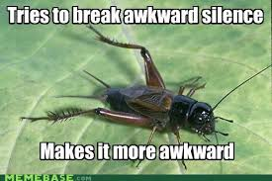
Questions? Crickets?
Awkward silence?

Slide 27
Thank you!
Black Lodge Research: Cryptomonkey Embalmed Hattz Spoons Dune Jake Colby Bryan (and his buddy for the servers!) Phil Ben Subterfuge Noid | DC206: Blibbet WA2600: Brand0 Charon Johnny Others: LadyD410 Steven Protocall7
A special thank you to Lil diesel
Oh to hell with it, thank you, ALL of you!

