Slide 1
“Bullet Bot” (Working Title) Game Pitch
Created By Team Quicksilver

Slide 2




Team Quicksilver
Rahmaan Lodhia
Graduate (E.C.E.)
PhD Student
rahmaanl@gatech.edu
Mitch Leff
Undergrad (C.S.)
Junior
mal8960@gatech.edu
Larry He
Undergrad (C.S.)
Senior
larry.he@gatech.edu
William Gu
Undergrad (C.S.)
Junior
wgu36@gatech.edu

Slide 3
Basic Gameplay and Core Mechanics
Bullet Bot is an isometric 3D stealth-action game where you control a robot that can shrink himself into a bullet to launch at enemies
The game’s core mechanics revolve around a stringent energy system where all your actions drain units of energy
Being caught by an enemy or running out of energy results in a Game Over, so every input and choice matters in this game

Slide 4
Formal Elements of the Game
Objectives
Navigate to the end of the level
Avoid enemy detection and eliminate enemies before they can eliminate you
Restrictions
Limiting energy resource
Low durability
Enemy detection
Procedures
Starting: Introduction of basic mechanics and simple enemies
Progression: More mechanics, harder levels, increasingly complex enemies
Special: Abilities that can be activated using a limited resource
Resolving: Beating all levels

Slide 5
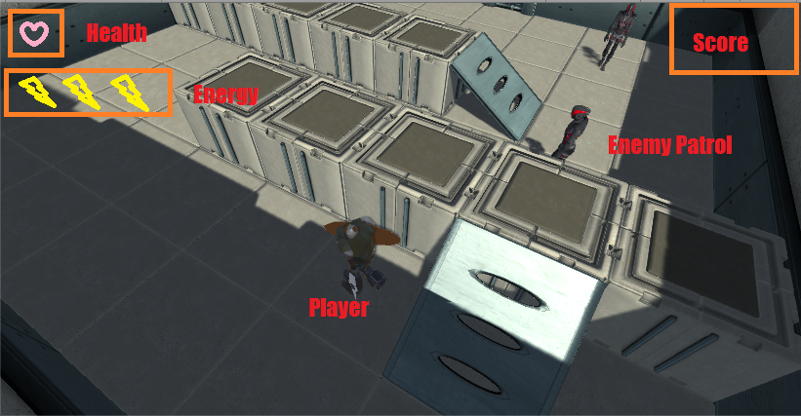
Game Mockup

Slide 6
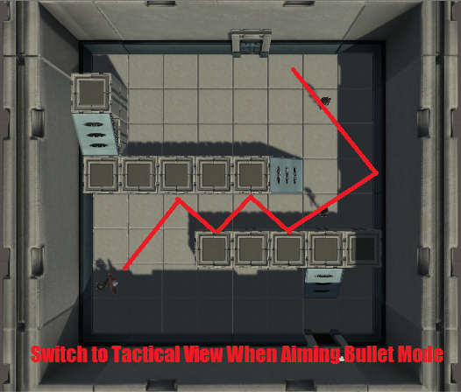
Tactical View

Slide 7
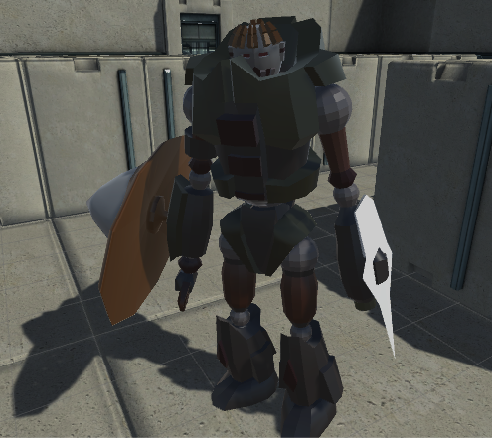
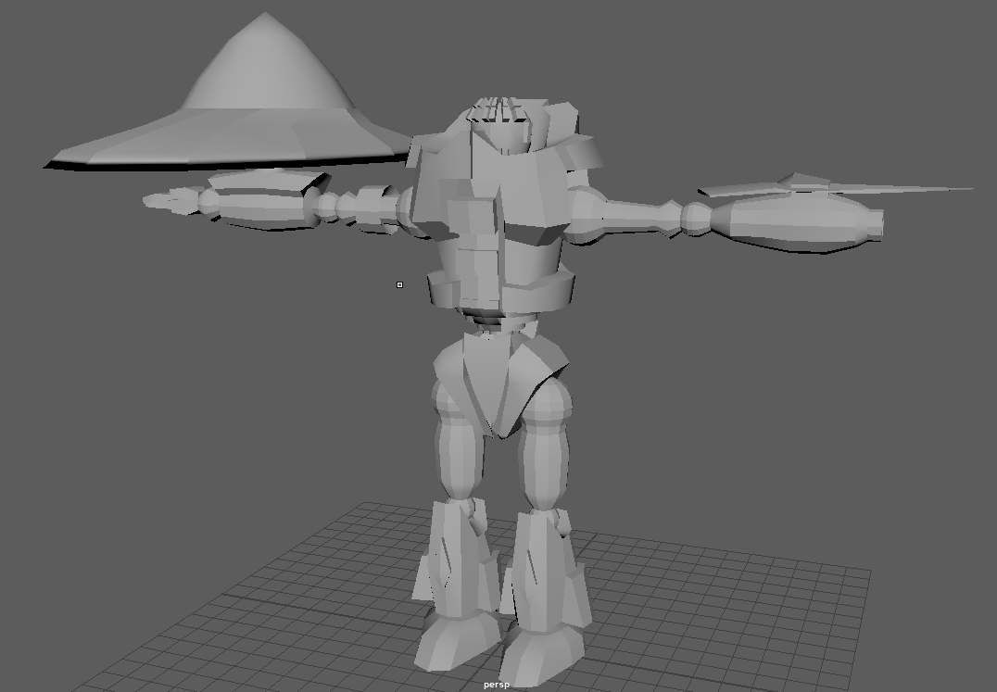
The Hero

Slide 8
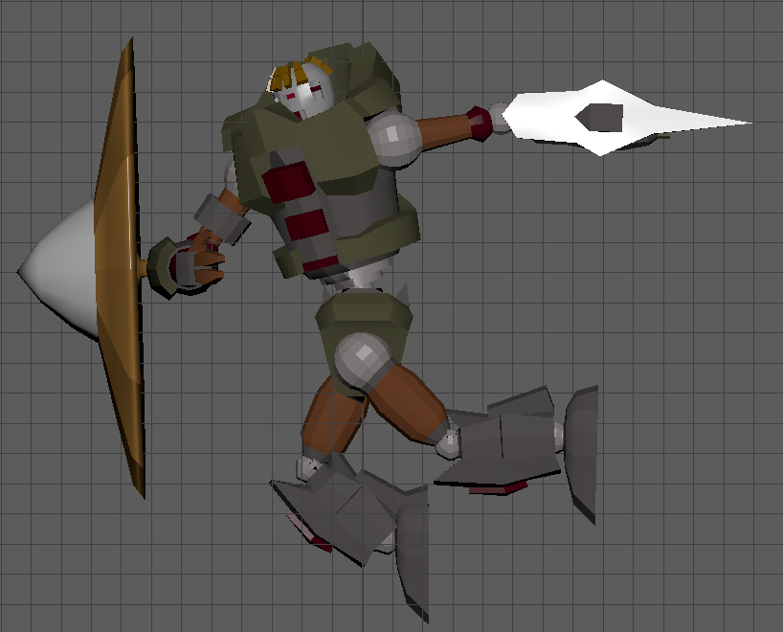
Player Abilities
Player Actions
Moving (walking, crouching, etc.)
Attacking
Shrinking
Shooting
Dashing
Every action costs energy
Cost varies between actions to help encourage careful approaches to levels
Can be regained by:
Defeating enemies
Energy recharge stations in level

Slide 9
Enemies
Enemies patrol and protect the level’s exit
Detect the player’s interaction with environment and react to them
Pre-determined enemy placement per level
Different Enemy types - simple, shielded, heavy, etc.
Not every enemy has to be killed
Some can be avoided if the player is careful
Some levels may require certain enemies to be defeated to unlock the level’s exit

Slide 10
Prototyping Plans
Pen and paper prototypes
Turn the game into a turn-based game on grid paper
Grid represents environmental units (obstacles, floor, doors, etc.)
Translates directly to a 3D level design
Goal is to rapidly build and test level designs and mechanics
Using successful paper level designs, create and play-test 3D version of levels in Unity

Slide 11
Key Prototyping Questions
How do players react to the energy system?
Are they running out of energy too quickly or too slowly?
How often does a player lose a level from running out of energy?
Are players avoiding fights, engaging enemies, or a mix of both?
Are the controls easy to pick up?
How often are players using each respective ability?
How much time did the player feel like they played?

Slide 12
Work Plan
Main Player
Refining controls and physics interactions
Developing the model, key animations, and blend tree
Enemy Design and AI Pathing
Create several types of enemies
Design AI to react to player movements and mistakes
Environment
Game obstacles - Crates, doors, tunnels, etc.
HUD - Display key game info in an aesthetically pleasing manner
Sound effects - Metal clank sounds when bullet hits walls or when player falls off high position, etc.

Slide 13
Questions?

