Slide 1
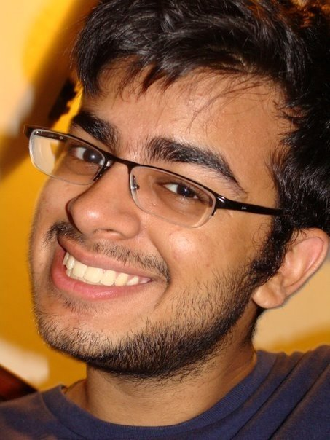
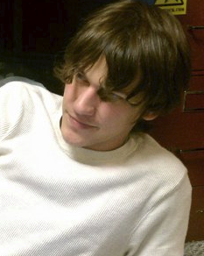
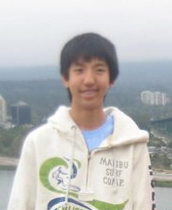
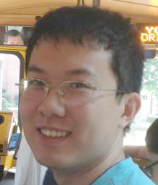
Team Quicksilver
Rahmaan Lodhia
Graduate (E.C.E.)
PhD Student
rahmaanl@gatech.edu
Mitch Leff
Undergrad (C.S.)
Junior
mal8960@gatech.edu
Larry He
Undergrad (C.S.)
Senior
larry.he@gatech.edu
William Gu
Undergrad (C.S.)
Junior
wgu36@gatech.edu

