Slide 1
Research Plan
Robust Temporal Representation Learning for Weakly Supervised Video Anomaly Detection
A doctoral research plan focused on efficient temporal models, vision-language semantics, and generalization to unseen anomalies.
WSVAD | SSMs | VLMs
Presented to the doctoral jury: Máximo Enrique Pacheco Martínez

Slide 2
Defense Roadmap
01
Academic background
02
Context and research problem
03
Scientific gap, objective and central hypothesis
04
Three-stage methodology, previous research, evaluation, and expected contributions

Slide 3
DOCTORAL RESEARCH PLAN
01 Academic background
Academic Background
Maximo Enrique Pacheco Martinez | Mexican | BUAP | Computer science researcher with work in artificial intelligence particularly in metaheuristics and NLP.
Profile
Publications
My previous work provided a strong foundation in machine learning, representation learning, and sequence modeling. These experiences motivated my transition from Natural Language Processing to Computer Vision, where temporal representation learning has become the main focus of my PhD.
Binary harmonic search for attribute selection. Research in Computing Science, Ciudad de México, México, August 2022
Harmony search for hyperparameters optimization of a low resource language transformer model trained with a novel parallel corpus Ocelotl Nahuatl – Spanish. Systems and Soft Computing, Netherlands, December 2024
Undergraduate thesis
Master's thesis
Recurrent neural networks applied to speech recognition and machine translation from Spanish to Japanese (2019)
Machine translator from Nahuatl to Spanish (2023)
Scholarships and awards
Conference Work
CONCYTEP Young Researchers Program, 2014
CONCYTEP Thesis Scholarship, 2018
CONACYT Graduate Scholarship, 2021-2023
MEXT – Research - Current
Binary Harmony Search for Attribute Selection, CONACIC (2022)
Ocelotl translator nahuatl – spanish, 4th International Conference on Natural Language Processing for Indigenous Languages (2024)
Ocelotl parallel corpus, 5th International Conference on Natural Language Processing for Indigenous Languages (2025)

Slide 4
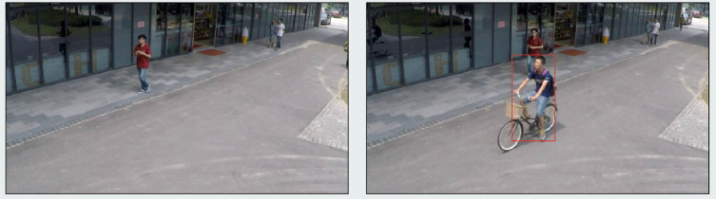
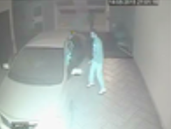
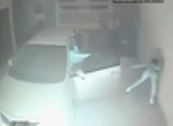
DOCTORAL RESEARCH PLAN
02 Context and research problem
What is Video Anomaly Detection (VAD)?
VAD
Computer vision task that aims to identify events in videos that significantly differ from learned normal patterns. Its main challenge is the rarity and diversity of anomalous events, making abnormal behavior difficult to model comprehensively.

Slide 5
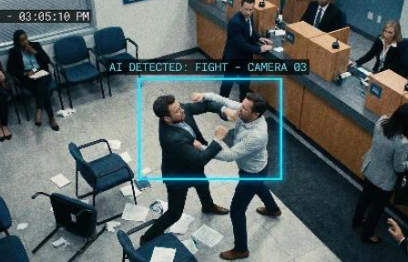

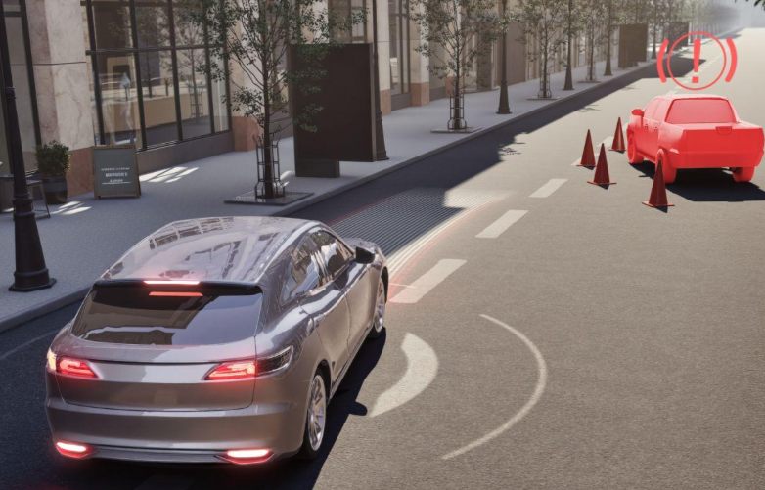
DOCTORAL RESEARCH PLAN
02 Context and research problem
Why Video Anomaly Detection (VAD) Matters?
Applications
Intelligent surveillance for public safety 📹
Industrial inspection 🏭
Autonomous systems 🚗
📹
🏭
🚗

Slide 6
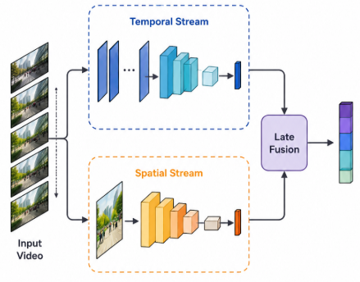
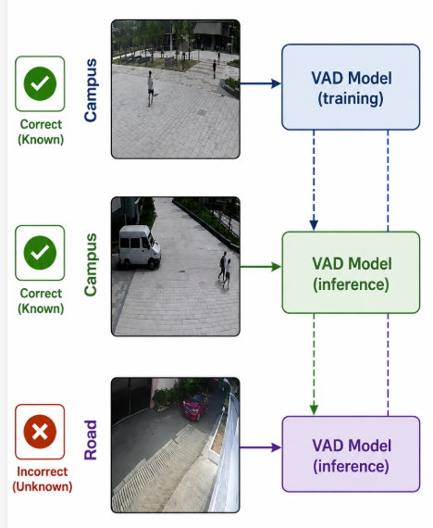
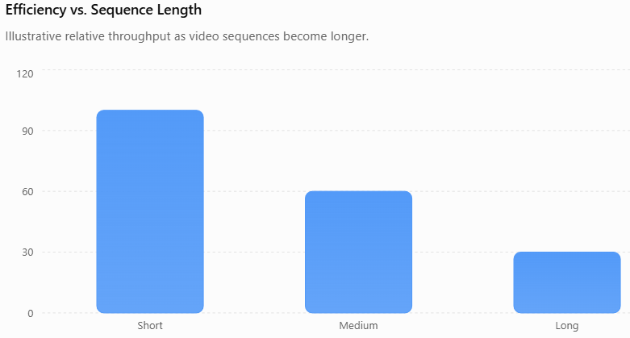
DOCTORAL RESEARCH PLAN
02 Context and research problem
Why Video Anomaly Detection (VAD) Matters?
Challenges
Learning effective temporal representations🧠
Generalizing to unseen anomalies🌐
Efficiently modeling long video sequences ⚡
🧠
🌐
⚡

Slide 7
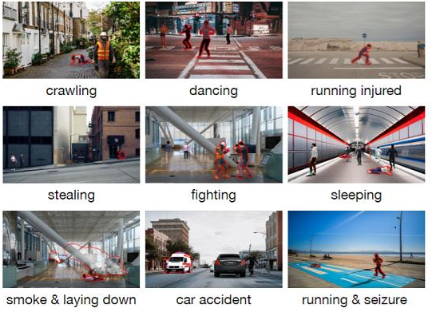
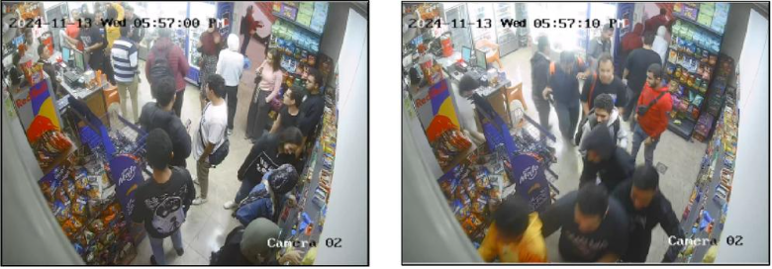
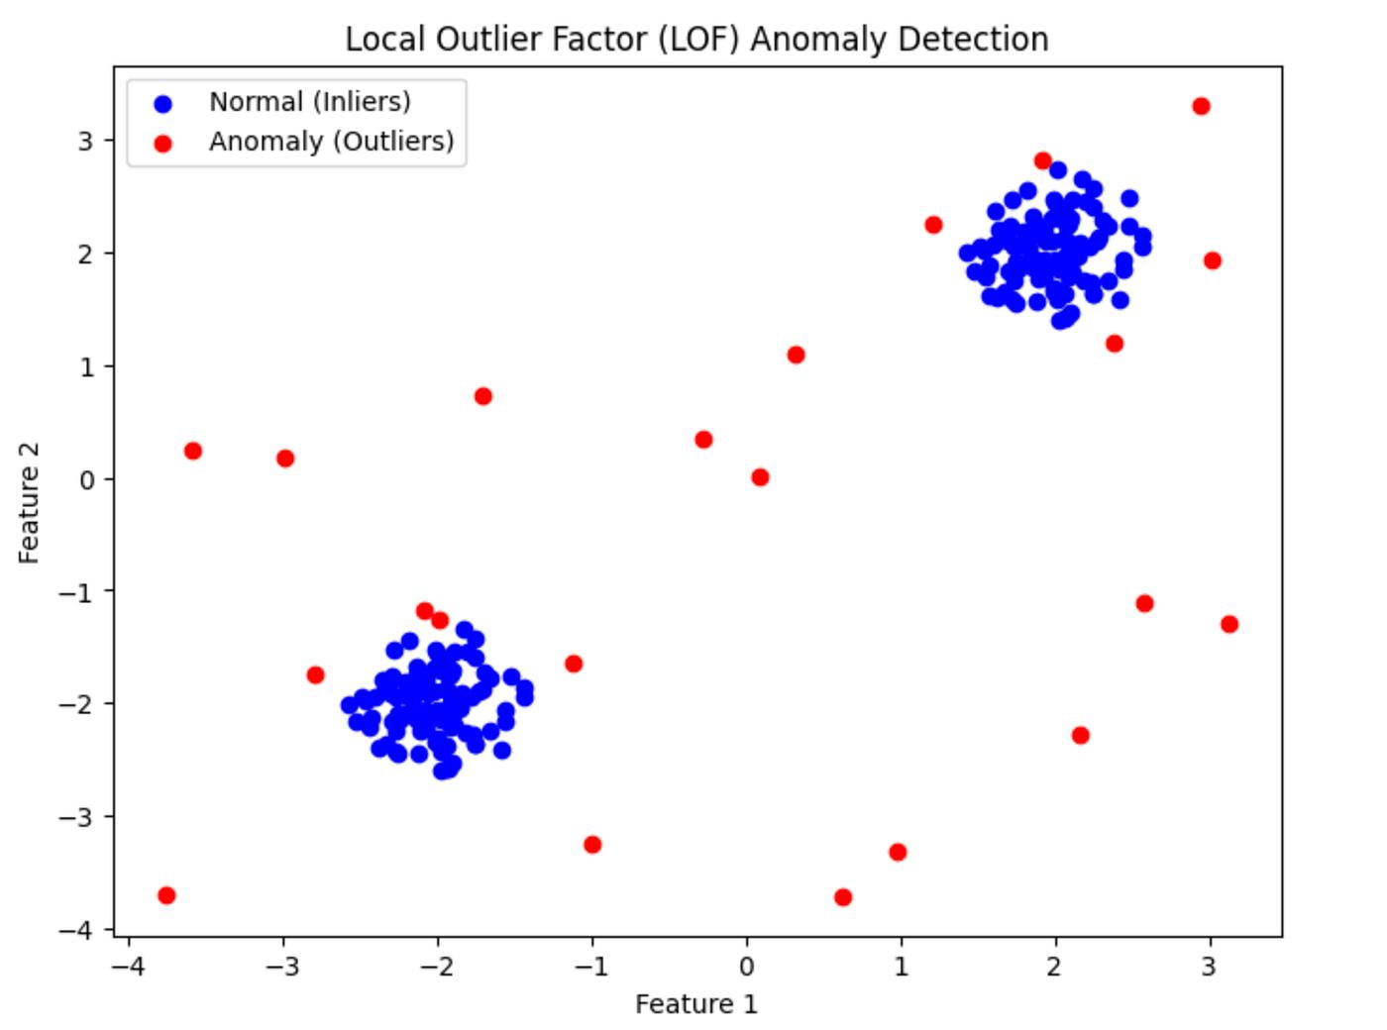
DOCTORAL RESEARCH PLAN
02 Context and research problem
Why Video Anomaly Detection (VAD) Matters?
Practical Difficulty
Anomalies are:
Diverse 🎭
Ambiguous ❓
Rare🪶
🎭
❓
🪶

Slide 8
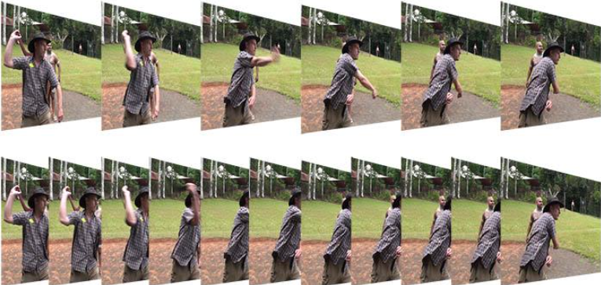
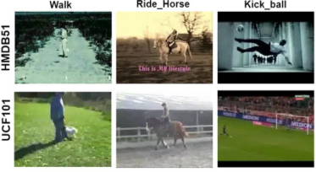
DOCTORAL RESEARCH PLAN
02 Context and research problem
Why Video Anomaly Detection (VAD) Matters?
🎭 Diverse · ❓ Ambiguous · 🪶 Rare → 🛡️ Temporal & Semantic Robustness
🛡️
Weak Supervision: In WSVAD, only video-level labels are available during training, making the task even more challenging because the model must infer which temporal segments are responsible for the anomalous event.

Slide 9
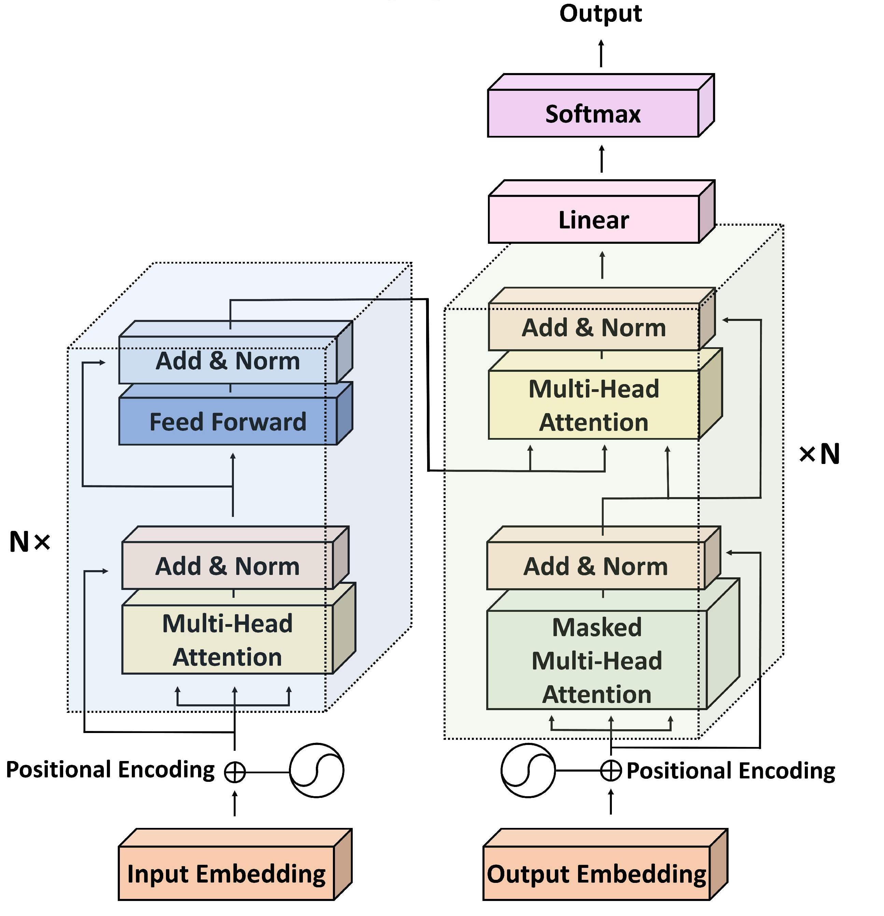
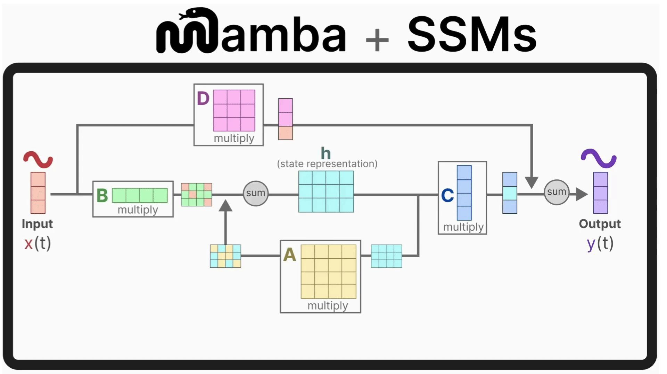
DOCTORAL RESEARCH PLAN
03 Scientific gap, objective and central hypothesis
Research Gap
Transformers and VLM-based methods have progressed, but may be costly for long videos.
SSMs such as Mamba promise efficiency, yet their original causal design does not directly fit VAD.
The starting point is not a single architecture; rather, it is determining which temporal properties the representation should learn and which architecture can best improve the evaluation metrics.
Objective
Investigate how robust temporal representations improve anomaly detection in long and complex videos.

Slide 10
DOCTORAL RESEARCH PLAN
03 Scientific gap, objective and central hypothesis
Central Hypothesis
Temporal representations enriched with complementary semantic or contextual information (e.g. VLM) can improve anomaly detection performance.
If temporal representations effectively integrate complementary semantic or contextual information, they can better distinguish normal from anomalous patterns, improving the detection of weak, ambiguous, or previously unseen anomalies.
Efficiency
Semantics
Robustness
Long sequences without quadratic cost.
Anomaly concepts beyond closed classes.
Better behavior under unseen events and domains.

Slide 11
DOCTORAL RESEARCH PLAN
04 Three-stage methodology, previous research, evaluation, and expected contributions
Three-Stage Methodology
The plan moves from understanding the state of the art to semantic-temporal integration.
01
02
03
Comparative Study
Efficient Temporal Modeling
Semantic Integration
Analyze CNN, Transformer, and VLM approaches for VAD/WSVAD; review RTFM, VadCLIP, OV-VAD, and related work.
- Identify strengths, limitations, and temporal modeling strategies.
Investigate SSMs, particularly Mamba and its variants as alternatives to Transformers.
- Characterize their temporal representations and identify when they outperform attention-based models.
- Combine SSM-based temporal representations with complementary semantic or contextual information (e.g., from Vision-Language Models) to improve the recognition of weakly defined or previously unseen anomalies.

Slide 12
DOCTORAL RESEARCH PLAN
04 Three-stage methodology, previous research, evaluation, and expected contributions
Specific Limitations in Previous Research
Previous approach | Strength | Remaining problem | Research direction
RTFM | Robust MIL + temporal dependencies | Temporal modeling relies on CNN/self-attention | Efficient sequence modeling
VadCLIP | Rich visual-language semantics | Limited temporal reasoning of dynamic anomalies | Temporal-semantic integration
OV-VAD | Detects unseen anomaly categories | Open-vocabulary semantics ≠ robust temporal representation | Generalizable temporal representation
Mamba-based VAD | Efficient long-sequence modeling | Original causal formulation is not directly suited to VAD | VAD-specific non-causal SSM design
Robust Temporal Representation Learning:
Efficient temporal modeling→ SSM/Mamba-based sequence modeling
Semantic enrichment→ VLM-based contextual/semantic information
Robust generalization→ representation designed to handle weak, ambiguous, and unseen anomalies
WSVAD

Slide 13
DOCTORAL RESEARCH PLAN
04 Three-stage methodology, previous research, evaluation, and expected contributions
Experimental Evaluation
The method will be defended through accuracy, efficiency, and robustness on established benchmarks.
AUC
AP
Cost
Robustness
Frame-level temporal accuracy
Quality under class imbalance
Memory, runtime, and scalability
Generalization to unseen anomalies
Datasets
UCF-Crime | XD-Violence | ShanghaiTech

Slide 14
DOCTORAL RESEARCH PLAN
04 Three-stage methodology, previous research, evaluation, and expected contributions
Expected Contributions
The outcome aims to contribute both scientific insight and practical methods for WSVAD.
Scientific Contribution
A better understanding of temporal representation learning for Weakly Supervised Video Anomaly Detection.
Combining efficient sequence modeling with semantic information.
Practical Impact
- More robust, scalable, and generalizable video anomaly detection systems under weak supervision.

Slide 15
Thank you for your attention

Slide 16
References
[1] Sultani, W., Chen, C., & Shah, M. (2018). Real-world anomaly detection in surveillance videos. Proceedings of the IEEE/CVF Conference on Computer Vision and Pattern Recognition (CVPR), 6479–6488.
[2] Tian, Y., Pang, G., Chen, Y., Singh, R., Verjans, J. W., & Carneiro, G. (2021). Weakly-supervised video anomaly detection with robust temporal feature magnitude learning. Proceedings of the IEEE/CVF International Conference on Computer Vision (ICCV), 4975–4986.
[3] Wu, P., Zhou, Y., Wang, X., et al. (2024). VadCLIP: Adapting vision-language models for weakly supervised video anomaly detection. Proceedings of the AAAI Conference on Artificial Intelligence, 38(6), 6076–6084.
[4] Wu, P., Zhou, Y., Wang, X., et al. (2024). Open-vocabulary video anomaly detection. Proceedings of the IEEE/CVF Conference on Computer Vision and Pattern Recognition (CVPR), 18267–18276.
[5] Gu, A., & Dao, T. (2024). Mamba: Linear-time sequence modeling with selective state spaces. International Conference on Learning Representations (ICLR).
[6] Vaswani, A., Shazeer, N., Parmar, N., et al. (2017). Attention is all you need. Advances in Neural Information Processing Systems (NeurIPS), 30.
[7] Acsintoae, A., Florescu, A., Georgescu, M. I., et al. (2022). UBnormal: New benchmark for supervised open-set video anomaly detection. Proceedings of the IEEE/CVF Conference on Computer Vision and Pattern Recognition (CVPR), 20157–20167.

