Slide 1
Weekly Progress Summary
Mamba-based video anomaly detection
Started the Mamba-for-VAD block after the general Video Mamba foundation.
Reviewed unsupervised VAD papers that use Mamba as an efficient temporal backbone.
Connected the Mamba line back to WSVAD through multilingual prompt-guided learning.

Slide 2
Narrative of the Work
The previous block established why Mamba is attractive for long video sequences.
This block asks a more specific question: how is Mamba used in video anomaly detection?
The first papers are mostly unsupervised: they learn normality and detect deviations.
The final paper reconnects the discussion to weak supervision, CLIP, prompts, and temporal reasoning.

Slide 3
Why This Step Matters
VAD requires temporal memory because anomalies may unfold slowly or appear briefly.
Transformers provide global reasoning but can be expensive for long surveillance videos.
Mamba offers linear-time sequence modeling and a practical path for long-range temporal context.
The key is deciding whether Mamba should replace, complement, or simply strengthen existing VAD pipelines.
Key Idea
The work shifts from understanding Mamba as a video backbone to evaluating Mamba as a VAD design choice.

Slide 4
Two VAD Directions
Unsupervised VAD
Weakly Supervised VAD
Training uses normal videos.
Anomalies are detected through reconstruction or prediction errors.
Typical datasets: Ped2, Avenue, ShanghaiTech.
Training uses video-level labels.
The model learns to localize anomalous segments.
Typical datasets: UCF-Crime, XD-Violence.

Slide 5
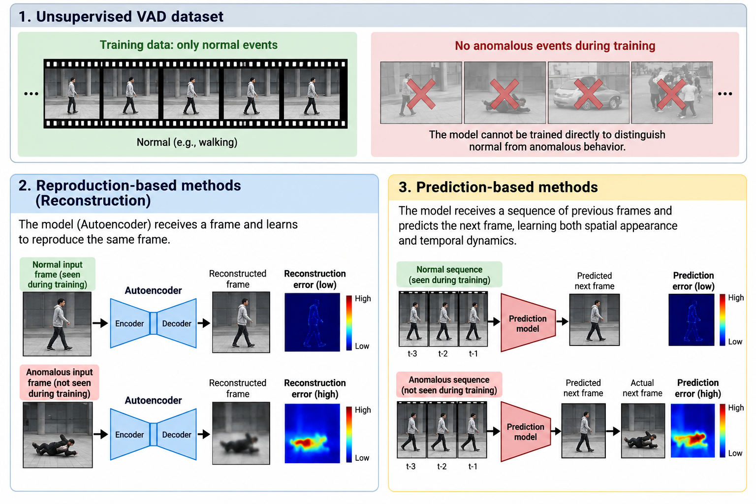
Unsupervised VAD - Proxy Tasks

Slide 6
Papers to review
Paper | Year | VAD Type
VADMamba: Exploring State Space Models for Fast Video Anomaly Detection | 2025 | Unsupervised
STNMamba: Mamba-based Spatial-Temporal Normality Learning for Video Anomaly Detection | 2024/2025 | Unsupervised
M²S²L: Mamba-based Multi-Scale Spatial-temporal Learning for Video Anomaly Detection | 2025 | Unsupervised
VADMamba++ | 2026 | Unsupervised
Multilingual-Prompt-Guided Directional Feature Learning for Weakly Supervised Video Anomaly Detection | 2025 | Weakly Supervised

Slide 7
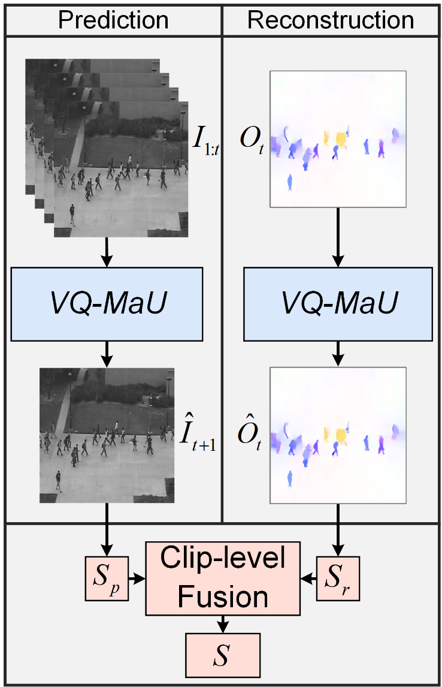
VADMamba
It is trained only on normal videos, not weak video-level anomaly labels.
Detects anomalies through frame prediction and optical-flow reconstruction (proxy tasks).
Contribution
It shows that Mamba can replace CNN or Transformer temporal modules in efficient unsupervised VAD.
NO PARALLEL TRAINING because the two tasks converge at different speeds.

Slide 8
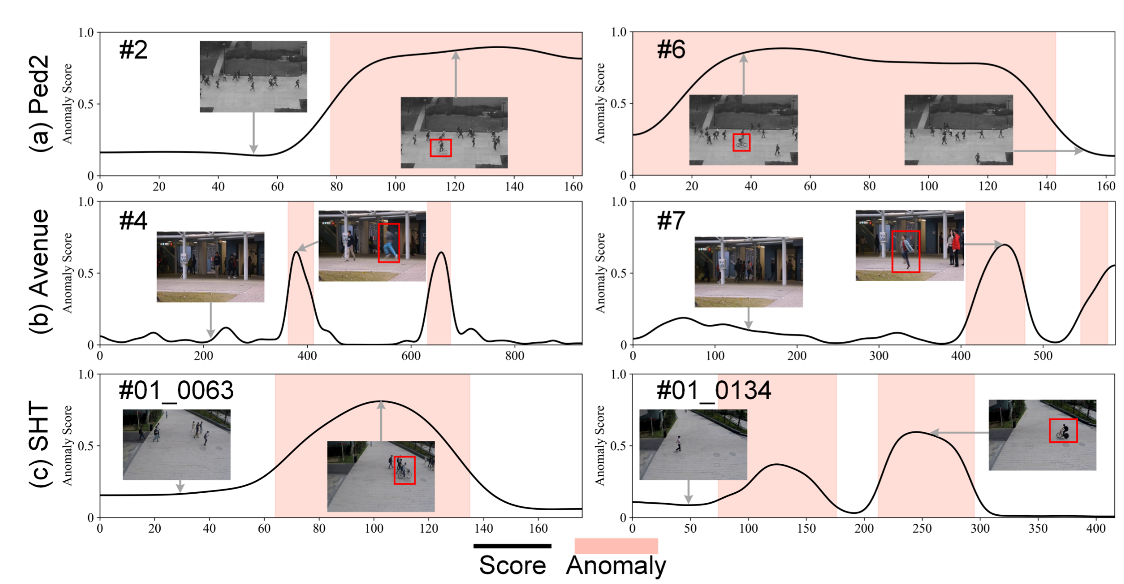
VADMamba

Slide 9
VADMamba: What It Does Not Solve
It does not compete directly with Sultani, RTFM, VADCLIP, or other WSVAD methods.
It does not use CLIP-style semantic guidance.
It does not learn from video-level abnormal labels.
For WSVAD research, its value is mainly as evidence that Mamba is a useful temporal backbone.

Slide 10
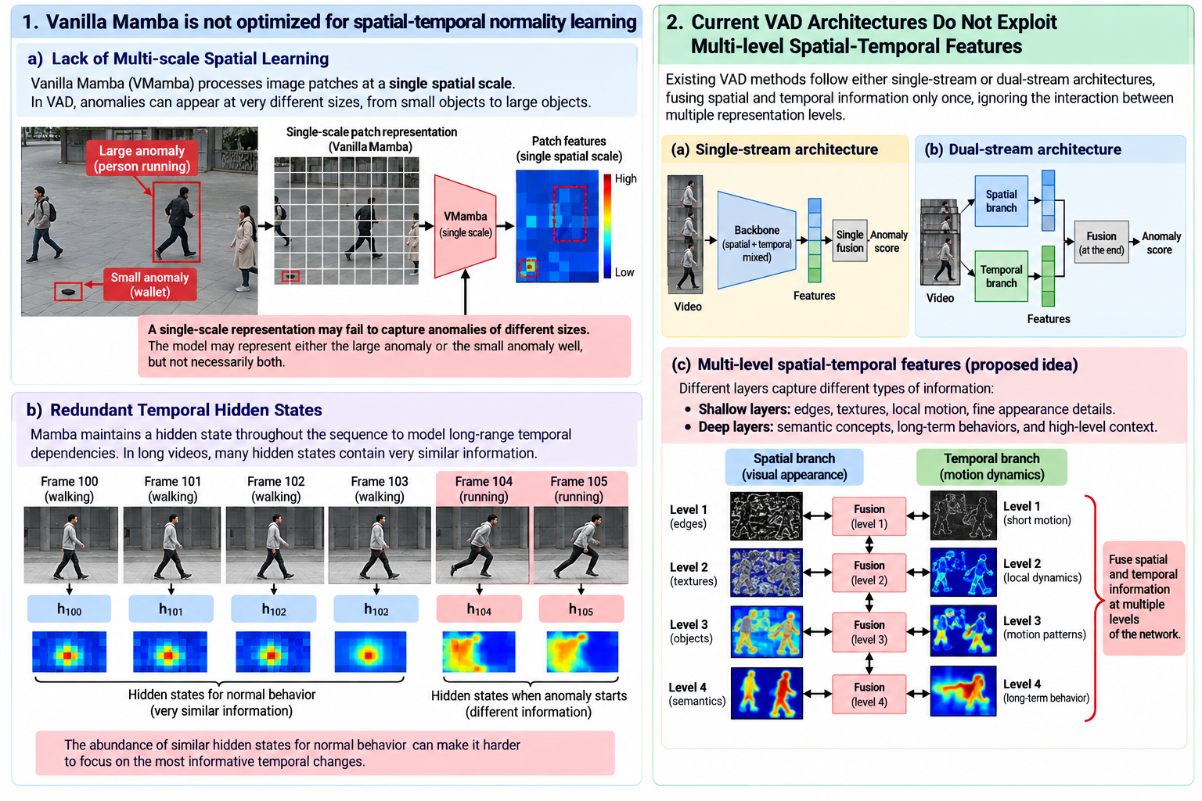
STNMamba: Spatial-Temporal Normality Learning for VAD

Slide 11
STNMamba
It introduces a multi-scale spatial encoder for anomalies of different sizes.
MS-VSSB
The Temporal Encoder employs channel-aware. It uses RGB frame differences instead of optical flow for lower-cost motion cues.
CA-VSSB
It performs multi-level spatial-temporal fusion.
Spatial-Temporal Fusion Block: Network learns joint appearance-motion representations at every encoder stage.
Memory Bank: Its purpose is to store spatial-temporal prototypes of normal events. During inference: query features are compared against stored prototypes.
STIM
STFB + Memory Banks

Slide 12
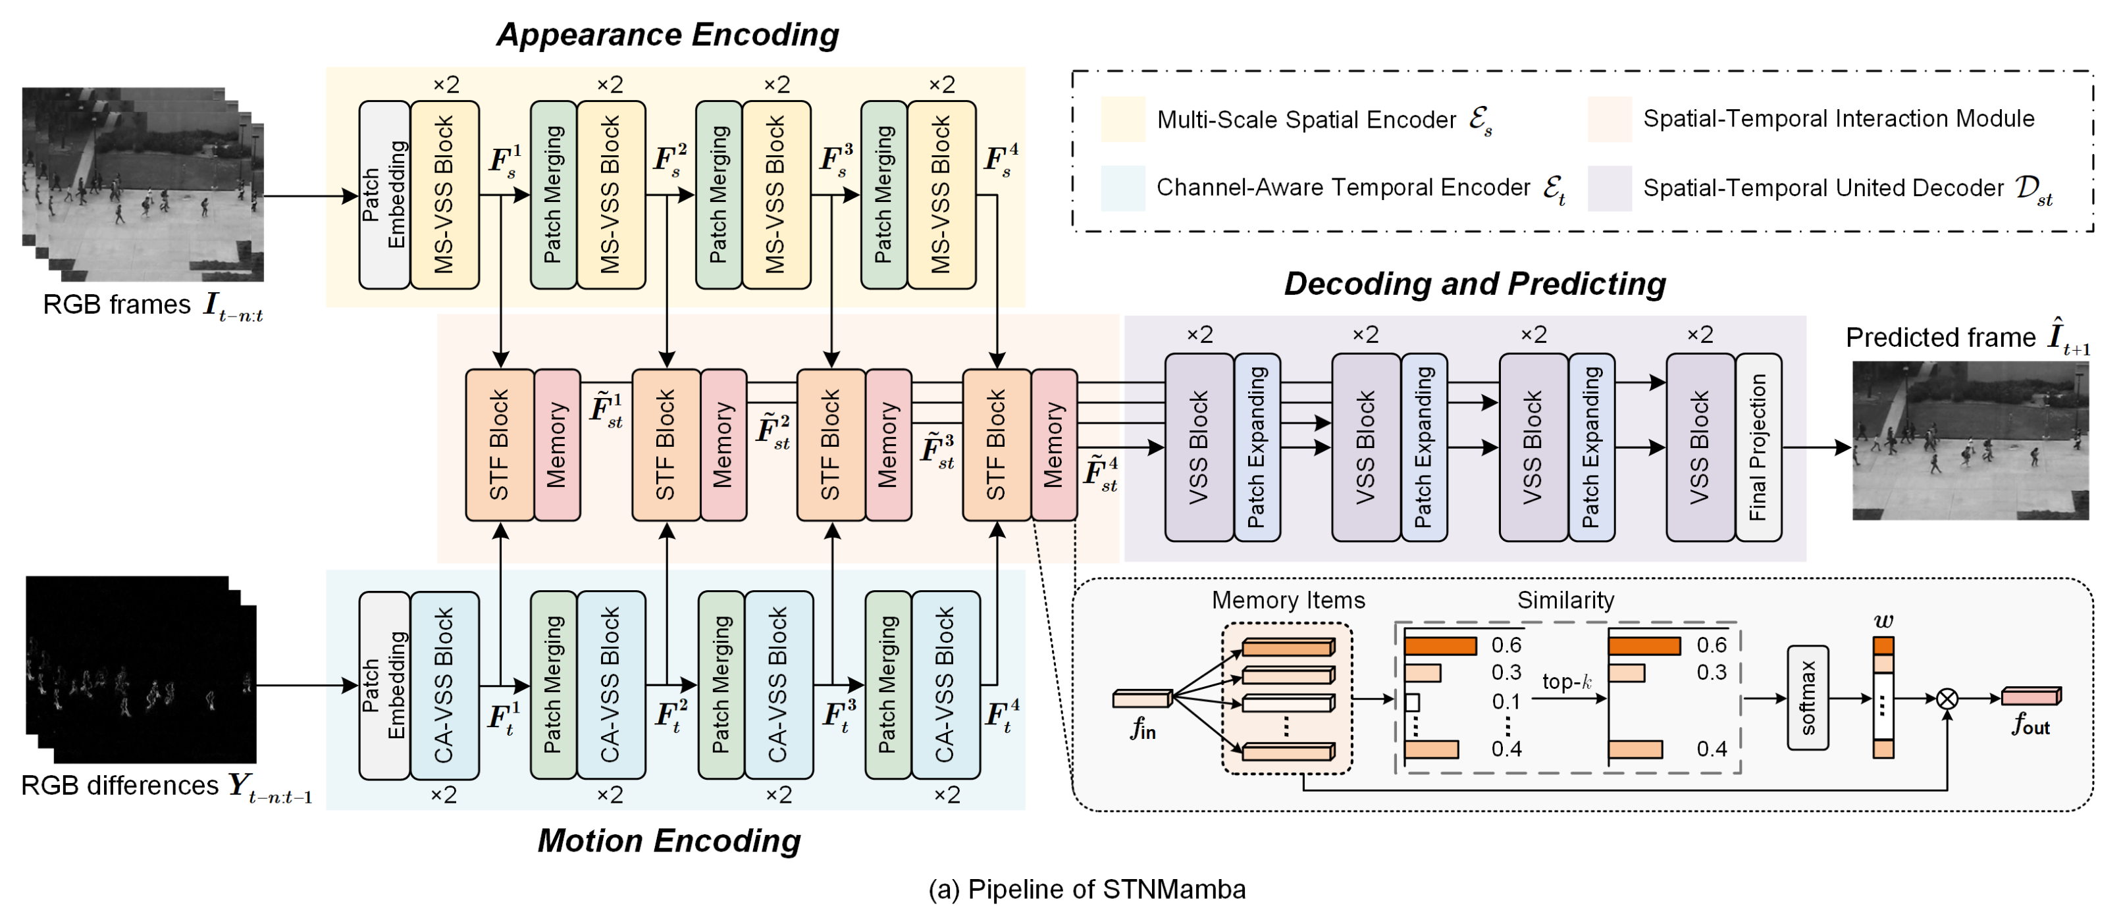
STNMamba

Slide 13
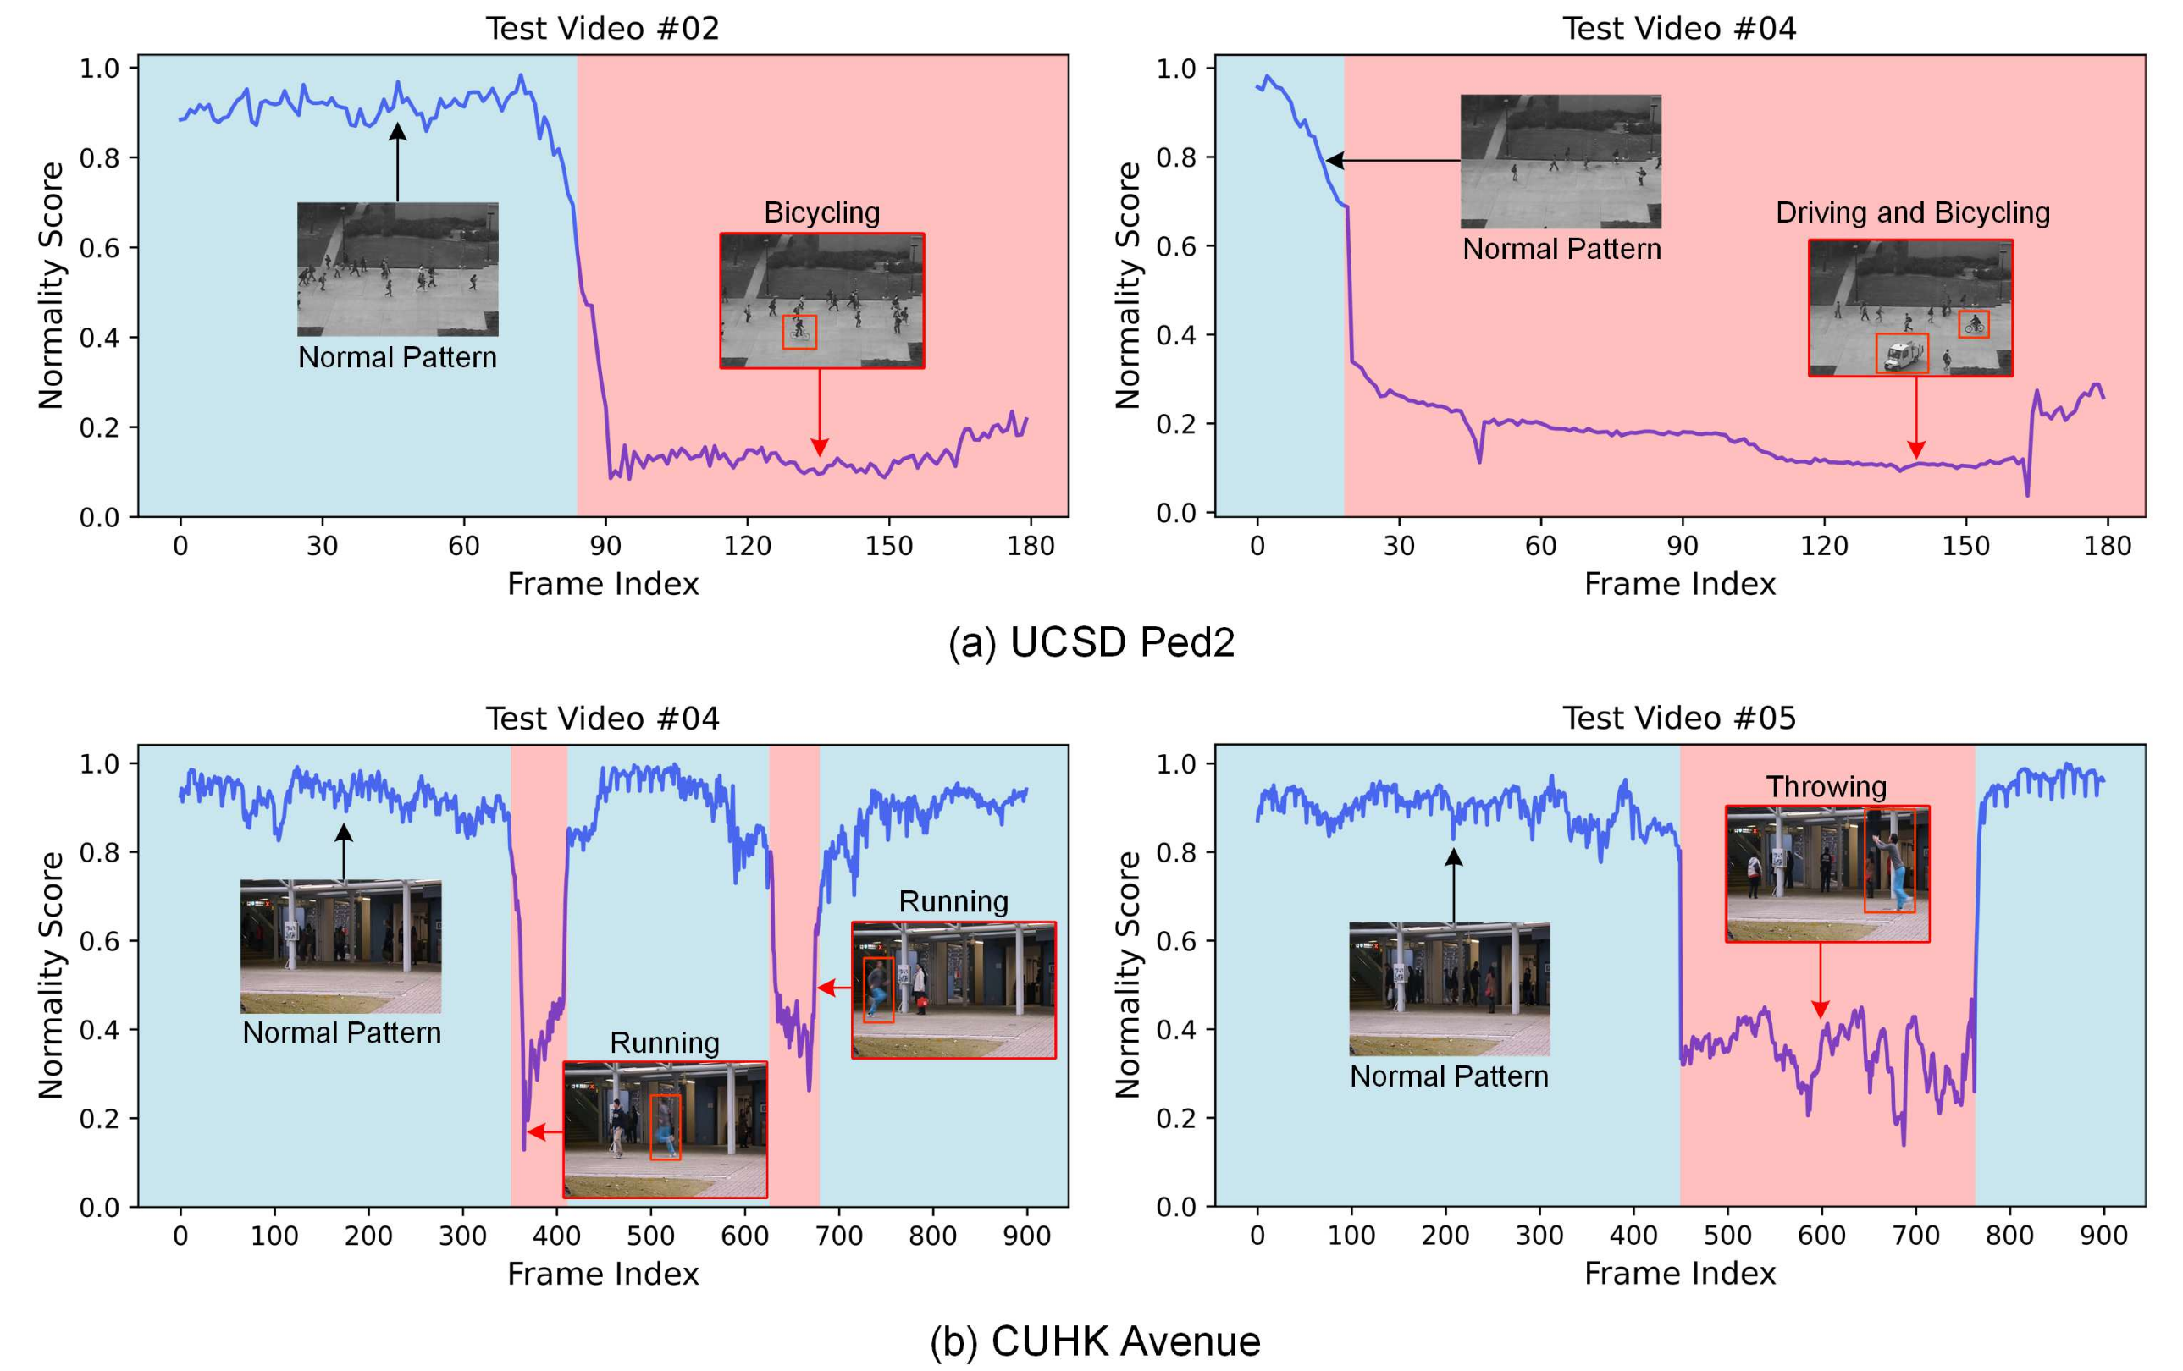
STNMamba

Slide 14
THANK YOU
FOR YOUR
ATTENTION

Slide 15
M2S2L: Multi-Scale Spatial-temporal Learning for VAD
M2S2L extends Mamba-based VAD through explicit multi-scale learning.
Spatial scales capture small local changes, medium patterns, and larger scene structure.
Temporal scales capture short motion, medium dynamics, and long behavior.
Feature decomposition separates common, appearance-specific, and motion-specific representations.
Multi-scale spatial
Multi-scale temporal
Feature decomposition

Slide 16
VADMamba++
VADMamba++ changes the proxy task rather than only changing the architecture.
It replaces RGB-to-RGB reconstruction with Gray-to-RGB reasoning.
The model receives grayscale frames and predicts plausible RGB frames.
This removes optical flow and converts the pipeline into a single-task framework.
Gray-to-RGB
The anomaly signal comes from both structural geometry errors and chromatic appearance errors.

Slide 17
VADMamba++: Hybrid Modeling
Transformer
Mamba
CNN
Global context modeling.
Long-range temporal dependencies.
Local spatial refinement.
The best encoder order is coarse-to-fine: Transformer, then Mamba, then CNN.

Slide 18
Results Pattern
VADMamba proves that selective SSMs can be effective for unsupervised VAD.
STNMamba improves spatial-temporal learning while remaining lightweight.
M2S2L improves accuracy by specializing scale and modality representations.
VADMamba++ improves the accuracy-speed trade-off with Gray-to-RGB and no optical flow.
Backbone
Architecture
Scale
Proxy task

Slide 19
Multilingual Prompt-Guided WSVAD
The final paper returns to the weakly supervised setting.
It extends CLIP-style WSVAD with multilingual prompt pools.
Adaptive Top-K selection chooses the most useful prompts for each video snippet.
Mamba and Transformer are combined for multi-granularity temporal modeling.
Bridge to WSVAD
Here Mamba is not the whole VAD paradigm. It is a temporal reasoning module inside a CLIP and prompt-guided pipeline.

Slide 20
Evolution of Ideas
VADMamba
STNMamba
M2S2L
VADM++
Multilingual WSVAD
From Mamba as an efficient temporal backbone.
To spatial-temporal normality learning with memory.
To multi-scale and modality-specialized reconstruction.
To simpler proxy tasks and better deployment efficiency.
To CLIP, multilingual prompts, and weakly supervised localization.

Slide 21
What Is Already in Place
A clear distinction between unsupervised VAD and WSVAD evaluation protocols.
A map of how Mamba enters VAD: backbone, spatial-temporal fusion, memory, and prompt-guided temporal modeling.
A comparison of architectural improvements versus proxy-task improvements.
A bridge from reconstruction-based Mamba papers back to the main weakly supervised research direction.

Slide 22
Suggested Next Step
Build a comparison matrix separating unsupervised VAD from WSVAD methods.
For each method, record supervision type, backbone, temporal module, anomaly score, datasets, and metrics.
Decide whether the PhD direction should use Mamba as a full backbone or as a temporal module inside a CLIP/WSVAD pipeline.
Use that decision to define the first implementation target and baseline set.

