Slide 1
Weekly Progress Summary
Action recognition and video anomaly detection for security
Reviewed core video action-recognition models: Two-Stream, C3D, and SlowFast.
Mapped the first set of relevant anomaly-detection datasets.

Slide 2
Narrative of the Work
Started from CNN foundations and moved toward video understanding.
Studied how models represent motion and temporal structure.
Compared historical approaches: optical flow, 3D convolutions, and multi-rate pathways.

Slide 3
Core Problem: Video Is Not Just an Image
Images mainly provide appearance: objects, people, scene context, and pose.
Videos add motion, temporal order, and causality.
A reversed sequence may represent a different action.
A useful model must capture both spatial and temporal information.
Key Idea
In video recognition, what appears in the frame and how it changes over time are both essential.

Slide 4
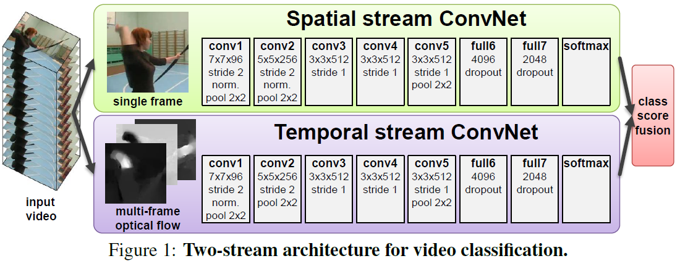
Two-Stream Networks (2014)
Spatial stream: RGB frames for visual appearance.
Temporal stream: optical flow for explicit motion.
Predictions from both streams are fused at the end.
The paper showed that RGB alone is not enough for strong action recognition.

Slide 5
Contribution and Limits of Two-Stream Models
Contribution: clearly separates spatial appearance and temporal motion.
Contribution: made optical flow a central input for deep video models.
Limitation: optical-flow computation is expensive.
Limitation: the pipeline is not fully end-to-end.
Impact: strongly influenced later architectures such as C3D, SlowFast, and video transformers.

Slide 6
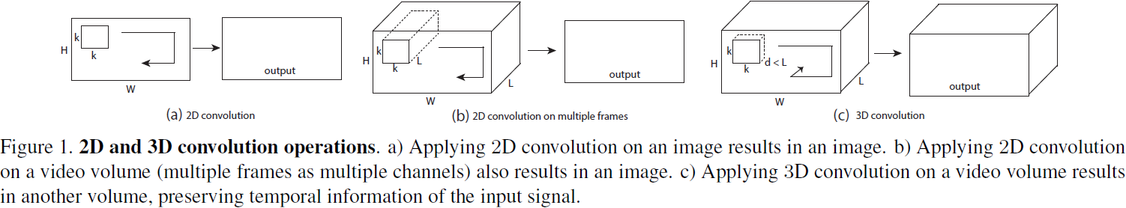
C3D: 3D Convolutional Networks (2015)
Extends convolution across height, width, and time.
Learns appearance and motion directly from short video clips.
Does not require precomputed optical flow.
Marks a shift toward end-to-end spatiotemporal learning.

Slide 7
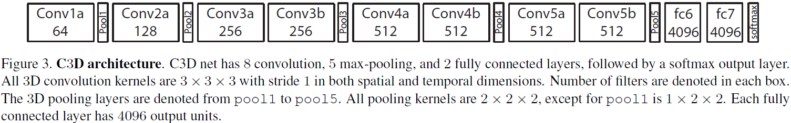
C3D Architecture
8 convolutional layers.
5 max-pooling layers.
3 x 3 x 3 convolution kernels.
Features can transfer to multiple video tasks.

Slide 8
Conceptual Comparison
Two-Stream
C3D
RGB + optical flow
Motion is computed first
Late fusion of streams
3D convolutions
Motion is learned directly
More end-to-end pipeline

Slide 9
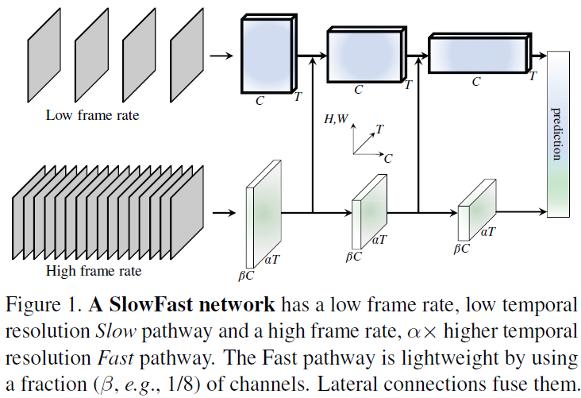
SlowFast Networks (2019)
Starts from a key observation: time is not isotropic like space.
Slow pathway: low frame rate for semantics and appearance.
Fast pathway: high frame rate for fine motion.
Combines both pathways for efficient and accurate action recognition.

Slide 10
Evolution of Ideas
Two-Stream
to
C3D
to
SlowFast
From explicit motion computed with optical flow.
To joint spatiotemporal learning with 3D convolutions.
To architectures that process appearance and motion at different temporal rates.

Slide 11
Security-Oriented Datasets Reviewed
UCF-Crime: primary candidate because it contains real CCTV footage and classes such as robbery and assault.
XD-Violence: strong complementary dataset for violent events, but with movie and YouTube domain bias.
ShanghaiTech: useful academic benchmark for evaluation.
Avenue and UCSD Ped2: useful for quick experiments or pipeline debugging.

Slide 12
Initial Dataset Strategy
Primary
Complementary
Benchmark
UCF-Crime
XD-Violence
ShanghaiTech
The research contribution will likely come from temporal modeling, architecture, and generalization rather than from the dataset alone.

Slide 13
What Is Already in Place
A conceptual foundation for why video requires temporal modeling.
A historical map of influential action-recognition models.
A comparison between optical flow, 3D CNNs, and SlowFast pathways.
An initial dataset map for surveillance and anomaly-detection research.
A clearer direction toward security-oriented action and anomaly detection.

Slide 14
Suggested Next Step
Review recent methods for action recognition and video anomaly detection.
Build a comparison table of recent models, metrics, strengths, and limitations.

