Slide 1
Weekly Progress Summary
From VADCLIP to open-vocabulary video anomaly detection
Extended the anomaly-detection block from weak supervision to open-vocabulary reasoning.
Reviewed the gap between closed-set, open-set, and open-vocabulary VAD.
Started organizing how CLIP can support both detection and semantic categorization.

Slide 2
Narrative of the Work
Continued from the previous block on Video Swin Transformer, RTFM, and VadCLIP.
Shifted attention from weakly supervised anomaly scoring toward semantic anomaly naming.
Studied open-set and open-vocabulary formulations as the next research step.
Connected the literature to a more realistic surveillance setting where new anomalies can appear.

Slide 3
Why This Step Matters
WSVAD can localize suspicious segments, but it usually stays inside the anomaly classes seen during training.
Open-set VAD improves generalization to unseen anomalies, but still leaves the anomaly type unnamed.
Open-vocabulary VAD adds semantic categorization on top of detection.
That makes the problem closer to how a real monitoring system should behave.
Key Idea
The research target moved from asking only whether a video is abnormal to also asking what anomaly it is.

Slide 4
From Closed Set to Open Vocabulary
WSVAD
Open-Set
OV-VAD
CLIP
Detects known anomalies
Detects unseen anomalies
Detects and names them
Semantic bridge
The progression is not only about better anomaly scores, but about richer supervision and richer outputs.

Slide 5
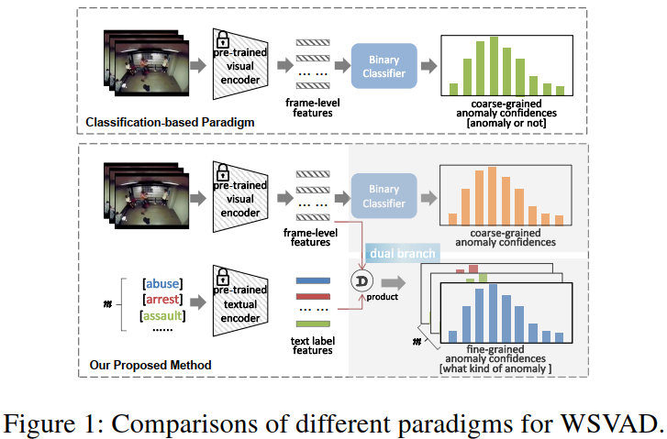
VadCLIP
VadCLIP adapts CLIP to weakly supervised video anomaly detection.
It keeps the binary detection task, but adds semantic alignment between video and text.
This makes it a bridge between MIL-based WSVAD and open-vocabulary anomaly understanding.

Slide 6
VadCLIP: Main Idea
Detection Branch
Alignment Branch
Uses a local-global temporal adapter to model video dynamics.
Produces anomaly confidence scores from frame-level visual features.
Keeps weak supervision through video-level labels and MIL-style reasoning.
Uses CLIP text embeddings for anomaly classes.
Adds learnable prompts and visual prompts to refine the class representation.
Aligns selected video snippets with semantic labels through MIL-Align.

Slide 7
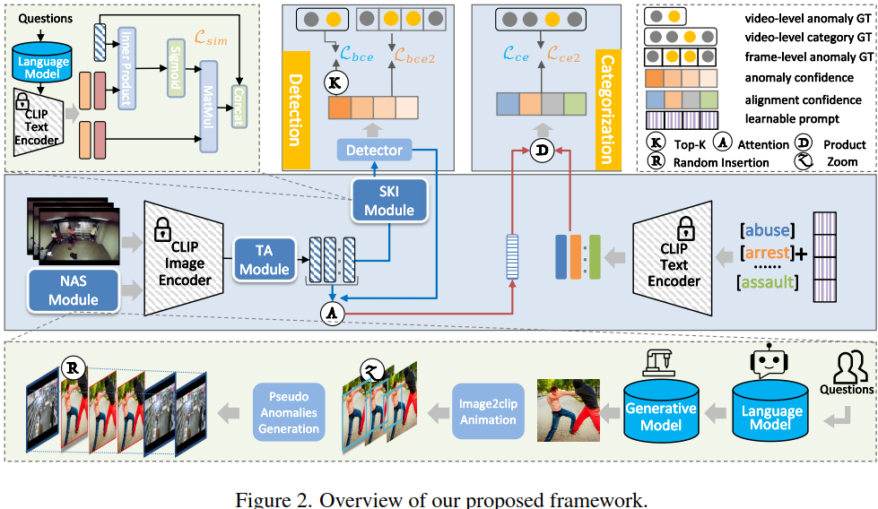
Open-Vocabulary VAD
OV-VAD aims to detect anomalies and assign semantic labels to both seen and unseen categories.
The model is built on CLIP to reuse its image-text alignment capability.
The detection branch produces frame-level anomaly confidence scores.
The categorization branch matches video features with text embeddings.

Slide 8
Overall Framework
Detection Branch
Categorization Branch
Video frames go through CLIP's image encoder.
Temporal Adapter injects video dynamics.
Semantic Knowledge Injection enriches visual features.
A binary detector outputs frame-level anomaly scores.
Video features are aggregated into a compact representation.
Category names are encoded with CLIP's text encoder.
Cross-modal alignment predicts the anomaly category.
This is the semantic layer that closed-set WSVAD lacks.

Slide 9
Temporal Adapter
The Temporal Adapter is designed to model frame-to-frame relationships with minimal extra parameters.
It preserves CLIP's pretrained knowledge while adding temporal structure.
The goal is to capture local temporal context without overfitting the seen anomaly classes.
Main Role
Bridge image features into a video-aware representation with a light temporal module rather than a heavy video transformer.

Slide 10
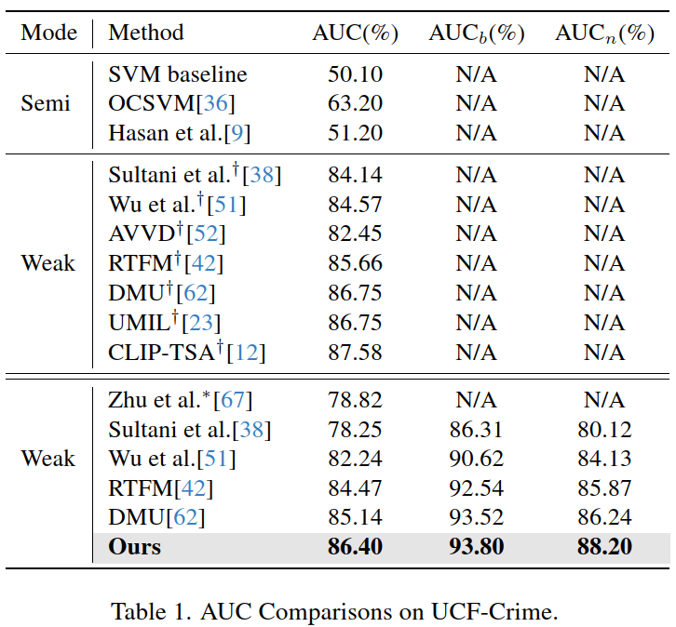
Semantic Knowledge Injection
SKI injects anomaly-related semantic knowledge from text into the visual stream.
This helps the model reason about what kind of event a frame is related to.
It moves the method beyond pure binary detection.

Slide 11
Novel Anomaly Synthesis
NAS generates synthetic anomalies to help the model handle novel classes.
LLM-guided descriptions are turned into visual content and inserted into normal videos.
This gives the model a way to see categories that were not present in the original training set.

Slide 12
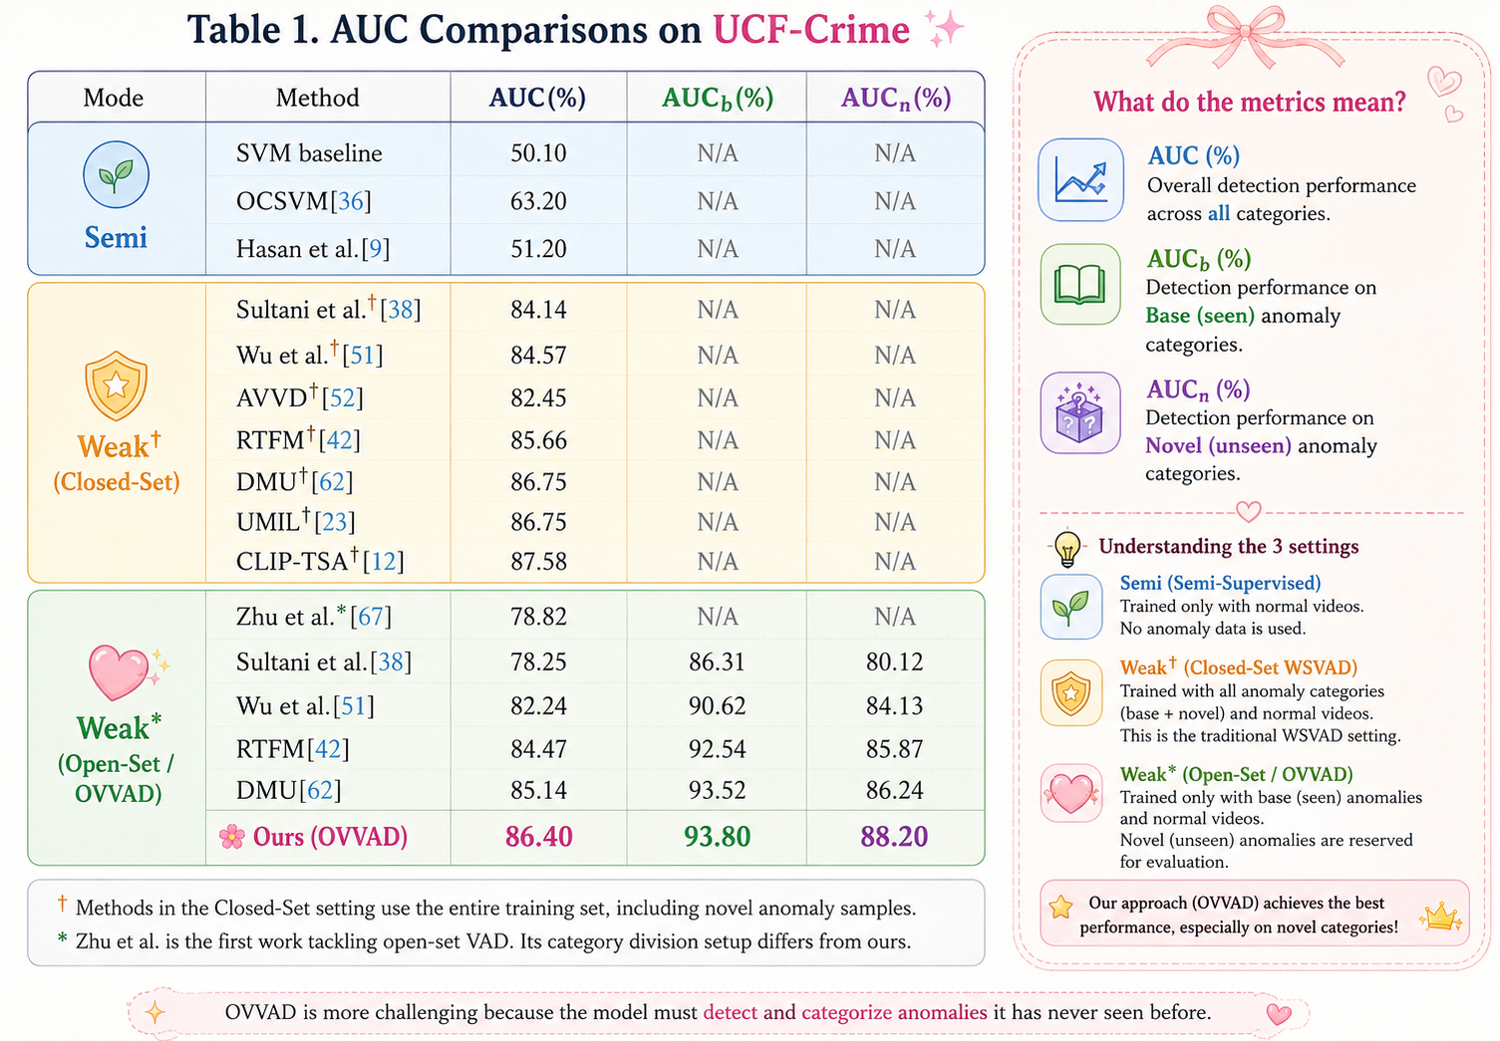
Results and Comparison
The reported results show that the proposed method is competitive with closed-set baselines.
The gain is most relevant on novel anomaly categories, which is the main point of the open-vocabulary setting.

Slide 13
Evolution of Ideas
WSVAD
VadCLIP
Open-Set
OV-VAD
CLIP
From weakly supervised anomaly localization.
To CLIP-based visual-language anomaly modeling.
To open-set generalization.
To open-vocabulary detection and semantic categorization.

Slide 14
What Is Already in Place
A coherent path from action recognition to anomaly detection.
A weakly supervised baseline centered on MIL-based reasoning.
A CLIP-based method that already connects visual and textual representations.
A clear next step toward open-vocabulary anomaly understanding.

Slide 15
Suggested Next Step
Move to state space models and Mamba as the next temporal modeling block.
Compare Mamba with the CLIP-based VAD line to see where it can improve sequence efficiency.
Identify how a state-space backbone could fit into weakly supervised or open-vocabulary VAD.
Prepare the next weekly summary around this transition instead of staying only on OV-VAD.

Slide 16
State Space Models
The next block shifts from anomaly semantics to sequence dynamics.
The question now is how to model long sequences efficiently.
State space models treat state as compressed memory of the past.
Mamba makes the state update input-dependent instead of fixed.

Slide 17
What Is a State?
A state is the information needed to describe a system at a given moment.
In sequence models, the state acts as compact memory for what has happened so far.
The transition updates that memory as new inputs arrive.
This is the conceptual base before S4 and Mamba.
State = memory
The point is not to store everything. The point is to keep only what is useful for predicting the next step.

Slide 18
S4 vs. Mamba
S4
Mamba
Uses fixed state dynamics.
Efficient for long sequences.
But every token updates memory in the same way.
Makes the update input-dependent.
Important tokens can produce larger state changes.
Selective scan keeps the computation efficient.

Slide 19
Mamba
Mamba asks what information deserves to remain in memory.
It introduces selective, time-varying dynamics instead of fixed transitions.
The result is an adaptive hidden state that can emphasize relevant tokens and suppress noise.
Selection
Selective scan
Adaptive state
Keep useful context
Efficient execution
Input-dependent memory

Slide 20
Why This Matters for VAD
Surveillance videos are long, noisy, and temporally uneven.
A state-space backbone could be a cleaner way to model long-range context than a heavy attention stack.
The next experiment is to ask where Mamba should sit in the VAD pipeline: before MIL, inside the temporal encoder, or after CLIP features.
That is the natural next bridge after OV-VAD.

