Slide 1
Weekly Progress Summary
From VADCLIP to open-vocabulary video anomaly detection
Extended the anomaly-detection block from weak supervision to open-vocabulary reasoning.
Reviewed the gap between closed-set, open-set, and open-vocabulary VAD.
Started organizing how CLIP can support both detection and semantic categorization.

Slide 2
Narrative of the Work
Continued from the previous block on Video Swin Transformer, RTFM, and VadCLIP.
Shifted attention from weakly supervised anomaly scoring toward semantic anomaly naming.
Studied open-set and open-vocabulary formulations as the next research step.
Connected the literature to a more realistic surveillance setting where new anomalies can appear.

Slide 3
Why This Step Matters
WSVAD can localize suspicious segments, but it usually stays inside the anomaly classes seen during training.
Open-set VAD improves generalization to unseen anomalies, but still leaves the anomaly type unnamed.
Open-vocabulary VAD adds semantic categorization on top of detection.
That makes the problem closer to how a real monitoring system should behave.
Key Idea
The research target moved from asking only whether a video is abnormal to also asking what anomaly it is.

Slide 4
From Closed Set to Open Vocabulary
WSVAD
Open-Set
OV-VAD
CLIP
Detects known anomalies
Detects unseen anomalies
Detects and names them
Semantic bridge
The progression is not only about better anomaly scores, but about richer supervision and richer outputs.

Slide 5
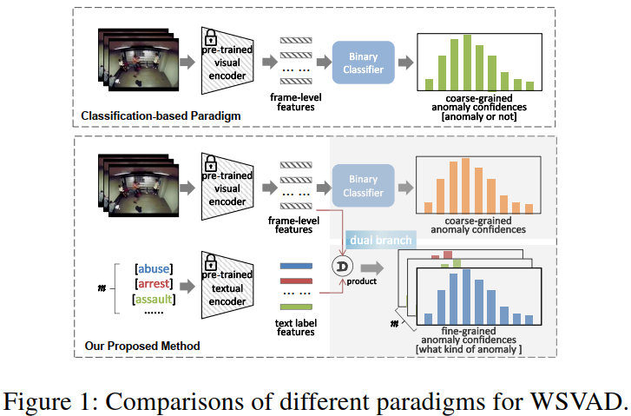
VadCLIP (2023)
VadCLIP adapts CLIP to weakly supervised video anomaly detection.
It keeps the binary detection task, but adds semantic alignment between video and text.
This makes it a bridge between MIL-based WSVAD and open-vocabulary anomaly understanding.

Slide 6
VadCLIP: Main Idea
Detection Branch
Alignment Branch
Uses a local-global temporal adapter to model video dynamics.
Produces anomaly confidence scores from frame-level visual features.
Keeps weak supervision through video-level labels and MIL-style reasoning.
Uses CLIP text embeddings for anomaly classes.
Adds learnable prompts and visual prompts to refine the class representation.
Aligns selected video snippets with semantic labels through MIL-Align.

Slide 7
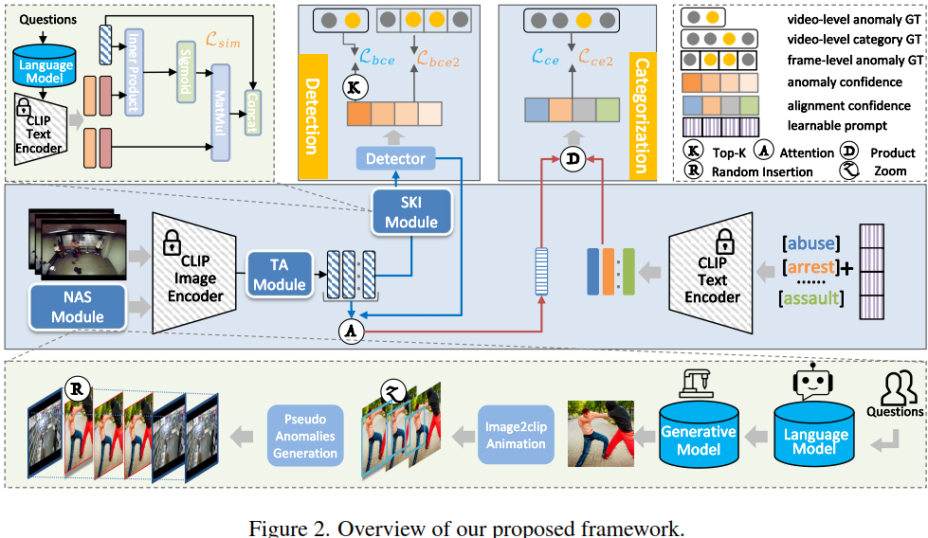
Open-Vocabulary VAD (2024)
OV-VAD aims to detect anomalies and assign semantic labels to seen and unseen categories.
The model is built on CLIP to reuse its image-text alignment capability.
The detection branch produces frame-level anomaly confidence scores.
The categorization branch matches video features with text embeddings.

Slide 8
Overall Framework
Detection Branch
Categorization Branch
Video frames go through CLIP's image encoder.
Temporal Adapter injects video dynamics.
Semantic Knowledge Injection enriches visual features.
A binary detector outputs frame-level anomaly scores.
Video features are aggregated into a compact representation.
Category names are encoded with CLIP's text encoder.
Cross-modal alignment predicts the anomaly category.
This is the semantic layer that closed-set WSVAD lacks.

Slide 9
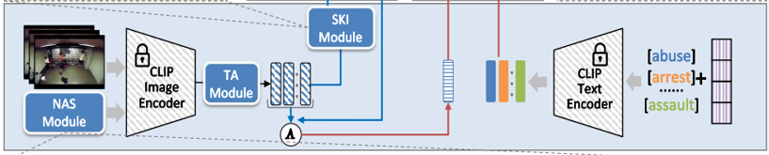
Overall Framework
Semantic Knowledge Injection
Temporal Adapter
The Temporal Adapter efficiently models local temporal relationships while preserving CLIP's pretrained knowledge, adding temporal context with minimal parameters to improve generalization.
SKI injects anomaly-related semantic knowledge into visual features, enabling the model to understand event types rather than performing only binary anomaly detection.

Slide 10
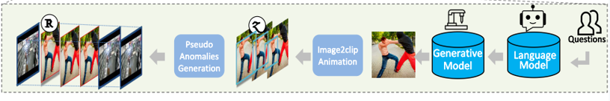
Novel Anomaly Synthesis
NAS generates synthetic anomalies to help the model handle novel classes.
LLM-guided descriptions are turned into visual content and inserted into normal videos.
This gives the model a way to see categories that were not present in the original training set.

Slide 11
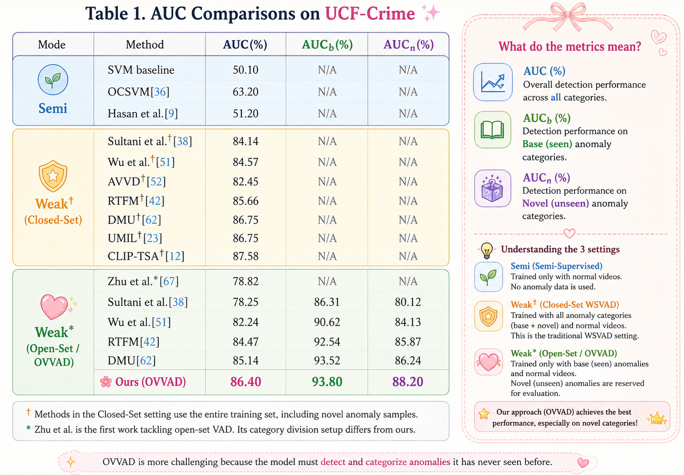
Results and Comparison
The reported results show that the proposed method is competitive with closed-set baselines.
The gain is most relevant on novel anomaly categories, which is the main point of the open-vocabulary setting.

Slide 12
Evolution of Ideas
WSVAD
VadCLIP
Open-Set
OV-VAD
From weakly supervised anomaly localization.
To CLIP-based visual-language anomaly modeling.
To open-set generalization.
To open-vocabulary detection and semantic categorization.

Slide 13
What Is Already in Place
A coherent path from action recognition to anomaly detection.
A weakly supervised baseline centered on MIL-based reasoning.
A CLIP-based method that already connects visual and textual representations.
A clear next step toward open-vocabulary anomaly understanding.

Slide 14
Suggested Next Step
Move to state space models and Mamba as the next temporal modeling block.
Compare Mamba with the CLIP-based VAD line to see where it can improve sequence efficiency.
Identify how a state-space backbone could fit into weakly supervised or open-vocabulary VAD.
Prepare the next weekly summary around this transition instead of staying only on OV-VAD.

