Slide 1
Weekly Progress Summary
From CNN and ViT foundations to TimeSformer and Swin Transformer
Extended the study beyond SlowFast into Transformer-based vision models.
Reviewed how images are converted into patch sequences for ViT.
Connected ViT ideas to video through TimeSformer and hierarchical Swin Transformer designs.

Slide 2
Narrative of the Work
Continued from action-recognition foundations: Two-Stream, C3D, and SlowFast.
Moved into Vision Transformers as a different way to represent images.
Studied how Transformer ideas scale from images to video and dense visual tasks.

Slide 3
Why This Step Matters
SlowFast models motion with specialized temporal pathways.
Transformers model relationships through attention instead of only local convolutions.
This opens a path toward long-range spatial and temporal reasoning.
Key Idea
The focus moved from hand-designed video pathways toward attention-based representations that can connect distant visual evidence.

Slide 4
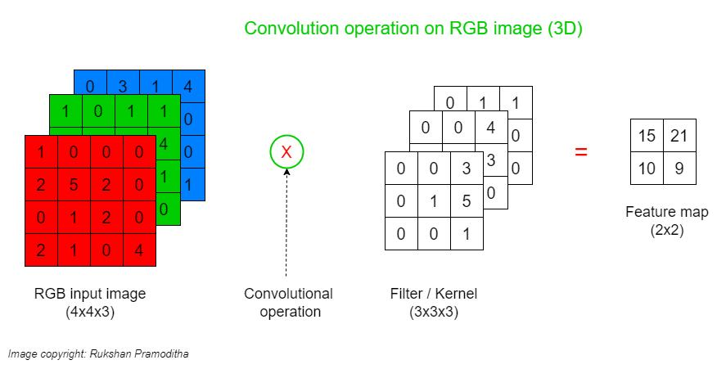
CNN Foundations
Reviewed how convolutional layers detect local visual patterns.
Connected filters, padding, pooling, flattening, and RGB channels.
Clarified why CNNs are strong for images but need extensions for temporal video structure.
This provides the baseline for understanding why ViT changes the representation style.

Slide 5
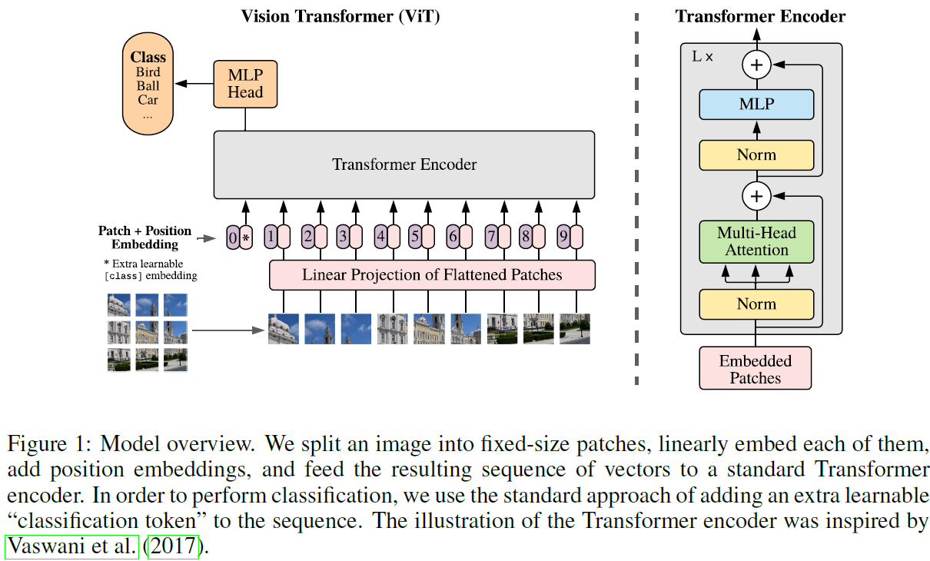
Vision Transformer (ViT)
Converts an image into a sequence of fixed-size patches.
Adds positional information and a class token.
Uses a standard Transformer encoder for image classification.
Shows that attention can replace convolution when enough data and compute are available.

Slide 6
From Images to Video Transformers
CNN
ViT
Video
Local visual patterns
Image patches as tokens
Patches across space and time
The same token-based view can be extended from image patches to frame-by-frame video patches.

Slide 7
TimeSformer (2021)
Adapts the ViT idea directly to video clips.
Represents video as a sequence of patches across frames.
Uses space-time attention to learn visual and temporal relationships.
A key strategy is divided attention: temporal attention followed by spatial attention.

Slide 8
TimeSformer: Main Takeaway
Temporal Attention
Spatial Attention
Looks across frames.
Captures how a patch changes over time.
Useful for motion and action dynamics.
Looks within each frame.
Captures relations between image regions.
Useful for objects, scene context, and pose.

Slide 9
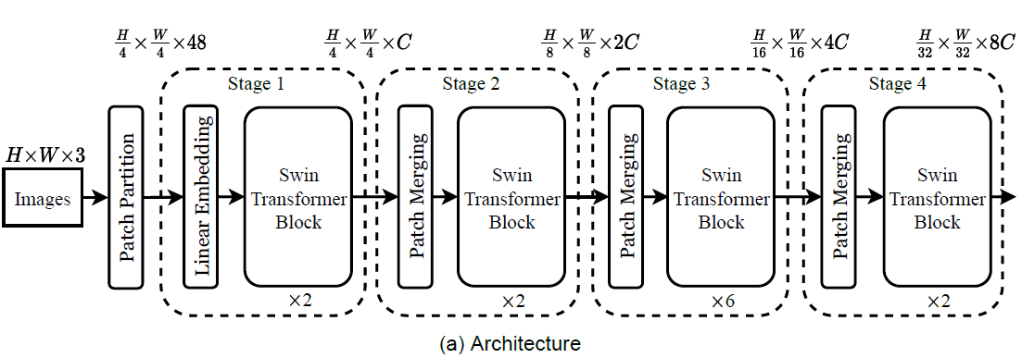
Swin Transformer
Addresses limitations of standard ViT for dense visual understanding.
Builds hierarchical representations through multiple stages.
Uses local window attention to reduce computational cost.
Uses shifted windows so neighboring windows can exchange information.

Slide 10
Evolution of Ideas
CNN
ViT
SlowFast
TimeSformer
Swin
From local convolutional features.
To patch-token image representations.
To video models that combine spatial and temporal attention.
To hierarchical attention models that are more efficient and scalable.

Slide 11
What Is Already in Place
A foundation in CNN operations and visual feature extraction.
A clear explanation of ViT as image patches plus Transformer encoder.
A bridge from ViT to video through TimeSformer.
A hierarchical Transformer direction through Swin and shifted windows.
A stronger conceptual base for selecting modern video-recognition architectures.

Slide 12
Suggested Next Step
Continue with Video Swin Transformer as the next architecture in Phase 0.s
After this, the foundations roadmap moves toward anomaly detection with Sultani et al. and MIL.
State-of-the-Art & Efficiency (The 2026 Frontier)

