Slide 1
Weekly Progress Summary
Video Swin Transformer and video anomaly detection
Completed the next step after Swin Transformer: Video Swin Transformer.
Started the anomaly-detection block with weak supervision and MIL.
Reviewed the first methods that connect surveillance videos to anomaly scores.

Slide 2
Narrative of the Work
Continued from ViT, TimeSformer, and Swin Transformer.
Studied how shifted-window attention is extended from images to video.
Moved from action-recognition architectures toward anomaly-detection formulations.
Connected model foundations to the research objective: security-oriented video understanding.

Slide 3
Why This Step Matters
Video Swin Transformer closes the current foundations block on modern video architectures.
Anomaly detection changes the problem from recognizing known actions to finding unusual events.
This is closer to real surveillance, where the system may not know every possible threat in advance.
The new material starts the bridge from model study to research design.
Key Idea
The focus is shifting from how to classify actions to how to localize suspicious temporal segments in long surveillance videos.

Slide 4
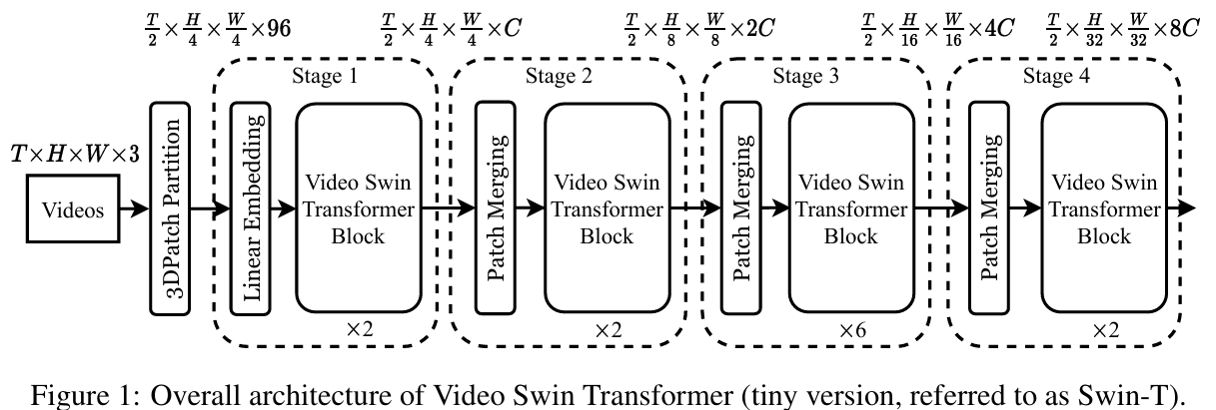
Video Swin Transformer
Extends Swin Transformer from images to video clips.
Uses local attention windows across space and time.
Maintains a hierarchical representation as the video features become deeper.
Offers a practical Transformer backbone for video recognition tasks.

Slide 5
From Action Recognition to Anomaly Detection
Action Recognition
Temporal Modeling
Anomaly Detection
Classify known actions in short clips.
Learn motion and context over time.
Find abnormal moments in long videos.
The research direction now moves from model foundations to surveillance-specific learning problems.

Slide 6
Core Anomaly-Detection Problem
Identify whether a video contains abnormal behavior.
Locate the time interval where the abnormal event occurs.
Optionally classify the type of event after detection.
Example
- Anomaly Detection: "Something unusual happened between 10:05 and 10:07."
- Classification: "The unusual event was a fight."

Slide 7
Weak Supervision and MIL
Weak supervision uses video-level labels instead of frame-level annotations.
Multiple Instance Learning treats each video as a bag of temporal segments.
An anomalous video is expected to contain at least one abnormal segment.
The model learns to assign higher anomaly scores to the most suspicious segments.

Slide 8
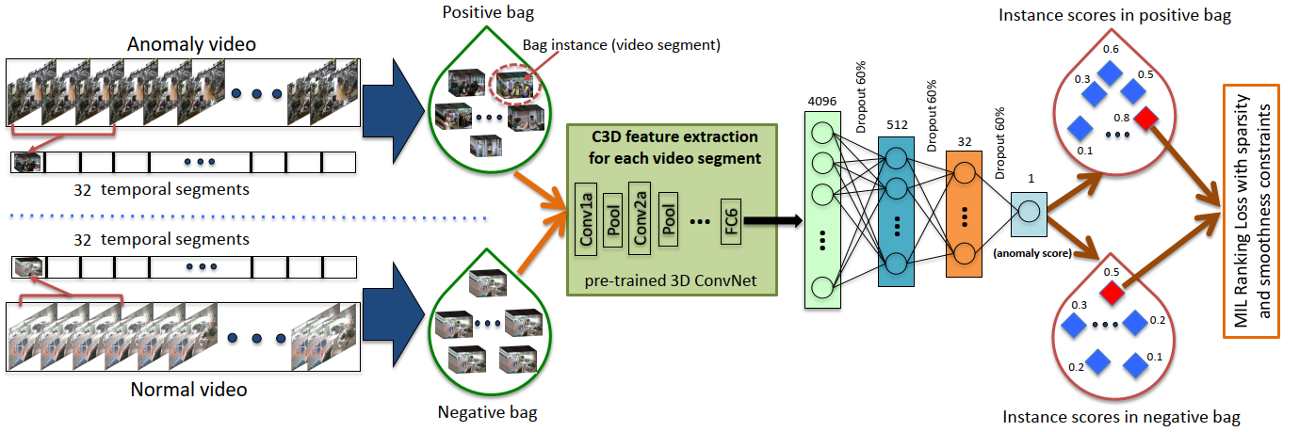
Sultani et al. (2018)
Introduced a weakly supervised formulation for real-world surveillance anomaly detection.
Uses normal and anomalous video bags with MIL ranking loss.

Slide 9
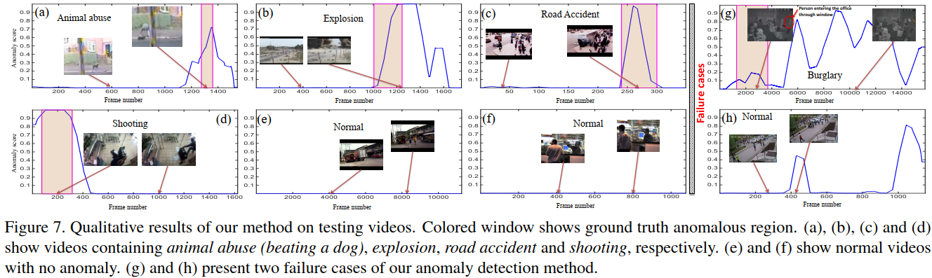
Sultani et al. (2018)
Works with UCF-Crime: real surveillance videos and 13 anomaly categories.
Provides the conceptual base for later weakly supervised VAD methods.

Slide 10
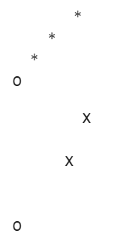
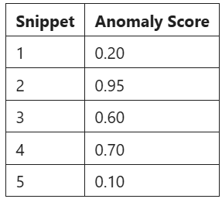
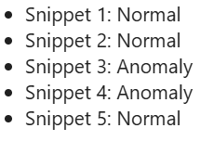
RTFM: Robust Temporal Feature Magnitude (2021)
Builds on weakly supervised video anomaly detection.
Uses feature magnitude as stronger evidence for abnormal snippets.
Aims to separate normal and abnormal temporal features more clearly.
Represents a step beyond traditional MIL scoring strategies.

Slide 11
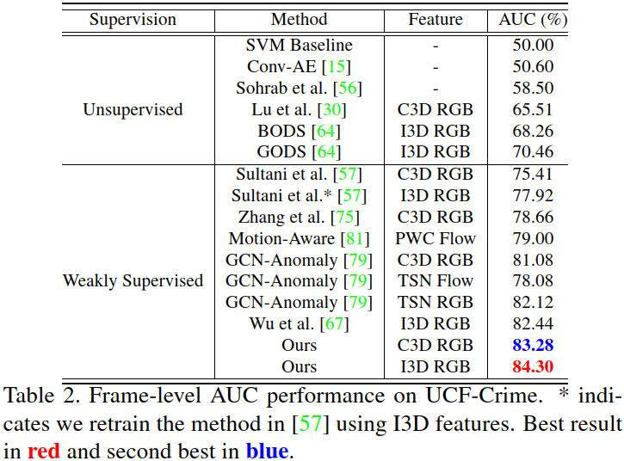
RTFM: Robust Temporal Feature Magnitude (2021)

Slide 12
Evolution of Ideas
Swin
Video Swin
MIL
RTFM
From hierarchical attention for images.
To hierarchical attention for videos.
To weakly supervised anomaly scores over temporal segments.
To stronger temporal features and pretrained visual-language representations.

Slide 13
What Is Already in Place
A complete path from CNN-based video recognition to Transformer-based video backbones.
A clear next architecture after Swin: Video Swin Transformer.
A first anomaly-detection formulation based on weak labels and MIL.
Initial coverage of UCF-Crime and RTFM.
A stronger bridge between foundations and the surveillance research objective.

Slide 14
Suggested Next Step
- VadCLIP: Adapting Vision-Language Models for Weakly Supervised Video Anomaly Detection
Peng Wu et al. (AAAI 2024)
- Open-Vocabulary Video Anomaly Detection
Peng Wu et al. (CVPR 2024)

