Slide 1
Weekly Progress Summary
Reproduction Mamba-based video anomaly detection
Reviewed actual implementation of VADMamba.
PACHECO MARTÍNEZ MÁXIMO ENRIQUE

Slide 2
Narrative of the Work
Review the arquitecture of VADMamba more in depth.
See results from some epochs based on the original github code

Slide 3
Why This Step Matters
Reproducing a paper is important in order to understand in depth the arquitecture.
Key Idea
Mamba can be use as a backbone for Anomaly Detection

Slide 4
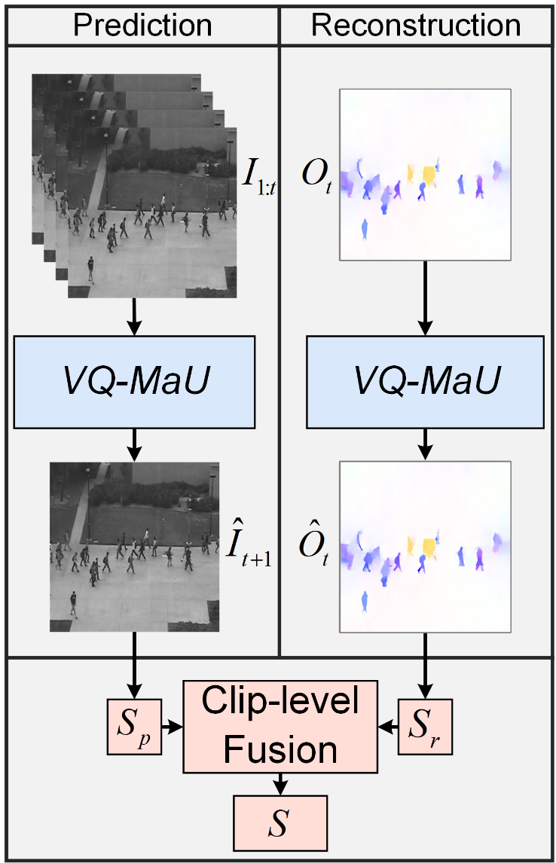
VADMamba
It is trained only on normal videos, not weak video-level anomaly labels.
Detects anomalies through frame prediction and optical-flow reconstruction (proxy tasks).
Contribution
It shows that Mamba can replace CNN or Transformer temporal modules in efficient unsupervised VAD.
NO PARALLEL TRAINING because the two tasks converge at different speeds.
MODEL IMPLEMENTATION ACCEPTS RGB IMAGES, image on grayscale is just how dataset of PED2 it is.

Slide 5
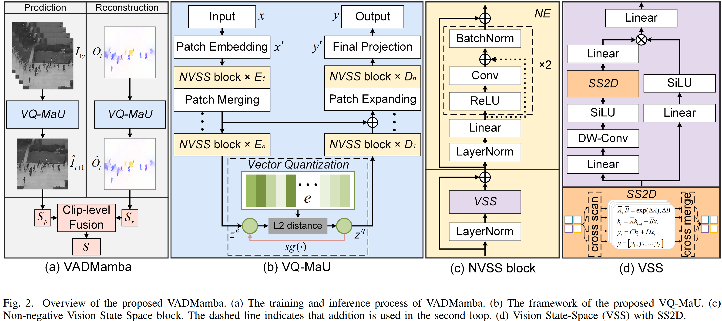
VADMamba: Architecture

Slide 6
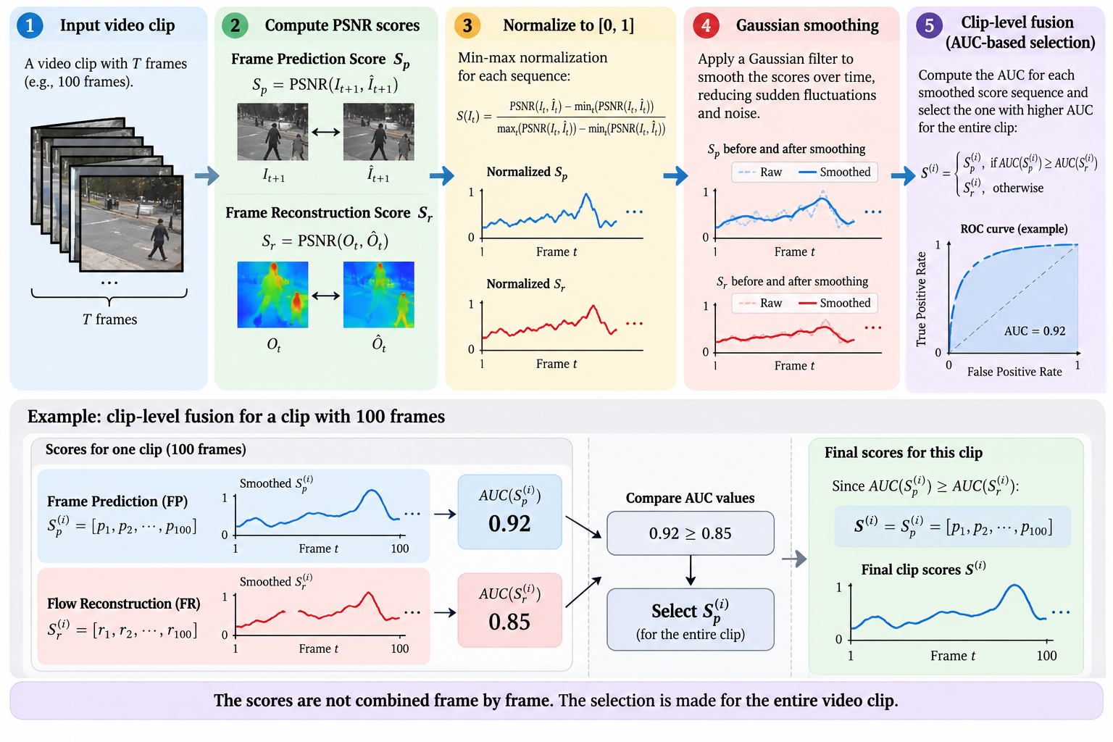
VADMamba: Inference

Slide 7
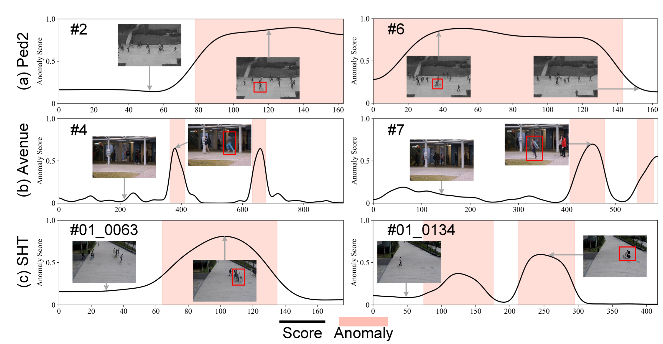
VADMamba: Paper Results

Slide 8
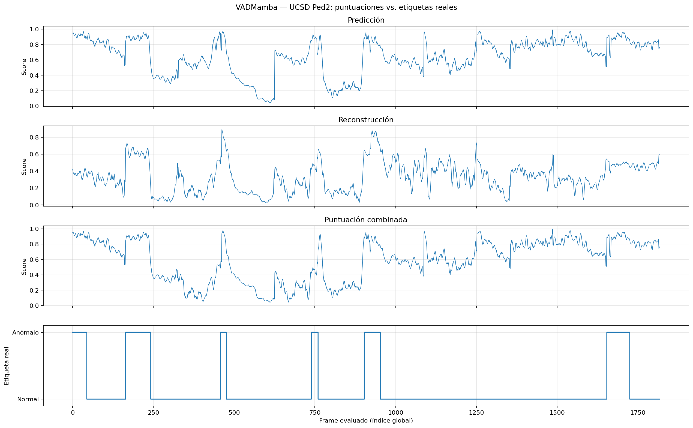
VADMamba: Reproduced Results
20 epochs
Pytorch
FlowNet2SD
AdamW
Lr = 2e-4

Slide 9
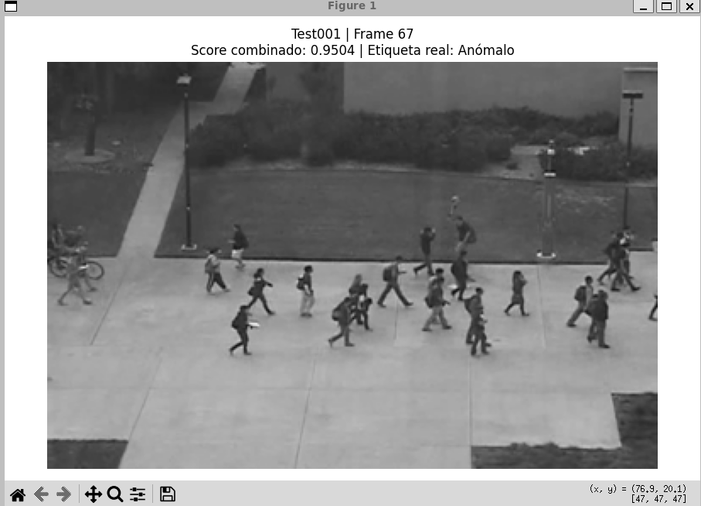
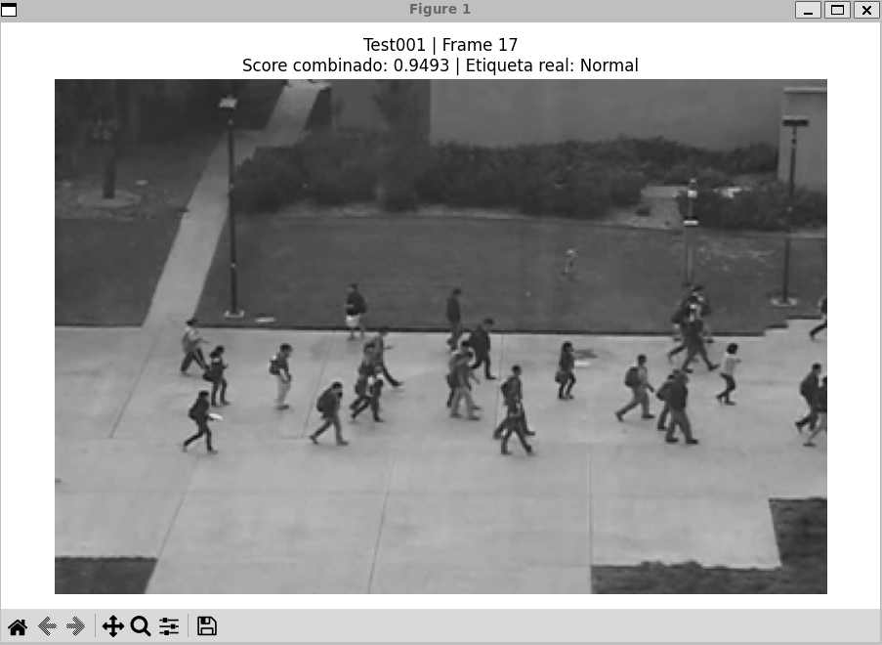
VADMamba: Reproduced Results

Slide 10
Future Work
Improve the quality of the model
Verify correct representation of Anomaly and Normal labels
Continue to next paper

Slide 11
THANK YOU
FOR YOUR
ATTENTION

