Slide 1
Weekly Progress Summary
STNMamba-based video anomaly detection
Reviewed in detail STNMamba and compare with previous VADMamba (updated results).
PACHECO MARTÍNEZ MÁXIMO ENRIQUE

Slide 2
Narrative of the Work
Review the arquitecture of STNMamba more in depth.
See updated results of VADMamba and compare paper results with STNMamba

Slide 3
Why This Step Matters
Understanding the proposal for STNMamba is important in order to compare in detail the differente arquitectures
Key Idea
STNMamba tackles in a different way the temporal encoder

Slide 4
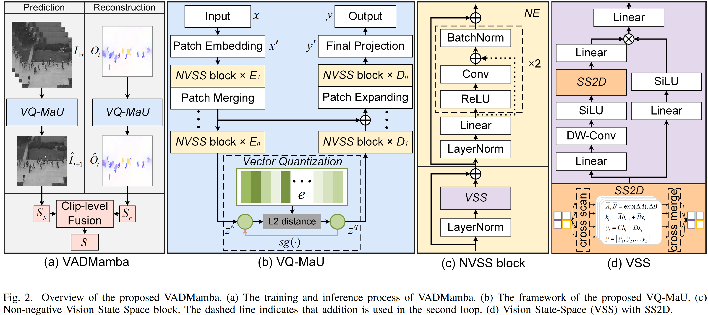
VADMamba: Architecture

Slide 5
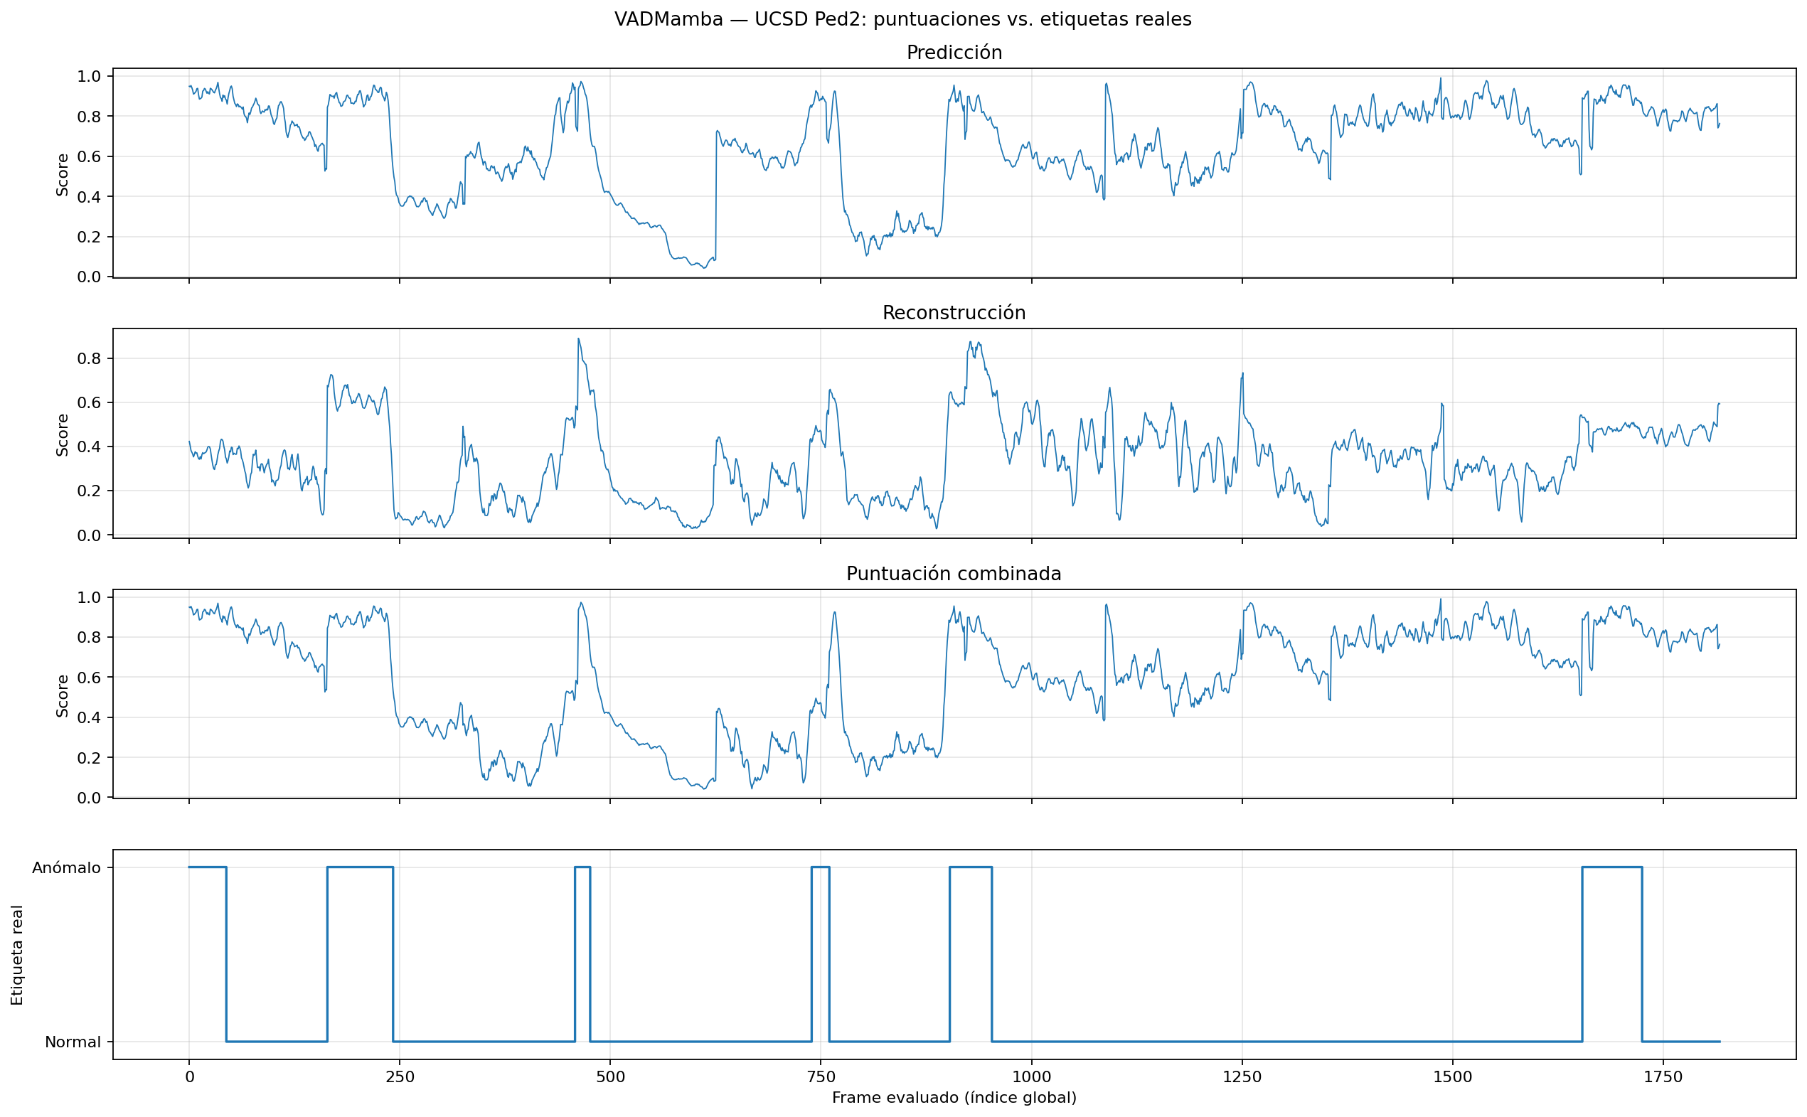
VADMamba: Reproduced Results
20 epochs
Pytorch
FlowNet2SD
AdamW
Lr = 2e-4

Slide 6
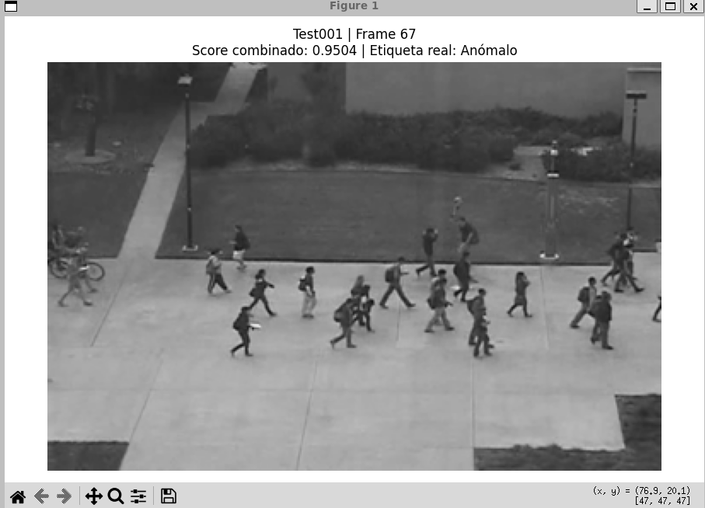
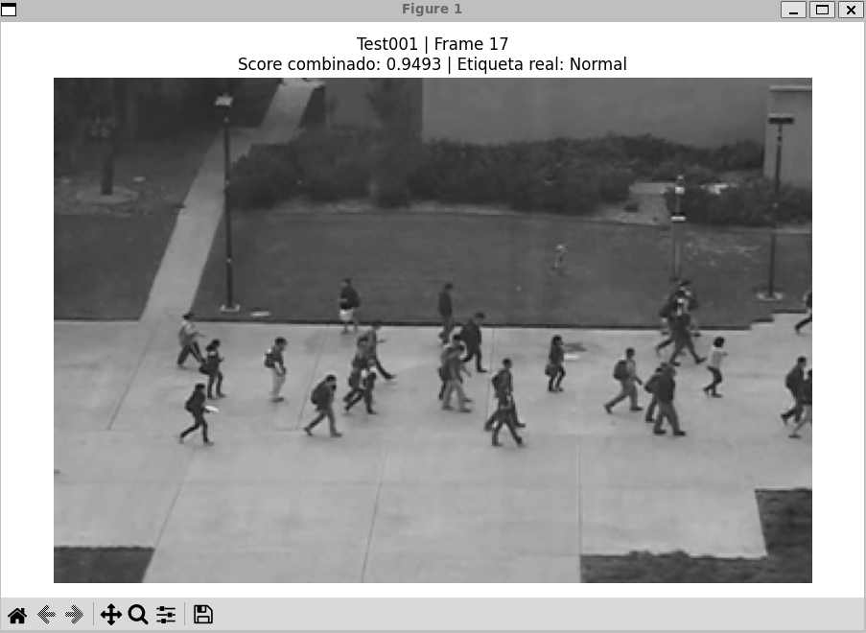
VADMamba: Reproduced Results

Slide 7
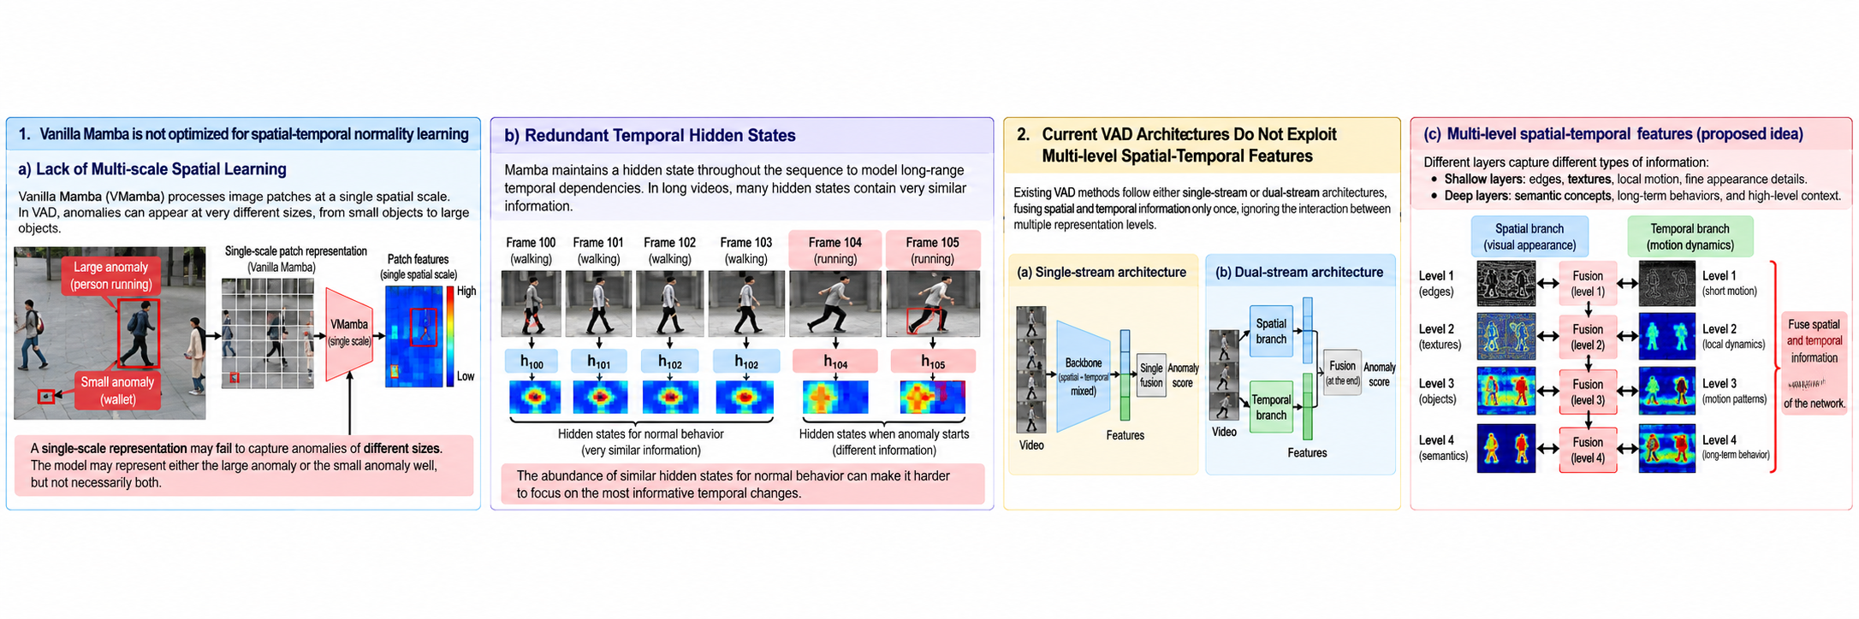
STNMamba

Slide 8
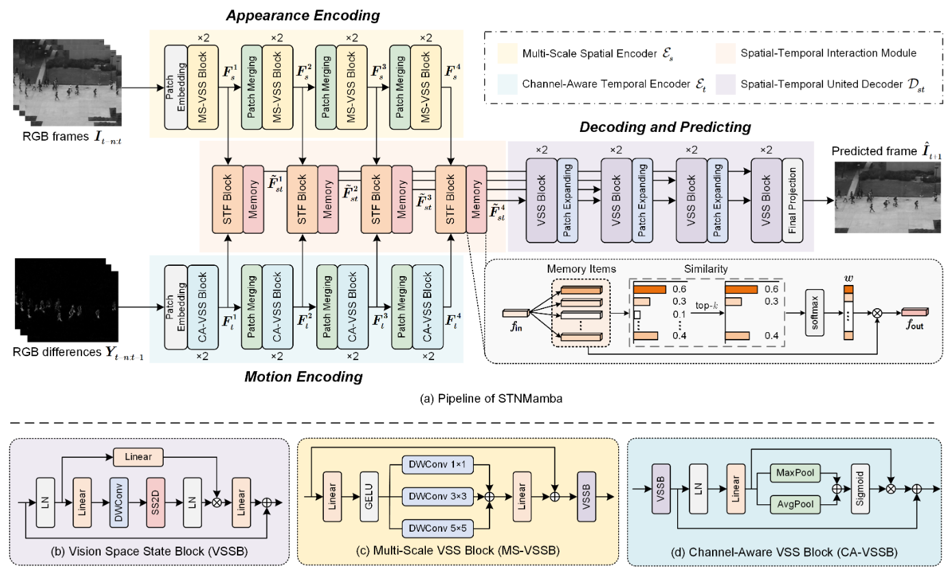
STNMamba

Slide 9
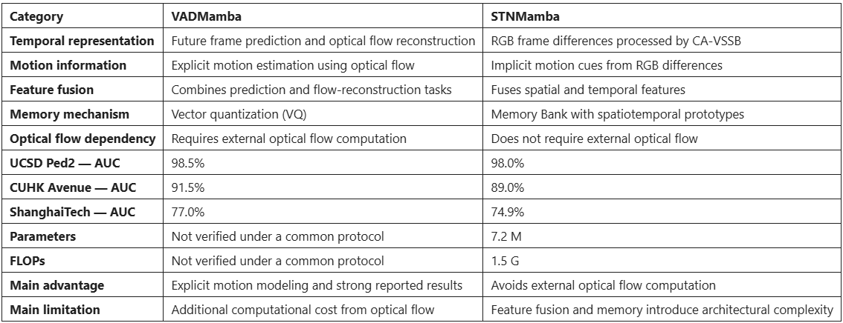
STNMamba vs VADMamba

Slide 10
Future Work
Improve the quality of the model
Verify correct representation of Anomaly and Normal labels
Continue to next paper

Slide 11
THANK YOU
FOR YOUR
ATTENTION

