Slide 1
Weekly Progress Summary
From attention-based models to S4 state space models to Video Mamba
Started the State Space Model block with S4 as the foundation.
Moved from fixed state-space dynamics to selective SSMs in Mamba.
Connected Mamba to vision and video through Vision Mamba and Video Mamba.

Slide 2
Narrative of the Work
Continued from Transformer-based video models into State Space Models.
Reviewed the SSM view: inputs, hidden states, dynamics, and outputs.
Then moved to Mamba, where the model selectively updates its state based on the input.
Move to Vision Mamba and Video Mamba

Slide 3
Why This Step Matters
Transformers are powerful but attention grows expensive with long sequences.
State Space Models offer a different path: recurrent dynamics with efficient sequence processing.
Mamba keeps the long-context advantage while adding input-dependent selection.
This is relevant for video because long clips require temporal memory without excessive cost.
Key Idea
The research path is shifting from attention-based temporal modeling to state-based sequence modeling.

Slide 4
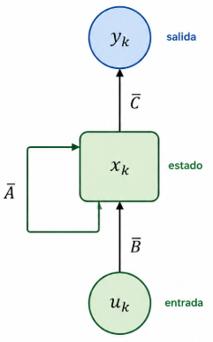




State Space Models: Efficiently Modeling Long Sequences (2021)
An SSM maps an input signal into a hidden state and then projects it to an output.
The hidden state stores information needed to describe the sequence over time.
In discrete form, the model can be interpreted as a recurrent update.
This provides a mathematical foundation for long-range temporal modeling.
Continuous view
Discrete view
$${\dot{x}}_{k}=Ax\left(t\right)+Bu(t)$$
$$x_{k}=\overline{A}x_{k−1}+\overline{B}u_{k}$$
$$y=Cx\left(t\right)$$
$$y_{k}=\overline{C}x_{k}$$

Slide 5
S4: Structured State Spaces
S4 is designed to make State Space Models practical for very long sequences.
The same model can be viewed as recurrent for inference and convolutional for parallel training.
This is the important bridge: stateful memory without giving up efficient computation.
S4 establishes the foundation that Mamba later modifies with selection.

Slide 6
From S4 to Mamba
S4
Selection
Mamba
Structured long-sequence memory.
Input-dependent state updates.
Linear-time sequence modeling.
The central change is that Mamba decides what information to keep or update based on the current token.

Slide 7
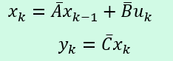
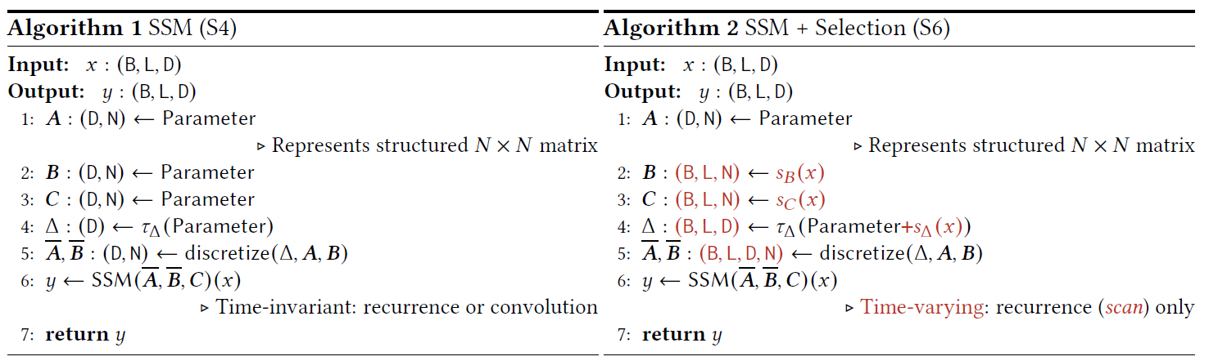
Mamba: Selective State Spaces (2023)
Mamba introduces selection into State Space Models.
The model can make its dynamics depend on the input sequence.
This helps it filter relevant information and ignore less useful tokens.
The result is a sequence model that competes with attention while scaling linearly.

Slide 8
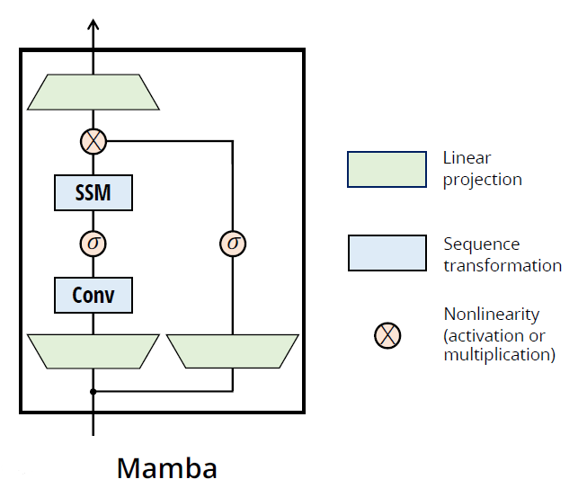
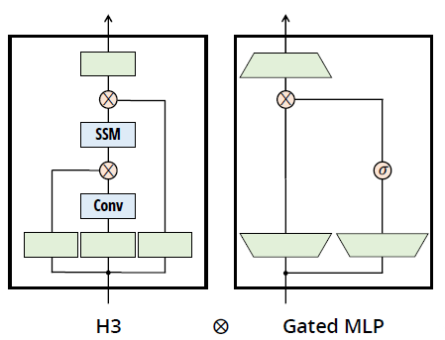
Mamba Block
The block combines projection, selective SSM computation, gating, and output projection.
Gating controls how much information passes through the block.
The selective scan allows recurrent-style processing to remain efficient.
This block becomes the reusable unit for later vision and video variants.

Slide 9
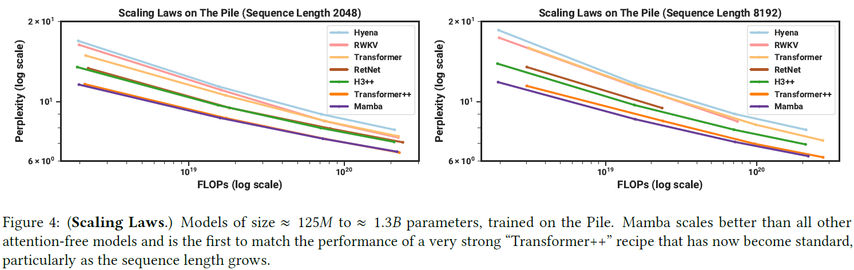
Mamba Perplexity

Slide 10
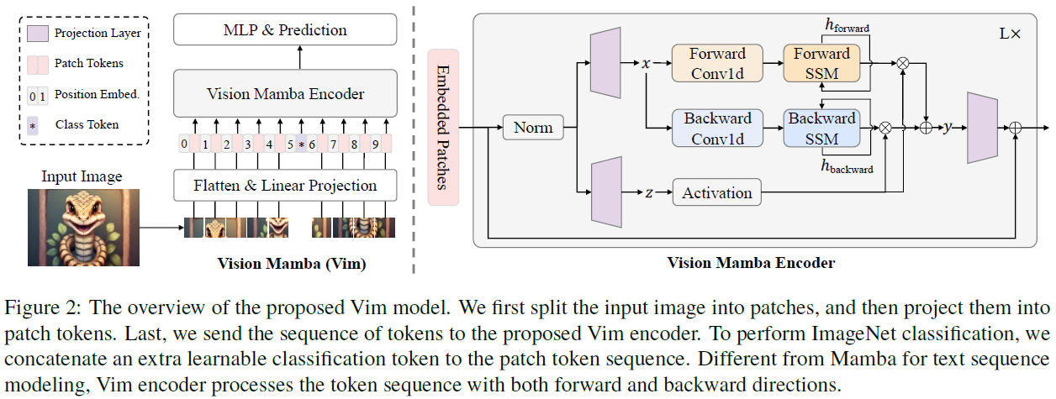
Vision Mamba (2024)
Vision Mamba adapts Mamba from 1-D sequences to image tokens.
The goal is to preserve Transformer-like representation power with linear complexity.
Bidirectional scanning helps visual tokens exchange information across the image.
This creates the bridge from language sequence modeling to visual representation learning.

Slide 11
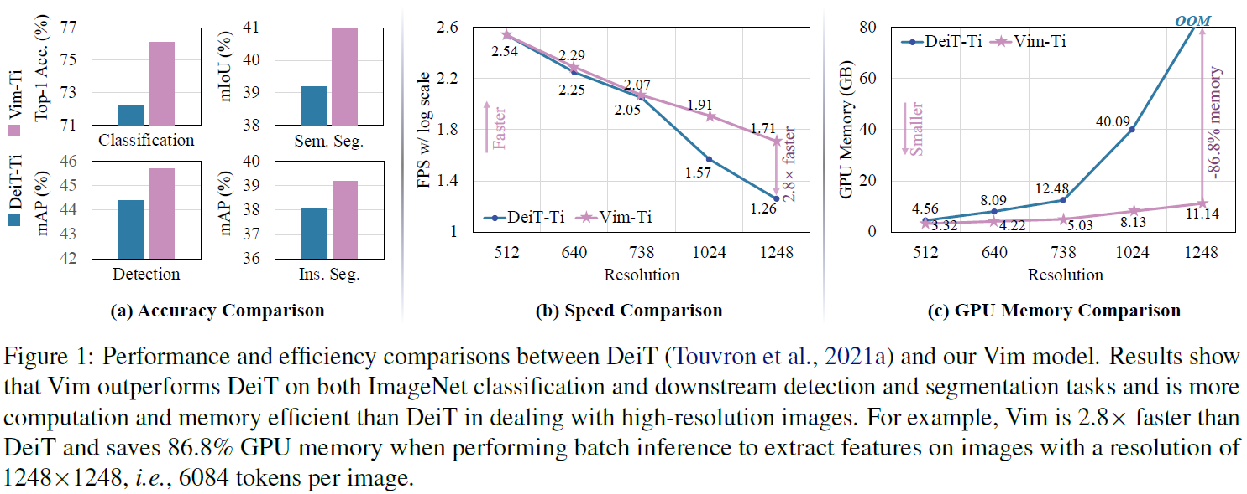
Visual Mamba Results

Slide 12
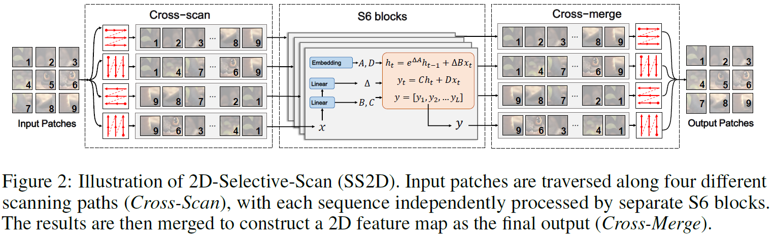
VMamba: Visual State Space Model (2024)
VMamba extends Mamba from 1D sequential modeling to 2D image understanding by introducing 2D Selective Scan (SS2D)
Instead of processing image patches as a single serialized sequence (as in Vision Mamba), VMamba performs four directional scans.
Each scan is processed independently by a Mamba (S6) block, and the outputs are merged to reconstruct the final 2D feature map.

Slide 13
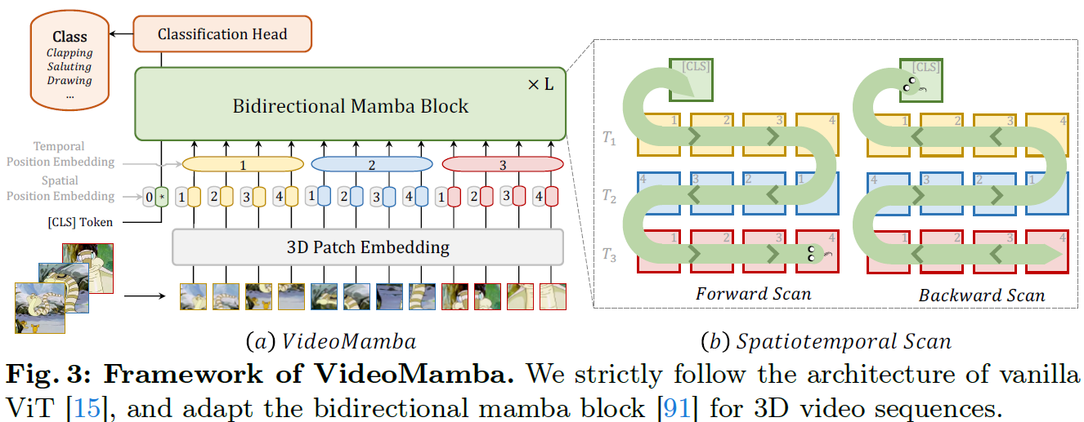
Video Mamba (2024)
Video Mamba extends Mamba-style sequence modeling to video understanding.
Video tokens require both spatial and temporal ordering.
The model uses scan strategies to process video efficiently.
This connects State Space Models directly to the earlier video-recognition roadmap.

Slide 14
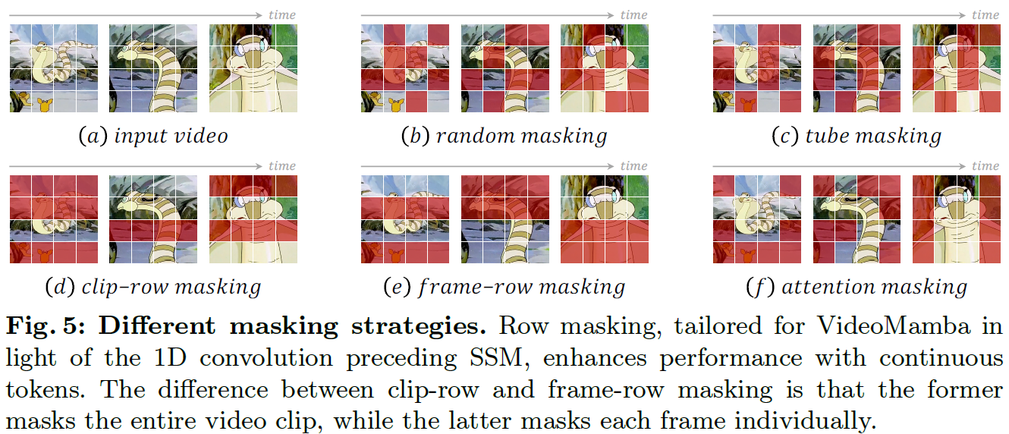
Video Mamba: Masked Modeling
Masked modeling trains the model to recover missing visual-temporal information.
This encourages robust video representations without requiring detailed labels.
The idea is useful for learning from large video data where annotation is expensive.
It also connects naturally to future anomaly-detection work.

Slide 15
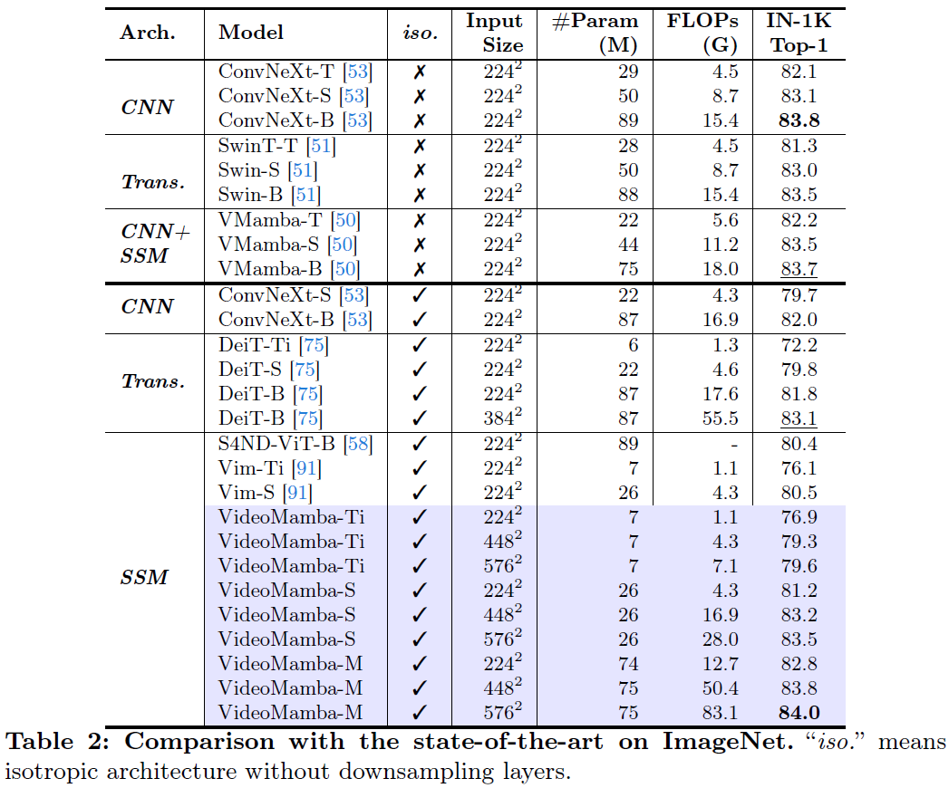
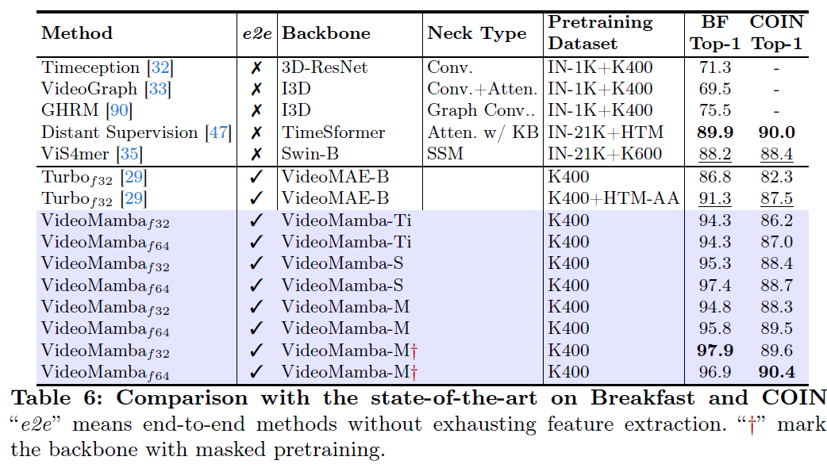
Video Mamba: Results

Slide 16
Evolution of Ideas
S4
Mamba
Vim
VMamba
Video Mamba
From structured state-space memory.
To selective input-dependent sequence modeling.
To image token scanning and visual representations.
To efficient video sequence modeling across space and time.

Slide 17
What Is Already in Place
A conceptual foundation for State Space Models and S4.
A clear transition from fixed SSM dynamics to selective SSMs.
An understanding of the Mamba block and selective scan.
A bridge from Mamba to visual models through Vision Mamba and VMamba.
A first map of how Video Mamba can support long video understanding.

Slide 18
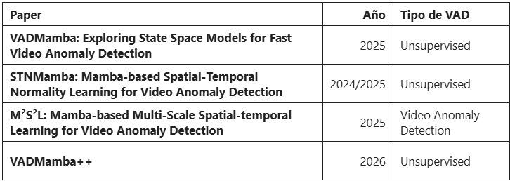
Suggested Next Step
Decide whether Mamba-based models are useful as backbones for surveillance anomaly detection.
Advance to Anomaly Detection with Mamba backbone

