Slide 1
Objectives
In this session, you will learn to:
  What is Java ?
  Features of Java
  Installing Eclipse IDE
  Creating Simple Project
  Generating Javadoc
Notes:
Introduce the students to the course by asking them what they know about forensics. Next, ask the students what they know about system forensics and why is it required in organizations dependent on IT. This could be a brief discussion of about 5 minutes.
Lead the discussion to the objectives of this chapter.

Slide 2
Java Language
Java was created by a team of members called "Green" led by James Arthur Gosling.
When Java was created in 1991, it was originally called Oak.
It is a free and open source software (FOSS) under GNU General Public License(GPL)
First version of Java was released in 1995.
Java is an Object oriented language, simple, portable, platform independent, robust and secure.
Notes:
A group of engineers from Sun Microsystems, now acquired by Oracle Corporation, led by James Gosling created Java. It was released in 1995. The Language was originally called Oak (in 1991) after the Oak tree that could be seen in Gosling's office. They later found that Oak was a name already taken. So, popular story goes that after many hours of trying to come up with a new name, the development team went out for coffee and the name Java was born!
FOSS (GPL):
FOSS is a free and open source software and GNU General Public License
The GNU General Public License is a free, copy-left license for software and other kinds of works
Copyleft is used to describe the practice of using copyright law to offer the right to distribute copies and modified versions of a work and requiring that the same rights be preserved in modified versions of the work

Slide 3

Simple Hello World in Java
Hello.java
public class Hello{
public static void main(String args[])
{
System.out.println(“Hello World!”);
}}
Special statement used to display data on console. ‘println’ causes the next print statement to be printed in the next line.
main() is a method from where program execution begins.
Notes:
System.out.print prints in the same line.

Slide 4
Environment to compile and execute
Compile java programs
  From command prompt
  Through an IDE (Integrated development environment)
    Eclipse →Apache
    NetBeans →Oracle SDN
    JBuilder → Borland
    Integrated Development Environment → IBM

Slide 5
Setup JDK
http://java.com/en/download/index.jsp or find appropriate link in http://www.oracle.com/technetwork/indexes/downloads
Download Java based on the type of OS
  Windows
  Linux
  Mac OS
  Solaris
Install JDK

Slide 6
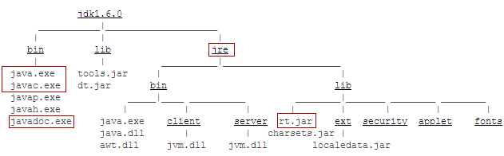
JDK Installation directory
Java Runtime Environment
Java virtual machine
Java Executables
Java Predefined Classes like
String, Date, Math etc.
Notes:
rt.jar is a library file that has all predefined Java classes that are part of core Java. Jar is java archive.

Slide 7
Compilation & execution: command prompt
Save the file as Hello.java. A public class must be saved in the same name as class name.
Compile
  C:\MyJava>javac Hello.java
Byte code
Hello.class
javac
Hello.java
compilation
Source code
execution
java
Platform specific code
Execute
  C:\MyJava>java Hello
Notes:
javac [ options ] [ sourcefiles ]
sourcefiles can also include relative or absolute path components
–d directory
Set the destination directory for class files.
D:\ javac –d bin Test.java places Test.class in D:\bin folder. Please note that the bin folder exist before giving this command
-nowarn
Disable warning messages.
-version
Displays the version used for compilation
-target
Generate class files for specific VM version

Slide 8
JRE and bytecode
Java Bytecode is produced when Java programs are compiled.
To execute Java program, JRE must be installed in the system
JRE or Java Runtime environment contains
  Java Virtual Machine
  Standard class libraries (APIs)
  Java Plug-in
  Java Webstart
JRE gets installed automatically when JDK is installed. JRE can be installed independent of JDK as well. This will mean that Java programs can be executed in that system.

Slide 9
Introducing Eclipse Helios 3.6 IDE
IDE is where the Java programs are written, compiled and executed.
Eclipse is an open source project
  Launched in November 2001
  Designed to help developers with specific development tasks
GUI and non-GUI application development support
Easy integration of tools
Supported by multiple operating systems like Windows, Mac, Linux, Solaris, IBM AIX and HP-UX.

Slide 10
Eclipse as an IDE
Java Development Tooling (JDT) is used for building Java code
Provides set of workbench plug-ins for manipulating Java code
  Java projects, packages, classes, methods, ....
Java compiler is built in
  Used for compiling Java code
  Creates errors (special markers of code) if compilation fails
Numerous content types support
  Java, HTML, C, XML, ...

Slide 11
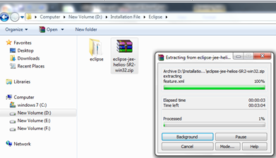
Activity: Installing Eclipse
Download Eclipse’s Install Zip File from http://www.eclipse.org
Click on the Download from the main page on http://www.eclipse.org
  Choose the best site from which to download
  Choose the latest build for download
  Choose the platform for download and type of download (http or ftp)
  Specify the location to save the downloaded file.
Unzip the downloaded file to the directory of your choice
Notes:
If Java is not installed then we need to download JVM.
Fix missing a Java VM? …
Download the latest Java Runtime Environment (JRE), e.g., v1.5.0_03 from http://java.sun.com/j2se/
Click on the downloaded EXE file to install
When given the option by the installer, identify a directory of your choice for the install files
There are two ways of specifying JVM for Eclipse:
By installing JVM under the \jre\ directory off the eclipse install directory
By specifying existing JVM in the PATH environment variable

Slide 12
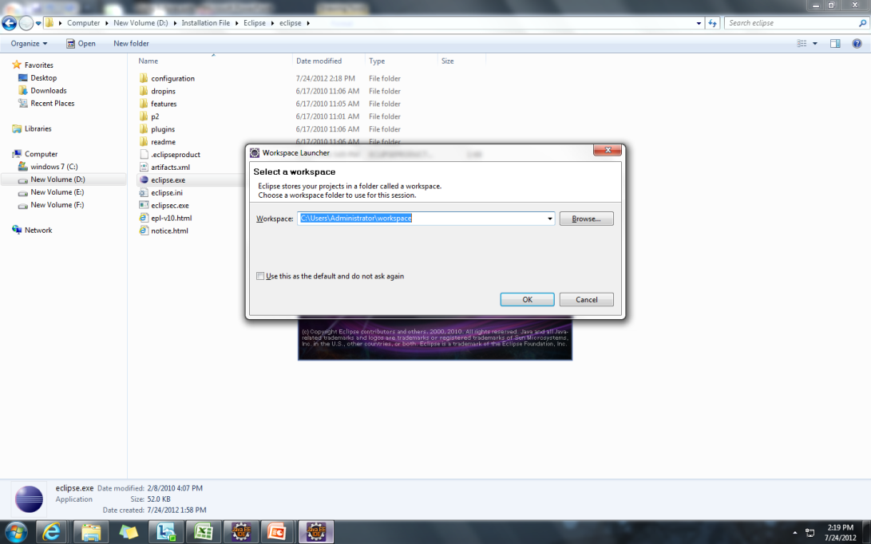
Activity: Specifying Workspace
By double-clicking on the eclipse.exe file, the workspace launcher will pop up.
The workspace is a place where the user defined data – projects and resources such as folders and files are stored.
Always when eclipse is launched, it prompts for a workspace location to open with.
This prompt could be turned off or on as per the user’s choice.

Slide 13
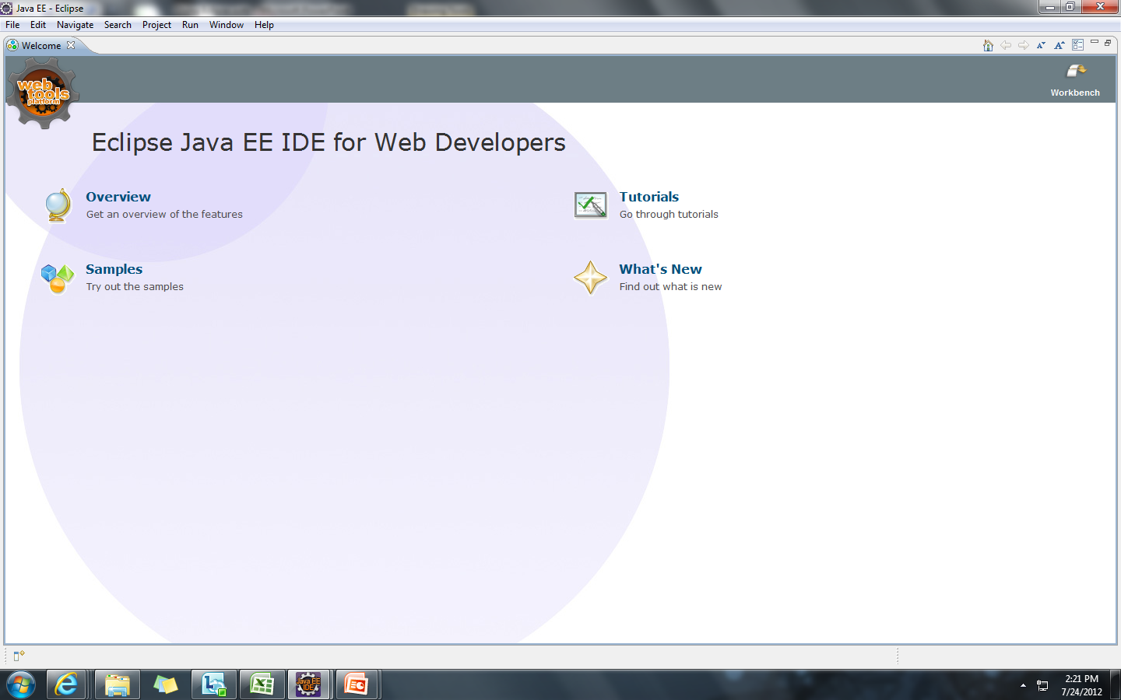
When Eclipse is run, a Welcome page opens

Slide 14
Running Different Workspace
It is possible to run different workspaces using command prompt
  Workspace location must be specified
Useful for grouping project specific data
Multiple workspaces can run at the same time

Slide 15
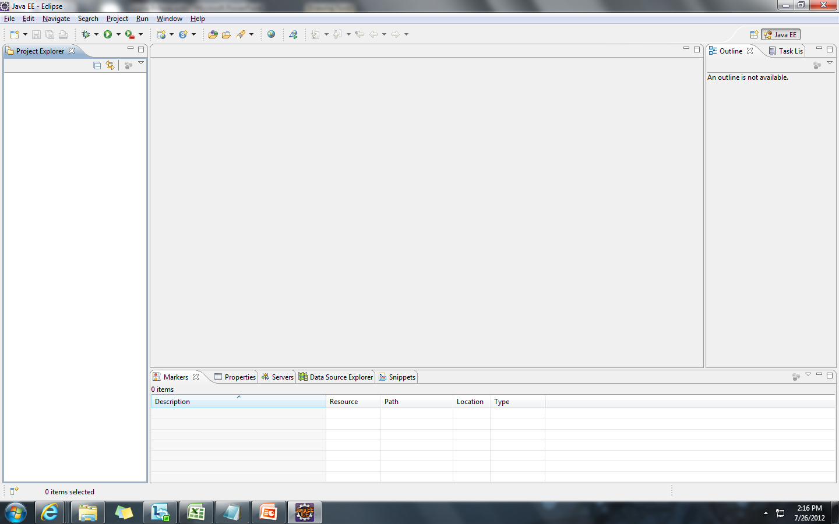
UI Overview
Closing the Welcome page gets you to the Eclipse workbench user interface
Notes:
The workbench is a collection of windows.
Each window contains a menu bar, a toolbar, a shortcut bar and one or more perspectives.
A perspective is a visual container for a set of views and content editors.
The views exist wholly within the perspective and are not shared, but any opened content editors are shared across perspectives.
The objects are stored as regular files within the Eclipse workspace.
The workspace consists of one or more top level projects.
Each project contains a collection of folders and files.

Slide 16
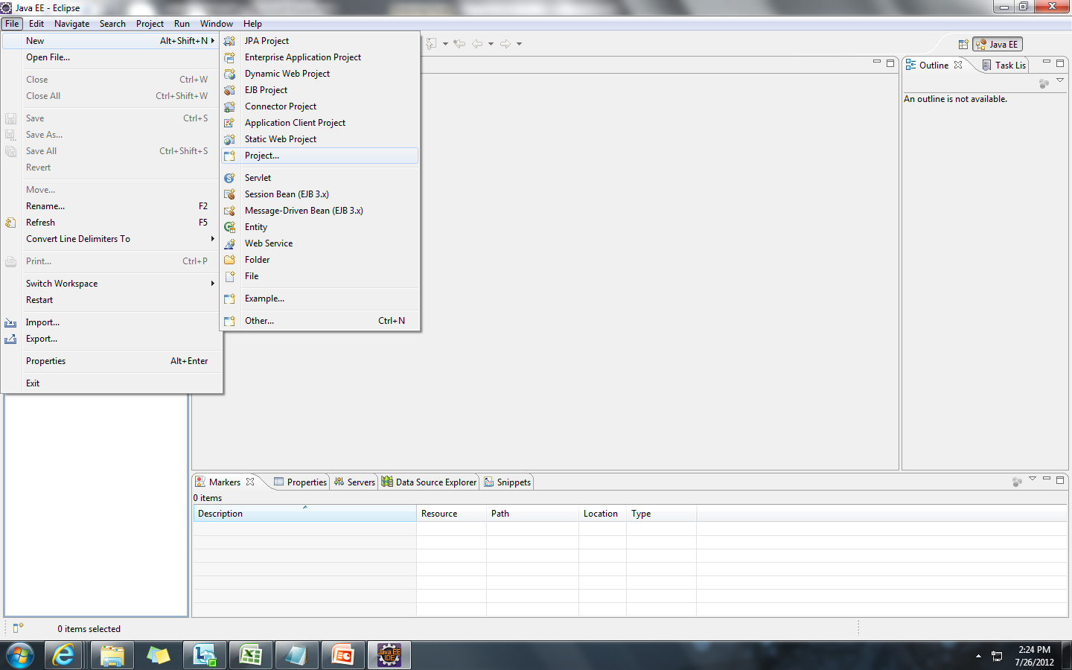
Activity : Create and Execute a Java project
Writing a simple HelloWorld program in Java using Eclipse.
Step 1: Start Eclipse.
Step 2: Create a new workspace called sample and select Ok.
Step 3: Close the Welcome page
  Step 4: File→New → Project

Slide 17
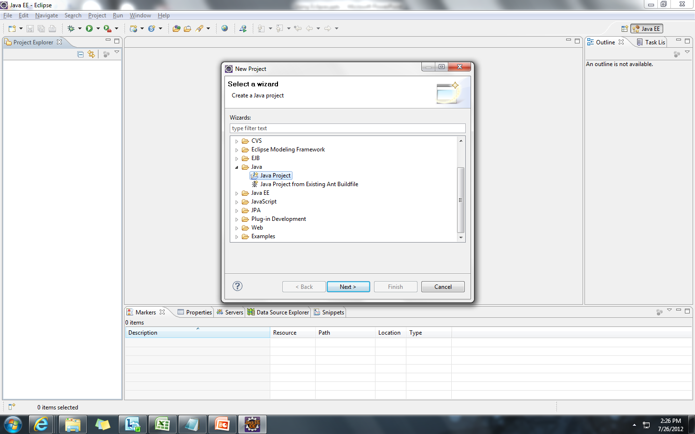
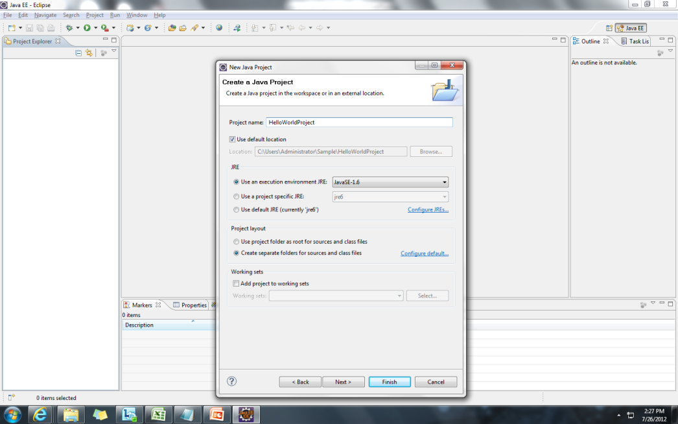
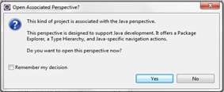
  Step 5: Select "Java" in the category list.
  Step 6: Select "Java Project" in the project list. Click "Next".
  Step 7: Enter a project name into the Project name field, for example, "Hello World Project". Click "Finish"
  It will ask you if you want the Java perspective to open.
  Select Yes.

Slide 18
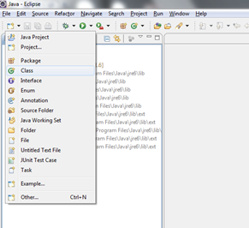
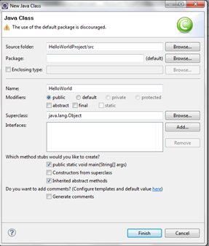
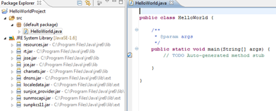
Step 8: Select New → Class option
Step 9: Specify the class name “HelloWorld” and select "public static void main(String[] args)" check box. Click Finish.
Step 10: In the main method enter the following line.
System.out.println("Hello World"); Save it.

Slide 19
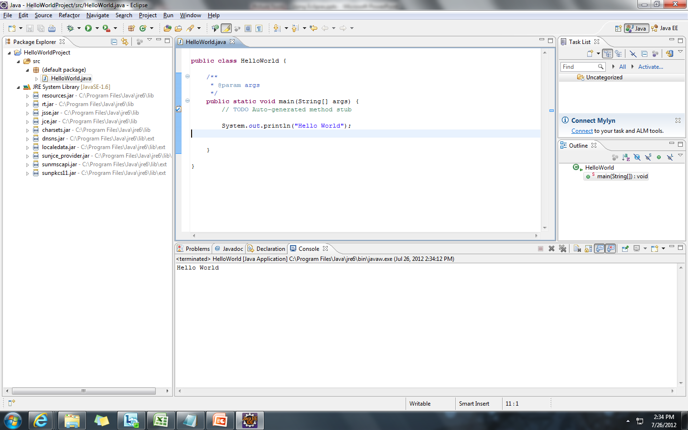
Step 11: Select Run → Run.

Slide 20
Features of Java Language
Simple
  Object oriented language
Portable and platform independent
Robust
Multithreaded
Dynamic Linking
Secure
Performance
Notes:
Simple: Syntax similar to C/C++,Same types of loops ,Same data types , no pointers, no array index out of bounds problems, no explicit memory allocation & de-allocation. Java is able to overcome memory related problems by the virtue of Garbage collection which is a tool that attempts to free unreferenced memory (memory occupied by objects that are no longer in use by the program) also called garbage, in program
Object oriented language: Java is an object oriented language. Every Java application begins with a class. There are no stand-alone functions or global variables in Java. Functions and methods are part of Java Class. Even the main method is part of a java class.
Portable and platform independent: discussed in next slides
Robust: Strong Error handling mechanism: Lot of checks are done at the compilation itself. More checks are performed at runtime system to make sure that code does not malfunction. Automatic garbage collection.
Thread:At the OS level, smallest unit of work that can be scheduled, is a thread. Thread is a sequence of execution of code. A process consists of one or more threads. Multiple threads in the same program share same resources. Unlike a multiple process, multiple threads in a process share same memory location. That is why threads are called Light weight process. Java Standard API has rich set of classes that allows us to work with multiple threads simultaneously
Dynamic Linking: The Java class loader(a represented by a class called ClassLoader) is a part of the Java Runtime Environment that dynamically loads Java classes into the Java Virtual Machine. It links classes with the executing code. Usually classes are only loaded on demand meaning that only the classes specified in the code are loaded. JVM class loaders looks for the classes specified in the following order-
Bootstrap classes :loads java libraries (rt.jar etc.)
Extensions classes : loads external libraries in lib/ext paths. For example, <JAVA_HOME>/lib/ext etc.
Classes in classpath: loads classes in CLASSPATH environment variable or system property java.class.path. (By default, the java.class.path property's value is ‘.’)
Secure: Security is in-built into Java's language rules. It has no syntax for pointers. So it is impossible to access illegal memory. Java has extensive syntax (like private, protected) to secure data from being accessed by illegal objects. It also has comprehensive API with support for a wide range of cryptographic services and for Authentication and Access Control, Secure communication. Java Compiler flags error on illegal conversions and also makes sure that all java's language rules are adhered to

Slide 21
Portable and platform independent
Java Code can be compiled anywhere
Bytecode can be executed anywhere

Slide 22
Portable
When java code executes, its behavior is exactly same in any java-aware system.
There are no platform-specific code in java programs that causes compilation problems in any other OS.
This makes Java programs are portable.
Notes:
There are no platform-specific code in java programs that causes compilation problems in any other OS. (For example in C if you include conio.h library, this will work only in Window OS and will not work in linux).
Also some features that were considered not portable in C/C++ (like sizes of int, right shift operator behavior etc.) were eliminated for Java

Slide 23
Platform Independent
A Java program requires JVM (part of JRE) to execute Java code. When java application starts to executes, Java Virtual Machine also starts.
Bytecode has instructions that Java Virtual Machine can understand and execute.
JVM converts the Bytecode to machine specific code.
Java Bytecode can be copied on to any machine that has JVM and executed. This is what makes Java Platform Independent.
“Write Once, Run any where”

Slide 24
Automatic garbage collection
The garbage collector is a tool that attempts to free unreferenced memory (memory occupied by objects that are no longer in use by the program) in programs.
Automatic garbage collection is an integral part of Java and its run-time system.
Java technology has no pointers. So there is no question of allocation and freeing by programmers.
Does that mean Java does not support dynamic memory allocation?
No. It means that Java takes care of memory and relieves the programmers from memory-related hassles.
java –verbose:gc can be used to get more information about garbage collection process.

Slide 25
Commenting source code
Question: Why should you comment your code?
How much should you comment?
3 types of comment
    Single line comment : //
    // this is a single line comment
    Multi-line comment: /* */
      /* this is multi
      line comment */
    Documentation Comment (Doc comment): /** */
  /** This class is used to represent a stack.
  * @author Murali
  * @version 1.0, 08/16/2010
  */

Slide 26
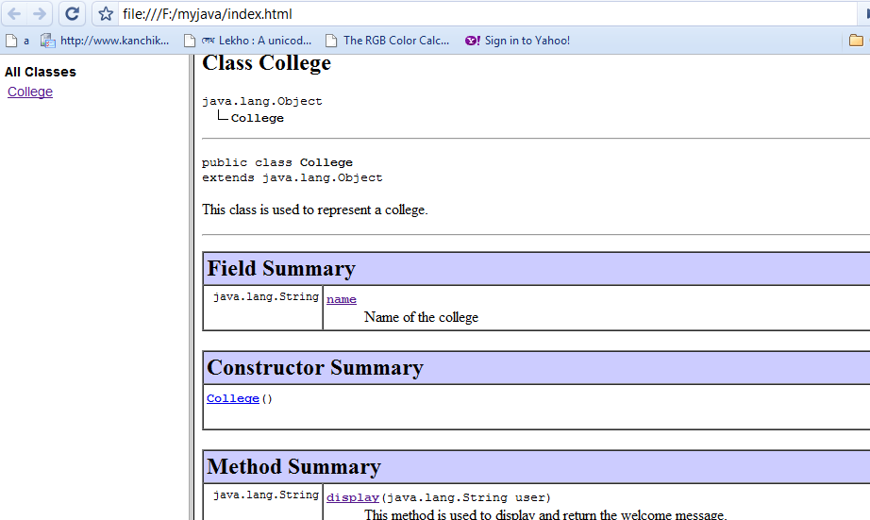
javadoc
Tool that is used to produce HTML pages by parsing through the documentation comment in java source code.
Produces documentation for public and protected classes/members.
Works on entire package or a single source file
Usage on source file
  javadoc sourcefilename.java
javadoc College.java

Slide 27
Nesting comments
Valid Nesting
/* // */ /** // */
///* */ // /** */
Invalid Nesting
/* */ and /** */ nested with itself and nested with each other gives error.
/* /* */ */
/** /* */ */

