Slide 1
Objectives
In this session, you will learn to:
  Object Orientation
Notes:
Introduce the students to the course by asking them what they know about forensics. Next, ask the students what they know about system forensics and why is it required in organizations dependent on IT. This could be a brief discussion of about 5 minutes.
Lead the discussion to the objectives of this chapter.

Slide 2
Feature: Object oriented programming
Object-oriented programming is a method of implementation in which programs are organized as cooperative collections of objects, each of which represents an instance of some class, and whose classes are all members of a hierarchy of classes united via inheritance relationships.
Grady Booch
Terms
Object
Class
Abstraction
Encapsulation
Inheritance
Notes:
Structured Approach
Based on functions
goto branching
C, C++, COBOL, Pascal
Some disadvantages: No constructs for encapsulation, chances of code repetition, No strong data hiding concept, difficult to debug
Object-oriented Approach
Smalltalk, Java, C#

Slide 3

Object
A thing in a real world that can be either physical or conceptual. An object in object oriented programming can be physical or conceptual.
Conceptual objects are entities that are not tangible in the way real-world physical objects are.
Bulb is a physical object. While college is a conceptual object.
Conceptual objects may not have a real world equivalent. For instance, a Stack object in a program.
Object has state and behavior.
What is the state and behavior of this bulb?

Slide 4
Attributes and Operations
The object’s state is determined by the value of its properties or attributes.
Properties or attributes → member variables or data members
The object’s behaviour is determined by the operations that it provides.
Operations → member functions or methods

Slide 5
Putting it together
object
A bulb:
It’s a real-world thing.
Can be switched on to generate light and switched off.
It has real features like the glass covering, filament and holder.
It also has conceptual features like power.
A bulb manufacturing factory produces many bulbs based on a basic description / pattern of what a bulb is.
methods
member variables
class

Slide 6
Class
A class is a construct created in object-oriented programming languages that enables creation of objects.
Also sometimes called blueprint or template or prototype from which objects are created.
It defines members (variables and methods).
A class is an abstraction.

Slide 7

Abstraction
Abstraction denotes essential characteristics of an object that distinguish it from all other kinds of objects and thus provide crisply defined conceptual boundaries, relative to the perspective of the viewer.
-Grady Booch
Abstraction is the process of taking only a set of essential characteristics from something.
Example
  For a Doctor→ you are a Patient
    Name, Age, Old medical records
  For a Teacher→ you are a Student
    Name, Roll Number/RegNo, Education background
  For HR Staff→ you are ______________
    ___________,_____________,___________
You

Slide 8
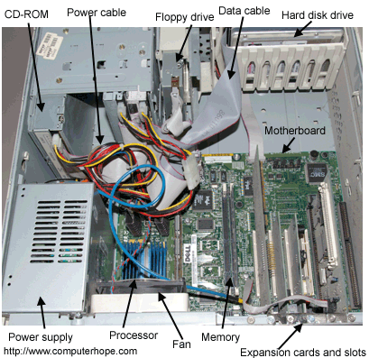
Encapsulation
Would you like it if your CPU is given to you like this?
What are the problems if it were given to you like this?
Encapsulation is the process of compartmentalizing the elements of abstraction that constitute its structure and behavior; encapsulation serves to separate the contractual interface of an abstraction and its implementation.
- Grady Booch
Encapsulation is binding data and operations that work on data together in a construct.
Encapsulation involves Data and Implementation Hiding.

Slide 9
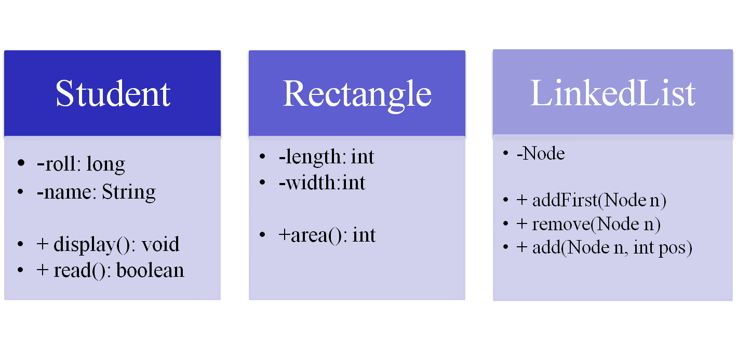
Class and Encapsulation
: private
+ : public

Slide 10
Reuse in Object Oriented Language
Object Oriented Languages also implements reuse in the same way that we do in real life.
Using
  has-a
  is-a
Has-a or composition relationship is implemented by having a class having another class as its member, or rather an object having another object as its member.
  Car has a Stereo
  College has Teachers and Students
Is-a is implemented through what we call inheritance relationship

Slide 11
Inheritance
Inheritance defines relationship among classes, wherein one class share structure or behavior defined in one or more classes.
- Grady Booch
Defines IS-A relationship between classes
Cat IS-A Animal
Car IS-A Vehicle
Rose IS-A Flower

Slide 12
Inheritance hierarchy
Animal
legs
tail
run()
Single -level
Multi-level
CatFamily
paddedClaws
whiskers
Dog
bark()
Tiger
growl()
Cat
meow()

Slide 13
Multiple inheritance
Mammal
Bird
Bat
Many Object-orientated language does not support this type of inheritance.
Java, C# are the examples of object-oriented language that does not support multiple inheritance through classes.

Slide 14
Real Time Example #1:OOPS
For example consider we have a Class of Cars under which Santro Xing, Alto and WaganR represents individual Objects.
In this context each Car Object will have its own,
Model,Year of Manufacture, Colour, Top Speed, Engine Power etc.,which form Properties of the Car class
and the associated actions i.e., object functions like Start, Move, Stop form the Methods of Car Class.
No memory is allocated when a class is created. Memory is
allocated only when an object is created, i.e., when an instance of a class is created.

Slide 15
Real Time Example #2:OOPS
An architect will have the blueprints for a house....those blueprints will be plans that explain exactly what properties the house will have and how they are all layed out.
However it is just the blueprint, you can't live in it.
Builders will look at the blueprints and use those blueprints to make a physical house.
They can use the same blueprint to make as many houses as they want....
each house will have the same layout and properties. Each house can accommodate it's own families...so one house might have the Smiths live in it, one house might have the Jones live in it.

Slide 16
Generalization and Specialization
WildAnimal
legs
tail
run()
Generalization
Specialization
CatFamily
paddedClaws
whiskers
Tiger
growl()
Cat
meow()

Slide 17
Activity: match the following
Super class
Subclass
Fruit
Library
Cat
Bird
Parrot
Music
Tiger
Books
Apple
Mango

Slide 18
Activity
Given the following classes. Can you form inheritance hierarchy?
  Person
  Teacher
  Student
  HOD
  Typist
  Clerk
What are the common members shared ?

Slide 19
Polymorphism
A concept in type theory, according to which a name (such as a
variable declaration) may denote objects of many different classes that are related by some common superclass; thus, any object denoted by this name is able to respond to some common set of operations in different ways.
- Grady Booch

Slide 20
Polymorphism example
Flower
fragrance()
Rose
fragrance()
Sunflower
fragrance()
FlowerVase
Flower f[]
smell()

Slide 21
f[0]= rose;
f[1]= sunflower;
….
Flower
fragrance()
FlowerVase
Flower f[]
smell()
Rose
fragrance()
Sunflower
fragrance()
f[0]. fragrance();
f[1]. fragrance();
…
You pick a rose from the vase and smell it?
What fragrance do you expect?

