Slide 1
Objectives
In this session, you will learn to:
  Inheritance
Notes:
Introduce the students to the course by asking them what they know about forensics. Next, ask the students what they know about system forensics and why is it required in organizations dependent on IT. This could be a brief discussion of about 5 minutes.
Lead the discussion to the objectives of this chapter.

Slide 2
Recall
What are the important features of object-oriented languages?

Slide 3
Definition
Inheritance defines relationship among classes, wherein one class shares structure or behavior defined in one or more classes.
Grady Booch
Approach:
  Common properties of related classes can be defined in a generic class.
  This generic class can then be used by more specific classes through inheritance.
  Each of these specific classes can add things that are unique to it.
As a result of inheritance, a hierarchy of classes is formed.
The class that is inherited is called super class and the class that is inheriting is called a subclass.
Java does not support inheritance from more than one class. That is, you can extend only from one class.
Notes:
Other names of super class – parent class, base class
Other names of subclass – child class, derived class

Slide 4
Example scenarios for inheritance
Student and Teacher are Person. Person can be a super class and Student and Teacher can be subclass of Person class. Student is-a Person, Teacher is-a Person
HOD is-a Teacher. Since Teacher is-a Person, HOD is also a Person
Written_Test and Viva are Test
Theory and Lab are ClassRoomSession
SeminarHall is a ClassRoom

Slide 5
Syntax and symbols
extends keyword is used to indicate inheritance relationship.
Syntax:
  Class-name2 extends Class-name1
public class HOD extends Teacher{
/*Features of Teacher class automatically available.
add additional members */
}
Teacher
getFactId()
getName()
setFactID()
setName()
HOD
getDateOfJoining
viewGrade()

Slide 6
Members that are not accessible
Super class members that cannot be accessed from subclass are
  private members
  Default members (if subclasses are in the different packages).
For example, HOD class cannot access factId, name or the static variable id of the Teacher class since they are private but can access all the other methods since they are public
Notes:
All the features that are there in super class are there in subclass as well. But there are some restrictions with respect to which of the super class features (members) can be accessed from subclass.

Slide 7
Example: code for inheritance
HOD has dateofAppointment and viewGrade as additional features.
package teacher;
public class HOD extends Teacher{
private String dateOfAppointment;
public HOD(String nm, String dt){
super(nm);
dateOfAppointment=dt; }
public void viewGrade(Grade[] grades){
System.out.println(getName()+ " HOD viewing appraisal ");
for(Grade g:grades){
System.out.println("Faculty :"+ g.getFaculty().getName());
Calling super class constructor
Calling super class method

Slide 8
System.out.println("Student ID : "+ g.getStudent().getRegNo());
System.out.println("Grade: "+ g.getGrade());
}
}
public static void main(String str[]){
student.Student s1= new student.Student("Ravi");
student.Student s2= new student.Student(“Kumar");
HOD h=new HOD("Maverick","1.1.2006");
Teacher f= new Teacher("Sam");

Slide 9
System.out.println(“HOD Name "+ h.getName());
Grade g[]=new Grade[2];
g[0]=new Grade(f,s1,"CS-001", Grade.A);
g[1]=new Grade(f,s2,"CS-001", Grade.B);
h.viewGrade(g);
}
}
Calling super class method

Slide 10
super
Keyword super() or super(<parameters)>) is used to call the super class constructor.
super() can be called only from the constructor.It must be the first statement of the constructor.
Compiler inserts a super() statement in all constructor if subclass constructor does not explicitly call some form of super() that calls super class constructor.
This is to ensure initialization of super class members because they are also part of subclass.
public HOD(String nm, String dt){
//super(nm);
dateOfAppointment=dt;}
…}
super();
Compiler inserts
Compilation error: cannot resolve symbol constructor Teacher()
Notes:
super() like this() can be called only from the constructor. Therefore, super() and this() cannot be used together.
If the super class does not have a no-argument constructor, a compile-time error occurs.
Therefore, for classes where super class does not have no-argument constructor, all subclass constructors must explicitly call appropriate super class constructor

Slide 11
Calling super class methods
The super keyword can also be used to invoke super class methods from the subclass method.
  super.getName()
This becomes necessary only when the subclass has redefined the method in super class.

Slide 12
Order of initializations
class Order {
  int i;
  static {
  System.out.println("Order class static block ");
  }
  Order(){
  i=10;
  System.out.println("Order class constructor,i= " + i);
  }
  {
  System.out.println("Order class instance block,i= " + i);
  }
}
Notes:
Static initializations of super class: Static variables are initialized and static blocks are executed in the order of their appearance in the code.
Static initializations of subclass class : Static variables are initialized and static blocks are executed in the order of their appearance in the code.
Instance initializations of super class : Instance variables are initialized and instance blocks are executed in the order of their appearance in the code.
Super class constructor is executed.
Instance initializations of subclass class : Instance variables are initialized and instance blocks are executed in the order of their appearance in the code.
Subclass class constructor is executed.
Only after the super class part, sub class part happens.

Slide 13
class SubOrder extends Order{
int j=9;
static {
System.out.println("SubOrder class static block");
}
SubOrder(){
j=15;
System.out.println("SubOrder class constructor,j= "+ j);
}
{
System.out.println("SubOrder class instance block,j= " + j);
}
public static void main(String str[]){
new SubOrder(); }}

Slide 14
And this is the result of executing the code…
Order class static block
SubOrder class static block
Order class instance block,i= 0
Order class constructor,i= 10
SubOrder class instance block,j= 9
SubOrder class constructor,j= 15

Slide 15
Activity
Find out how inherited class can be created in Eclipse.

Slide 16
Subclass outside the package
According to Java Language Specification
6.6.2 Details on protected Access
A protected member or constructor of an object may be accessed from outside the package in which it is declared only by code that is responsible for the implementation of that object.

Slide 17
Overriding
Redefinition of an inherited method declared in the super class by the subclass is called Overriding.
Rules
  The signature of the method( method name + argument list) must exactly match.
  The return type must be same or a subtype of the return type of super class method (covariant returns)
  The access can be same or be increased.
  (List of access specifiers in order of their increasing accessibility: private→default→protected→public)
  Instance methods can be overridden only if they are inherited/visible by the subclass.
  Exception thrown cannot be new exceptions or parent class exception.
Notes:
Many times we may have to redefine some of the existing features of a class in a subclass.
For example, a big car inheriting from a small car may retain its features like steering wheel but needs to have interiors like seats, seat cover etc of bigger size.
When a method is redefined there is some flexibility in terms of not having exactly same method declaration as the super class method.
They are defined by a set of 5 rules.
For now let us ignore the 5th rule.

Slide 18
Access specifier rule
package admin;
public class HOD extends Teacher{
..
public void display(){
super.display();
System.out.println(
"Date of appointment "+dateOfAppointment);
}
}
package teacher;
public class Teacher{
..
protected void display(){
System.out.println(
"Name "+getName());
System.out.println("ID :"+factId) ;
}
}
Cannot have private or default access specifier for display()

Slide 19
Visibility rule
package teacher;
public class Teacher{
..
void display(){
System.out.println(
"Name "+getName());
System.out.println("ID :"+factId) ;
}
}
package admin;
public class HOD extends Teacher{
..
private void display(){
System.out.println(
"Name "+getName()); System.out.println(
"Date of appointment "+dateOfAppointment);
}
}
Can have any access specifier here. Since private and default methods are not inherited/visible !

Slide 20
@Override
When overriding a method, @Override annotation could be used
This tells the compiler that you intend to override a method in the superclass.
If, for some reason, the compiler detects that the method does not exist in one of the superclasses, it will generate an error.
@Override
public void display(){
System.out.println("Name "+getName());
System.out.println("Date of appointment "+dateOfAppointment);
}

Slide 21
Hiding .Vs. Overriding
A method is said to be overridden only if it can take the advantage of runtime polymorphism!.
Otherwise it is only hidden.
The static methods of the super class are hidden when they are redefined in the sub class.
The static methods of the super class cannot be redefined as non-static method in subclass or vice-versa.
class ClassRoom{
static int capacity=50;
public static void printCapacity(){
System.out.println("Class Room seating capacity "+ capacity); }
}
Notes:
While instance methods are overridden, class methods are only hidden.
Also, instance method cannot be overridden to be a class method and vice versa.

Slide 22
Example: Hiding
class SeminarHall extends ClassRoom{
static int capacity =500;
public static void printCapacity(){
System.out.println("Seminar Hall seating capacity "+ capacity); }
public static void main(String str[]){
ClassRoom examHall= new SeminarHall ();
examHall.printCapacity();
}
}
//Prints :Class Room seating capacity 50.

Slide 23
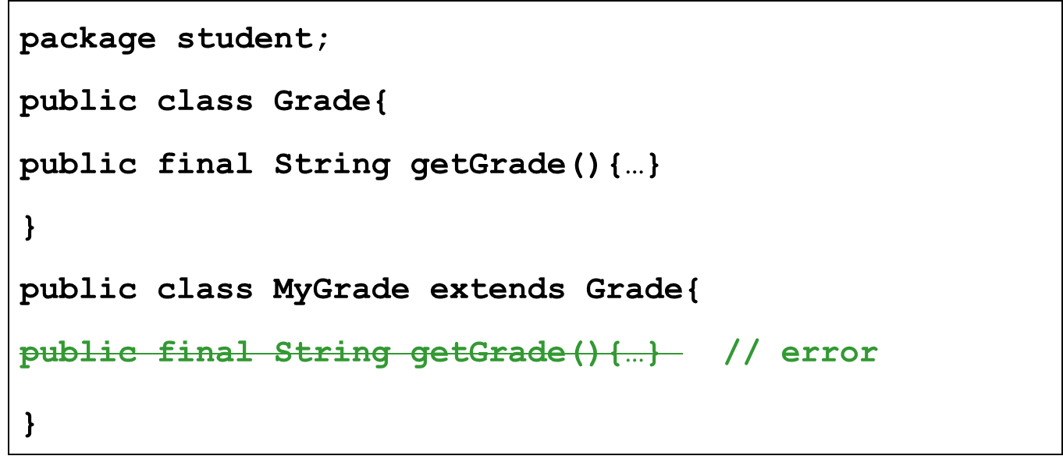
final method
A method that is declared as final prevents an inheriting class from overriding that method.

Slide 24
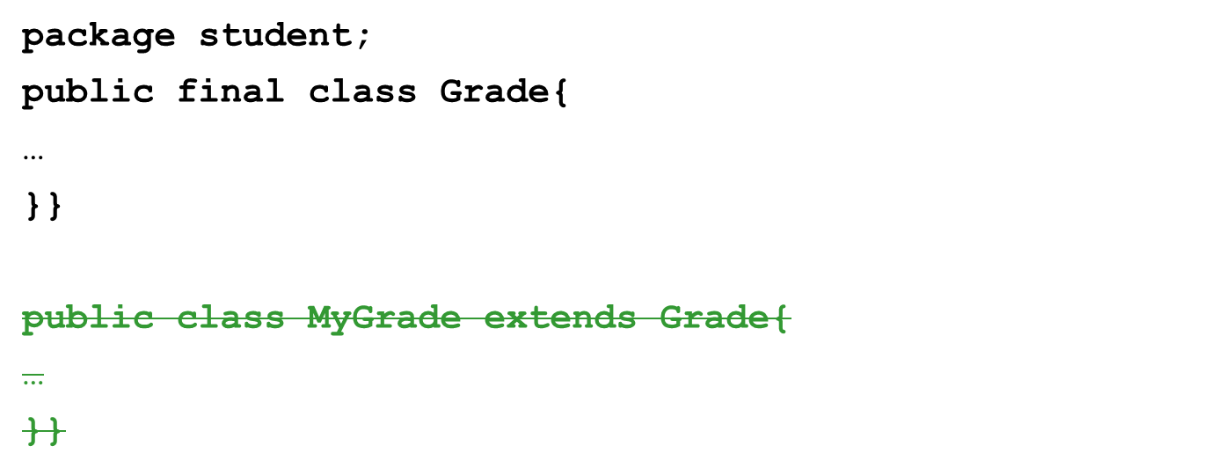
final class
A class that is declared as final prevents other classes from inheriting from it.
System, Scanner, String class and all the wrapper classes (Boolean, Double, Integer etc.) are final.
error

Slide 25
Abstract class and methods
Declaring a class as an abstract class prevents you from creating instances of that class.
Abstract methods are the methods that don’t have the method body. They are just declarations
While an abstract class can have abstract methods, it could also NOT have any abstract methods.
The whole class must be declared abstract, even if a single method is abstract.
An abstract method must not be static.
  A class can inherit from abstract class either by complete or partial Implementation. In the case of partial implementation, the class should be marked abstract.
Notes:
Please note that the classes that we have created so far are called concrete classes (classes from which we can create instances).
A class can inherit from abstract class in two ways
By Complete Implementation
A class that inherits from the abstract class and override all the abstract methods by providing implementations specific to that class.
This results in a concrete class
By Partial Implementation
A class that inherits from the abstract class and does NOT override one or more abstract methods.
Such class must be marked as an abstract class.

Slide 26

Example scenario for abstract class
Person
<<abstract>>
Teacher
…
getName()
getAddress()
…
Student
…
package general;
public abstract class Person{
//getters and setters
}
package student;
public class Student extends general.Person{
…}
Notes:
College needs to maintain information a student or a faculty or a principal or a HOD.
If we notice carefully, most of the common information about all these entities are name, address, date of birth, unique id.
Imagine writing getters and setter for all these in all the classes (even if it were copy paste, it is not easy !)
Instead a generic class called Person with all common attributes can be created and have Teacher class, Student class and others inherit from Person.
But we don’t want anybody to create Person objects. In other words, a college needs not just a person but Teachers, Students etc.
To prevent instance creation we can mark Person as abstract.

Slide 27
Example scenario for abstract method
Each person must have a unique id.
Teacher
Person
<<abstract>>
getUID()
…
getName()
getAddress()
<<abstract >>
getUID()
…
Student
getUID()
…
Since the implementation of id is dependent on the individual classes, we make the getUID() method abstract.
Notes:
package general;
public abstract class Person{
private String name;
private String address;
protected Person(){}
public void setName(String name){
if(name==null)
System.out.println("Invalid name");
else
this.name=name;}
public String getName(){
return name;}
public void setAddress(String address){
if(address==null)
System.out.println("Invalid name");
else
this.address=address;}
public String getAddress(){return address;}
public abstract int getUID();
public Person(String name, String address){
setName(name); setAddress(address);}
public Person(String name){
setName(name);
} }
package student;
public class Student extends general.Person{
//remove getters and setter for name attribute
public int getUID(){return regNo;}
public Student(String nm, String d){
super(nm);
…}}
package teacher;
public class Teacher extends general.Person{
//remove getters and setter for name attribute
public int getUID(){return factId;}
etc…}

Slide 28
Object
All classes in java, by default, inherit from a predefined java class called Object.
Object class is defined in java.lang package.
This class is the root of the class hierarchy.
Object class is a concrete class and has a no-argument constructor.
java.lang.Object
Multi-level inheritance
general.Person
teacher.Teacher
student.Student
teacher.HOD
Notes:
All classes, including arrays, directly or indirectly inherit the methods of this class.
Even if we do not explicitly write code to inherit from Object, the compiler inserts extends Object to our class if it finds no extends clause specified in our class definition.

Slide 29
Object class - important methods
public String toString()
protected void finalize() throws Throwable
// ignore throws Throwable for now

Slide 30
finalize()
This methods is called just before the object is going to get garbage collector.
A subclass will have to overrides the finalize method to dispose of system resources or to perform other cleanup.
The finalize method is never invoked more than once by a Java virtual machine for any given object.
  public class Test{
  public void finalize() throws Throwable{
  }
  }

