Slide 1

Low hanging fruit with local LLMs
Combining local LLM with tools and RAG to get network assistant out of AI
Peter Havrila | IBM | 2026
© IBM Corporation 2026 | Peter Havrila

Slide 2
Motivations
Network Management is stability-first operations, LLMs are not there yet to take over. HOWEVER:
Networks are not complicated, only complex, so LLMs should be able to be very helpful reviewing large network datasets and be in review/advisory roles accelerating tasks inside network engineer's role
With RAG and other post-training context extensions, we should be able to enforce rules, and post-training knowledge specific to our enterprise networks (e.g. vectorize a new vendor configuration guide or enforce IBM specifics like interface/description/hostname conventions and etc… )
Only using local LLMs on workflow backend (or technically watsonx) this can be inserted into automation platforms with tentacles to FSoT.
With large RAG contexts insertions, the cost of using commercial tokens based LLM the costs would sky-rocket
Secondary motivation is to have AI assistant that knows everything I have in my Obsidian/OneNote and can help me recover work specific contacts / processes / and potentially answer Slack
© IBM Corporation 2026 | Peter Havrila

Slide 3
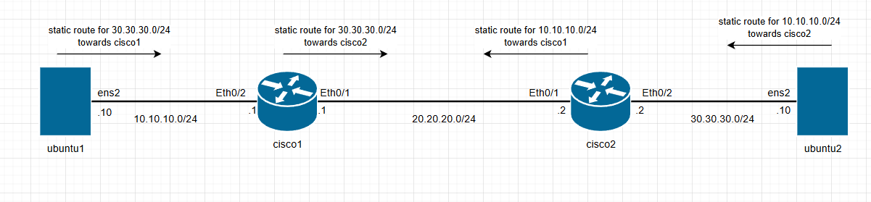
Demo Lab: Simplified to use larger LLM in timeslot
2× Spines | 2× L3 Leaf Pairs | 2× L2 Leaves | 2× Server Endpoints
Demo: containerlab redeploy topology.clab.yaml
* **ubuntu1**:
* **Username**: `clab`
* **Password**: `clab@123`
* **cisco1**:
* **Username**: `admin`
* **Password**: `admin`
© IBM Corporation 2026 | Peter Havrila

Slide 4
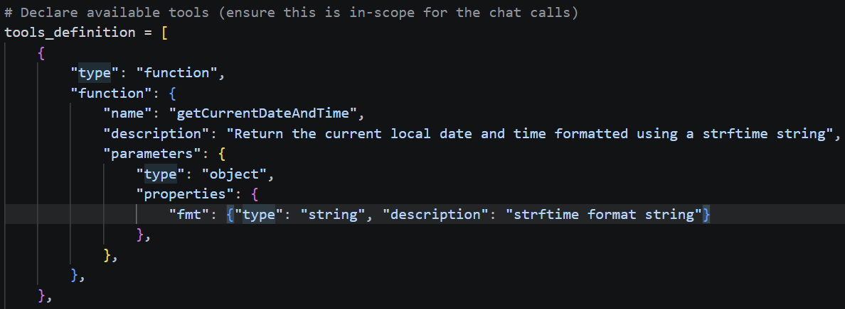
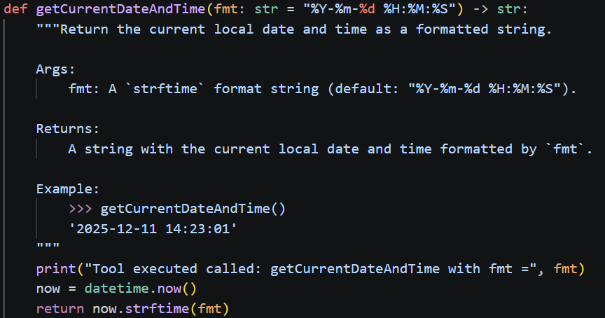
LLM Tools and KnowledgeSources (RAG + tools search)
Tools.py
Tools exposed to LLM via OpenAI tools, insertion
What get’s preloaded to LLM’s context on initialization:
Ollama or LMStudio
Qwen / Gamma 4 / Mistral / Deepseek
(prerequisite trained for tool’s use)
getCurrentDateAndTime()
getContainerLabTopologyInformation()
When LLM ask’s for that tool, this is executed:
getContainerLabDeviceConfiguration()
executeCommandsOnContainerLabDevice()
(with authorization mechanism!!)
RAG (chroma_db vectorized knowledge)
These are simply told to LLM in system prompt to use and reference before taking action
searchKnowledgeFiles() (backup tool if RAG fails)
All devices inherit variables from their parent groups — no per-device configuration files needed
© IBM Corporation 2026 | Peter Havrila

Slide 5

Retrieval-Augmented Generation (RAG)
How to pre-load context into LLM based on the “context approximation” from the prompt
User PROMPT
“Do we have cisco config standards in acmeco?”
RAG inserted BEFORE the prompt hits the LLM
LLM processes prompt + RAG chunks as one input
Hopefully a “smart answer”
STEP 1: PROMPT INPUT
STEP 2: Extend the context with top K chunks of data/text from chroma_db that are closes to the prompt’s question
STEP 3: LLM gets both prompt + RAG chunks
STEP 4: LLM answers
HOW RAG is created in my case
Collection of Obsidian data
Image Processing + Chunks parser!
Vectorization
Context match K chunks based on your memory limits
Text in .md files
Pictures in random formats
Directory structure is important!
This part is human assisted logic how to best structure the data into “chunks”
In my case, 1) have AI pre-describe images to meta texts and insert them instead of ()[]
2) Infuse directory structure to the markdown as extra “level 0” header
3) If you need to cut large text to chunks, duplicate headlines
Have AI vectorize the chunks into texts into numerical vectors
-literary every word is 1 and a something of tokens stored as
[0, 3, 5 ,6 ,7 , 2 , 4 …. ]
E.g. get me k=5 documents that have words most context-related to the words in prompt
Yes, this is a game of chances and can fail. This is why my Obsidian data structure matters very much.
© IBM Corporation 2026 | Peter Havrila

Slide 6
Thank You
You can wake up now …
Peter Havrila | IBM | 2026
© IBM Corporation 2026 | Peter Havrila

