Slide 1
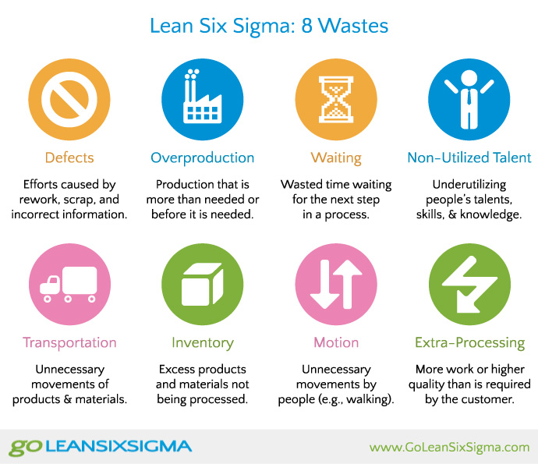
The 8 Types of Waste
Transportation: unnecessarily moving specimens, materials and patients
Inventory: Improper inventory control or excess of ordering materials
Motion: unnecessary walking, searching, filing, bending and stretching
Unused Creativity/Talent: underutilizing people’s talent, skill and knowledge
Unused creativity
Notes:
Examples:
Cath lab being far away from the ED, staff going back and forth to get supplies, meds etc.
2. Too many supplies, medications etc. Created spoilage and waste (expired meds and supplies). Wastes space that could be used for more critical items.
3. Staff walking out of their way due to poor hospital layout, manual reporting systems
4. Administrative or manual tasks, staff that are not engaged or listened to

Slide 2
Waiting: Idle, unproductive time spent waiting for the next event or activity to occur
Over processing: Performing steps for which the patient receives no direct value
Overproduction: doing more than what is needed for the patient
Defects/rework: time spent doing something incorrectly or fixing errors
Over processing
Notes:
Examples
5. Patients waiting for appointment, nurse waiting for Pharmacy to replace a missing dose of medication
6. Nurses having to do narcotic counts every time a controlled substance is removed from the automated drug cart, manual tracking of expiration dates, bed moves, repeat paper work
7. Excessive or repetitive diagnostic tests, requiring patients to fill out multiple registration forms with PHI as they move through the system
8. Cost and effort treating hospital acquired infections. Placing a medication in the wrong bin in the automated drug cart,, med errors, blood redraws

