Slide 1
Problem1

Slide 2
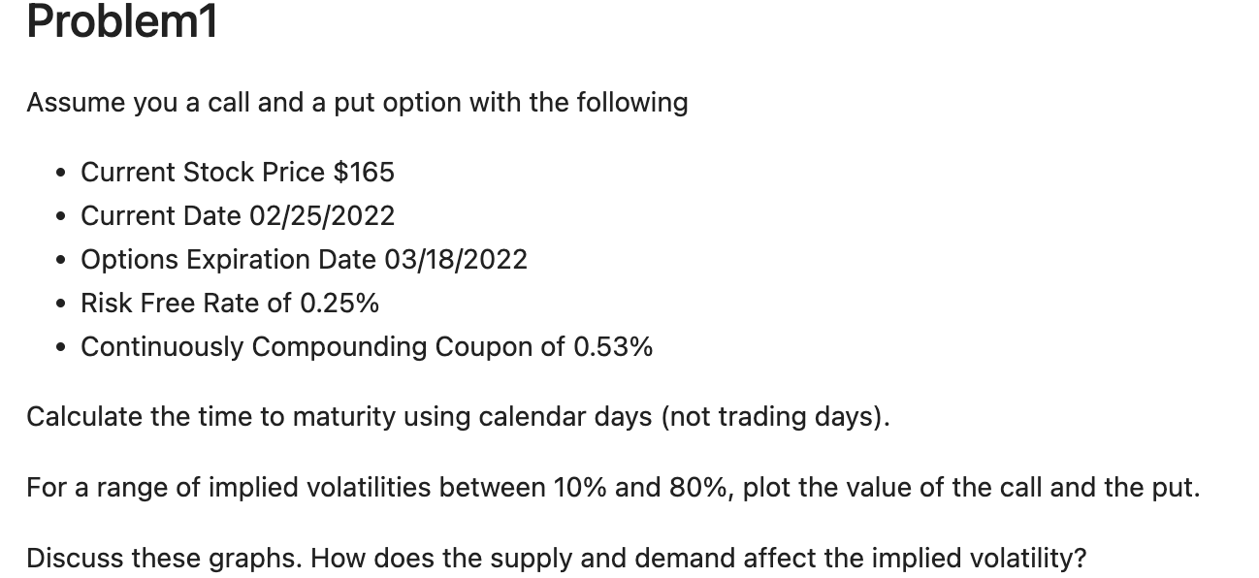



Slide 3
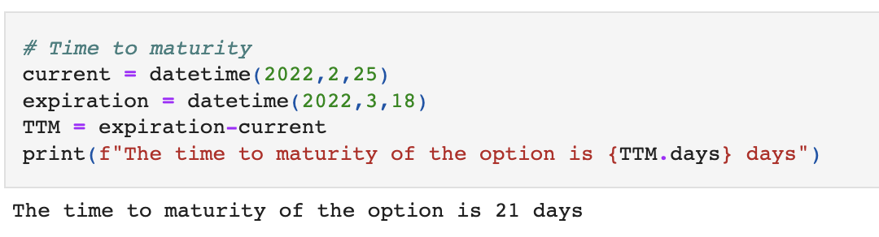
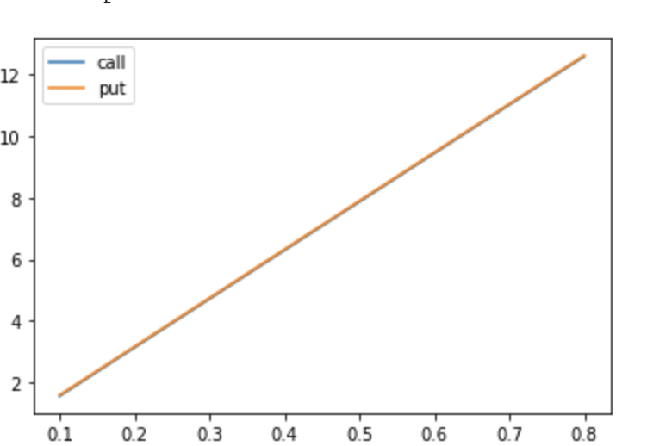
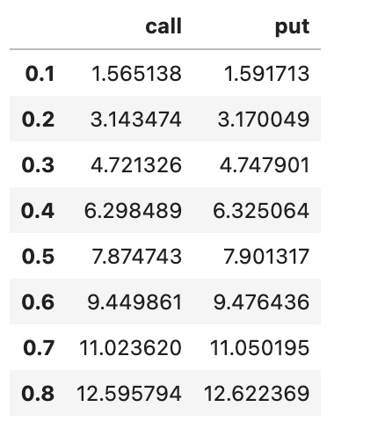

Slide 4
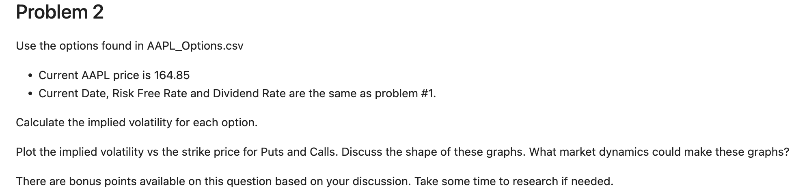
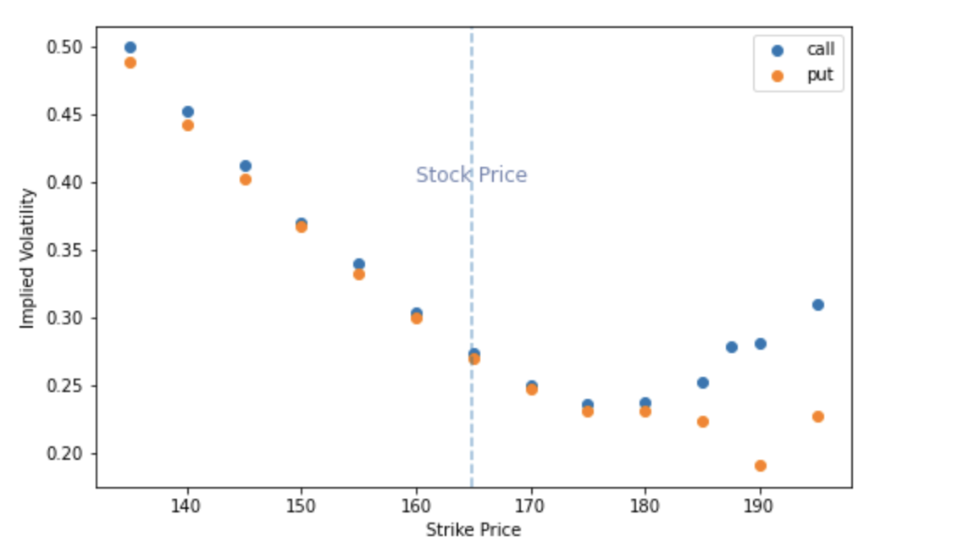

Slide 5
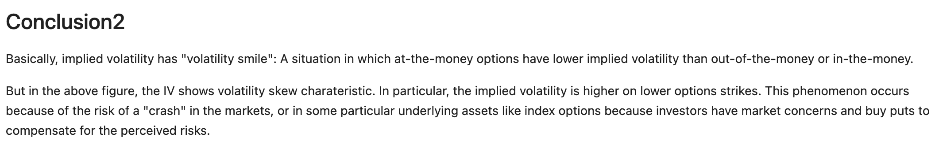
Conclusion

Slide 6
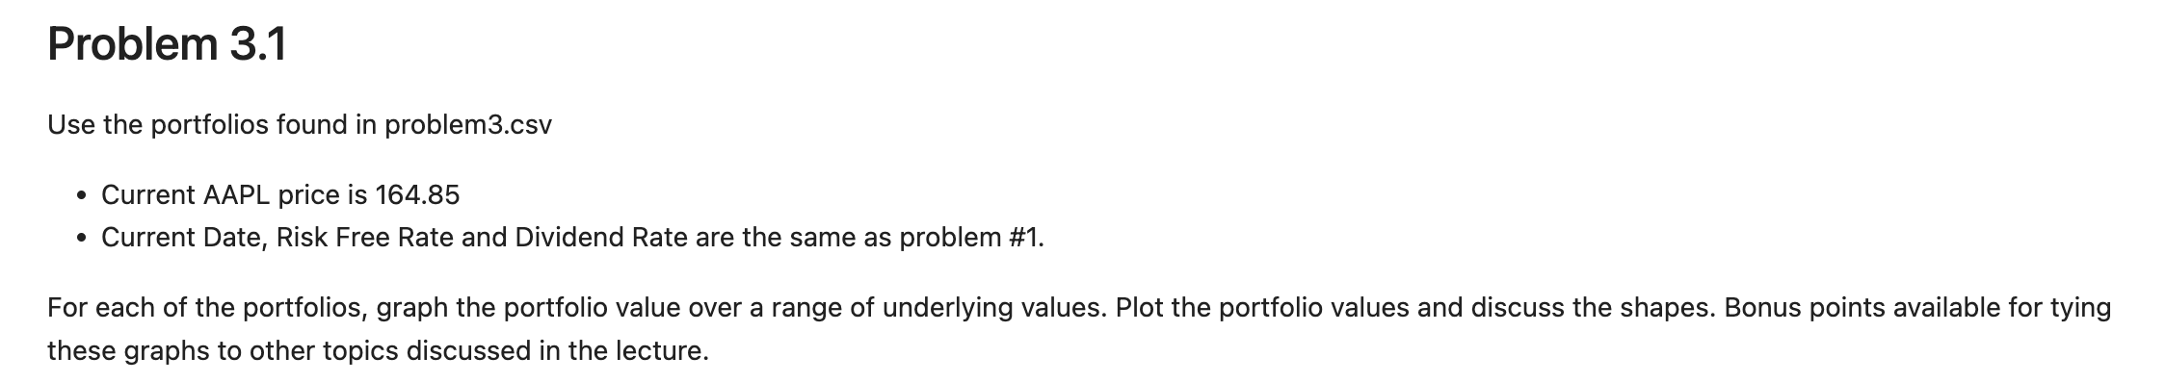
Problem3

Slide 7
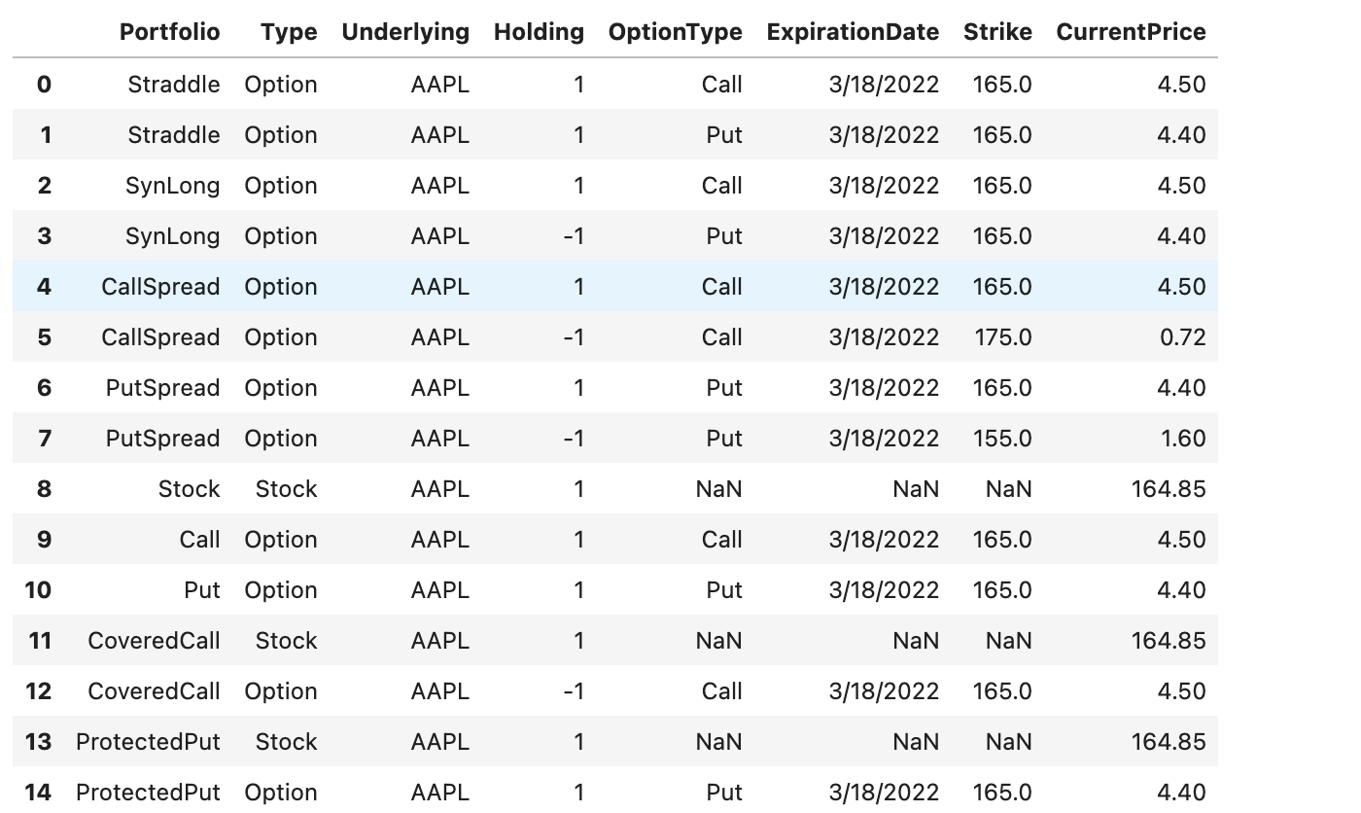

Slide 8
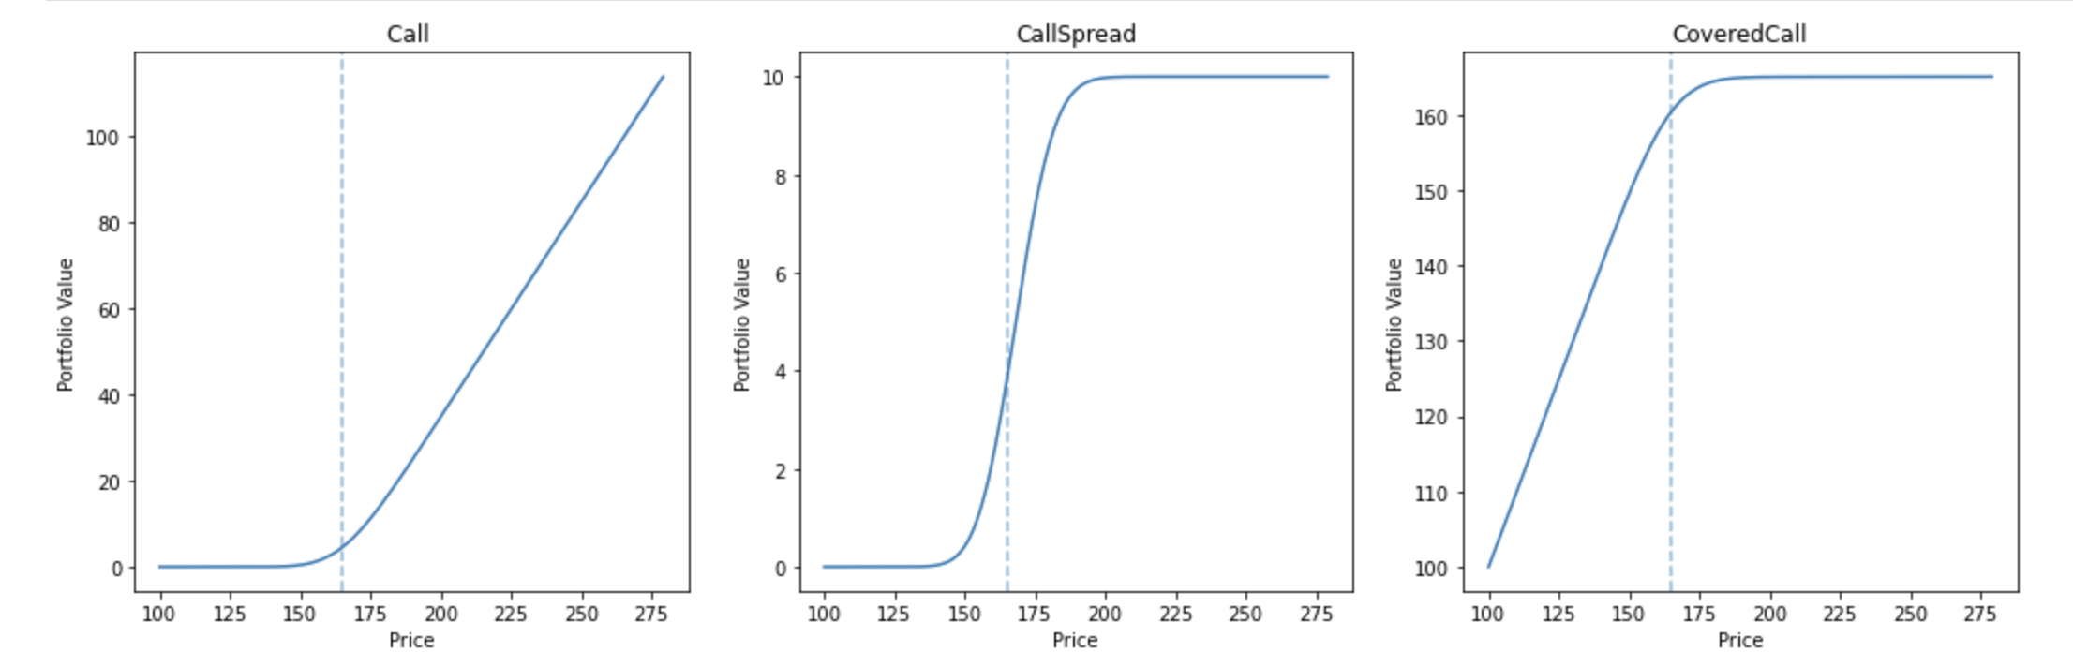
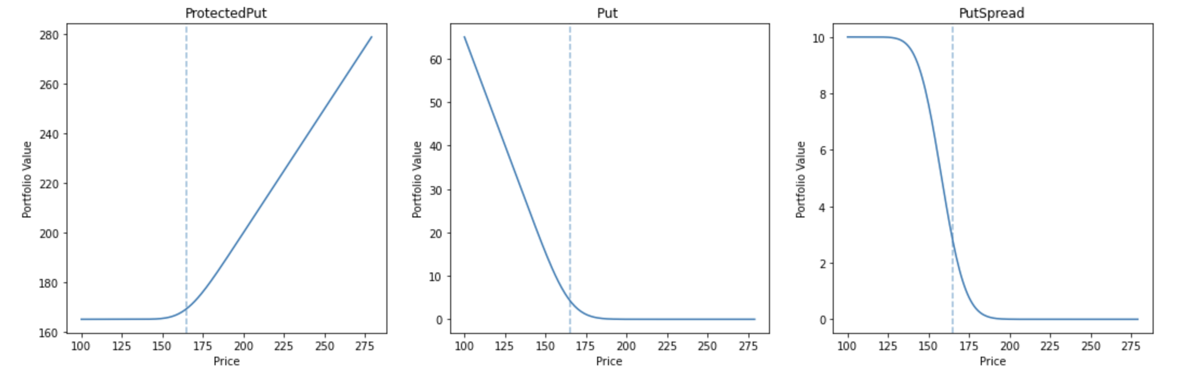

Slide 9
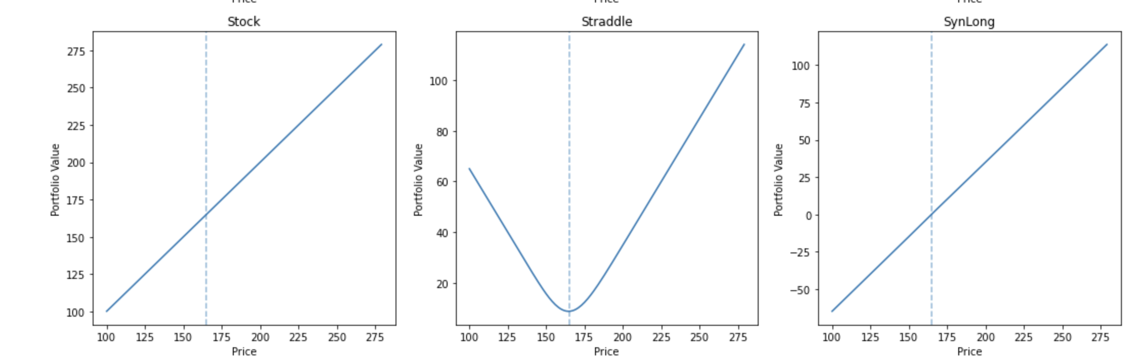
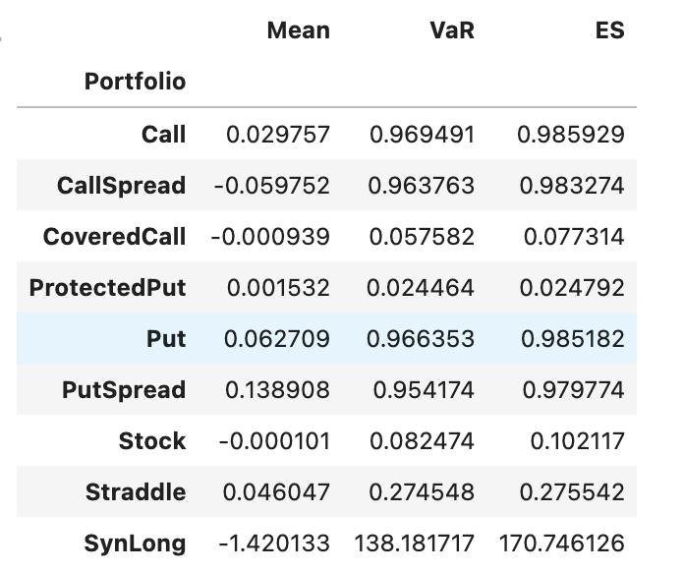

Slide 10
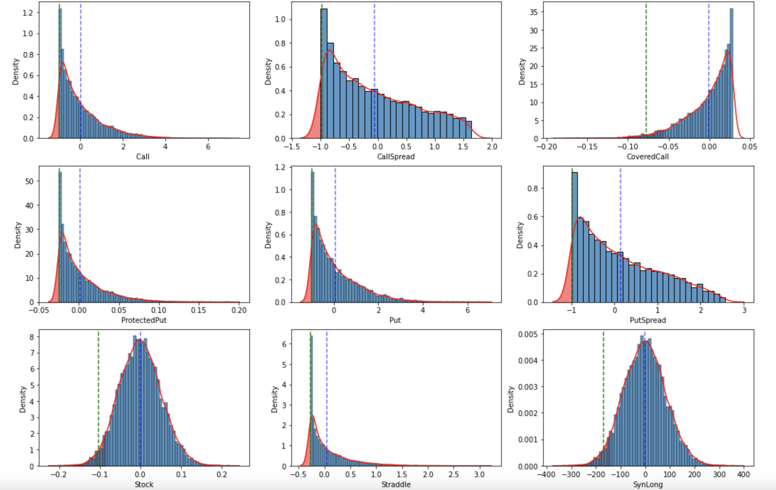

Slide 11
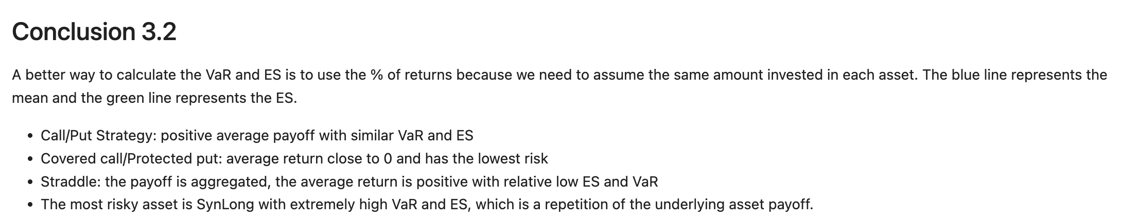
Conclusion

Slide 12
Problem3
Using Portfolio.csv and DailyPrices.csv. Assume the expected return on all stocks is 0. This file contains the stock holdings of 3 portfolios. You own each of these portfolios. Calculate the VaR of each portfolio as well as your total VaR (VaR of the total holdings). Discuss your methods, why you chose those methods, and your results.

Slide 13
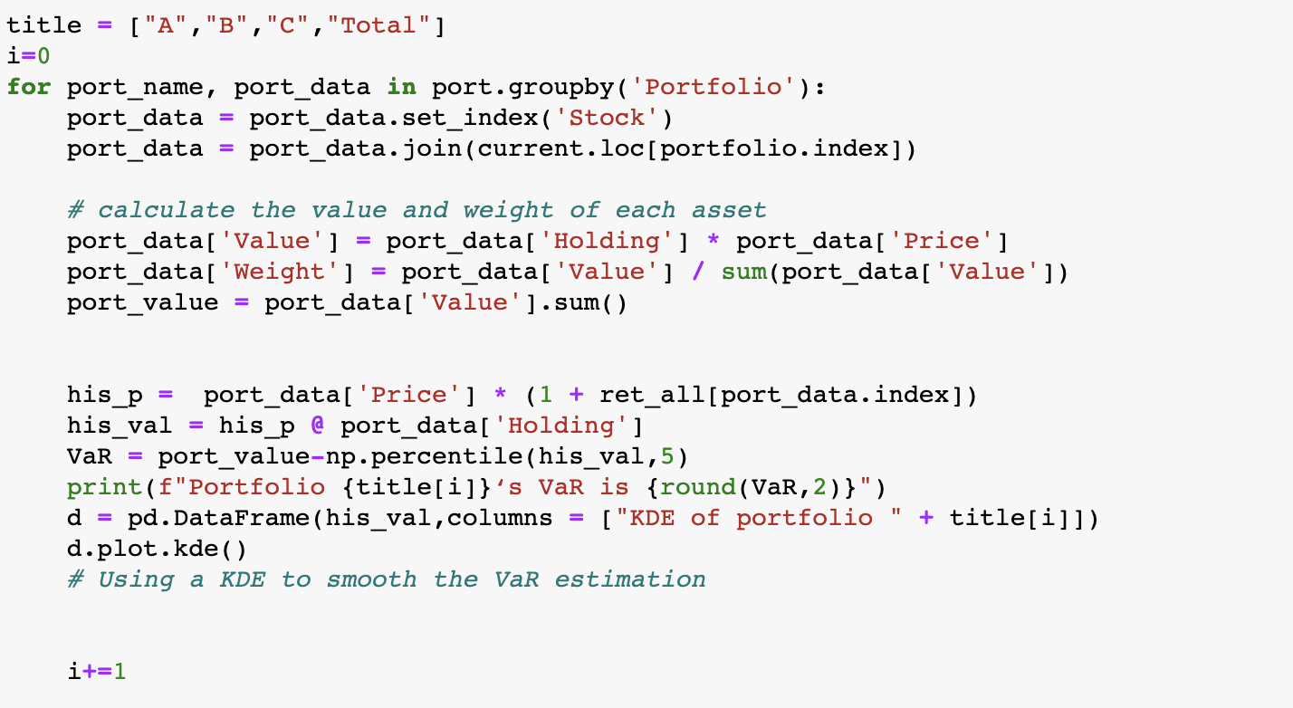
1.

Slide 14
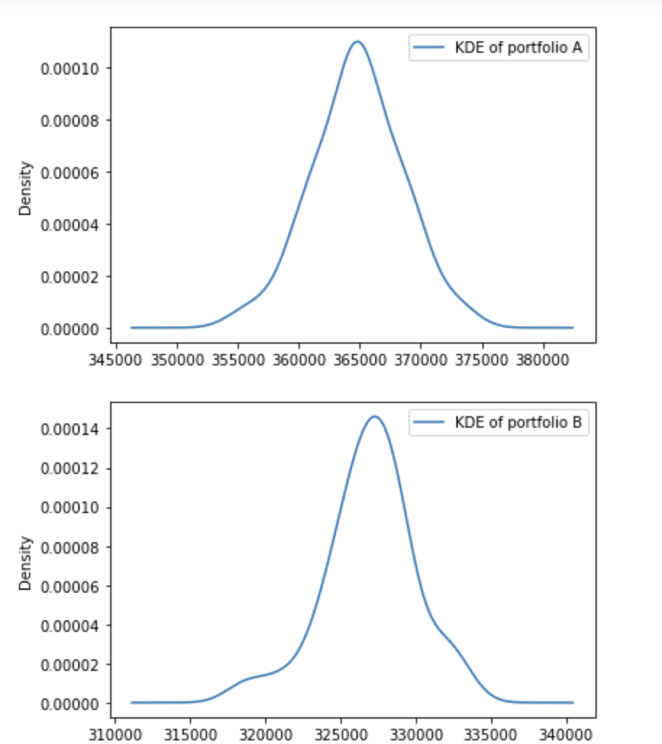
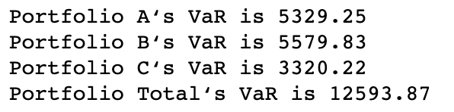

Slide 15
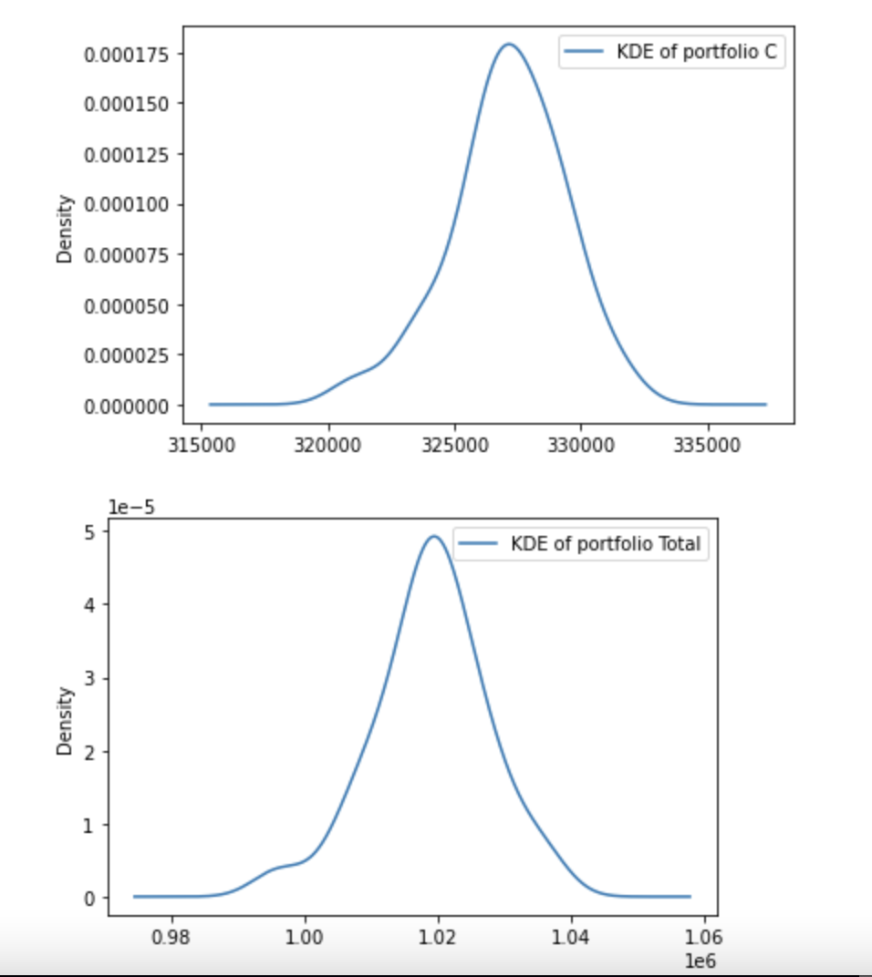

Slide 16
Conclusion for Problem 3¶
Due to the returns are not normally distributed and asset prices are not always linear, Financial market has the characteristic of fat tail and often receives the influence of emergencies. Moreover, our historical data is not enough for us to judge the state of all market risks. So we use KDE to optimize the VaR calculation.

