Slide 1
Problem1

Slide 2
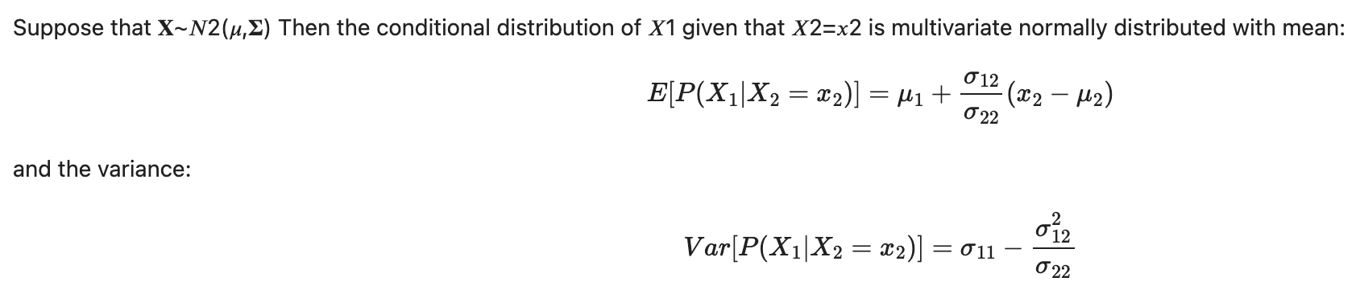


Problem1:
Compare the conditional distribution of the Multivariate Normal, to the OLS equations

Slide 3
Problem1:
Compare the conditional distribution of the Multivariate Normal, to the OLS equations

Slide 4
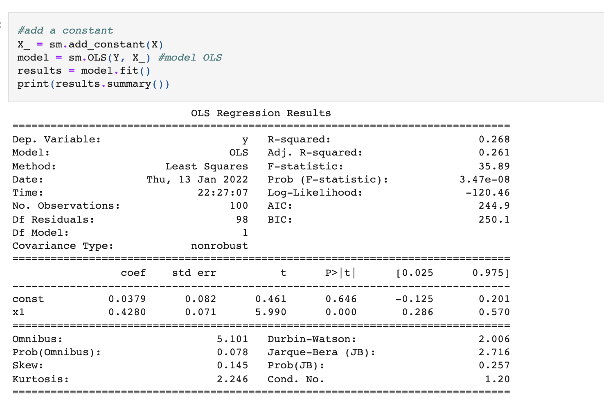
Problem1:
Compare the conditional distribution of the Multivariate Normal, to the OLS equations

Slide 5
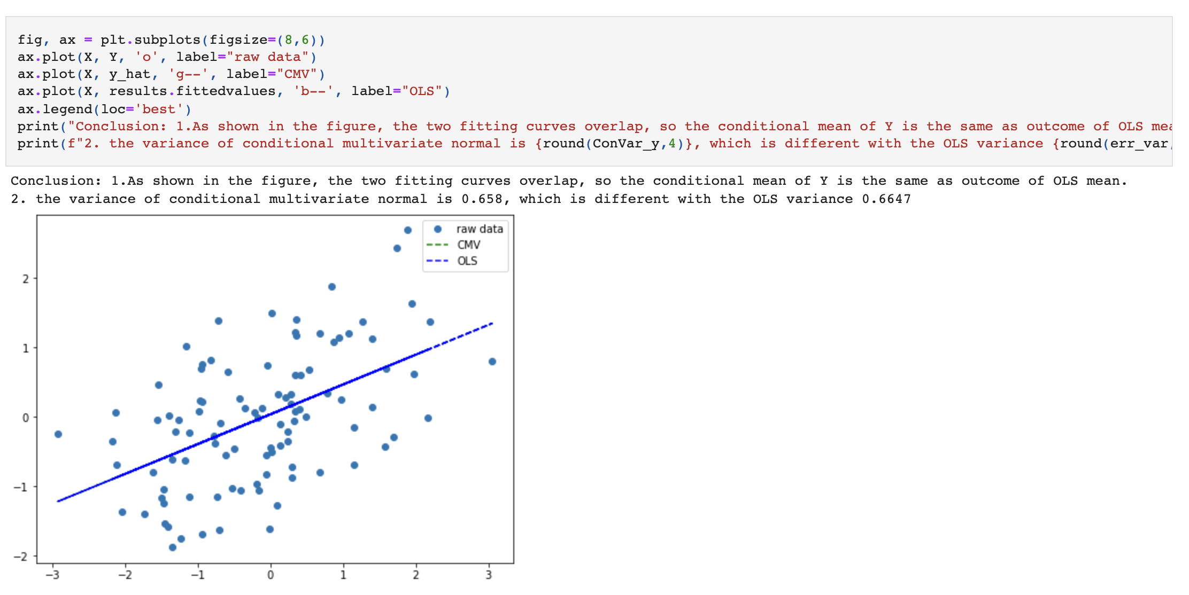
Problem1:
Compare the conditional distribution of the Multivariate Normal, to the OLS equations

Slide 6

Problem2

Slide 7
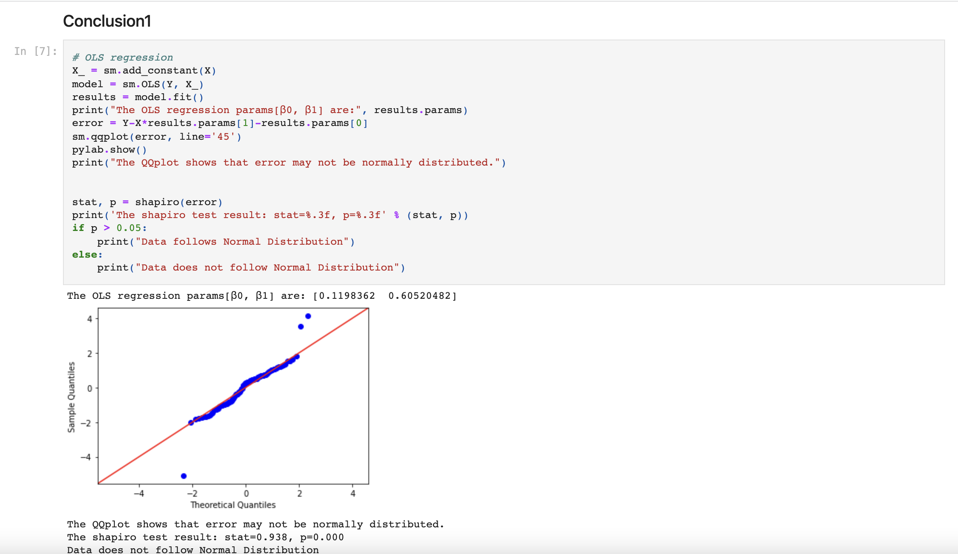

Slide 8
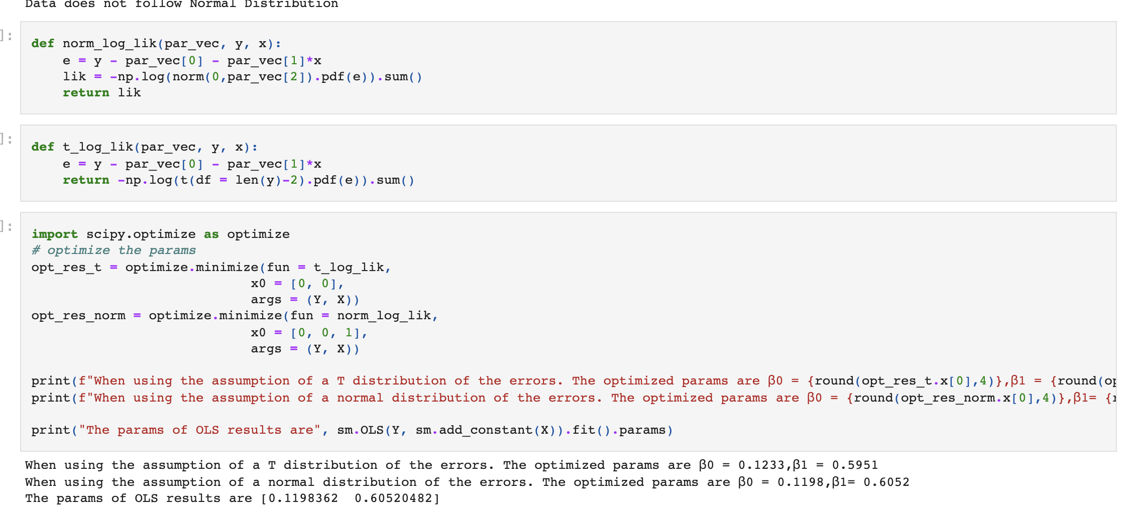

Slide 9
Conclusion 1
The QQplot shows that error may not be normally distributed. The shapiro test result: stat=0.938, p=0.000 Data does not follow Normal Distribution
Conclusion 2 and 3
Compared with 2 distributions of sum of standard error, the SSE of t distribution 143.6256 is larger than SSE of normal distribution assumption 143.6148.
In this case, the assumption of normality cannot be broken, because the sum of square residuals of the T-distribution hypothesis is larger than that of the normal distribution hypothesis, indicating that the goodness of fit of the T-distribution hypothesis is not a good model.

Slide 10
Problem3

Slide 11
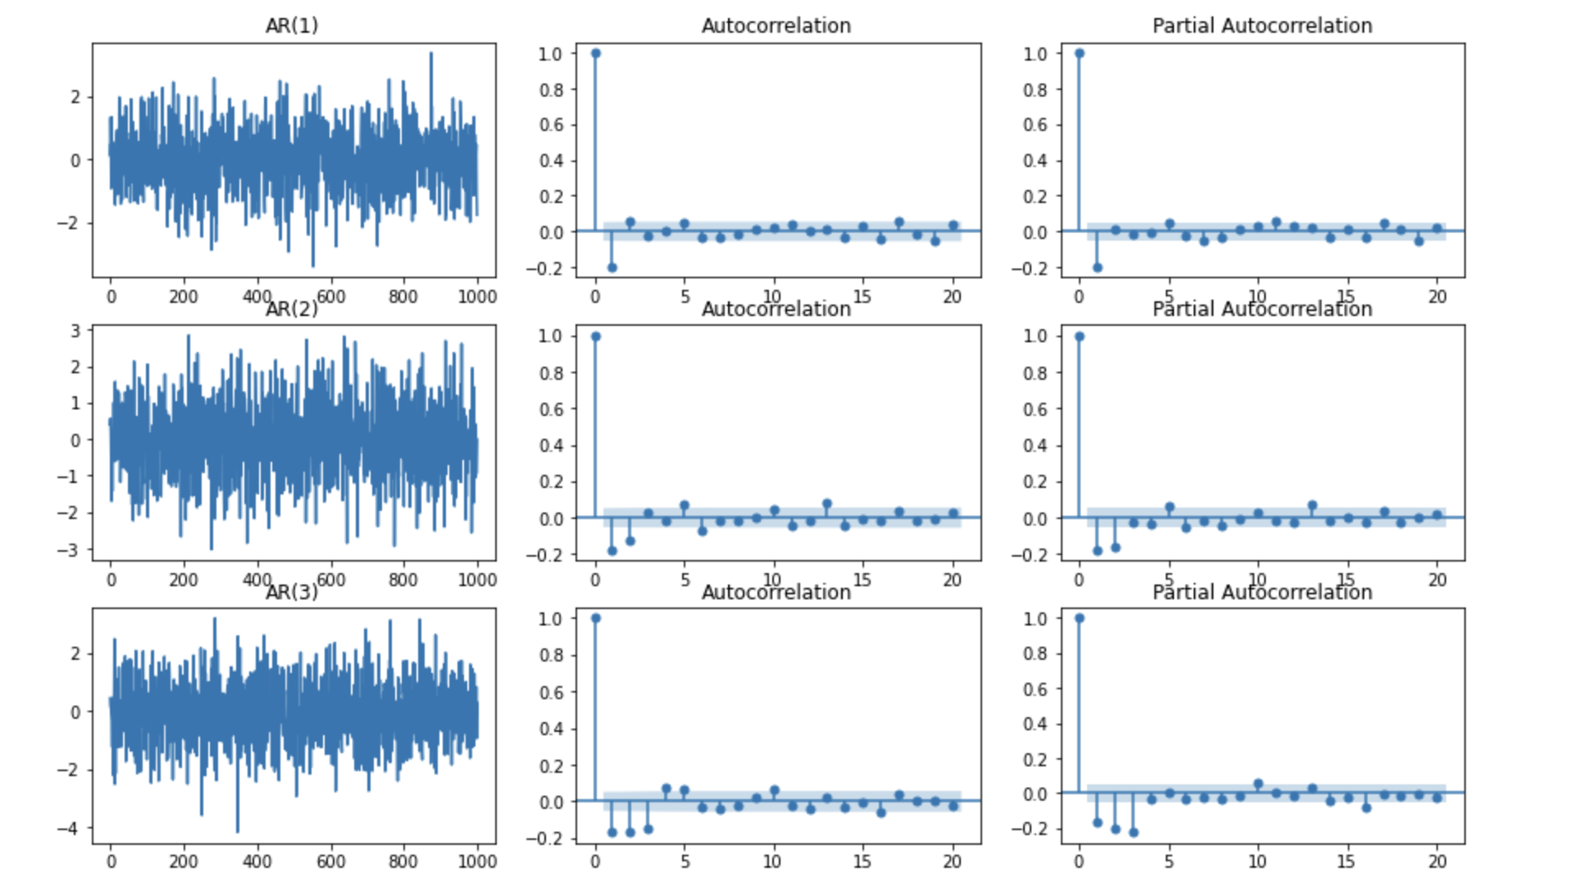

Slide 12
Conclusion1
In the autocorrelation figures, the coefficient is slowly decaying. it suggests that the time series can probably be modelled with an autoregressive process.
As you can see, in the partial autocorrelation figure, the coefficients are not significant after orresponding number. For example, in the AR(3), the coef is not significant after lag 3. Therefore, the partial autocorrelation plot is useful to determine the order of an AR(p) process. For an AR model, the theoretical PACF “shuts off” past the order of the model.

Slide 13
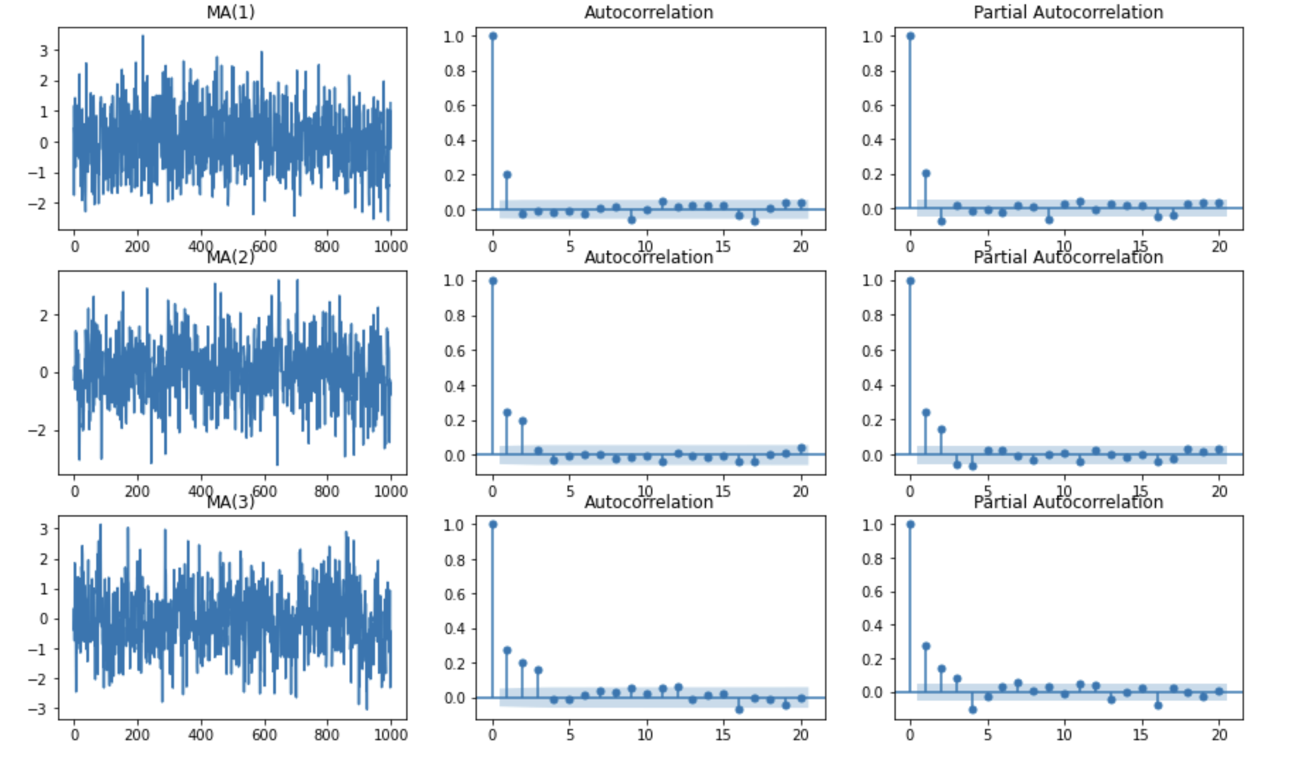

Slide 14
Conclusion2
The ACF and PACF plots indicate that an the ACF figure in the MA(q) model would be cuts after q lag while the PACF shows a slowly decreasing Therefore, the autocorrelatioConclusion1
n plot is useful to determine the order of an MA(p) process.

