Slide 1
Problem1

Slide 2
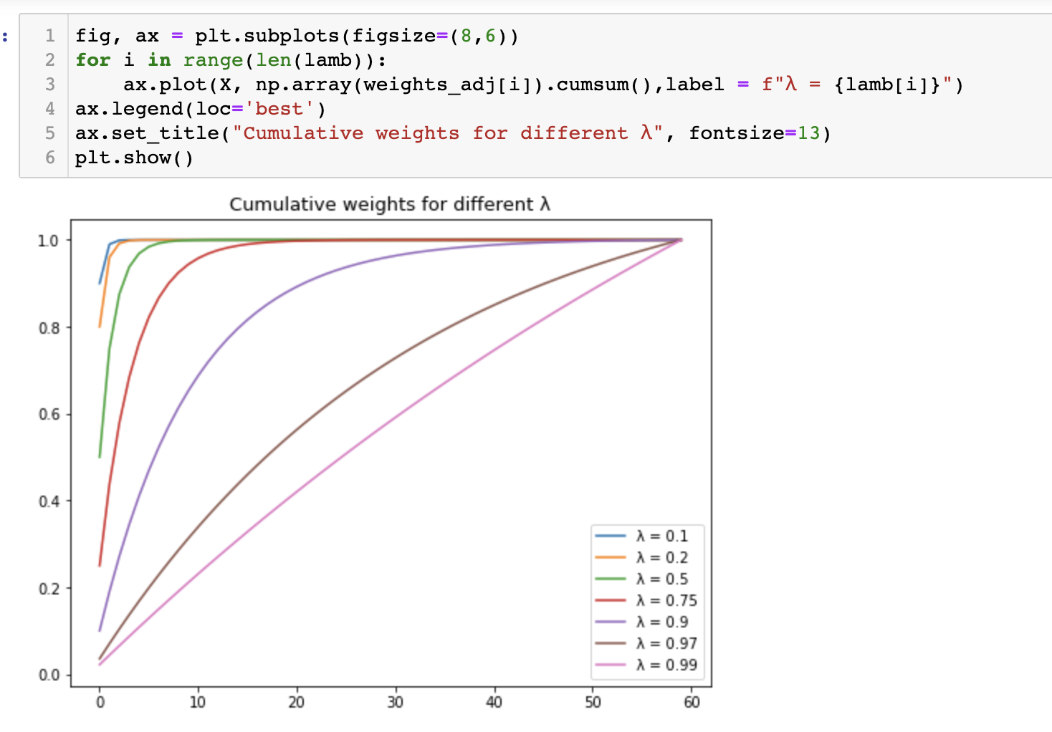


Problem1:
Use the stock returns in DailyReturn.csv for this problem. DailyReturn.csv contains returns for 100 large US stocks and as well as the ETF, SPY which tracks the S&P500.
Create a routine for calculating an exponentially weighted covariance matrix. If you have a package that calculates it for you, verify that it calculates the values you expect. This means you still have to implement it.

Slide 3
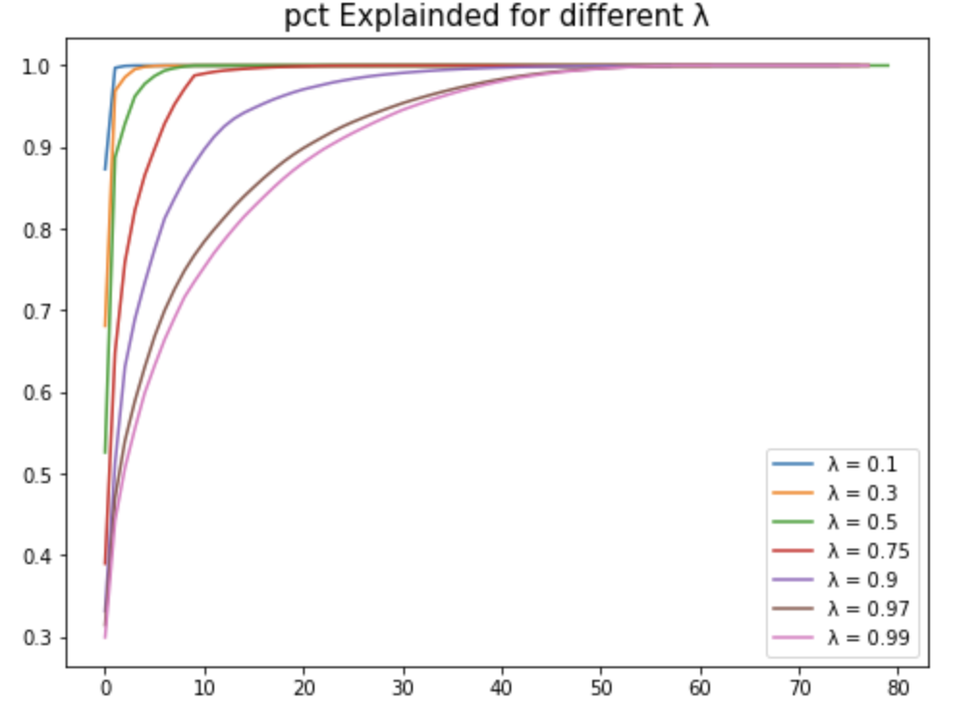
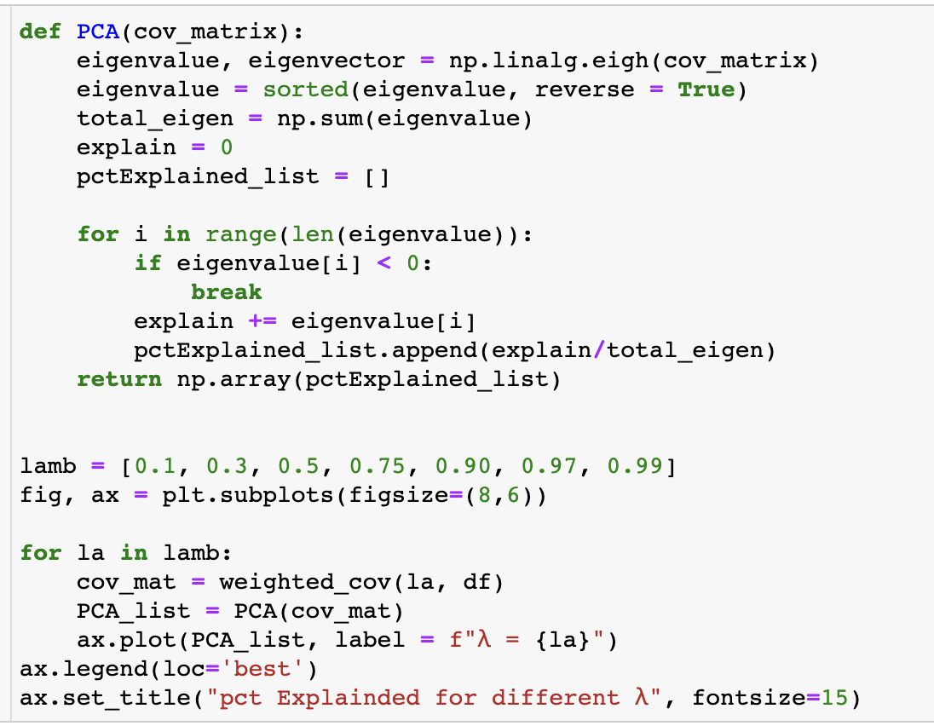
Problem1:
Vary λ ∈ (0, 1). Use PCA and plot the cumulative variance explained by each eigenvalue for each λ chosen.

Slide 4
What does this tell us about values of λ and the effect it has on the covariance matrix?
Conclusion for Problem 1
We plot the different λ to see the explained information through time. The less λ shows we put more weight on the current data, so we can see in the figure that the greater λ, the smaller explained percent in the same time.

Slide 5
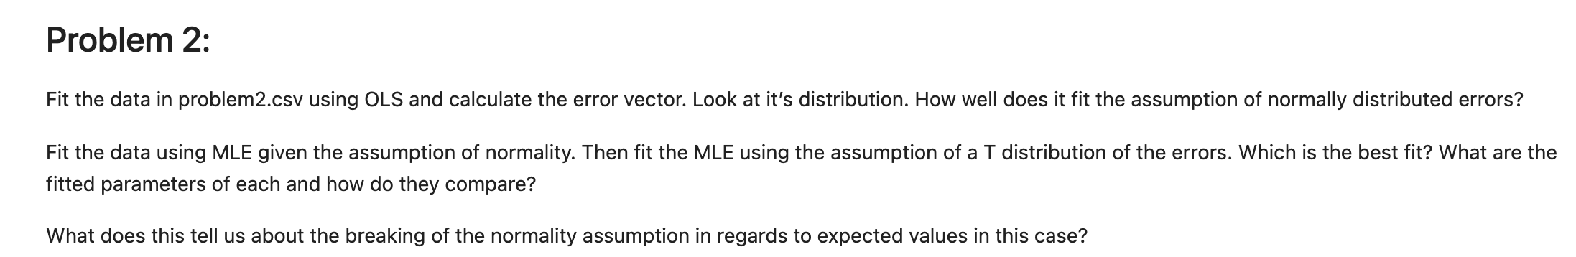
Problem2

Slide 6
Problem2
Copy the chol_psd(), and near_psd() functions from the course repository – implement in your programming language of choice. These are core functions you will need throughout the remainder of the class.
Implement Higham’s 2002 nearest psd correlation function.

Slide 7
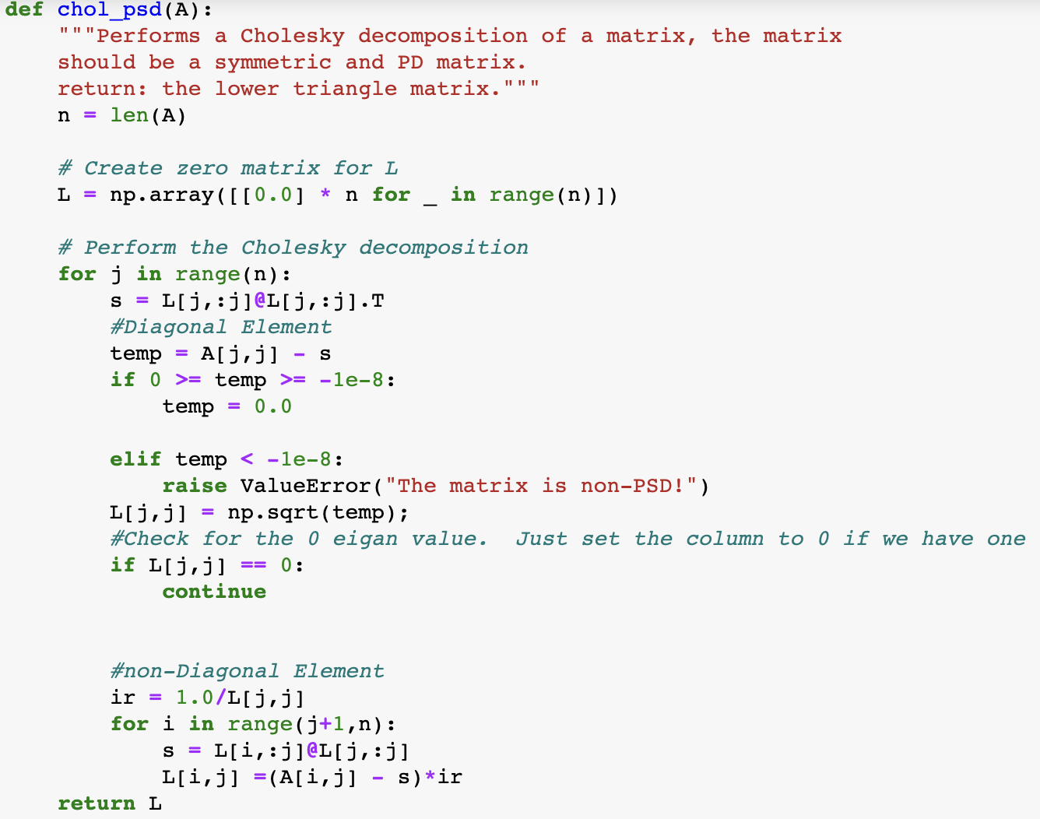
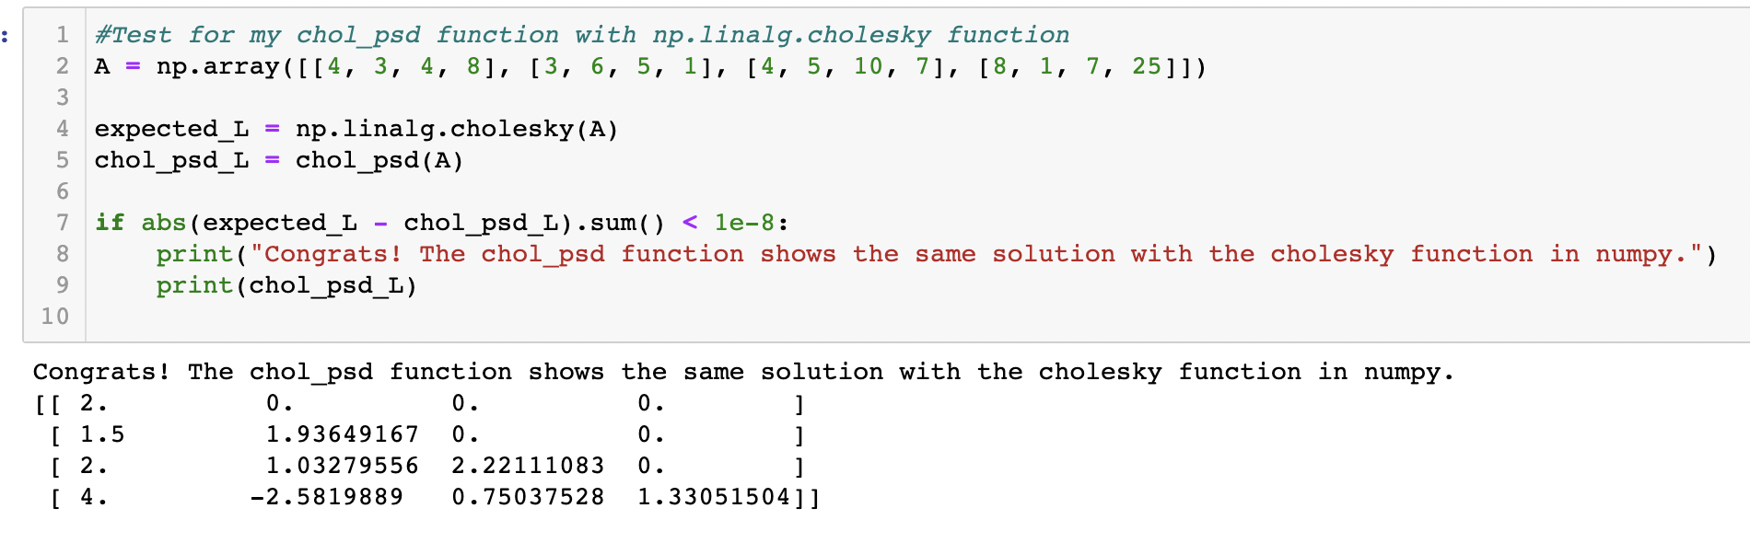
Implement the chol_psd(), and near_psd() functions

Slide 8
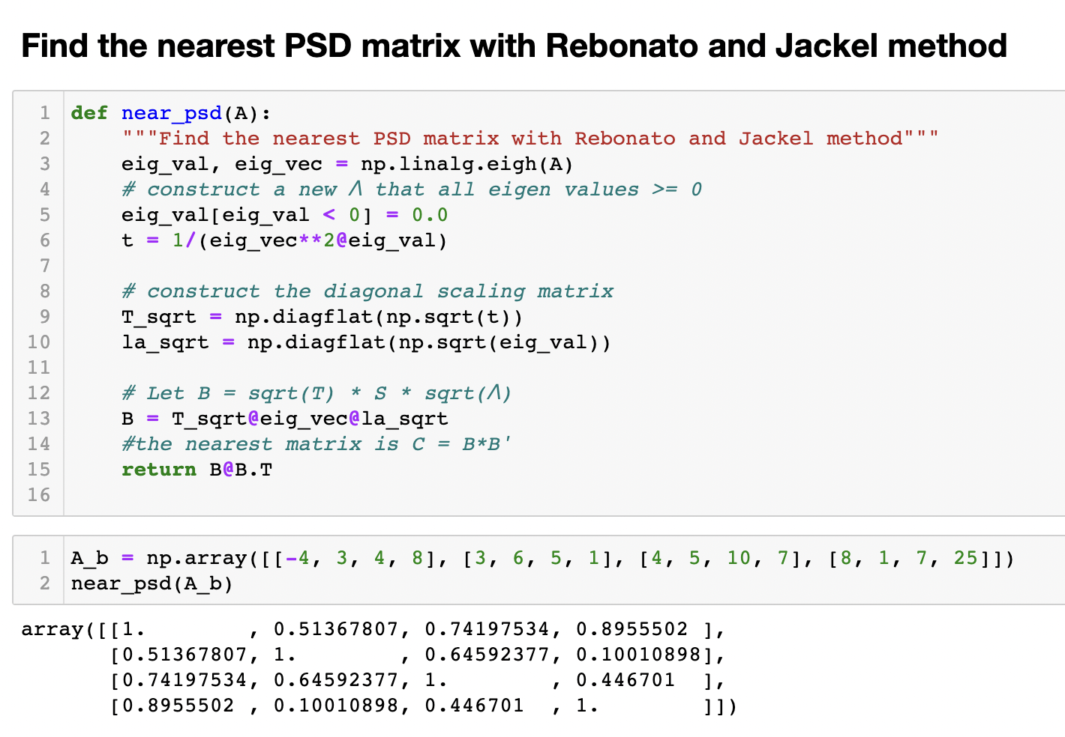

Slide 9
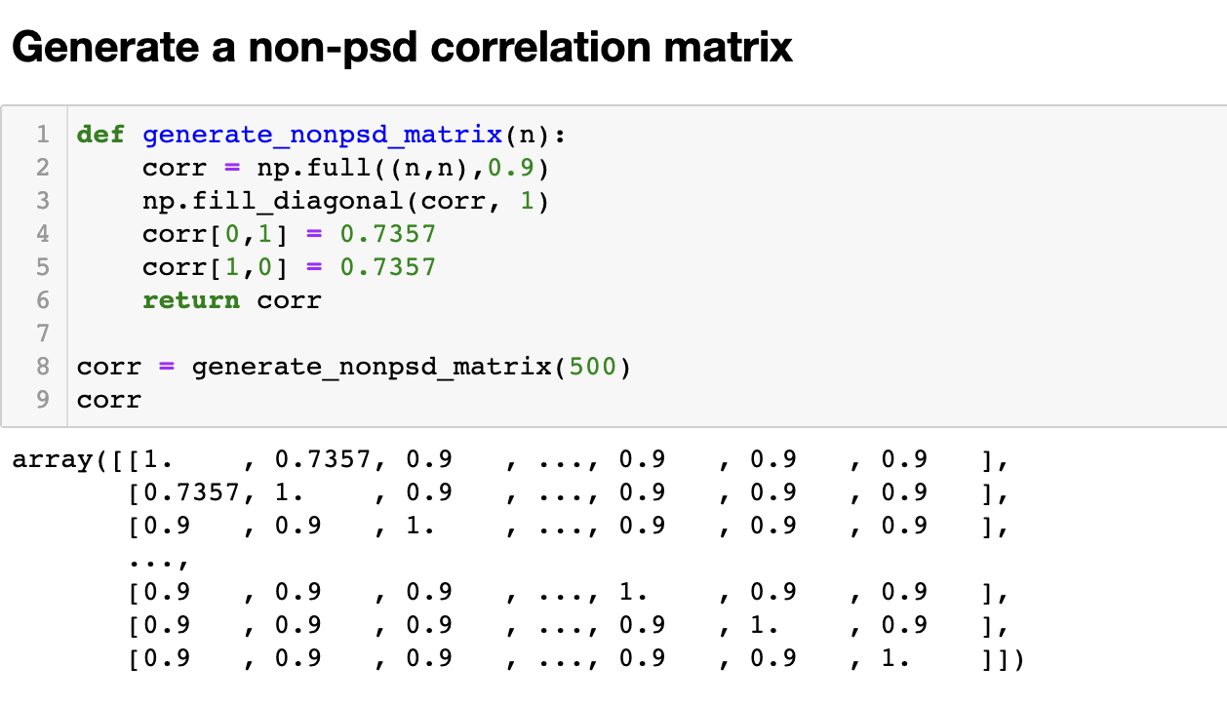
Higham’s PSD matrix
Implement Higham’s 2002 nearest psd correlation function.

Slide 10
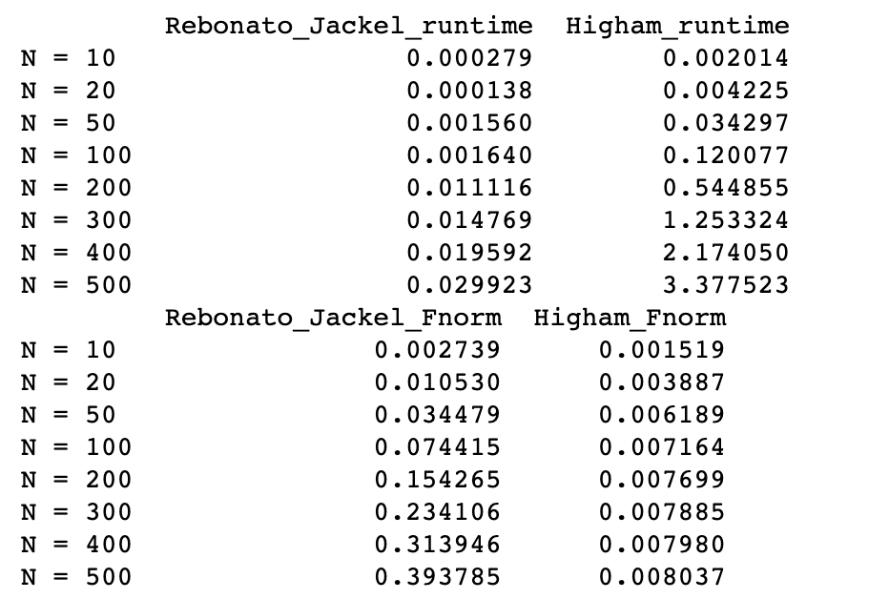
compare the runtime
Implement Higham’s 2002 nearest psd correlation function.

Slide 11
compare the runtime
Implement Higham’s 2002 nearest psd correlation function.

Slide 12
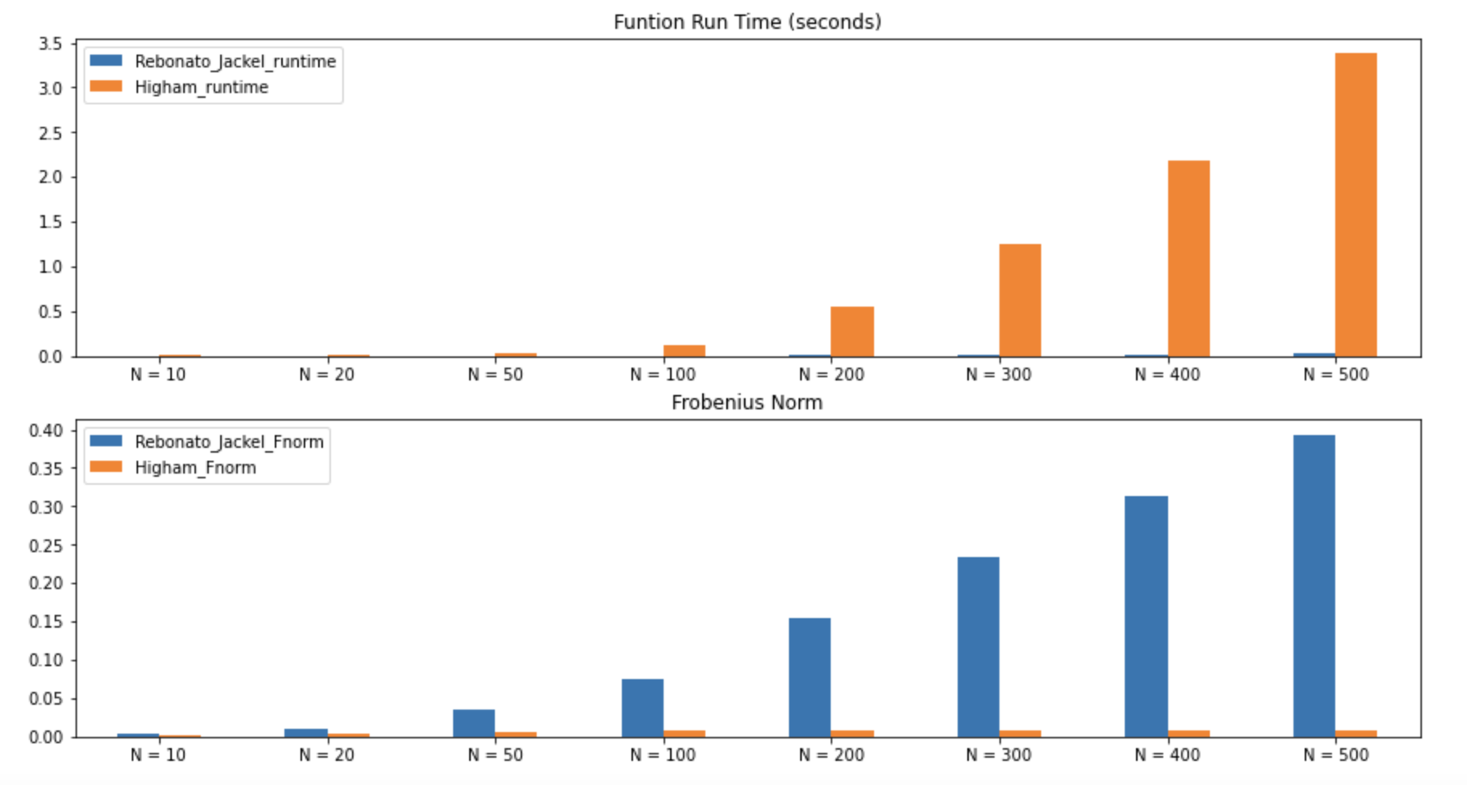
compare the runtime
Implement Higham’s 2002 nearest psd correlation function.

Slide 13
Conclusion for Problem 2
When N is very small, such as less than 50, Run time for Higham's method runs at about the same time as Rebonato and Jackel method, and the goal of Higham's method is to minimize the Frobenius Norm, so Higham is more appropriate and has less information loss when N is extremely small.
With the gradual increase of N, the running time of Higham method increases significantly, while the running time of Rebonato and Jackel method does not change much. The fast Rebonato and Jackel method sacrifices its information. Higham's generated PSD matrix has a smaller loss of information but a longer running time.
So when N is large, we need to choose between run time and information loss.

Slide 14
Problem3

Slide 15
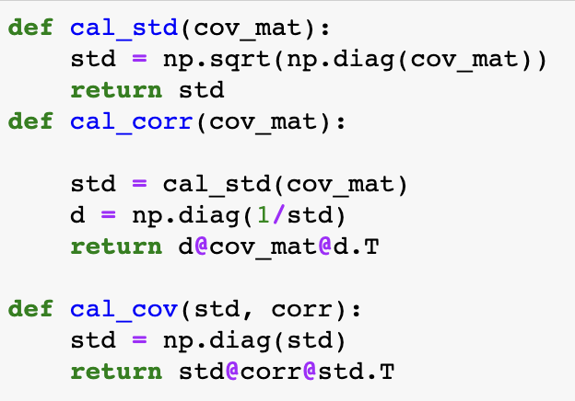
Standard Pearson correlation/variance

Slide 16
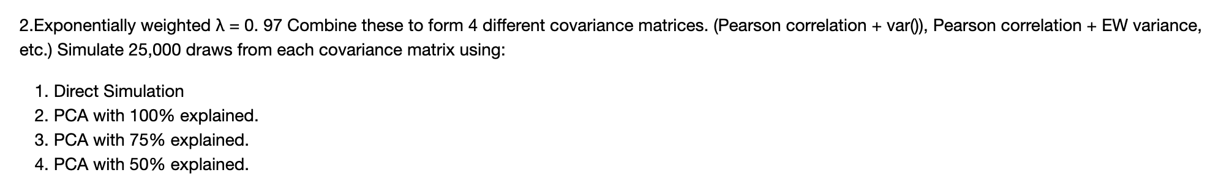
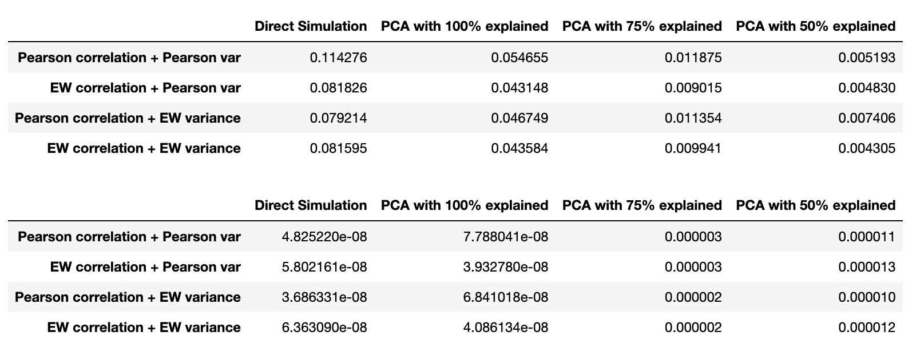
1.

Slide 17
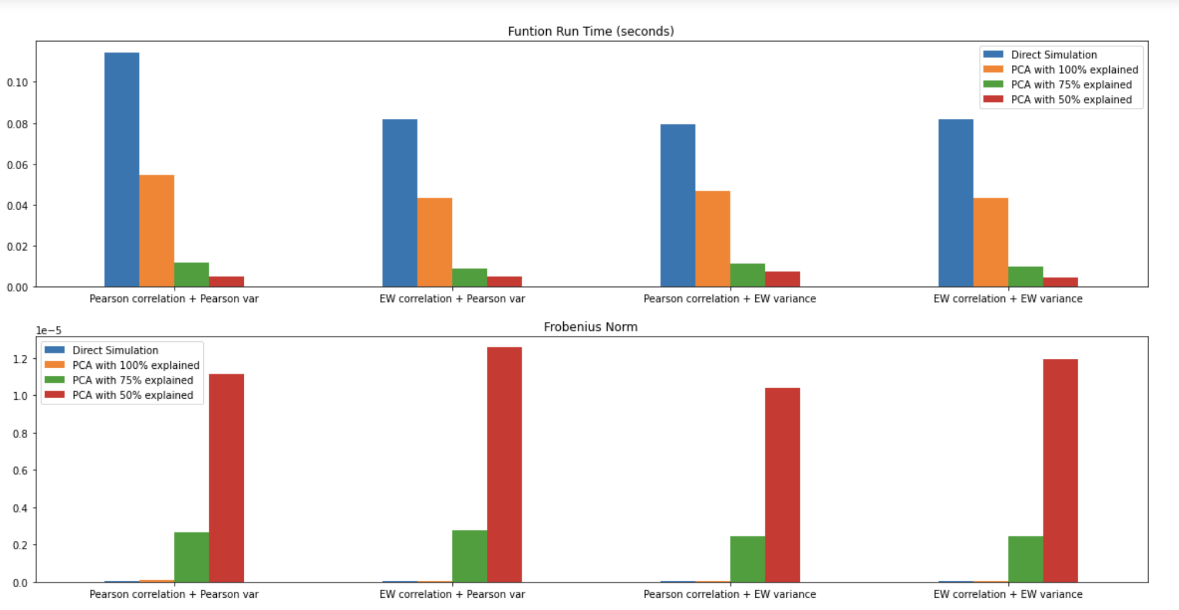
1.

Slide 18
Conclusion for Problem 3¶
When dealing with a extremely high-dimensional data, the processing speed of the function has to be considered. When applying direct method for simulating time series, we use all the information, so the information loss would be the least but the run time is the longest because the high volume of the data.
However, Principal Component Analysis is dimension reduction technique for high-dimensional data. Although there is a loss of information, there are still many dimensions of data computation that can be reduced by retaining 100% of the information, and the loss of information is not much different from running directly.
So PCA is a very useful tool to reduce the computation of multi-dimensional data. However, when only 75% or even 50% information is selected, although the running time is greatly accelerated, more information will be missing in the generated data.
Therefore, we need to maintain more information while maintaining acceptable uptime is the most important.

