Slide 1
Problem1

Slide 2
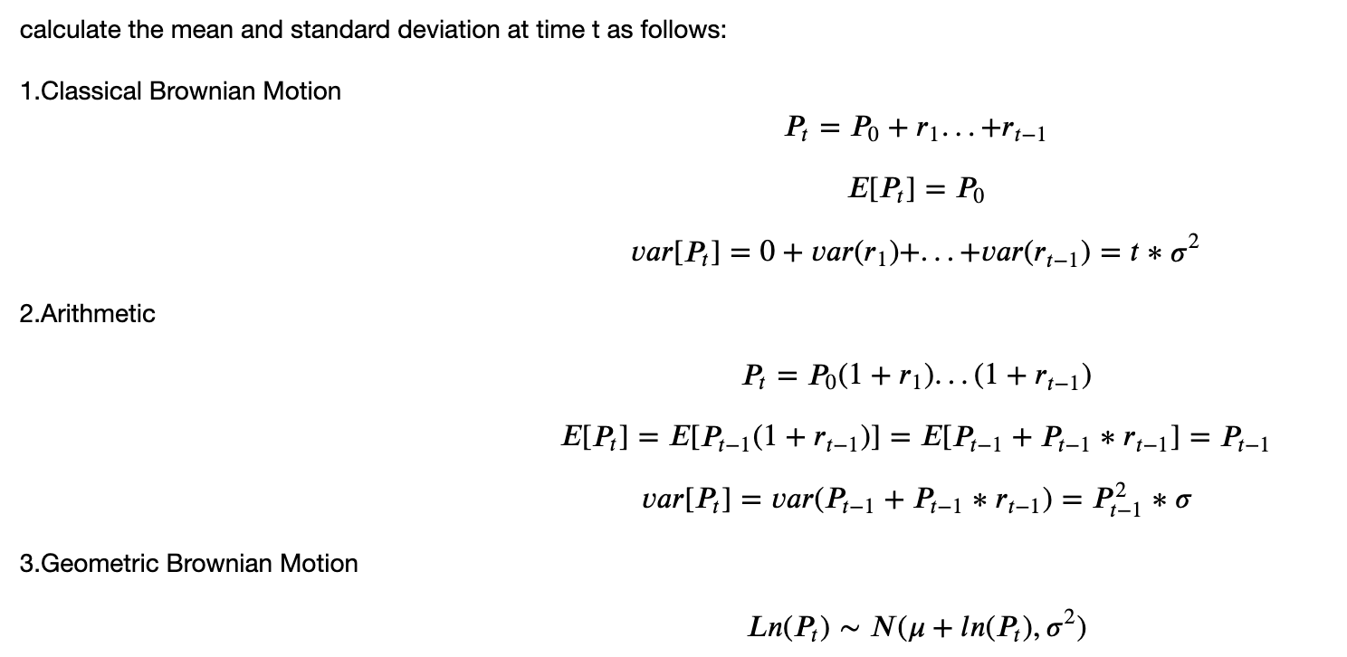


Problem1:
Calculate and compare the expected value and standard deviation of price at time 𝑡(𝑃𝑡) , given each of the 3 types of price returns, assuming 𝑟 ~ 𝑁(0,𝜎2) . Simulate each return equation using 𝑟𝑡∼𝑁(0,𝜎2) and show the mean and standard deviation match your expectations.

Slide 3
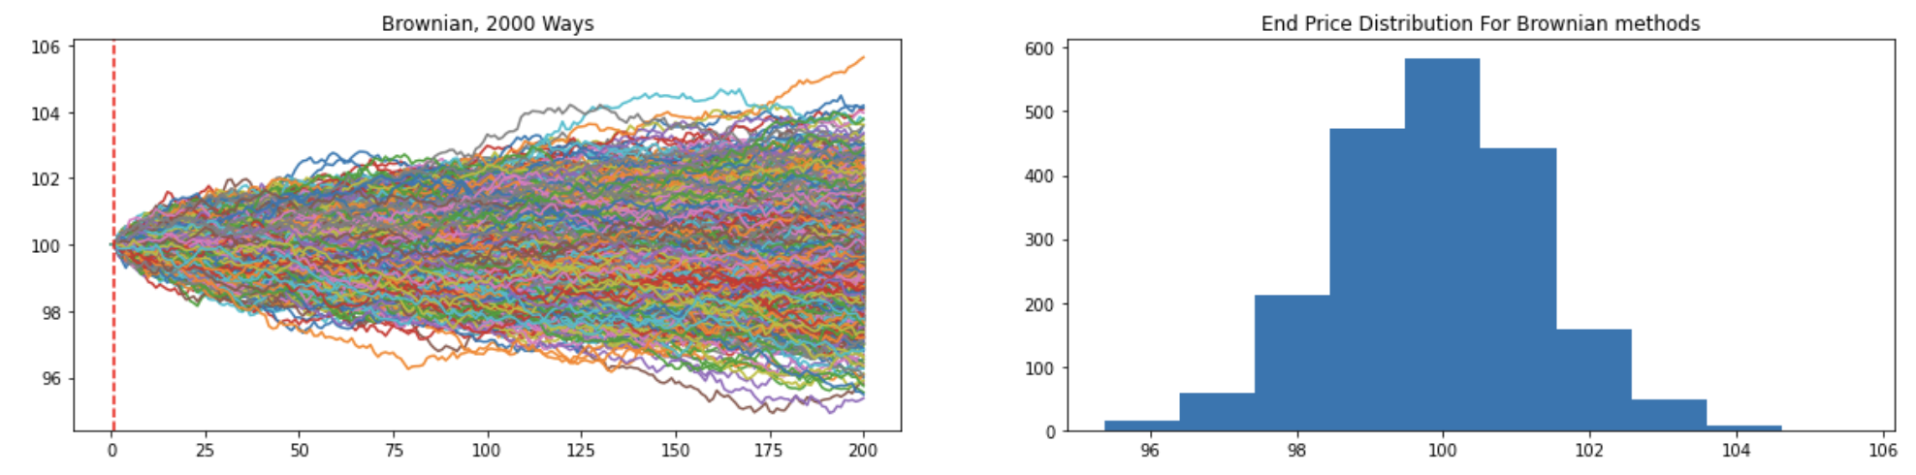
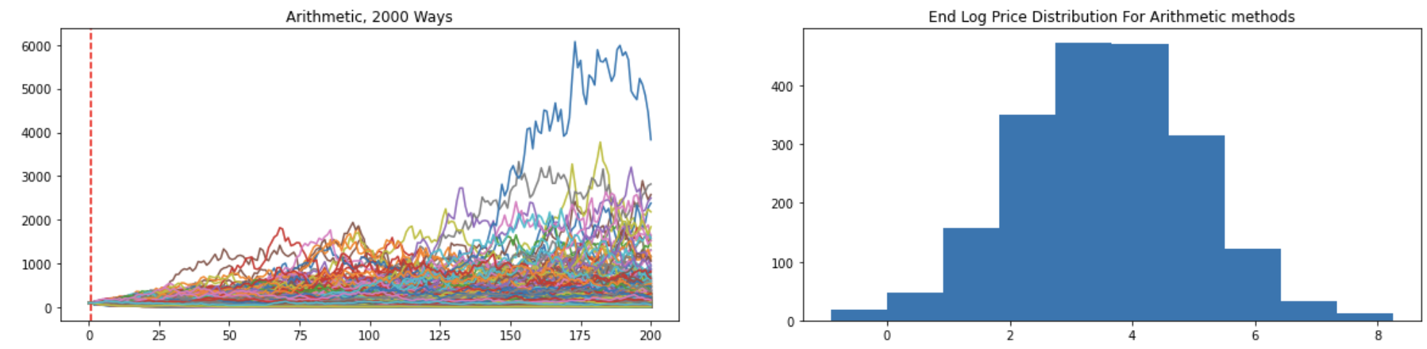
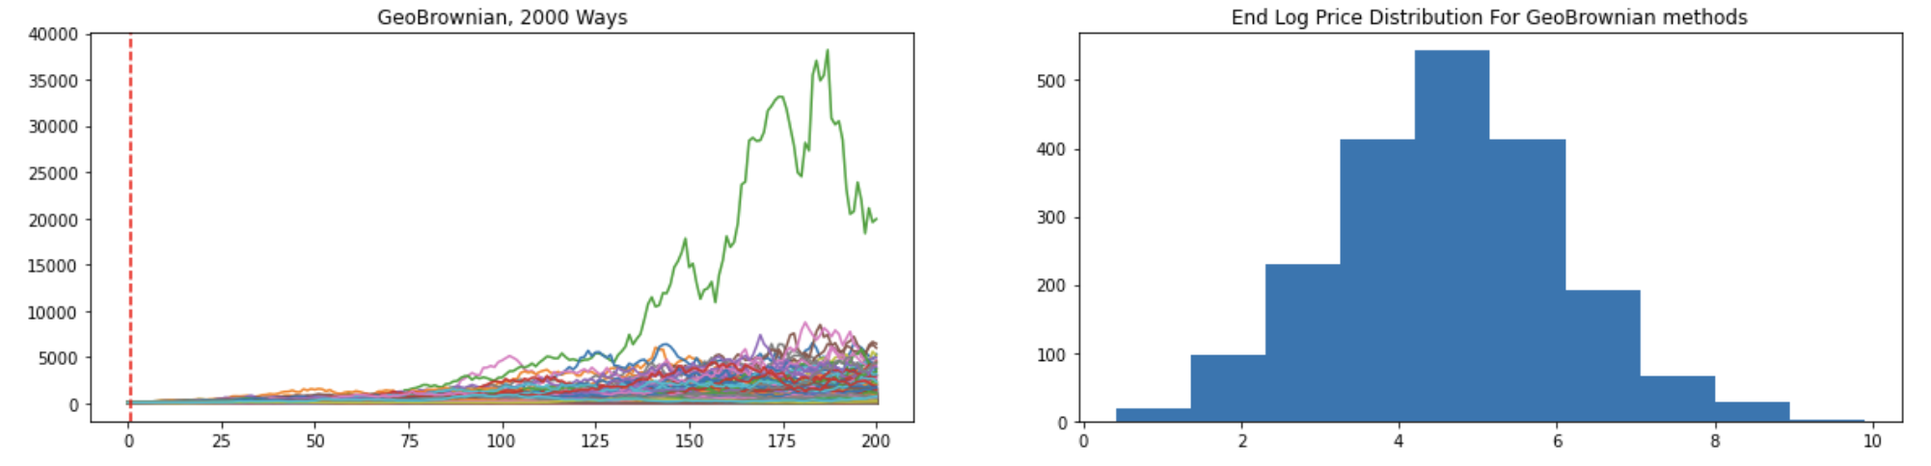

Slide 4
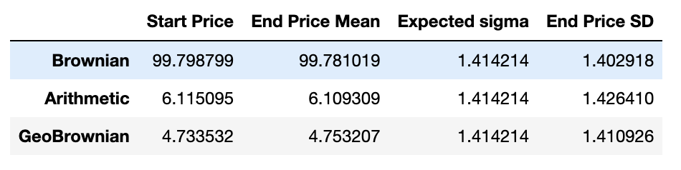

Slide 5
Conclusion
At known moments, the future stock prices is only relevant to the present moment's price.
The mean of the stock price at time T in the future is normal distribution when applying the Classical Brownian Motion, but lognormally distributed when applying the Arithmetic and Geometric Brownian Motion. The price volatility at time T will accumulate over time at a speed of square root of T.

Slide 6
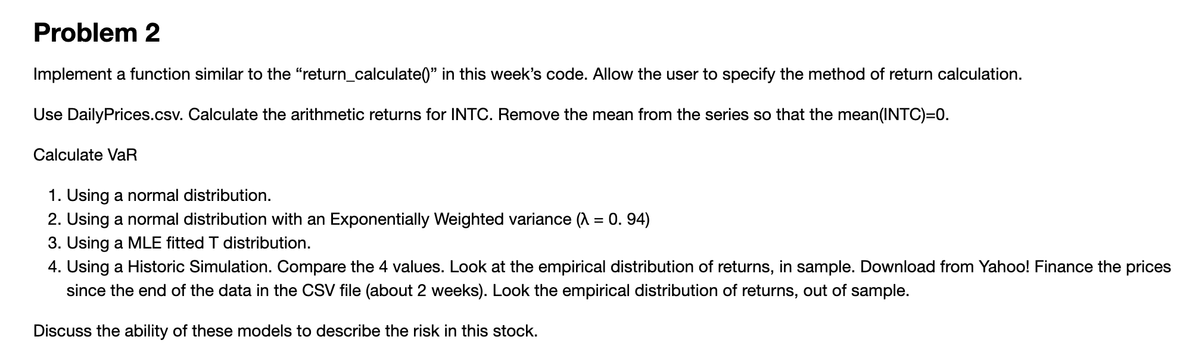
Problem2

Slide 7
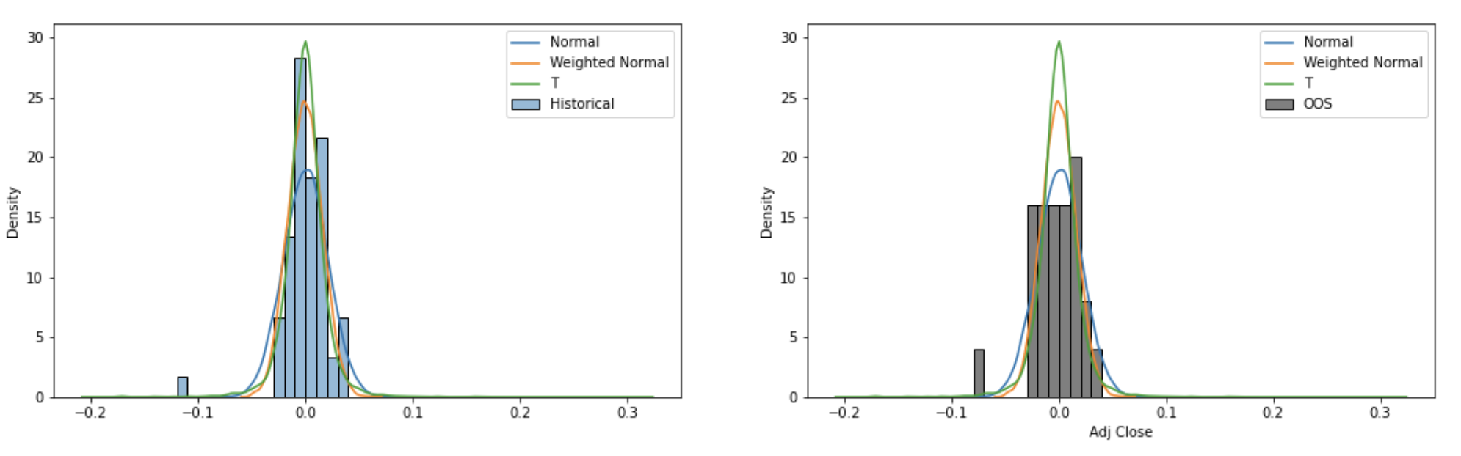
Discussion
# Discuss the ability of these models to describe the risk in this stock.

Slide 8
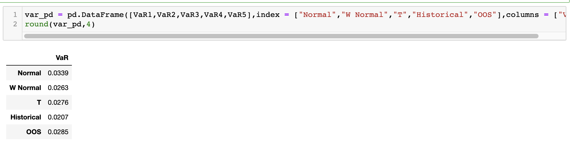
VaR
At known moments, the future stock prices is only relevant to the present moment's price.
The mean of the stock price at time T in the future is normal distribution when applying the Classical Brownian Motion, but lognormally distributed when applying the Arithmetic and Geometric Brownian Motion. The price volatility at time T will accumulate over time at a speed of square root of T.

Slide 9
Conclusion
From the comparison of histogram and VaR dataframe, The most unreliable method is to directly use historical data to predict future VaR. So using Monte Carlo simulation to simulate the VaR is a better method. We applied Normal, Exponentially Weighted Normal and T distribution to simulate the future return data. We can see that the return rate of the financial market has the fat-tail characteristic, which indicates drastic fluctuations sometimes happen. Therefore, when predicting risks, the normal distribution can better consider the tail risk.

Slide 10
Problem3
Using Portfolio.csv and DailyPrices.csv. Assume the expected return on all stocks is 0. This file contains the stock holdings of 3 portfolios. You own each of these portfolios. Calculate the VaR of each portfolio as well as your total VaR (VaR of the total holdings). Discuss your methods, why you chose those methods, and your results.

Slide 11
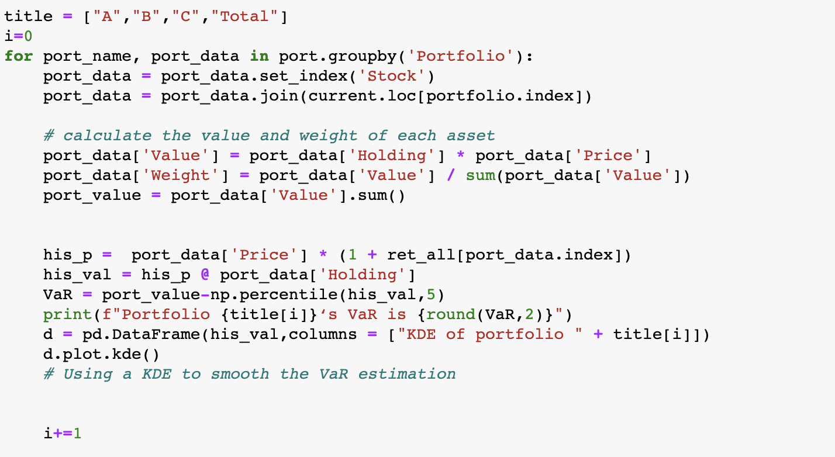
1.

Slide 12
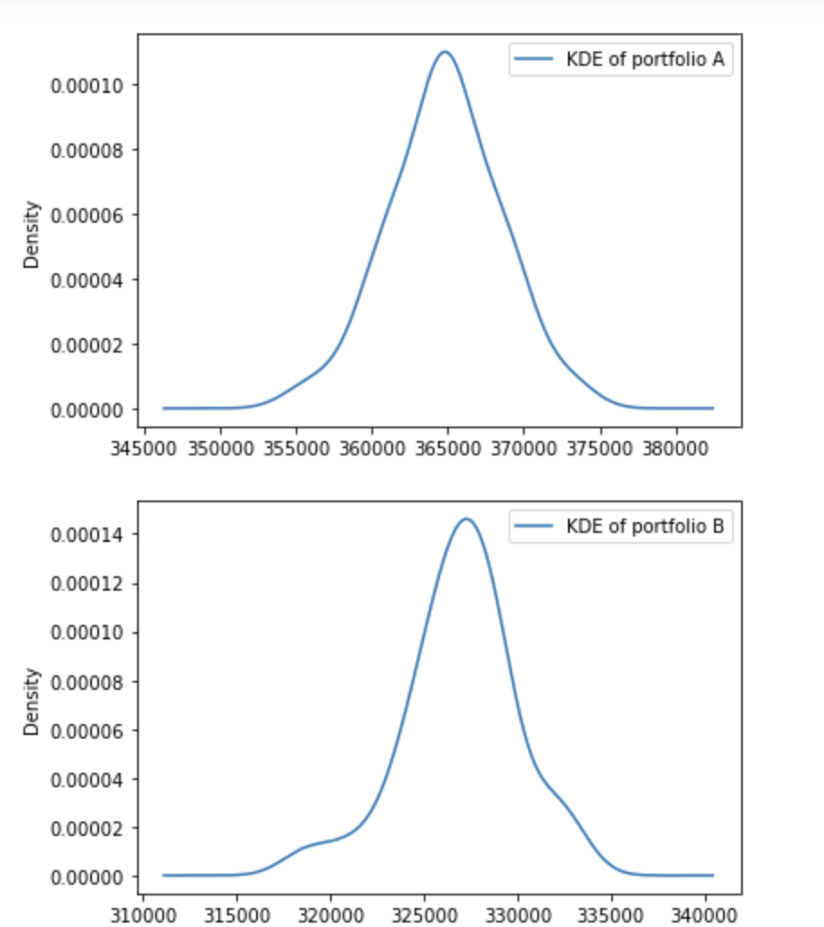
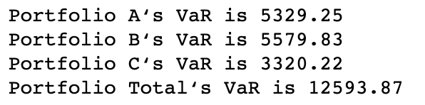

Slide 13
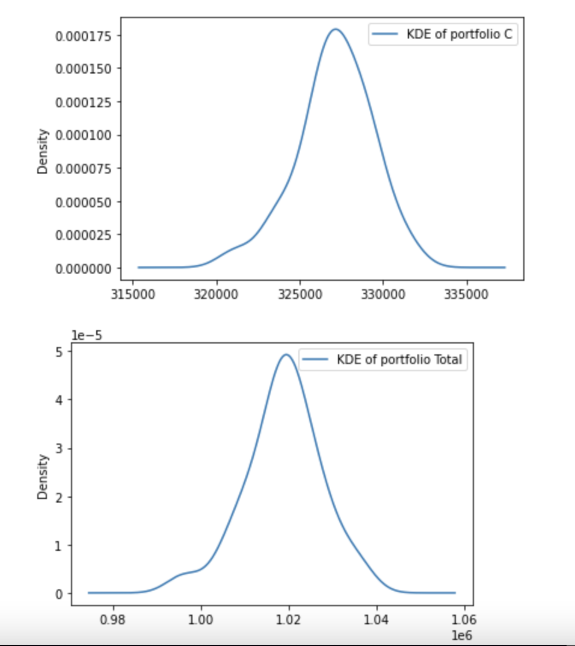

Slide 14
Conclusion for Problem 3¶
Due to the returns are not normally distributed and asset prices are not always linear, Financial market has the characteristic of fat tail and often receives the influence of emergencies. Moreover, our historical data is not enough for us to judge the state of all market risks. So we use KDE to optimize the VaR calculation.

