Slide 1
Travelling Salesman Problem: Convergence Properties of Optimization Algorithms
Group 2
Zachary Estrada
Chandini Jain
Jonathan Lai

Slide 2
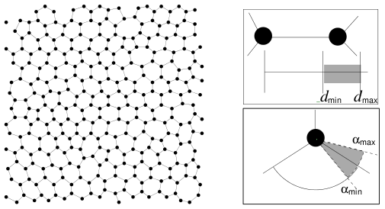
Introduction
B
F
A
C
E
D
Travelling Salesman Problem
Surface Reconstruction
Test algorithms for:
Convergence Rate
Wall-clock Time
Solution Space Exploration
Marcus Peinado and Thomas Lengauer. `go with the winners' generators with applications to molecular modeling. RANDOM, pages 135{149, 1997.

Slide 3
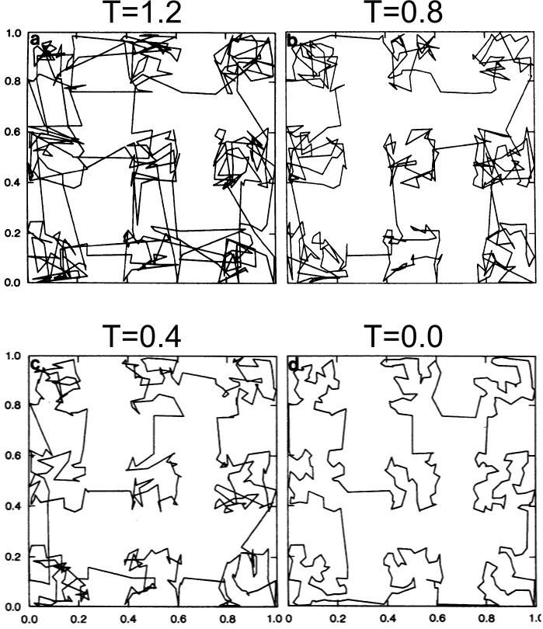

Simulated Annealing: Controlled Cooling
"Optimization by Simulated Annealing" S. Kirkpatrick, C. D. Gelatt, Jr., and M. P. Vecchi, Science 13 May 1983: 220 (4598), 671-680.

Slide 4
Genetic Algorithms: Survival of the Fittest
Generate an initial random population
1 | 1 | 0 | 1 | 1
1 | 0 | 0 | 0 | 1
0 | 1 | 0 | 0 | 1
0 | 1 | 1 | 1 | 0
Evaluate fitness of individuals
Select parents for crossover based on fitness
Introduce children into the population and replace individuals with least fitness
1 | 1 | 0 | 1 | 1
1 | 0 | 0 | 0 | 1
Perform crossover to produce children
1 | 1 | 0 | 0 | 1
1 | 0 | 0 | 1 | 1
1 | 0 | 1 | 1 | 1
Mutate randomly selected children
“A genetic algorithm tutorial”, Darrell Whitley , Statistics and Computing, Volume 4, Number 2, 65-85, DOI: 10.1007/BF00175354

Slide 5
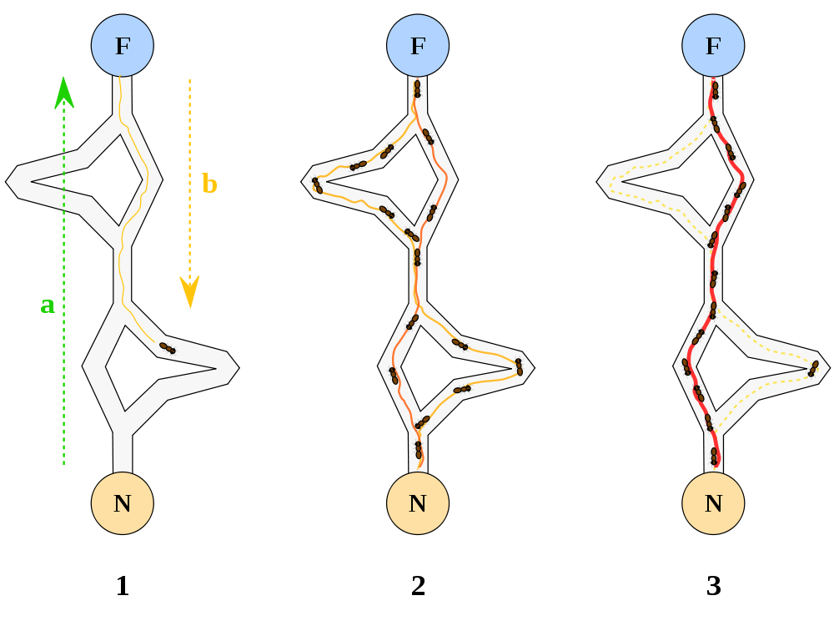
Ant Colony Optimization: Follow the Pheromones
http://en.wikipedia.org/wiki/File:Aco_branches.svg

Slide 6


Go with the Winners: Solutions to the multimodal problem
Clone most probable states
Kill off least probable states
Recalculate probabilities using biased random walk
http://www.toyemporium.com.au/shop/medium/WT3017R%20Russian%20Doll%20Red.jpg
Aldous, Vazirani (1994) “Go with the winners” Proc. 35th IEEE Sympos. on Foundations of CS
Grassberger, Nadler (2000) “Go with the winners”
Notes:
Unlike GA, there is no recombination to get new solutions.

Slide 7
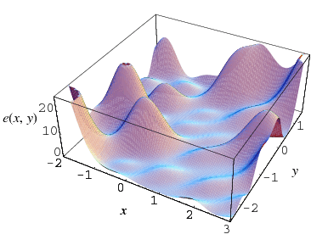
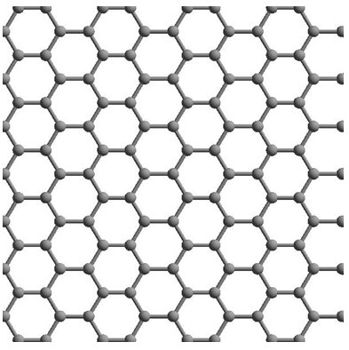
Analysis
http://mathworld.wolfram.com/GlobalOptimization.html
http://www.imec.be/ScientificReport/SR2007/html/1384092.html
Notes:
Plot3D[Abs[x*y*Cos[10*x]*Sin[10*y]]/10-15*Exp[-Abs[Sqrt[x*x+y*y]]]-7*Exp[-Abs[Sqrt[(x-3)^2+(y-3)^2]]]-7*Exp[-Abs[Sqrt[(x+3)^2+(y+3)^2]]]-7*Exp[-Abs[Sqrt[(x+3)^2+(y-3)^2]]]-7*Exp[-Abs[Sqrt[(x-3)^2+(y +3 )^2]]],{x,-5,5},{y,-5,5},PlotRange->All]
7

Slide 8
Thank You
Notes:
Plot3D[Abs[x*y*Cos[10*x]*Sin[10*y]]/10-15*Exp[-Abs[Sqrt[x*x+y*y]]]-7*Exp[-Abs[Sqrt[(x-3)^2+(y-3)^2]]]-7*Exp[-Abs[Sqrt[(x+3)^2+(y+3)^2]]]-7*Exp[-Abs[Sqrt[(x+3)^2+(y-3)^2]]]-7*Exp[-Abs[Sqrt[(x-3)^2+(y +3 )^2]]],{x,-5,5},{y,-5,5},PlotRange->All]
8

