Slide 1
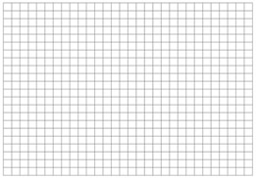
Simulated Annealing Moves
http://mathbits.com/mathbits/studentresources/graphpaper/graphpaper.htm

Slide 2
Simulated Annealing Moves
http://mathbits.com/mathbits/studentresources/graphpaper/graphpaper.htm

Slide 3
Simulated Annealing Moves
http://mathbits.com/mathbits/studentresources/graphpaper/graphpaper.htm

Slide 4
Simulated Annealing Moves
http://mathbits.com/mathbits/studentresources/graphpaper/graphpaper.htm

Slide 5
Go With The Winner
GWTW – SA with survival of fittest
Moves are predetermined
Create/destroy bonds
Swap bonds to explore phase space faster
Survival of the fittest
Select single winner of system
Kill off lower half of population
Repopulate single winner clone

Slide 6
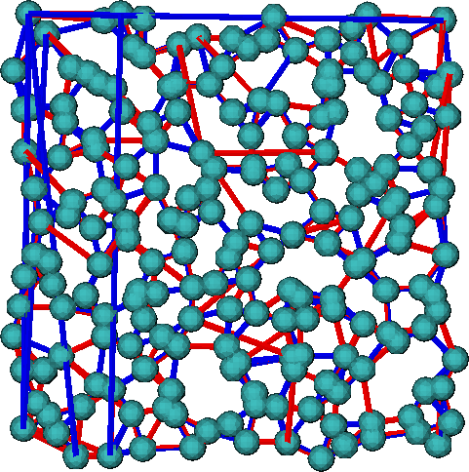
Comparison between solutions
Comparison
ACO
GA
Connections
634 similar
270 unique
138 : 132 L vs R

Slide 7
Conclusion
ACO ~ GA >> GWTW > SA
Choice of move is essential for efficient computation
Must highly tune code to run

